Slide 1
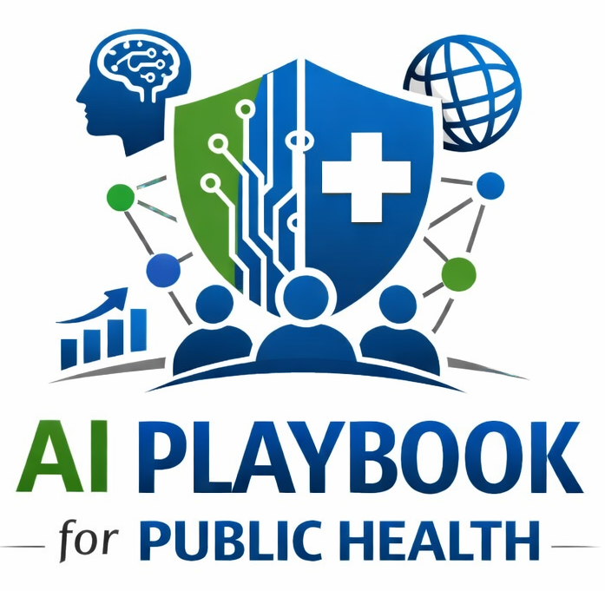
Lesson 7
AI as a Public Health Systems Shift
Staff Training Module
AI Playbook and Toolkit for Public Health Departments
Notes:
Welcome participants to the AI as a Public Health Systems Shift lesson.
Explain that this deck is designed for staff training, leadership orientation, governance preparation, or cross-program discussion.
Frame the topic in plain language: AI changes public health infrastructure, workforce expectations, policy, data systems, procurement, public trust, communications, surveillance, and service delivery.
Invite participants to think about where this topic already appears in their department's workflows, vendor tools, data systems, communications, or planning conversations.

Slide 2
AI PLAYBOOK AND TOOLKIT
Why this topic matters
AI changes public health infrastructure, workforce expectations, policy, data systems, procurement, public trust, communications, surveillance, and service delivery.
Public health value
Guardrail
AI changes public health infrastructure, not just individual tasks. Departments need to align AI adoption with data modernization, workforce development, procurement, legal review, community engagement, funding, and evaluation so AI does not.
Treating AI as a one-off technology purchase can create fragmented adoption, uneven safeguards, and unowned risk.
AI as a Public Health Systems Shift
02
Notes:
Use this slide in the AI as a Public Health Systems Shift training module.
Use this slide to explain the practical public health reason for learning this topic before AI tools are approved or deployed.
Connect the discussion back to the playbook: this topic supports Plays 1, 2, 3, 9, 12 and Tools 4, 10, 6.
Emphasize the core guardrail: Treating AI as a one-off technology purchase can create fragmented adoption, uneven safeguards, and unowned risk.
Ask participants how this topic could affect their own program area, staff roles, community relationships, data, or public communications.

Slide 3
AI PLAYBOOK AND TOOLKIT
Learning objectives
By the end of this lesson, staff should be able to:
• Explain AI as a Public Health Systems Shift in plain language.
• Identify appropriate public health uses and limits.
• Describe human review, governance, equity, privacy, and monitoring expectations.
• Connect the topic to the related plays and tools.
AI as a Public Health Systems Shift
03
Notes:
Use this slide in the AI as a Public Health Systems Shift training module.
Walk through the objectives and connect each one to a practical implementation decision.
Connect the discussion back to the playbook: this topic supports Plays 1, 2, 3, 9, 12 and Tools 4, 10, 6.
Explain that participants do not need technical expertise to use this material. The goal is enough shared understanding to participate in governance, readiness assessment, use case review, procurement, deployment, or monitoring.

Slide 4
AI PLAYBOOK AND TOOLKIT
Module overview
AI adoption is a systems change for public health departments. It affects data modernization, procurement, workforce roles, governance authority, legal review, community engagement, communications, emergency response, program operations, and evaluation. Treating AI as a one-time technology purchase leaves agencies with fragmented pilots and unmanaged risk.
Working definition
AI changes public health infrastructure, workforce expectations, policy, data systems, procurement, public trust, communications, surveillance, and service delivery.
AI as a Public Health Systems Shift
04
Notes:
Use this slide in the AI as a Public Health Systems Shift training module.
Use this slide to provide the narrative overview and definition before moving into detailed application.
Connect the discussion back to the playbook: this topic supports Plays 1, 2, 3, 9, 12 and Tools 4, 10, 6.
Ask the group to restate the topic in their own words.

Slide 5
AI PLAYBOOK AND TOOLKIT
What this means in practice
Systems Affected
Planning Implications
Leadership Role
Data systems need quality checks, access rules, documentation, interoperability, and appropriate AI environments. Workforce systems need training, role clarity, bridge professionals, change support, and leadership expectations. Governance.
Sequence adoption through plays rather than approving isolated pilots. Connect AI planning to data modernization, workforce development, funding, procurement, and quality improvement. Identify where existing policies can be extended and where.
Leaders should set the expectation that responsible AI is mission infrastructure, not a side project. Executive sponsors should ensure governance has authority, staff have time, and public accountability is built into decisions.
AI as a Public Health Systems Shift
05
Notes:
Use this slide in the AI as a Public Health Systems Shift training module.
Use this slide to turn the concept into practical behaviors, decisions, and safeguards.
Connect the discussion back to the playbook: this topic supports Plays 1, 2, 3, 9, 12 and Tools 4, 10, 6.
Invite participants to identify where these practices would need to be documented in their own department.
Start with Systems Affected, then compare it with the other practice areas on the slide.

Slide 6
AI PLAYBOOK AND TOOLKIT
Public health application
Use the topic to examine real workflows, not abstract technology.
Plan agency-wide governance
Coordinate data modernization with workforce training
Align AI pilots with public accountability
Discuss how this could support a public health workflow, what data would be involved, who would review outputs, and what safeguards would be needed.
Discuss how this could support a public health workflow, what data would be involved, who would review outputs, and what safeguards would be needed.
Discuss how this could support a public health workflow, what data would be involved, who would review outputs, and what safeguards would be needed.
AI as a Public Health Systems Shift
06
Notes:
Use this slide in the AI as a Public Health Systems Shift training module.
Use this slide to make the topic concrete through public health workflow examples.
Connect the discussion back to the playbook: this topic supports Plays 1, 2, 3, 9, 12 and Tools 4, 10, 6.
For each example, ask: What problem is being solved? What data would be used? Who reviews the AI output? What decision remains human? What could go wrong?

Slide 7
AI PLAYBOOK AND TOOLKIT
Facilitated discussion and exercise
Discussion questions
Training exercise
Which agency systems must change for AI to be governed and sustained? Where do existing policies already apply, and where are AI-specific standards needed? How will leadership coordinate AI work across programs rather than approving isolated.
Create a systems map showing how AI adoption affects governance, data, technology, workforce, procurement, communications, equity, and funding. Identify gaps that must be addressed before pilots scale.
AI as a Public Health Systems Shift
07
Notes:
Use this slide in the AI as a Public Health Systems Shift training module.
Use this slide for a facilitated activity near the end of the lesson.
Connect the discussion back to the playbook: this topic supports Plays 1, 2, 3, 9, 12 and Tools 4, 10, 6.
Give participants time to work individually or in small groups. Ask them to produce a practical artifact that can feed into readiness assessment, governance review, use case prioritization, or implementation planning.
Expected takeaways include: AI systems-change map, Cross-program implementation dependencies, Leadership decision agenda.

Slide 8
AI PLAYBOOK AND TOOLKIT
Next steps and resources
Apply the lesson
References and resources
Use this topic with Plays 1, 2, 3, 9, 12 and Tools 4, 10, 6. Turn the discussion into a documented question, decision, gap, or implementation artifact.
ASPPH AI Framework Report: Frames AI as a public health systems issue rather than a narrow technology purchase. CDC STLT resources: State, tribal, local, and territorial public health implementation context. Public Health Infrastructure Grant:.
AI as a Public Health Systems Shift
08
Notes:
Use this slide in the AI as a Public Health Systems Shift training module.
Close by connecting the lesson to next actions and resources.
Connect the discussion back to the playbook: this topic supports Plays 1, 2, 3, 9, 12 and Tools 4, 10, 6.
Point participants to the first resource: ASPPH AI Framework Report.
End by asking each participant or team to name one follow-up action they will take after the session.

