Slide 1
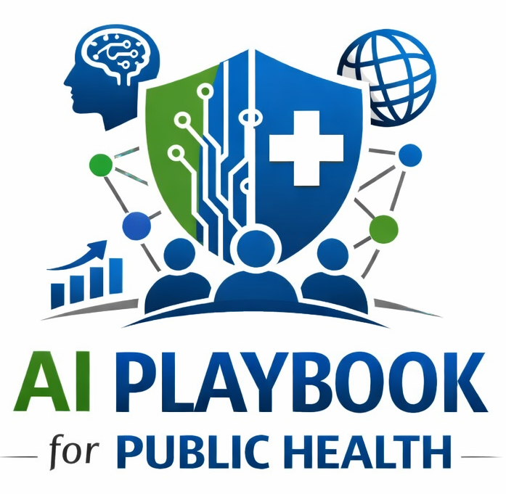
Lesson 9
Human-Centered AI
Staff Training Module
AI Playbook and Toolkit for Public Health Departments
Notes:
Welcome participants to the Human-Centered AI lesson.
Explain that this deck is designed for staff training, leadership orientation, governance preparation, or cross-program discussion.
Frame the topic in plain language: Human-centered AI keeps public health professionals, affected communities, and accountable decision-makers at the center of design, review, and action.
Invite participants to think about where this topic already appears in their department's workflows, vendor tools, data systems, communications, or planning conversations.

Slide 2
AI PLAYBOOK AND TOOLKIT
Why this topic matters
Human-centered AI keeps public health professionals, affected communities, and accountable decision-makers at the center of design, review, and action.
Public health value
Guardrail
Human-centered AI keeps public health purpose, staff expertise, and community accountability at the center. This is especially important when AI affects outreach, communication, prioritization, inspections, surveillance, or services.
AI should support judgment, not replace community relationships, public accountability, or final decisions in consequential workflows.
Human-Centered AI
02
Notes:
Use this slide in the Human-Centered AI training module.
Use this slide to explain the practical public health reason for learning this topic before AI tools are approved or deployed.
Connect the discussion back to the playbook: this topic supports Plays 1, 7, 11, 12, 13 and Tools 6, 19, 46.
Emphasize the core guardrail: AI should support judgment, not replace community relationships, public accountability, or final decisions in consequential workflows.
Ask participants how this topic could affect their own program area, staff roles, community relationships, data, or public communications.

Slide 3
AI PLAYBOOK AND TOOLKIT
Learning objectives
By the end of this lesson, staff should be able to:
• Explain Human-Centered AI in plain language.
• Identify appropriate public health uses and limits.
• Describe human review, governance, equity, privacy, and monitoring expectations.
• Connect the topic to the related plays and tools.
Human-Centered AI
03
Notes:
Use this slide in the Human-Centered AI training module.
Walk through the objectives and connect each one to a practical implementation decision.
Connect the discussion back to the playbook: this topic supports Plays 1, 7, 11, 12, 13 and Tools 6, 19, 46.
Explain that participants do not need technical expertise to use this material. The goal is enough shared understanding to participate in governance, readiness assessment, use case review, procurement, deployment, or monitoring.

Slide 4
AI PLAYBOOK AND TOOLKIT
Module overview
Human-centered AI begins with the people affected by a workflow: public health staff, community members, partners, and decision-makers. The goal is not to automate as much as possible. The goal is to improve public health work while preserving human judgment, relationships, dignity, explainability, and accountability.
Key definition
Definition: Human-centered AI is designed to assist people, not displace accountability. Public health staff, communities, and accountable leaders remain responsible for interpretation, judgment, relationship-building, and consequential.
Human-Centered AI
04
Notes:
Use this slide in the Human-Centered AI training module.
Use this slide to provide the narrative overview and definition before moving into detailed application.
Connect the discussion back to the playbook: this topic supports Plays 1, 7, 11, 12, 13 and Tools 6, 19, 46.
Reinforce this definition: Definition: Human-centered AI is designed to assist people, not displace accountability. Public health staff, communities, and accountable leaders remain responsible for interpretation, judgment, relationship-building, and consequential decisions.

Slide 5
AI PLAYBOOK AND TOOLKIT
What this means in practice
Design Principles
Workflow Practices
Community Accountability
Start with a public health problem and affected users, not with a tool. Define what humans must decide, approve, explain, or correct. Make AI outputs reviewable, editable, and contestable. Design for the staff who will use the system and the.
Name the decision owner for every AI-supported workflow. Require expert review before public-facing communication, enforcement, resource allocation, or clinical/care coordination action. Document correction, appeal, complaint, and escalation.
Use engagement to identify concerns before launch, especially for high-impact or community-facing systems. Explain AI use in plain language and invite feedback. Avoid deploying systems where affected people cannot understand or challenge the.
Human-Centered AI
05
Notes:
Use this slide in the Human-Centered AI training module.
Use this slide to turn the concept into practical behaviors, decisions, and safeguards.
Connect the discussion back to the playbook: this topic supports Plays 1, 7, 11, 12, 13 and Tools 6, 19, 46.
Invite participants to identify where these practices would need to be documented in their own department.
Start with Design Principles, then compare it with the other practice areas on the slide.

Slide 6
AI PLAYBOOK AND TOOLKIT
Public health application
Use the topic to examine real workflows, not abstract technology.
Define human decision owners
Require expert review before public communications
Document appeal or correction pathways
Discuss how this could support a public health workflow, what data would be involved, who would review outputs, and what safeguards would be needed.
Discuss how this could support a public health workflow, what data would be involved, who would review outputs, and what safeguards would be needed.
Discuss how this could support a public health workflow, what data would be involved, who would review outputs, and what safeguards would be needed.
Human-Centered AI
06
Notes:
Use this slide in the Human-Centered AI training module.
Use this slide to make the topic concrete through public health workflow examples.
Connect the discussion back to the playbook: this topic supports Plays 1, 7, 11, 12, 13 and Tools 6, 19, 46.
For each example, ask: What problem is being solved? What data would be used? Who reviews the AI output? What decision remains human? What could go wrong?

Slide 7
AI PLAYBOOK AND TOOLKIT
Facilitated discussion and exercise
Discussion questions
Training exercise
Who is affected by the workflow and who has been consulted? What decision remains with a named human owner? How can people ask questions, correct information, or challenge an outcome?
For one proposed use case, write a human decision rule that defines what AI may support, what it may recommend, what a human must approve, and what the AI may not do.
Human-Centered AI
07
Notes:
Use this slide in the Human-Centered AI training module.
Use this slide for a facilitated activity near the end of the lesson.
Connect the discussion back to the playbook: this topic supports Plays 1, 7, 11, 12, 13 and Tools 6, 19, 46.
Give participants time to work individually or in small groups. Ask them to produce a practical artifact that can feed into readiness assessment, governance review, use case prioritization, or implementation planning.
Expected takeaways include: Human decision rule, User and community needs summary, Appeal, correction, or feedback pathway.

Slide 8
AI PLAYBOOK AND TOOLKIT
Next steps and resources
Apply the lesson
References and resources
Use this topic with Plays 1, 7, 11, 12, 13 and Tools 6, 19, 46. Turn the discussion into a documented question, decision, gap, or implementation artifact.
Blueprint for an AI Bill of Rights: Principles for automated systems that preserve human agency, notice, explanation, and safeguards. NIST AI Risk Management Framework: Useful for defining human oversight, decision accountability, and risk.
Human-Centered AI
08
Notes:
Use this slide in the Human-Centered AI training module.
Close by connecting the lesson to next actions and resources.
Connect the discussion back to the playbook: this topic supports Plays 1, 7, 11, 12, 13 and Tools 6, 19, 46.
Point participants to the first resource: Blueprint for an AI Bill of Rights.
End by asking each participant or team to name one follow-up action they will take after the session.

