Slide 1
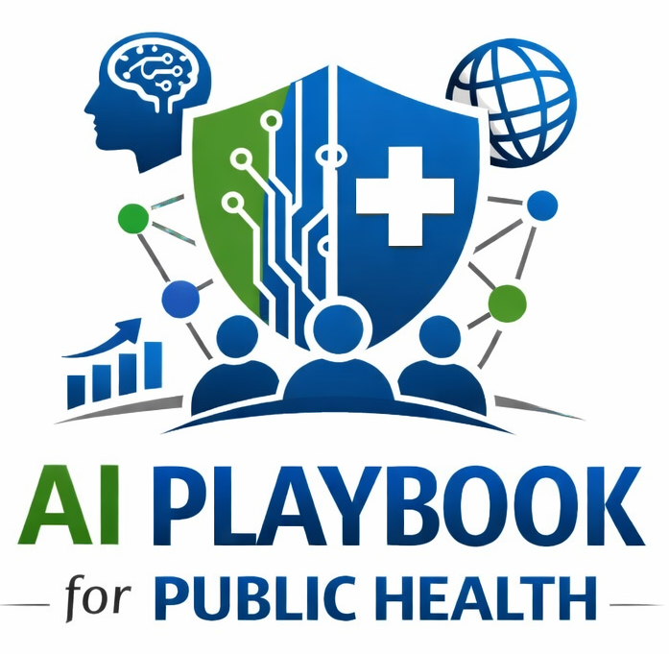
Lesson 10
AI Literacy for Public Health Staff
Staff Training Module
AI Playbook and Toolkit for Public Health Departments
Notes:
Welcome participants to the AI Literacy for Public Health Staff lesson.
Explain that this deck is designed for staff training, leadership orientation, governance preparation, or cross-program discussion.
Frame the topic in plain language: AI literacy means staff can recognize AI use, understand major failure modes, protect sensitive data, communicate uncertainty, document use, and know when not to use AI.
Invite participants to think about where this topic already appears in their department's workflows, vendor tools, data systems, communications, or planning conversations.

Slide 2
AI PLAYBOOK AND TOOLKIT
Why this topic matters
AI literacy means staff can recognize AI use, understand major failure modes, protect sensitive data, communicate uncertainty, document use, and know when not to use AI.
Public health value
Guardrail
AI literacy is necessary for safe use at every level of the department. Staff need role-appropriate knowledge before they are asked to use AI tools, review outputs, approve vendors, participate in governance, or explain AI to the public.
Staff should not be asked to use AI tools before they understand privacy, hallucination, bias, documentation, and human review expectations.
AI Literacy for Public Health Staff
02
Notes:
Use this slide in the AI Literacy for Public Health Staff training module.
Use this slide to explain the practical public health reason for learning this topic before AI tools are approved or deployed.
Connect the discussion back to the playbook: this topic supports Plays 5, 6, 10 and Tools 27, 24, 26, 29.
Emphasize the core guardrail: Staff should not be asked to use AI tools before they understand privacy, hallucination, bias, documentation, and human review expectations.
Ask participants how this topic could affect their own program area, staff roles, community relationships, data, or public communications.

Slide 3
AI PLAYBOOK AND TOOLKIT
Learning objectives
By the end of this lesson, staff should be able to:
• Explain AI Literacy for Public Health Staff in plain language.
• Identify appropriate public health uses and limits.
• Describe human review, governance, equity, privacy, and monitoring expectations.
• Connect the topic to the related plays and tools.
AI Literacy for Public Health Staff
03
Notes:
Use this slide in the AI Literacy for Public Health Staff training module.
Walk through the objectives and connect each one to a practical implementation decision.
Connect the discussion back to the playbook: this topic supports Plays 5, 6, 10 and Tools 27, 24, 26, 29.
Explain that participants do not need technical expertise to use this material. The goal is enough shared understanding to participate in governance, readiness assessment, use case review, procurement, deployment, or monitoring.

Slide 4
AI PLAYBOOK AND TOOLKIT
Module overview
AI literacy is a workforce capability. Staff should know what AI is, what it is approved for, what data may be used, how outputs can fail, how to document AI use, and when to escalate concerns. Literacy expectations should be role-based because leaders, program staff, analysts, IT, privacy, procurement, communications, and governance members have different responsibilities.
Key definition
What AI Literacy Means: AI literacy is the ability to recognize AI use, understand what a system can and cannot do, evaluate outputs critically, protect sensitive information, communicate uncertainty, and know when AI should not be used.
AI Literacy for Public Health Staff
04
Notes:
Use this slide in the AI Literacy for Public Health Staff training module.
Use this slide to provide the narrative overview and definition before moving into detailed application.
Connect the discussion back to the playbook: this topic supports Plays 5, 6, 10 and Tools 27, 24, 26, 29.
Reinforce this definition: What AI Literacy Means: AI literacy is the ability to recognize AI use, understand what a system can and cannot do, evaluate outputs critically, protect sensitive information, communicate uncertainty, and know when AI should not be used.

Slide 5
AI PLAYBOOK AND TOOLKIT
What this means in practice
Core Competencies
Role-Based Training
Sustainment
Recognize approved and unapproved AI use. Protect PHI, confidential, restricted, and sensitive data. Identify hallucination, bias, automation bias, data quality problems, and inappropriate use. Use prompts, source materials, and review steps.
Executives need governance, risk, resource, and public accountability orientation. Program staff need workflow, privacy, prompt, and review guidance. Analysts need validation, documentation, model monitoring, and data quality practices..
Refresh training as tools, policies, and risks change. Create reporting pathways for staff concerns and near misses. Use AI champions or bridge professionals to support day-to-day adoption.
AI Literacy for Public Health Staff
05
Notes:
Use this slide in the AI Literacy for Public Health Staff training module.
Use this slide to turn the concept into practical behaviors, decisions, and safeguards.
Connect the discussion back to the playbook: this topic supports Plays 5, 6, 10 and Tools 27, 24, 26, 29.
Invite participants to identify where these practices would need to be documented in their own department.
Start with Core Competencies, then compare it with the other practice areas on the slide.

Slide 6
AI PLAYBOOK AND TOOLKIT
Public health application
Use the topic to examine real workflows, not abstract technology.
Role-based AI training
Prompt and privacy coaching
Staff reporting pathways for concerns
Discuss how this could support a public health workflow, what data would be involved, who would review outputs, and what safeguards would be needed.
Discuss how this could support a public health workflow, what data would be involved, who would review outputs, and what safeguards would be needed.
Discuss how this could support a public health workflow, what data would be involved, who would review outputs, and what safeguards would be needed.
AI Literacy for Public Health Staff
06
Notes:
Use this slide in the AI Literacy for Public Health Staff training module.
Use this slide to make the topic concrete through public health workflow examples.
Connect the discussion back to the playbook: this topic supports Plays 5, 6, 10 and Tools 27, 24, 26, 29.
For each example, ask: What problem is being solved? What data would be used? Who reviews the AI output? What decision remains human? What could go wrong?

Slide 7
AI PLAYBOOK AND TOOLKIT
Facilitated discussion and exercise
Discussion questions
Training exercise
What does each role need to know to use or oversee AI responsibly? How will the department train new staff and refresh training over time? How will staff report concerns, near misses, or unsafe outputs?
Create a role-based training matrix for executives, program staff, analysts, IT, privacy, procurement, communications, and governance members.
AI Literacy for Public Health Staff
07
Notes:
Use this slide in the AI Literacy for Public Health Staff training module.
Use this slide for a facilitated activity near the end of the lesson.
Connect the discussion back to the playbook: this topic supports Plays 5, 6, 10 and Tools 27, 24, 26, 29.
Give participants time to work individually or in small groups. Ask them to produce a practical artifact that can feed into readiness assessment, governance review, use case prioritization, or implementation planning.
Expected takeaways include: Role-based AI literacy matrix, Training plan, Staff concern reporting pathway.

Slide 8
AI PLAYBOOK AND TOOLKIT
Next steps and resources
Apply the lesson
References and resources
Use this topic with Plays 5, 6, 10 and Tools 27, 24, 26, 29. Turn the discussion into a documented question, decision, gap, or implementation artifact.
ASPPH AI Framework Report: AI literacy, bridge professional, and workforce preparation concepts for public health. Public Health Foundation TRAIN Learning Network: Training platform for public health workforce development. CDC Public Health.
AI Literacy for Public Health Staff
08
Notes:
Use this slide in the AI Literacy for Public Health Staff training module.
Close by connecting the lesson to next actions and resources.
Connect the discussion back to the playbook: this topic supports Plays 5, 6, 10 and Tools 27, 24, 26, 29.
Point participants to the first resource: ASPPH AI Framework Report.
End by asking each participant or team to name one follow-up action they will take after the session.

