Slide 1
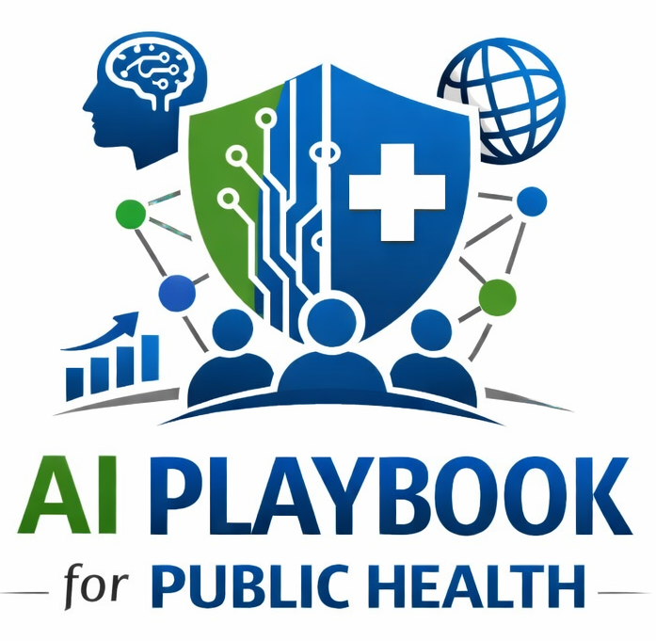
Lesson 11
Automation Bias and Over-Trust
Staff Training Module
AI Playbook and Toolkit for Public Health Departments
Notes:
Welcome participants to the Automation Bias and Over-Trust lesson.
Explain that this deck is designed for staff training, leadership orientation, governance preparation, or cross-program discussion.
Frame the topic in plain language: Automation bias occurs when people accept AI outputs too readily because they appear confident, precise, or authoritative.
Invite participants to think about where this topic already appears in their department's workflows, vendor tools, data systems, communications, or planning conversations.

Slide 2
AI PLAYBOOK AND TOOLKIT
Why this topic matters
Automation bias occurs when people accept AI outputs too readily because they appear confident, precise, or authoritative.
Public health value
Guardrail
Automation bias is a practical operational risk. Staff may over-trust outputs that are fluent, precise, or repeated often. Public health workflows need review steps that make skepticism normal and expected.
Repeated exposure to fluent AI outputs can reduce scrutiny unless workflows require deliberate review and documentation.
Automation Bias and Over-Trust
02
Notes:
Use this slide in the Automation Bias and Over-Trust training module.
Use this slide to explain the practical public health reason for learning this topic before AI tools are approved or deployed.
Connect the discussion back to the playbook: this topic supports Plays 3, 7, 11, 12, 13 and Tools 14, 40, 46, 6.
Emphasize the core guardrail: Repeated exposure to fluent AI outputs can reduce scrutiny unless workflows require deliberate review and documentation.
Ask participants how this topic could affect their own program area, staff roles, community relationships, data, or public communications.

Slide 3
AI PLAYBOOK AND TOOLKIT
Learning objectives
By the end of this lesson, staff should be able to:
• Explain Automation Bias and Over-Trust in plain language.
• Identify appropriate public health uses and limits.
• Describe human review, governance, equity, privacy, and monitoring expectations.
• Connect the topic to the related plays and tools.
Automation Bias and Over-Trust
03
Notes:
Use this slide in the Automation Bias and Over-Trust training module.
Walk through the objectives and connect each one to a practical implementation decision.
Connect the discussion back to the playbook: this topic supports Plays 3, 7, 11, 12, 13 and Tools 14, 40, 46, 6.
Explain that participants do not need technical expertise to use this material. The goal is enough shared understanding to participate in governance, readiness assessment, use case review, procurement, deployment, or monitoring.

Slide 4
AI PLAYBOOK AND TOOLKIT
Module overview
Automation bias occurs when people give too much weight to AI output because it appears confident, precise, or authoritative. In public health, this can affect surveillance review, risk scoring, inspection documentation, prioritization, public messaging, or resource decisions. Deliberate review practices are needed so AI supports, rather than substitutes for, professional judgment.
Key definition
Definition: Automation bias occurs when people over-rely on AI outputs because the system appears fast, confident, technical, or authoritative. Over-trust can be especially risky in high-pressure public health settings.
Automation Bias and Over-Trust
04
Notes:
Use this slide in the Automation Bias and Over-Trust training module.
Use this slide to provide the narrative overview and definition before moving into detailed application.
Connect the discussion back to the playbook: this topic supports Plays 3, 7, 11, 12, 13 and Tools 14, 40, 46, 6.
Reinforce this definition: Definition: Automation bias occurs when people over-rely on AI outputs because the system appears fast, confident, technical, or authoritative. Over-trust can be especially risky in high-pressure public health settings.

Slide 5
AI PLAYBOOK AND TOOLKIT
What this means in practice
Warning Signs
Controls
Monitoring
Staff stop checking sources because AI summaries are usually fluent. Risk scores become the primary basis for decisions without review of context. Draft messages are approved without checking public health guidance, equity implications, or.
Use second-review requirements for high-impact outputs. Require confidence, limitation, source, and uncertainty notes in briefs. Separate AI recommendations from human decisions in documentation. Train staff to look for omissions, unsupported.
Audit samples of AI-assisted work. Track overrides, corrections, incidents, complaints, and false positives or false negatives. Review whether staff are using the tool as intended or developing unsafe shortcuts.
Automation Bias and Over-Trust
05
Notes:
Use this slide in the Automation Bias and Over-Trust training module.
Use this slide to turn the concept into practical behaviors, decisions, and safeguards.
Connect the discussion back to the playbook: this topic supports Plays 3, 7, 11, 12, 13 and Tools 14, 40, 46, 6.
Invite participants to identify where these practices would need to be documented in their own department.
Start with Warning Signs, then compare it with the other practice areas on the slide.

Slide 6
AI PLAYBOOK AND TOOLKIT
Public health application
Use the topic to examine real workflows, not abstract technology.
Second-review requirements
Decision owner sign-off
Confidence and limitation notes in briefs
Discuss how this could support a public health workflow, what data would be involved, who would review outputs, and what safeguards would be needed.
Discuss how this could support a public health workflow, what data would be involved, who would review outputs, and what safeguards would be needed.
Discuss how this could support a public health workflow, what data would be involved, who would review outputs, and what safeguards would be needed.
Automation Bias and Over-Trust
06
Notes:
Use this slide in the Automation Bias and Over-Trust training module.
Use this slide to make the topic concrete through public health workflow examples.
Connect the discussion back to the playbook: this topic supports Plays 3, 7, 11, 12, 13 and Tools 14, 40, 46, 6.
For each example, ask: What problem is being solved? What data would be used? Who reviews the AI output? What decision remains human? What could go wrong?

Slide 7
AI PLAYBOOK AND TOOLKIT
Facilitated discussion and exercise
Discussion questions
Training exercise
Where might staff accept AI output too quickly? What second-review or sign-off is needed for high-impact outputs? How will overrides, corrections, and disagreements be documented?
Take one AI-assisted output and design a review form that asks staff to check sources, uncertainty, missing context, subgroup impact, and whether the recommendation should be accepted, modified, or rejected.
Automation Bias and Over-Trust
07
Notes:
Use this slide in the Automation Bias and Over-Trust training module.
Use this slide for a facilitated activity near the end of the lesson.
Connect the discussion back to the playbook: this topic supports Plays 3, 7, 11, 12, 13 and Tools 14, 40, 46, 6.
Give participants time to work individually or in small groups. Ask them to produce a practical artifact that can feed into readiness assessment, governance review, use case prioritization, or implementation planning.
Expected takeaways include: Automation bias review checklist, Decision owner sign-off process, Override and correction log.

Slide 8
AI PLAYBOOK AND TOOLKIT
Next steps and resources
Apply the lesson
References and resources
Use this topic with Plays 3, 7, 11, 12, 13 and Tools 14, 40, 46, 6. Turn the discussion into a documented question, decision, gap, or implementation artifact.
NIST AI Risk Management Framework: Risk controls for over-trust, human review, testing, and monitoring. HHS Civil Rights and AI: Equity and civil rights considerations when automated systems influence decisions. WHO: Ethics and governance of.
Automation Bias and Over-Trust
08
Notes:
Use this slide in the Automation Bias and Over-Trust training module.
Close by connecting the lesson to next actions and resources.
Connect the discussion back to the playbook: this topic supports Plays 3, 7, 11, 12, 13 and Tools 14, 40, 46, 6.
Point participants to the first resource: NIST AI Risk Management Framework.
End by asking each participant or team to name one follow-up action they will take after the session.

