Slide 1
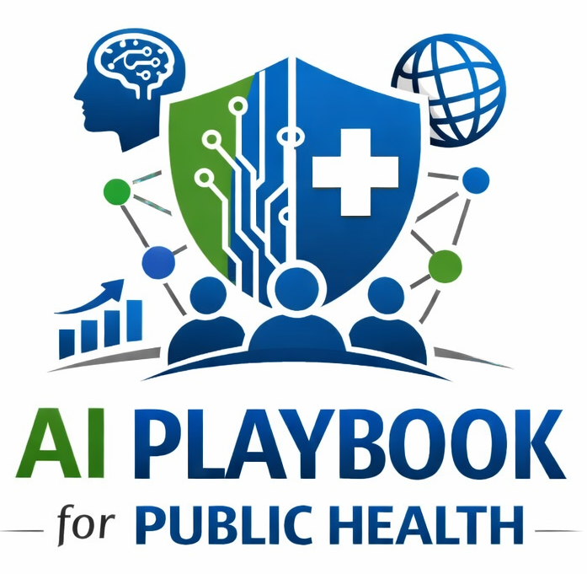
Lesson 16
The AI Bridge Professional Role
Staff Training Module
AI Playbook and Toolkit for Public Health Departments
Notes:
Welcome participants to the The AI Bridge Professional Role lesson.
Explain that this deck is designed for staff training, leadership orientation, governance preparation, or cross-program discussion.
Frame the topic in plain language: The bridge professional translates across public health programs, IT, legal/privacy, procurement, vendors, leadership, data teams, and community partners.
Invite participants to think about where this topic already appears in their department's workflows, vendor tools, data systems, communications, or planning conversations.

Slide 2
AI PLAYBOOK AND TOOLKIT
Why this topic matters
The bridge professional translates across public health programs, IT, legal/privacy, procurement, vendors, leadership, data teams, and community partners.
Public health value
Guardrail
Many AI problems are translation problems: program needs do not automatically become technical requirements, and technical risks do not automatically become operational controls. Bridge professionals help keep AI implementation coherent across.
Without translation capacity, AI efforts can stall between technical, operational, legal, and community expectations.
The AI Bridge Professional Role
02
Notes:
Use this slide in the The AI Bridge Professional Role training module.
Use this slide to explain the practical public health reason for learning this topic before AI tools are approved or deployed.
Connect the discussion back to the playbook: this topic supports Plays 5, 6, 9, 11 and Tools 27, 23, 36.
Emphasize the core guardrail: Without translation capacity, AI efforts can stall between technical, operational, legal, and community expectations.
Ask participants how this topic could affect their own program area, staff roles, community relationships, data, or public communications.

Slide 3
AI PLAYBOOK AND TOOLKIT
Learning objectives
By the end of this lesson, staff should be able to:
• Explain The AI Bridge Professional Role in plain language.
• Identify appropriate public health uses and limits.
• Describe human review, governance, equity, privacy, and monitoring expectations.
• Connect the topic to the related plays and tools.
The AI Bridge Professional Role
03
Notes:
Use this slide in the The AI Bridge Professional Role training module.
Walk through the objectives and connect each one to a practical implementation decision.
Connect the discussion back to the playbook: this topic supports Plays 5, 6, 9, 11 and Tools 27, 23, 36.
Explain that participants do not need technical expertise to use this material. The goal is enough shared understanding to participate in governance, readiness assessment, use case review, procurement, deployment, or monitoring.

Slide 4
AI PLAYBOOK AND TOOLKIT
Module overview
The AI bridge professional is a role or function that connects public health programs, data teams, IT, privacy, legal, procurement, vendors, leadership, and community partners. This role helps translate public health needs into technical requirements and technical risks into practical governance and implementation decisions.
Key definition
Role Definition: The AI bridge professional is a public health translator: someone with enough technical understanding to work with IT and vendors, enough program knowledge to understand workflows, and enough communication skill to support.
The AI Bridge Professional Role
04
Notes:
Use this slide in the The AI Bridge Professional Role training module.
Use this slide to provide the narrative overview and definition before moving into detailed application.
Connect the discussion back to the playbook: this topic supports Plays 5, 6, 9, 11 and Tools 27, 23, 36.
Reinforce this definition: Role Definition: The AI bridge professional is a public health translator: someone with enough technical understanding to work with IT and vendors, enough program knowledge to understand workflows, and enough communication skill to support leadership, governance, and community conversations.

Slide 5
AI PLAYBOOK AND TOOLKIT
What this means in practice
Core Responsibilities
Where the Role Fits
Staffing Models
Help programs define use cases, workflow needs, success measures, and documentation requirements. Coordinate governance submissions, risk review, stakeholder engagement, and procurement questions. Translate model limitations, data quality.
During readiness assessment to identify capacity gaps. During governance to prepare complete intake and review materials. During prioritization to compare public health value, feasibility, and risk. During deployment to coordinate training,.
A large department may create a dedicated role or small AI implementation office. A smaller department may assign bridge responsibilities to an informatics, quality improvement, data modernization, or program leader. Regional or shared-service.
The AI Bridge Professional Role
05
Notes:
Use this slide in the The AI Bridge Professional Role training module.
Use this slide to turn the concept into practical behaviors, decisions, and safeguards.
Connect the discussion back to the playbook: this topic supports Plays 5, 6, 9, 11 and Tools 27, 23, 36.
Invite participants to identify where these practices would need to be documented in their own department.
Start with Core Responsibilities, then compare it with the other practice areas on the slide.

Slide 6
AI PLAYBOOK AND TOOLKIT
Public health application
Use the topic to examine real workflows, not abstract technology.
Coordinate governance submissions
Translate technical risk for leadership
Help program staff document AI workflows
Discuss how this could support a public health workflow, what data would be involved, who would review outputs, and what safeguards would be needed.
Discuss how this could support a public health workflow, what data would be involved, who would review outputs, and what safeguards would be needed.
Discuss how this could support a public health workflow, what data would be involved, who would review outputs, and what safeguards would be needed.
The AI Bridge Professional Role
06
Notes:
Use this slide in the The AI Bridge Professional Role training module.
Use this slide to make the topic concrete through public health workflow examples.
Connect the discussion back to the playbook: this topic supports Plays 5, 6, 9, 11 and Tools 27, 23, 36.
For each example, ask: What problem is being solved? What data would be used? Who reviews the AI output? What decision remains human? What could go wrong?

Slide 7
AI PLAYBOOK AND TOOLKIT
Facilitated discussion and exercise
Discussion questions
Training exercise
Who can translate between program, data, IT, privacy, procurement, legal, equity, communications, vendors, and leadership? What authority and protected time does the bridge role need? How will bridge work be sustained in smaller departments?
Define the bridge role for one AI project. Identify responsibilities during intake, governance review, procurement, implementation, staff training, monitoring, and issue escalation.
The AI Bridge Professional Role
07
Notes:
Use this slide in the The AI Bridge Professional Role training module.
Use this slide for a facilitated activity near the end of the lesson.
Connect the discussion back to the playbook: this topic supports Plays 5, 6, 9, 11 and Tools 27, 23, 36.
Give participants time to work individually or in small groups. Ask them to produce a practical artifact that can feed into readiness assessment, governance review, use case prioritization, or implementation planning.
Expected takeaways include: Bridge professional role description, Cross-functional coordination map, Implementation support responsibilities.

Slide 8
AI PLAYBOOK AND TOOLKIT
Next steps and resources
Apply the lesson
References and resources
Use this topic with Plays 5, 6, 9, 11 and Tools 27, 23, 36. Turn the discussion into a documented question, decision, gap, or implementation artifact.
ASPPH AI Framework Report: Bridge professional concept and AI workforce implications. Public Health Foundation TRAIN Learning Network: Training infrastructure for building cross-functional workforce capacity. CDC STLT Data Connection:.
The AI Bridge Professional Role
08
Notes:
Use this slide in the The AI Bridge Professional Role training module.
Close by connecting the lesson to next actions and resources.
Connect the discussion back to the playbook: this topic supports Plays 5, 6, 9, 11 and Tools 27, 23, 36.
Point participants to the first resource: ASPPH AI Framework Report.
End by asking each participant or team to name one follow-up action they will take after the session.

