Slide 1
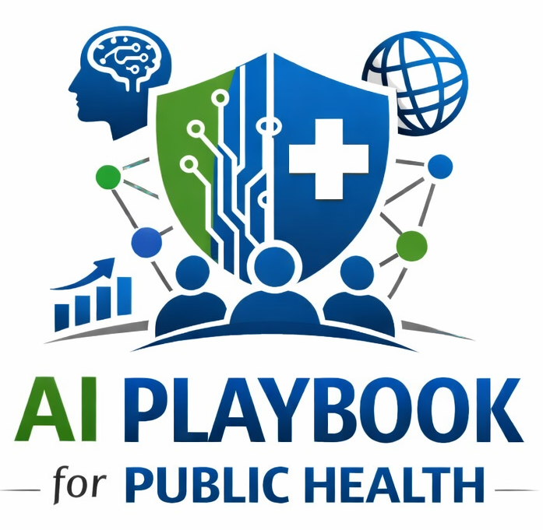
Lesson 17
Federal Funding Opportunities
Staff Training Module
AI Playbook and Toolkit for Public Health Departments
Notes:
Welcome participants to the Federal Funding Opportunities lesson.
Explain that this deck is designed for staff training, leadership orientation, governance preparation, or cross-program discussion.
Frame the topic in plain language: AI work can often be positioned as a capability layer on top of data modernization, infrastructure, workforce, and equity investments.
Invite participants to think about where this topic already appears in their department's workflows, vendor tools, data systems, communications, or planning conversations.

Slide 2
AI PLAYBOOK AND TOOLKIT
Why this topic matters
AI work can often be positioned as a capability layer on top of data modernization, infrastructure, workforce, and equity investments.
Public health value
Guardrail
AI projects often require resources that are easy to overlook: staff time, governance, training, validation, data modernization, monitoring, accessibility, community engagement, and sustainment. Funding strategy should make the full cost of.
Do not approve projects without confirmed pilot, scale, and sustainment resources.
Federal Funding Opportunities
02
Notes:
Use this slide in the Federal Funding Opportunities training module.
Use this slide to explain the practical public health reason for learning this topic before AI tools are approved or deployed.
Connect the discussion back to the playbook: this topic supports Plays 8, 9 and Tools 33, 32, 36.
Emphasize the core guardrail: Do not approve projects without confirmed pilot, scale, and sustainment resources.
Ask participants how this topic could affect their own program area, staff roles, community relationships, data, or public communications.

Slide 3
AI PLAYBOOK AND TOOLKIT
Learning objectives
By the end of this lesson, staff should be able to:
• Explain Federal Funding Opportunities in plain language.
• Identify appropriate public health uses and limits.
• Describe human review, governance, equity, privacy, and monitoring expectations.
• Connect the topic to the related plays and tools.
Federal Funding Opportunities
03
Notes:
Use this slide in the Federal Funding Opportunities training module.
Walk through the objectives and connect each one to a practical implementation decision.
Connect the discussion back to the playbook: this topic supports Plays 8, 9 and Tools 33, 32, 36.
Explain that participants do not need technical expertise to use this material. The goal is enough shared understanding to participate in governance, readiness assessment, use case review, procurement, deployment, or monitoring.

Slide 4
AI PLAYBOOK AND TOOLKIT
Module overview
AI projects need funding for more than software licenses. Responsible implementation may require data modernization, cloud or secure infrastructure, staff time, training, governance, legal and procurement review, evaluation, monitoring, translation, accessibility, community engagement, and sustainment. Funding strategy should be developed before pilots are approved for scale.
Working definition
AI work can often be positioned as a capability layer on top of data modernization, infrastructure, workforce, and equity investments.
Federal Funding Opportunities
04
Notes:
Use this slide in the Federal Funding Opportunities training module.
Use this slide to provide the narrative overview and definition before moving into detailed application.
Connect the discussion back to the playbook: this topic supports Plays 8, 9 and Tools 33, 32, 36.
Ask the group to restate the topic in their own words.

Slide 5
AI PLAYBOOK AND TOOLKIT
What this means in practice
Funding Alignment
Budget Categories
Sustainment Questions
Position AI as an enabling capability within data modernization, workforce, equity, emergency preparedness, surveillance,. Match use cases to allowable costs in DMI, PHIG, HRSA, FEMA, EPA, SAMHSA, NIH, NSF, or state and local funding streams.
Technology licenses, hosting, security review, integration, and vendor support. Staff time for governance, implementation, training, monitoring, and evaluation. Community engagement, accessibility, translation, and communications support..
Who pays after the pilot? What staffing is required to keep the system safe and useful? What costs increase if the system scales across programs or jurisdictions? What functions can be shared regionally or through partnerships?
Federal Funding Opportunities
05
Notes:
Use this slide in the Federal Funding Opportunities training module.
Use this slide to turn the concept into practical behaviors, decisions, and safeguards.
Connect the discussion back to the playbook: this topic supports Plays 8, 9 and Tools 33, 32, 36.
Invite participants to identify where these practices would need to be documented in their own department.
Start with Funding Alignment, then compare it with the other practice areas on the slide.

Slide 6
AI PLAYBOOK AND TOOLKIT
Public health application
Use the topic to examine real workflows, not abstract technology.
DMI-supported data pipelines
PHIG-supported workforce and governance
Grant-aligned pilots
Use data modernization investments to strengthen interoperability, data quality, cloud readiness, and analytics infrastructure needed for AI.
Use infrastructure funding to support AI literacy, governance capacity, data staff, policy development, and implementation readiness.
Design small pilots that map to allowable funding activities, measurable outputs, evaluation requirements, and sustainment plans.
Federal Funding Opportunities
06
Notes:
Use this slide in the Federal Funding Opportunities training module.
Use this slide to make the topic concrete through public health workflow examples.
Connect the discussion back to the playbook: this topic supports Plays 8, 9 and Tools 33, 32, 36.
For each example, ask: What problem is being solved? What data would be used? Who reviews the AI output? What decision remains human? What could go wrong?

Slide 7
AI PLAYBOOK AND TOOLKIT
Facilitated discussion and exercise
Discussion questions
Training exercise
What costs are required before pilot, during deployment, and after scale? Which funding streams align with data, workforce, equity, emergency response, surveillance, or service delivery goals? What happens when short-term funding ends?
Build a funding map for one approved use case that includes pilot costs, scale costs, sustainment costs, staffing, evaluation, governance, and possible funding sources.
Federal Funding Opportunities
07
Notes:
Use this slide in the Federal Funding Opportunities training module.
Use this slide for a facilitated activity near the end of the lesson.
Connect the discussion back to the playbook: this topic supports Plays 8, 9 and Tools 33, 32, 36.
Give participants time to work individually or in small groups. Ask them to produce a practical artifact that can feed into readiness assessment, governance review, use case prioritization, or implementation planning.
Expected takeaways include: Funding alignment table, Sustainment plan, Budget categories for responsible AI implementation.

Slide 8
AI PLAYBOOK AND TOOLKIT
Next steps and resources
Apply the lesson
References and resources
Use this topic with Plays 8, 9 and Tools 33, 32, 36. Turn the discussion into a documented question, decision, gap, or implementation artifact.
CDC Data Modernization Initiative: Potential alignment for data infrastructure and AI-ready modernization investments. Public Health Infrastructure Grant: Potential alignment for workforce, data systems, organizational capacity, and equity.
Federal Funding Opportunities
08
Notes:
Use this slide in the Federal Funding Opportunities training module.
Close by connecting the lesson to next actions and resources.
Connect the discussion back to the playbook: this topic supports Plays 8, 9 and Tools 33, 32, 36.
Point participants to the first resource: CDC Data Modernization Initiative.
End by asking each participant or team to name one follow-up action they will take after the session.

