Slide 1
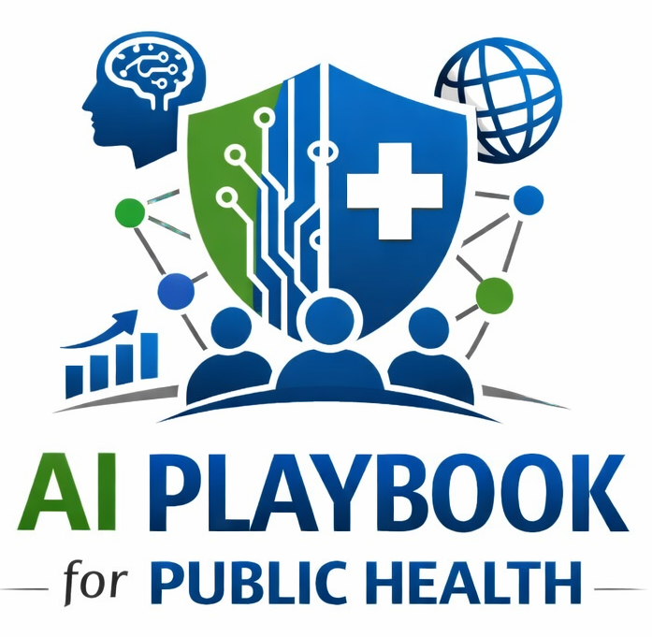
Lesson 19
Privacy, Confidentiality, and Public Records
Staff Training Module
AI Playbook and Toolkit for Public Health Departments
Notes:
Welcome participants to the Privacy, Confidentiality, and Public Records lesson.
Explain that this deck is designed for staff training, leadership orientation, governance preparation, or cross-program discussion.
Frame the topic in plain language: AI use in public health must account for PHI, PII, confidential public health records, investigation data, data-sharing limits, retention rules, and public records obligations.
Invite participants to think about where this topic already appears in their department's workflows, vendor tools, data systems, communications, or planning conversations.

Slide 2
AI PLAYBOOK AND TOOLKIT
Why this topic matters
AI use in public health must account for PHI, PII, confidential public health records, investigation data, data-sharing limits, retention rules, and public records obligations.
Public health value
Guardrail
Privacy, confidentiality, and records controls are foundational for STLT public health AI because departments handle sensitive information, regulatory records, investigations, partner data, and public accountability obligations.
Sensitive or confidential data can be exposed, retained, reused, or disclosed if staff use the wrong AI environment.
Privacy, Confidentiality, and Public Records
02
Notes:
Use this slide in the Privacy, Confidentiality, and Public Records training module.
Use this slide to explain the practical public health reason for learning this topic before AI tools are approved or deployed.
Connect the discussion back to the playbook: this topic supports Plays 2, 3, 7, 11, 12 and Tools 7, 10, 15, 17, 34.
Emphasize the core guardrail: Sensitive or confidential data can be exposed, retained, reused, or disclosed if staff use the wrong AI environment.
Ask participants how this topic could affect their own program area, staff roles, community relationships, data, or public communications.

Slide 3
AI PLAYBOOK AND TOOLKIT
Learning objectives
By the end of this lesson, staff should be able to:
• Explain Privacy, Confidentiality, and Public Records in plain language.
• Identify appropriate public health uses and limits.
• Describe human review, governance, equity, privacy, and monitoring expectations.
• Connect the topic to the related plays and tools.
Privacy, Confidentiality, and Public Records
03
Notes:
Use this slide in the Privacy, Confidentiality, and Public Records training module.
Walk through the objectives and connect each one to a practical implementation decision.
Connect the discussion back to the playbook: this topic supports Plays 2, 3, 7, 11, 12 and Tools 7, 10, 15, 17, 34.
Explain that participants do not need technical expertise to use this material. The goal is enough shared understanding to participate in governance, readiness assessment, use case review, procurement, deployment, or monitoring.

Slide 4
AI PLAYBOOK AND TOOLKIT
Module overview
AI can change where data travel, who can access them, how long they are retained, and whether outputs become records. Staff need plain-language training on what information may be used, which AI environments are approved, and when legal, privacy, records, or data-sharing review is required.
Working definition
AI use in public health must account for PHI, PII, confidential public health records, investigation data, data-sharing limits, retention rules, and public records obligations.
Privacy, Confidentiality, and Public Records
04
Notes:
Use this slide in the Privacy, Confidentiality, and Public Records training module.
Use this slide to provide the narrative overview and definition before moving into detailed application.
Connect the discussion back to the playbook: this topic supports Plays 2, 3, 7, 11, 12 and Tools 7, 10, 15, 17, 34.
Ask the group to restate the topic in their own words.

Slide 5
AI PLAYBOOK AND TOOLKIT
What this means in practice
Key Data Categories
Public Records and Retention
Implementation Check
Public information that can safely be used in approved public-facing contexts. Internal information that may be used in enterprise tools under agency policy. Confidential, identifiable, or protected information that requires restricted.
AI prompts, outputs, summaries, edits, decisions, and approvals may become records depending on jurisdiction and use. Departments should define when AI-assisted work must be retained, where it is stored, and how it is labeled. Staff should.
Classify data before selecting an AI tool. Review data use agreements, vendor terms, retention rules, and public records obligations. Train staff on prohibited data entry and escalation pathways for uncertain cases.
Privacy, Confidentiality, and Public Records
05
Notes:
Use this slide in the Privacy, Confidentiality, and Public Records training module.
Use this slide to turn the concept into practical behaviors, decisions, and safeguards.
Connect the discussion back to the playbook: this topic supports Plays 2, 3, 7, 11, 12 and Tools 7, 10, 15, 17, 34.
Invite participants to identify where these practices would need to be documented in their own department.
Start with Key Data Categories, then compare it with the other practice areas on the slide.

Slide 6
AI PLAYBOOK AND TOOLKIT
Public health application
Use the topic to examine real workflows, not abstract technology.
Classify data before AI use
Review public records implications
Avoid entering sensitive data in public tools
Discuss how this could support a public health workflow, what data would be involved, who would review outputs, and what safeguards would be needed.
Discuss how this could support a public health workflow, what data would be involved, who would review outputs, and what safeguards would be needed.
Discuss how this could support a public health workflow, what data would be involved, who would review outputs, and what safeguards would be needed.
Privacy, Confidentiality, and Public Records
06
Notes:
Use this slide in the Privacy, Confidentiality, and Public Records training module.
Use this slide to make the topic concrete through public health workflow examples.
Connect the discussion back to the playbook: this topic supports Plays 2, 3, 7, 11, 12 and Tools 7, 10, 15, 17, 34.
For each example, ask: What problem is being solved? What data would be used? Who reviews the AI output? What decision remains human? What could go wrong?

Slide 7
AI PLAYBOOK AND TOOLKIT
Facilitated discussion and exercise
Discussion questions
Training exercise
Which types of department data should never be entered into public AI tools? Where should AI prompts and outputs be stored when they support official work? Who decides whether a proposed AI use requires privacy, legal, or records review?
Sort example AI tasks into public, internal, confidential, and highly restricted data-use categories, then identify the approved AI environment and review pathway for each.
Privacy, Confidentiality, and Public Records
07
Notes:
Use this slide in the Privacy, Confidentiality, and Public Records training module.
Use this slide for a facilitated activity near the end of the lesson.
Connect the discussion back to the playbook: this topic supports Plays 2, 3, 7, 11, 12 and Tools 7, 10, 15, 17, 34.
Give participants time to work individually or in small groups. Ask them to produce a practical artifact that can feed into readiness assessment, governance review, use case prioritization, or implementation planning.
Expected takeaways include: AI data classification examples, Privacy escalation rules, Public records documentation notes.

Slide 8
AI PLAYBOOK AND TOOLKIT
Next steps and resources
Apply the lesson
References and resources
Use this topic with Plays 2, 3, 7, 11, 12 and Tools 7, 10, 15, 17, 34. Turn the discussion into a documented question, decision, gap, or implementation artifact.
HIPAA: Federal privacy framework when protected health information may be involved. CDC Public Health Data Policy and Standards: Public health data policy and standards context for responsible data use. NIST Privacy Framework: Privacy risk.
Privacy, Confidentiality, and Public Records
08
Notes:
Use this slide in the Privacy, Confidentiality, and Public Records training module.
Close by connecting the lesson to next actions and resources.
Connect the discussion back to the playbook: this topic supports Plays 2, 3, 7, 11, 12 and Tools 7, 10, 15, 17, 34.
Point participants to the first resource: HIPAA.
End by asking each participant or team to name one follow-up action they will take after the session.

