Slide 1
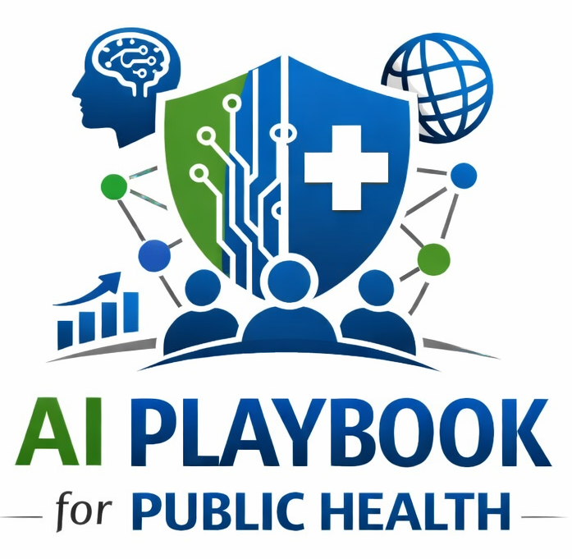
Lesson 21
AI Incident Response
Staff Training Module
AI Playbook and Toolkit for Public Health Departments
Notes:
Welcome participants to the AI Incident Response lesson.
Explain that this deck is designed for staff training, leadership orientation, governance preparation, or cross-program discussion.
Frame the topic in plain language: AI incident response defines how staff report, triage, investigate, correct, communicate, and document problems involving AI-supported systems or outputs.
Invite participants to think about where this topic already appears in their department's workflows, vendor tools, data systems, communications, or planning conversations.

Slide 2
AI PLAYBOOK AND TOOLKIT
Why this topic matters
AI incident response defines how staff report, triage, investigate, correct, communicate, and document problems involving AI-supported systems or outputs.
Public health value
Guardrail
AI incidents can affect privacy, public trust, legal compliance, staff confidence, equity, and operational safety. A clear response pathway reduces harm and improves governance.
Without an incident pathway, errors, bias concerns, privacy exposures, and unsafe outputs may be handled inconsistently or too late.
AI Incident Response
02
Notes:
Use this slide in the AI Incident Response training module.
Use this slide to explain the practical public health reason for learning this topic before AI tools are approved or deployed.
Connect the discussion back to the playbook: this topic supports Plays 3, 10, 11, 12, 13 and Tools 17, 18, 38, 44, 45, 46.
Emphasize the core guardrail: Without an incident pathway, errors, bias concerns, privacy exposures, and unsafe outputs may be handled inconsistently or too late.
Ask participants how this topic could affect their own program area, staff roles, community relationships, data, or public communications.

Slide 3
AI PLAYBOOK AND TOOLKIT
Learning objectives
By the end of this lesson, staff should be able to:
• Explain AI Incident Response in plain language.
• Identify appropriate public health uses and limits.
• Describe human review, governance, equity, privacy, and monitoring expectations.
• Connect the topic to the related plays and tools.
AI Incident Response
03
Notes:
Use this slide in the AI Incident Response training module.
Walk through the objectives and connect each one to a practical implementation decision.
Connect the discussion back to the playbook: this topic supports Plays 3, 10, 11, 12, 13 and Tools 17, 18, 38, 44, 45, 46.
Explain that participants do not need technical expertise to use this material. The goal is enough shared understanding to participate in governance, readiness assessment, use case review, procurement, deployment, or monitoring.

Slide 4
AI PLAYBOOK AND TOOLKIT
Module overview
AI incidents can involve incorrect outputs, privacy exposure, biased results, unsafe recommendations, unauthorized use, vendor failure, staff over-reliance, public misinformation, or model performance drift. Staff need to know what to report and what happens next.
Working definition
AI incident response defines how staff report, triage, investigate, correct, communicate, and document problems involving AI-supported systems or outputs.
AI Incident Response
04
Notes:
Use this slide in the AI Incident Response training module.
Use this slide to provide the narrative overview and definition before moving into detailed application.
Connect the discussion back to the playbook: this topic supports Plays 3, 10, 11, 12, 13 and Tools 17, 18, 38, 44, 45, 46.
Ask the group to restate the topic in their own words.

Slide 5
AI PLAYBOOK AND TOOLKIT
What this means in practice
Incident Types
Response Steps
Implementation Check
Harmful or inaccurate output used in a public health workflow. Sensitive data entered into an unapproved AI tool or exposed through a vendor system. Bias or disparate impact concern raised by staff, partners, or community members. Model drift,.
Capture the issue, system, date, user, output, data involved, and immediate risk. Triage severity and determine whether the system should continue, be limited, paused, or shut off. Notify privacy, security, legal, program leadership,.
Train staff to report concerns without blame. Define emergency contacts and pause authority before deployment. Review incidents regularly through governance and continuous improvement.
AI Incident Response
05
Notes:
Use this slide in the AI Incident Response training module.
Use this slide to turn the concept into practical behaviors, decisions, and safeguards.
Connect the discussion back to the playbook: this topic supports Plays 3, 10, 11, 12, 13 and Tools 17, 18, 38, 44, 45, 46.
Invite participants to identify where these practices would need to be documented in their own department.
Start with Incident Types, then compare it with the other practice areas on the slide.

Slide 6
AI PLAYBOOK AND TOOLKIT
Public health application
Use the topic to examine real workflows, not abstract technology.
Report harmful AI output
Escalate privacy exposure
Pause a drifting model
Discuss how this could support a public health workflow, what data would be involved, who would review outputs, and what safeguards would be needed.
Discuss how this could support a public health workflow, what data would be involved, who would review outputs, and what safeguards would be needed.
Discuss how this could support a public health workflow, what data would be involved, who would review outputs, and what safeguards would be needed.
AI Incident Response
06
Notes:
Use this slide in the AI Incident Response training module.
Use this slide to make the topic concrete through public health workflow examples.
Connect the discussion back to the playbook: this topic supports Plays 3, 10, 11, 12, 13 and Tools 17, 18, 38, 44, 45, 46.
For each example, ask: What problem is being solved? What data would be used? Who reviews the AI output? What decision remains human? What could go wrong?

Slide 7
AI PLAYBOOK AND TOOLKIT
Facilitated discussion and exercise
Discussion questions
Training exercise
What AI-related problems should staff be required to report? Who has authority to pause an AI-supported workflow? How will lessons from incidents update training, policy, and monitoring?
Walk through a tabletop scenario involving an incorrect AI-generated public message or privacy exposure, then document reporting steps, escalation contacts, communications needs, corrective actions, and governance review.
AI Incident Response
07
Notes:
Use this slide in the AI Incident Response training module.
Use this slide for a facilitated activity near the end of the lesson.
Connect the discussion back to the playbook: this topic supports Plays 3, 10, 11, 12, 13 and Tools 17, 18, 38, 44, 45, 46.
Give participants time to work individually or in small groups. Ask them to produce a practical artifact that can feed into readiness assessment, governance review, use case prioritization, or implementation planning.
Expected takeaways include: AI incident scenario response, Escalation pathway, Corrective action log.

Slide 8
AI PLAYBOOK AND TOOLKIT
Next steps and resources
Apply the lesson
References and resources
Use this topic with Plays 3, 10, 11, 12, 13 and Tools 17, 18, 38, 44, 45, 46. Turn the discussion into a documented question, decision, gap, or implementation artifact.
NIST AI Risk Management Framework: Governance and response structure for AI-related harms and failures. WHO: Ethics and governance of artificial intelligence for health: Health AI accountability, safety, and oversight principles. HHS Office.
AI Incident Response
08
Notes:
Use this slide in the AI Incident Response training module.
Close by connecting the lesson to next actions and resources.
Connect the discussion back to the playbook: this topic supports Plays 3, 10, 11, 12, 13 and Tools 17, 18, 38, 44, 45, 46.
Point participants to the first resource: NIST AI Risk Management Framework.
End by asking each participant or team to name one follow-up action they will take after the session.

