Slide 1
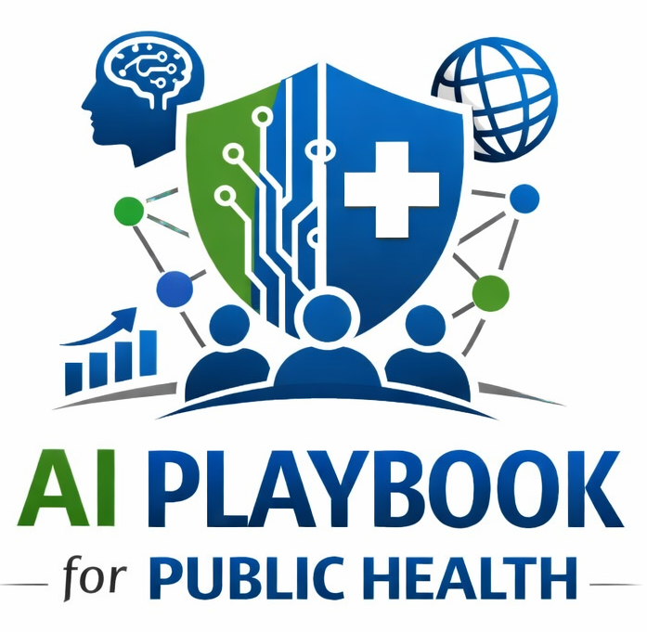
Lesson 26
Cybersecurity and Secure AI Use
Staff Training Module
AI Playbook and Toolkit for Public Health Departments
Notes:
Welcome participants to the Cybersecurity and Secure AI Use lesson.
Explain that this deck is designed for staff training, leadership orientation, governance preparation, or cross-program discussion.
Frame the topic in plain language: Secure AI use requires approved environments, access controls, vendor security review, audit logs, prompt-injection awareness, data-loss prevention, and incident escalation.
Invite participants to think about where this topic already appears in their department's workflows, vendor tools, data systems, communications, or planning conversations.

Slide 2
AI PLAYBOOK AND TOOLKIT
Why this topic matters
Secure AI use requires approved environments, access controls, vendor security review, audit logs, prompt-injection awareness, data-loss prevention, and incident escalation.
Public health value
Guardrail
Cybersecurity protects public health operations, sensitive data, system integrity, and community trust.
AI tools can create new attack surfaces, data leakage pathways, and social engineering risks if security is not built into implementation.
Cybersecurity and Secure AI Use
02
Notes:
Use this slide in the Cybersecurity and Secure AI Use training module.
Use this slide to explain the practical public health reason for learning this topic before AI tools are approved or deployed.
Connect the discussion back to the playbook: this topic supports Plays 2, 3, 7, 11, 12 and Tools 10, 15, 17, 34, 39, 43.
Emphasize the core guardrail: AI tools can create new attack surfaces, data leakage pathways, and social engineering risks if security is not built into implementation.
Ask participants how this topic could affect their own program area, staff roles, community relationships, data, or public communications.

Slide 3
AI PLAYBOOK AND TOOLKIT
Learning objectives
By the end of this lesson, staff should be able to:
• Explain Cybersecurity and Secure AI Use in plain language.
• Identify appropriate public health uses and limits.
• Describe human review, governance, equity, privacy, and monitoring expectations.
• Connect the topic to the related plays and tools.
Cybersecurity and Secure AI Use
03
Notes:
Use this slide in the Cybersecurity and Secure AI Use training module.
Walk through the objectives and connect each one to a practical implementation decision.
Connect the discussion back to the playbook: this topic supports Plays 2, 3, 7, 11, 12 and Tools 10, 15, 17, 34, 39, 43.
Explain that participants do not need technical expertise to use this material. The goal is enough shared understanding to participate in governance, readiness assessment, use case review, procurement, deployment, or monitoring.

Slide 4
AI PLAYBOOK AND TOOLKIT
Module overview
AI security is broader than protecting the model. It includes user accounts, data flows, integrations, APIs, vendor hosting, prompts, outputs, logs, plugins, browser extensions, and connections to existing systems. Staff need to know how secure AI use differs from general software use.
Working definition
Secure AI use requires approved environments, access controls, vendor security review, audit logs, prompt-injection awareness, data-loss prevention, and incident escalation.
Cybersecurity and Secure AI Use
04
Notes:
Use this slide in the Cybersecurity and Secure AI Use training module.
Use this slide to provide the narrative overview and definition before moving into detailed application.
Connect the discussion back to the playbook: this topic supports Plays 2, 3, 7, 11, 12 and Tools 10, 15, 17, 34, 39, 43.
Ask the group to restate the topic in their own words.

Slide 5
AI PLAYBOOK AND TOOLKIT
What this means in practice
Security Concerns
Secure Practices
Implementation Check
Sensitive data entered into unapproved tools or retained by vendors. Prompt injection or malicious content that manipulates AI behavior. Unauthorized access through weak role controls, shared accounts, or unmanaged integrations. Unverified.
Use only approved AI tools for official work. Apply role-based access, multi-factor authentication, logging, data-loss prevention, and least-privilege access. Review vendor security documentation, hosting, subcontractors, breach notification,.
Include security review before pilot approval. Test integrations in controlled environments. Coordinate AI incident response with cybersecurity and privacy response plans.
Cybersecurity and Secure AI Use
05
Notes:
Use this slide in the Cybersecurity and Secure AI Use training module.
Use this slide to turn the concept into practical behaviors, decisions, and safeguards.
Connect the discussion back to the playbook: this topic supports Plays 2, 3, 7, 11, 12 and Tools 10, 15, 17, 34, 39, 43.
Invite participants to identify where these practices would need to be documented in their own department.
Start with Security Concerns, then compare it with the other practice areas on the slide.

Slide 6
AI PLAYBOOK AND TOOLKIT
Public health application
Use the topic to examine real workflows, not abstract technology.
Use approved AI environments
Review vendor integrations
Train staff on prompt injection
Discuss how this could support a public health workflow, what data would be involved, who would review outputs, and what safeguards would be needed.
Discuss how this could support a public health workflow, what data would be involved, who would review outputs, and what safeguards would be needed.
Discuss how this could support a public health workflow, what data would be involved, who would review outputs, and what safeguards would be needed.
Cybersecurity and Secure AI Use
06
Notes:
Use this slide in the Cybersecurity and Secure AI Use training module.
Use this slide to make the topic concrete through public health workflow examples.
Connect the discussion back to the playbook: this topic supports Plays 2, 3, 7, 11, 12 and Tools 10, 15, 17, 34, 39, 43.
For each example, ask: What problem is being solved? What data would be used? Who reviews the AI output? What decision remains human? What could go wrong?

Slide 7
AI PLAYBOOK AND TOOLKIT
Facilitated discussion and exercise
Discussion questions
Training exercise
Which AI tools are approved for official work? Which integrations or data flows require security review? How should staff report suspicious AI behavior, data leakage, or unauthorized access?
Map the security controls needed for one AI use case, including data classification, access controls, vendor hosting, integrations, logging, incident response, and staff training.
Cybersecurity and Secure AI Use
07
Notes:
Use this slide in the Cybersecurity and Secure AI Use training module.
Use this slide for a facilitated activity near the end of the lesson.
Connect the discussion back to the playbook: this topic supports Plays 2, 3, 7, 11, 12 and Tools 10, 15, 17, 34, 39, 43.
Give participants time to work individually or in small groups. Ask them to produce a practical artifact that can feed into readiness assessment, governance review, use case prioritization, or implementation planning.
Expected takeaways include: AI security review notes, Approved-use rules, Security escalation checklist.

Slide 8
AI PLAYBOOK AND TOOLKIT
Next steps and resources
Apply the lesson
References and resources
Use this topic with Plays 2, 3, 7, 11, 12 and Tools 10, 15, 17, 34, 39, 43. Turn the discussion into a documented question, decision, gap, or implementation artifact.
NIST Cybersecurity Framework: Cybersecurity risk management structure for organizational systems. CISA AI and Cybersecurity: Cybersecurity context for AI systems and AI-enabled threats. FedRAMP: Cloud security authorization context for.
Cybersecurity and Secure AI Use
08
Notes:
Use this slide in the Cybersecurity and Secure AI Use training module.
Close by connecting the lesson to next actions and resources.
Connect the discussion back to the playbook: this topic supports Plays 2, 3, 7, 11, 12 and Tools 10, 15, 17, 34, 39, 43.
Point participants to the first resource: NIST Cybersecurity Framework.
End by asking each participant or team to name one follow-up action they will take after the session.

