Slide 1

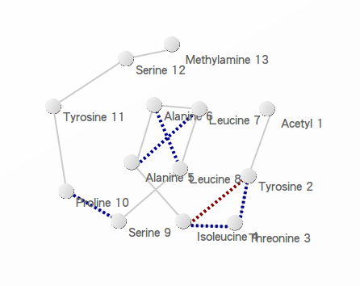
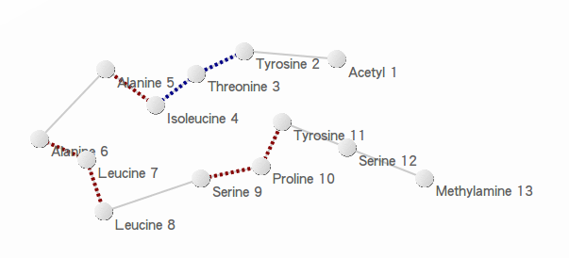
GestureCV
Hand gesture control based on histogram analysis (C++/OpenCL/OpenCV)
(click to view the source code repository)
CL-VAF [3, 4, 5, 7, 8]
(click to jump to the reference)
1. Precursory Signatures of Protein Folding/Unfolding: From Time Series Correlation Analysis to Atomistic Mechanisms, P. J. Hsu, S. A. Cheong, and S. K. Lai, J. Chem. Phys. 140, 204905 (2014).
(click to view pdf file)
(Click here to see the on-line demonstration)
(click to view the demo clip)
(click & drag)
(click & drag)
Alpha-helix conformation of peptide fragment of transthyretin.
(Click to view the beta-hairpin conformation)
Beta-hairpin conformation of peptide fragment of transthyretin.
(Click to view the alpha-helix conformation)
(click to switch)
(click to switch)

Slide 2
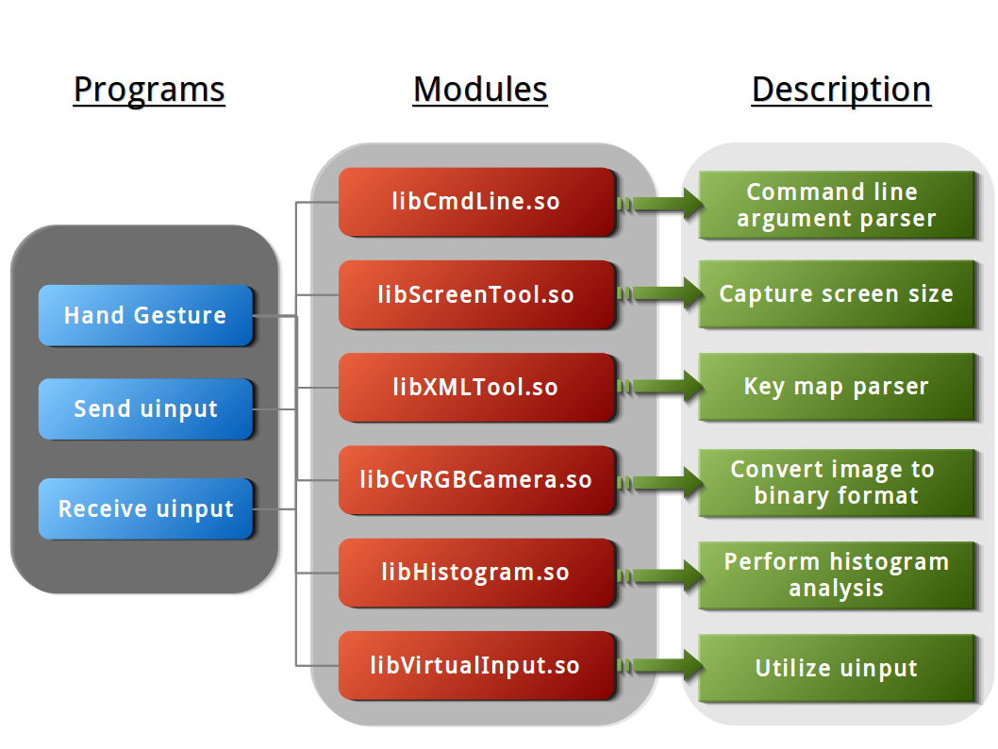
GestureCV
Hand gesture control based on histogram analysis (C++/OpenCL/OpenCV)
(click to view the GitHub source code repository)
CL-VAF [3, 4, 5, 7, 8]
(click to enlarge the picture)
(click to jump to the reference)
1. Precursory Signatures of Protein Folding/Unfolding: From Time Series Correlation Analysis to Atomistic
Mechanisms, P. J. Hsu, S. A. Cheong, and S. K. Lai, J. Chem. Phys. 140, 204905 (2014).
(click to view the pdf file)
(Click here to see the on-line demonstration)
HTML5/JavaScript, XML, D3.js
(click to view the demo clip)
(click for more information)
Dynamical view of time series clustering results using D3.js (web version only)
(click & drag)
(click & drag)
Alpha-helix conformation of peptide fragment of transthyretin.
(Click to view the beta-hairpin conformation)
Beta-hairpin conformation of peptide fragment of transthyretin.
(Click to view the alpha-helix conformation)
(click to switch)
(click to switch)

