Slide 1
Cambodia Team :
Agriculture and
Healthcare
The links between agriculture and health:
an intersectoral opportunity to improve the health

Slide 2
1.
Introduction

Slide 3
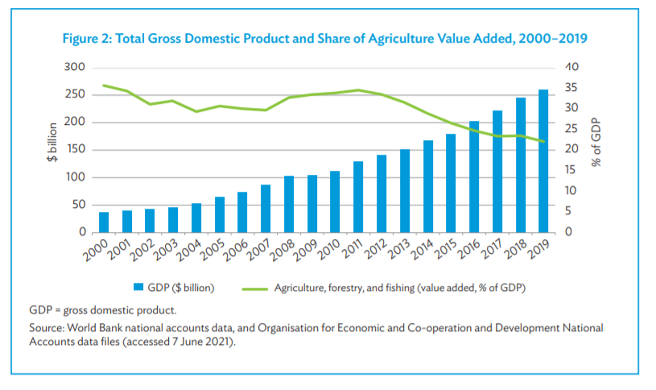
Agriculture in Cambodia
Agriculture remains the most important sector of the Cambodian economy in terms of its share of the gross domestic product (GDP), and it employs the vast majority of the workforce.

Slide 4
Main Agriculture Products
Rice: The country’s 4.5 million ha of cultivated land remain largely dominated by rice (70%), followed by subsidiary and industrial crops (20%),29 rubber plantations (7%), and permanent crops (4%).30 The cultivated area of rice increased from 3.2 million ha in 2017 to 3.3 million ha in 2018, comprising 2.7 million ha of wet-season rice and 0.6 million ha of dry-season rice. The increased cultivated area of rice resulted in an increase in rice production by around 10.5 million tons in 2017 to 10.9 million tons in 2018
Rubber: Despite the major price falls in recent years, the total planted area of rubber has continued to increase from 329,771 ha in 2013 to 436,682 ha in 2018. Rubber production has grown by an annual average of 22.0% (2010–2018) to reach 220,100 tons in 2018; however, production declined by 20.6% to 174,700 tons in 2019. Rubber exports increased from 190,000 tons in 2017 to 217,500 tons in 2018. Rubber is exported in the form of dry sheets or blocks only (i.e., with the absolute minimum amount of processing consistent with producing a saleable commodity).

Slide 5
The links between agriculture and health: an intersectoral opportunity to improve the health
Agriculture and health are linked in many ways:
First, agriculture is essential for good health: it produces the world’s food, fiber and materials for shelter; in many countries it is also an important source of livelihood among the poor.
At the same time, agriculture can be linked with poor health, including malnutrition, malaria, foodborne illnesses, human immunodeficiency virus/acquired immunodeficiency syndrome (HIV/AIDS), livestock-related diseases, chronic diseases and occupational ill-health.

Slide 6
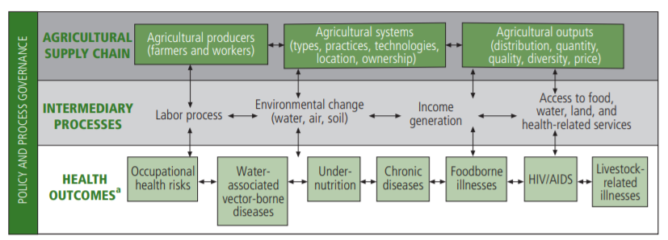
How is agriculture linked with healthcare?

Slide 7
How is agriculture linked with healthcare? Agriculture Supply chain
Agricultural Producers
The labor supplied by agricultural households interacts with health in several ways. First, labor influences nutritional status by affecting energy expenditure and the time available for child care and food preparation. Second, farming exposes producers to a range of occupational health hazards, such as dehydration, accidents, zoonoses, and acute and chronic pesticide poison. Third, the amount and type of agricultural employment has implications for the spread of and exposure to disease (e.g. HIV/AIDS) because it influences migration and the search for alternative income sources.8 All these interactions are affected by gender relations in agricultural communities.
Agriculture Output
Agricultural outputs are also linked with chronic diseases. Agricultural policies can create incentives or disincentive to the production of different foods, tobacco and alcohol, and in turn determine their prices, thus affecting the environment in which people make choices about these products, and their subsequent level of exposure to risk fact tors for chronic disease.
Another agricultural product is medicinal plants, many of which are believed to be effective in the treatment of certain diseases.

Slide 8
2.
Big Data in Agriculture

Slide 9
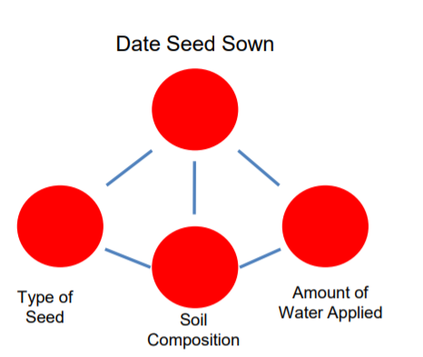
Supported datasets

Slide 10
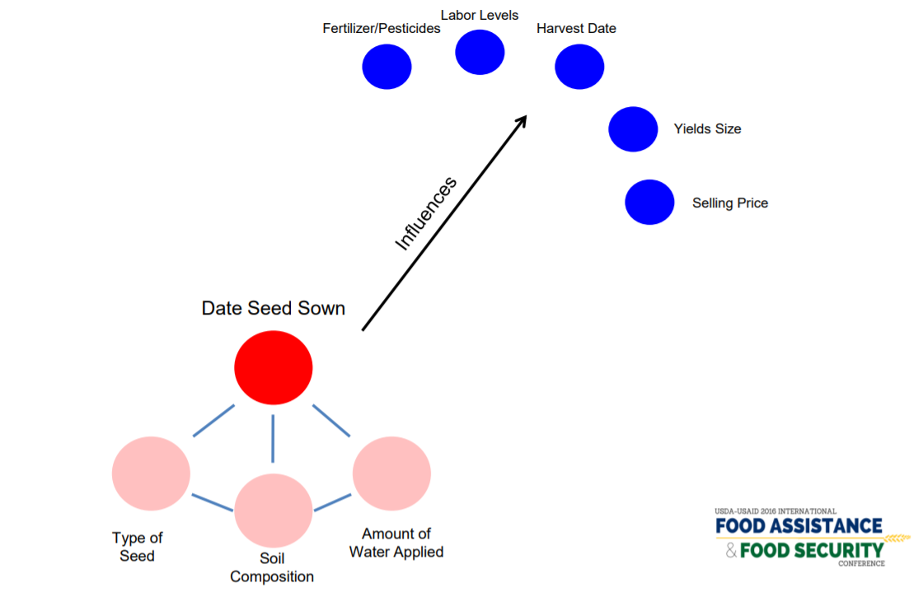
Supported datasets

Slide 11
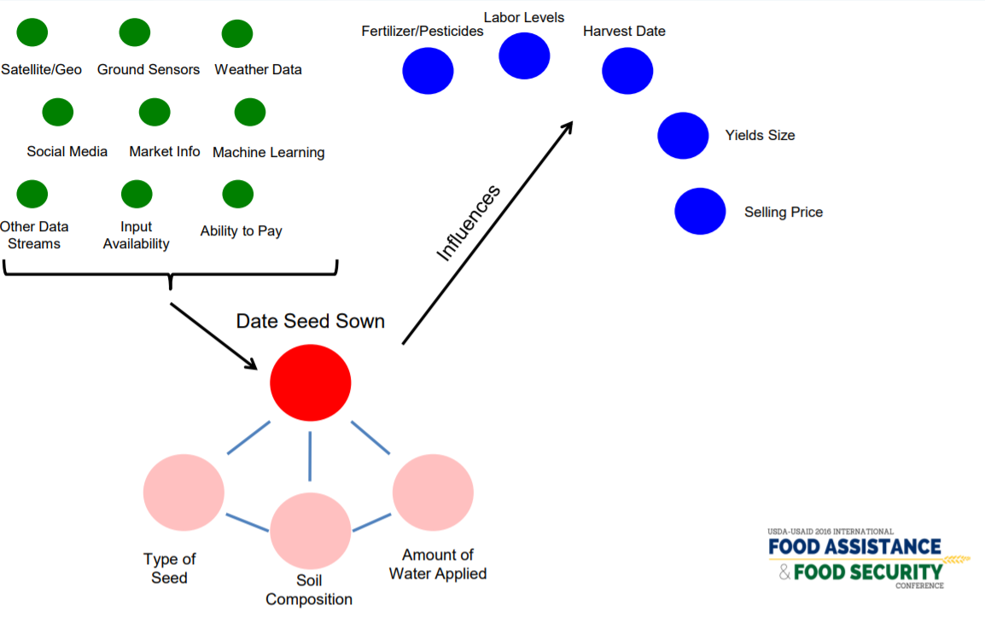
Supported datasets

Slide 12
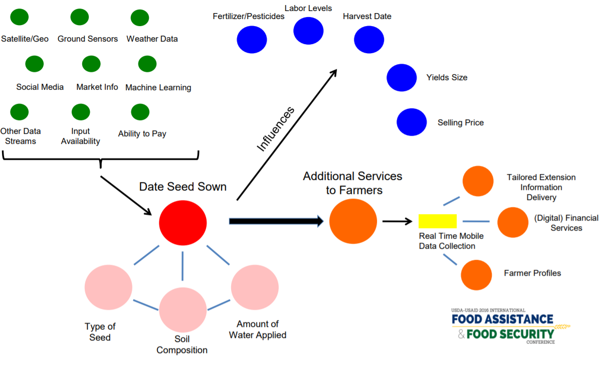
Supported Datasets

Slide 13
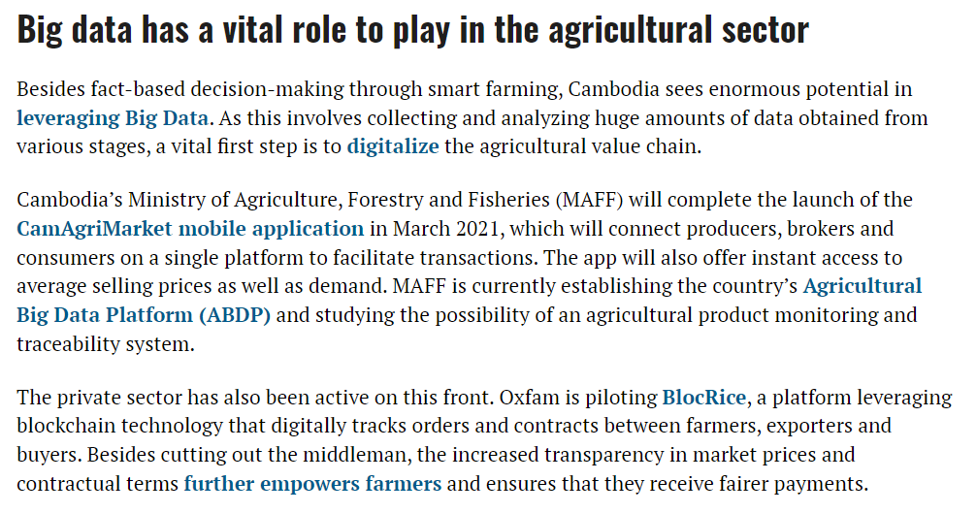

Slide 14
Comment
Whole Process from agriculture suppliers to customer
Insect/climate change/disease
Drone to collect big data

Slide 15
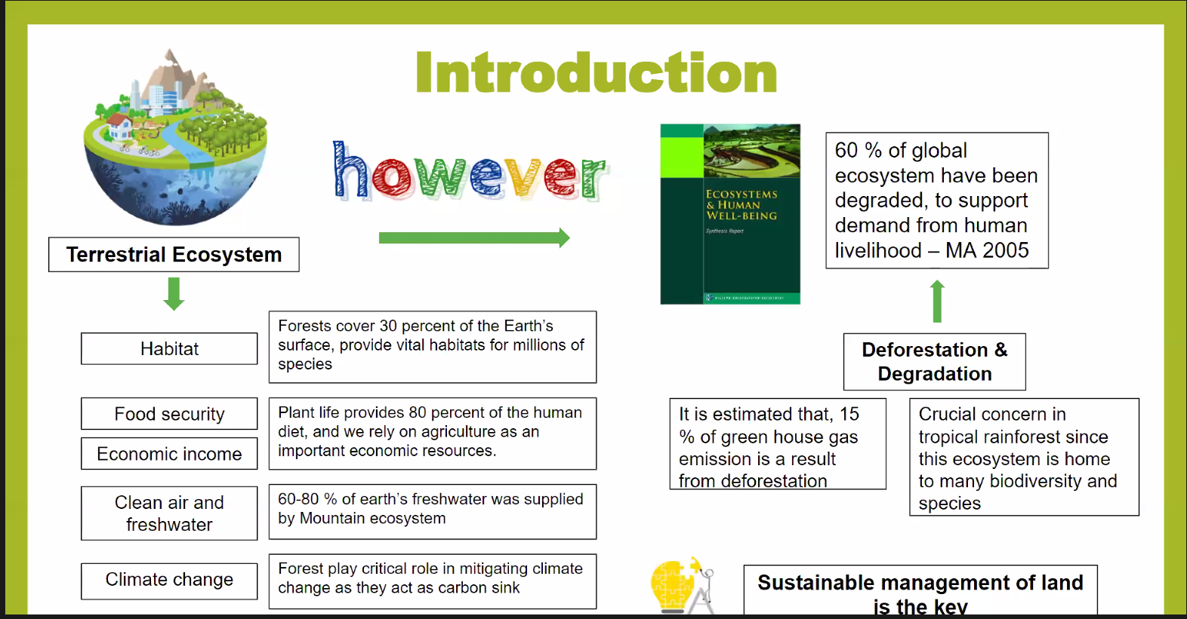

Slide 16
Conclusion
These links between agriculture and health present an opportunity for the two sectors to work together to find solutions to each other’s problems. Yet the health and agricultural sectors remain poorly coordinated. Leadership from global health and agricultural institutions is needed to build policies and good governance to facilitate integration, while capacity building is needed at all levels to help translate the conceptual links into comprehensive action on the ground. Health and agricultural researchers likewise need to work more closely together to achieve common goals.

