Slide 1
The Nature of Information Technology Projects
Chapter 1

Slide 2
Class Outline

Slide 3
Introduction
The world as a whole spends nearly $10 trillion of its $40.7 trillion gross product on projects of all kinds
More than 16 million people regard project management as their profession
The overall information and communications technology market grew by 6 percent to almost $3 trillion in 2010

Slide 4
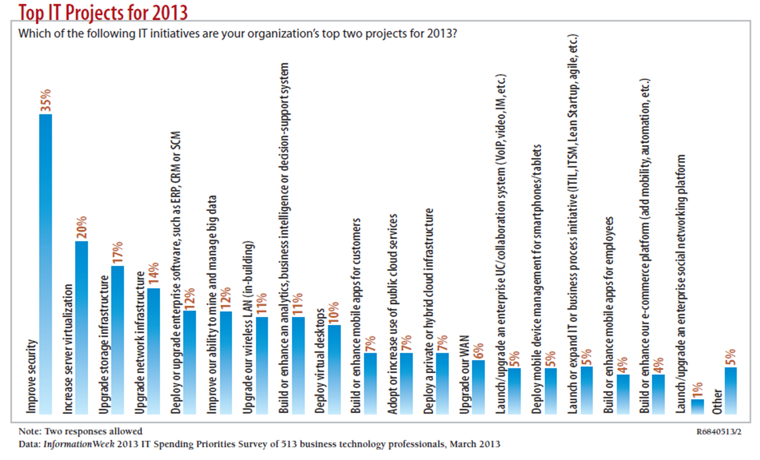
What Is a Project?

Slide 5
Project Attributes
A project

Slide 6
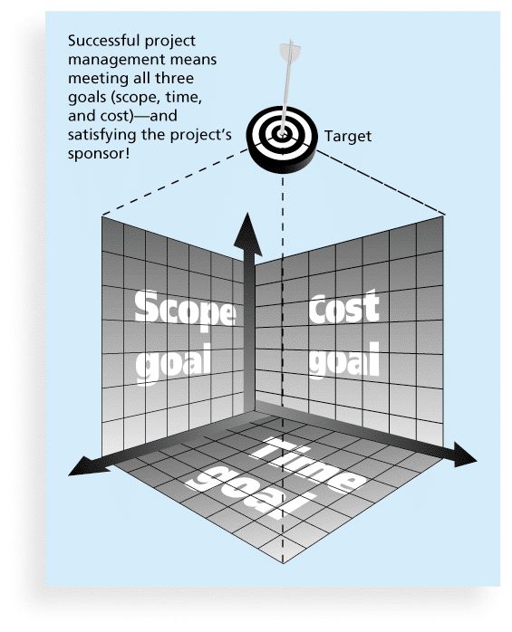
The Triple Constraint of Project Management

Slide 7
Project and Program Managers
Project managers work with project sponsors, project team, and other people involved in a project to meet project goals
Program: group of related projects managed in a coordinated way to obtain benefits and control not available from managing them individually (PMBOK® Guide, Fifth Edition, 2012)
Program manager provides leadership and direction for the project managers heading the projects within the program

Slide 8
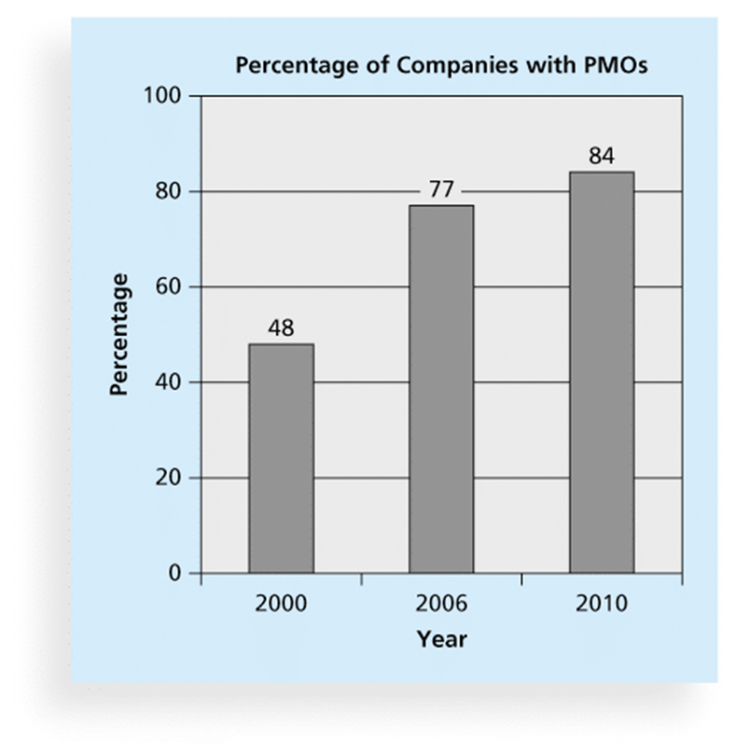
Project Management Offices
A Project Management Office (PMO) is an organizational group responsible for coordinating the project management function throughout an organization

Slide 9
Project Stakeholders
Who are the stakeholders in a project?

Slide 10
An IT PM Approach
“If technology does not accelerate a business objective, it should be at the bottom of the list.”
CIO Panel, AMCIS 2014
Organizational resources are limited, so organizations must choose among competing interests to fund specific projects
This decision should be based on the value a competing project will provide to an organization

Slide 11
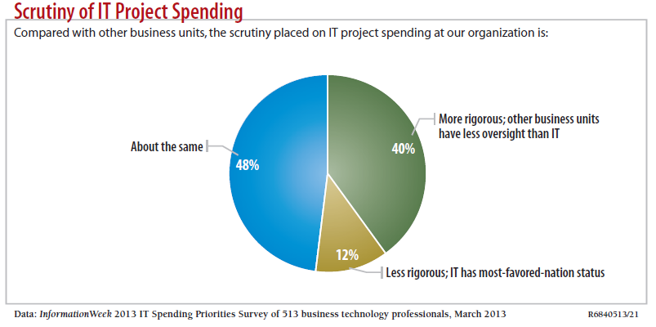
Motivation for Studying Information Technology (IT) Project Management
IT Projects have a terrible track record, as described in the “What Went Wrong?”

Slide 12
Advantages of Using Formal Project Management
Better control of financial, physical, and human resources
Improved customer relations
Shorter development times
Lower costs
Higher quality and increased reliability
Higher profit margins
Improved productivity
Better internal coordination
Higher worker morale

Slide 13
Which Situation is Worse?
Successfully building and implementing a system that provides little or no value to the organization?
Or…
Failing to implement an information system that could have provided value to the organization, but was underdeveloped or poorly managed?

Slide 14
Why Do IT Projects Fail?
Larger projects have the lowest success rate and appear to be more risky than medium and smaller projects
The CHAOS studies also provides some insight as to the factors that influence project success

Slide 15
The Software Crisis
The CHAOS study published in 1995 by The Standish Group found that although the U.S spent over $250 billion on IT projects, approximately…
31% were cancelled before completion
53% were completed but over budget, over schedule, & did not meet original specifications
For mid-size companies, average cost overruns were 182%, while average schedule overruns were 202%!
Has it gotten better?

Slide 16
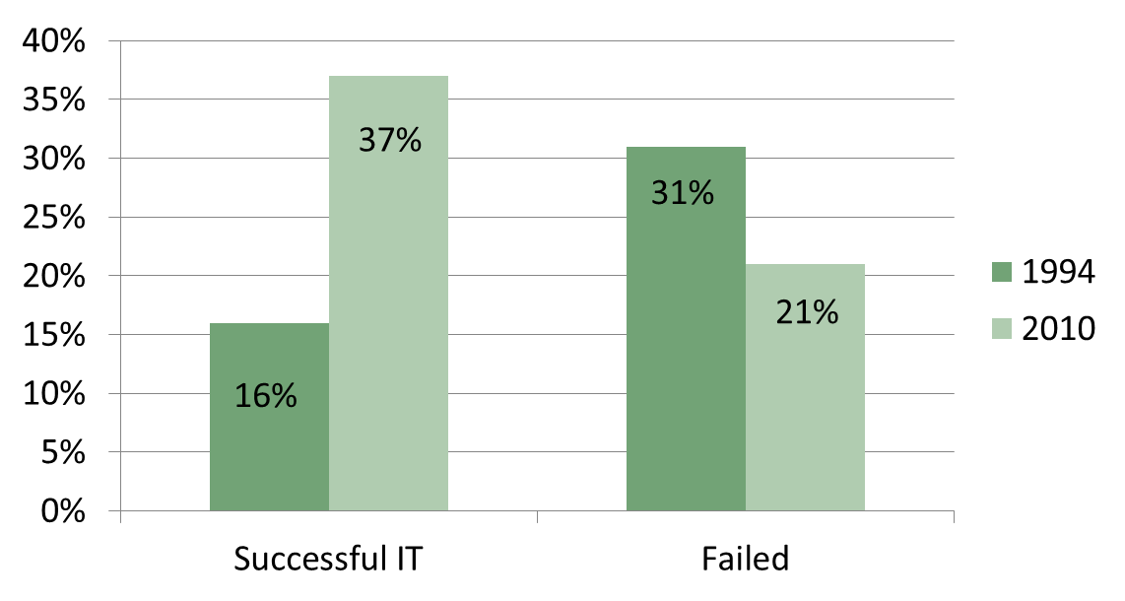
Why the Improvements?
Results of increased focus on PM:
Improved Project Performance

Slide 17
Project Success
There are several ways to define project success:

Slide 18
What Helps Projects Succeed?*
1. User involvement
2. Executive support
3. Clear business objectives
4. Emotional maturity
5. Optimizing scope
6. Agile process
7. Project management expertise
8. Skilled resources
9. Execution
10. Tools and infrastructure
*The Standish Group, “CHAOS Activity News” (August 2011).

Slide 19
Table 1.1 Summary of CHAOS Study Factor Rankings for Successful Projects
Sources: Adapted from the Standish Group. CHAOS (West Yarmouth, MA: 1995, 2010) & http://www.infoq.com/articles/Interview-Johnson-Standish-CHAOS
Rank | 1994 | 2001 | 2006 | 2008
1 | User Involvement | Executive Support | User Involvement | User Involvement
2 | Executive Management Support | User Involvement | Executive Management Support | Executive Support
3 | Clear Statement of Requirements | Experienced Project Manager | Clear Business Objectives | Clear Business Objectives
4 | Proper Planning | Clear Business Objectives | Optimizing Scope | Emotional Maturity
5 | Realistic Expectations | Minimized Scope | Agile Process | Optimizing Scope
6 | Smaller Project Milestones | Standard Software Infrastructure | Project Management Expertise | Agile Process
7 | Competent Staff | Firm Basic Requirements | Financial Management | Project Management Expertise
8 | Ownership | Formal Methodology | Skilled Resources | Skilled Resources
9 | Clear Vision & Objectives | Reliable Estimates | Formal Methodology | Execution
10 | Hard-working, focused team | Other | Standard Tools and Infrastructure | Tools & Infrastructure

Slide 21
Improving the likelihood of success
A Value-Driven Approach
Socio-technical Approach
Project Management Approach
Knowledge Management Approach

Slide 22
Project Management Institute
The Project Management Institute (PMI) is an international professional society for project managers with 380,000 members worldwide in 2012
Project Management Professional (PMP) has documented sufficient project experience, agreed to follow a code of ethics, and passed the PMP exam
Certified Associate in PM (CAPM) is achievable with less experience
CompTIA offers another certification option
CompTIA Project+ has less requirements but is not as well recognized as PMP

Slide 23
Project Management Knowledge Areas
Knowledge areas describe the key competencies that project managers must develop
Core Functions
Facilitating Functions
Integration Function

Slide 24
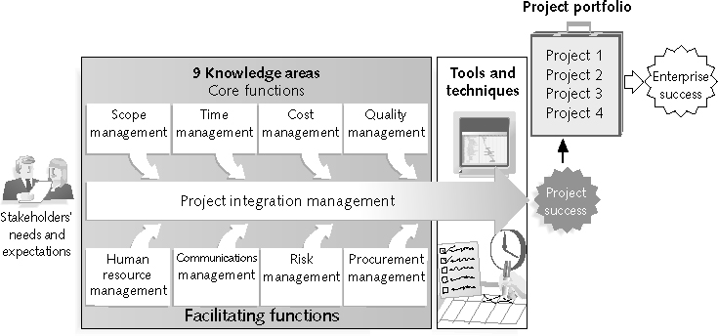
What is Project Management?
“the application of knowledge, skills, tools and techniques to project activities to meet project requirements” (PMBOK® Guide, Fourth Edition, 2012)
Stakeholders
Core Functions
Facilitating
Functions

Slide 25
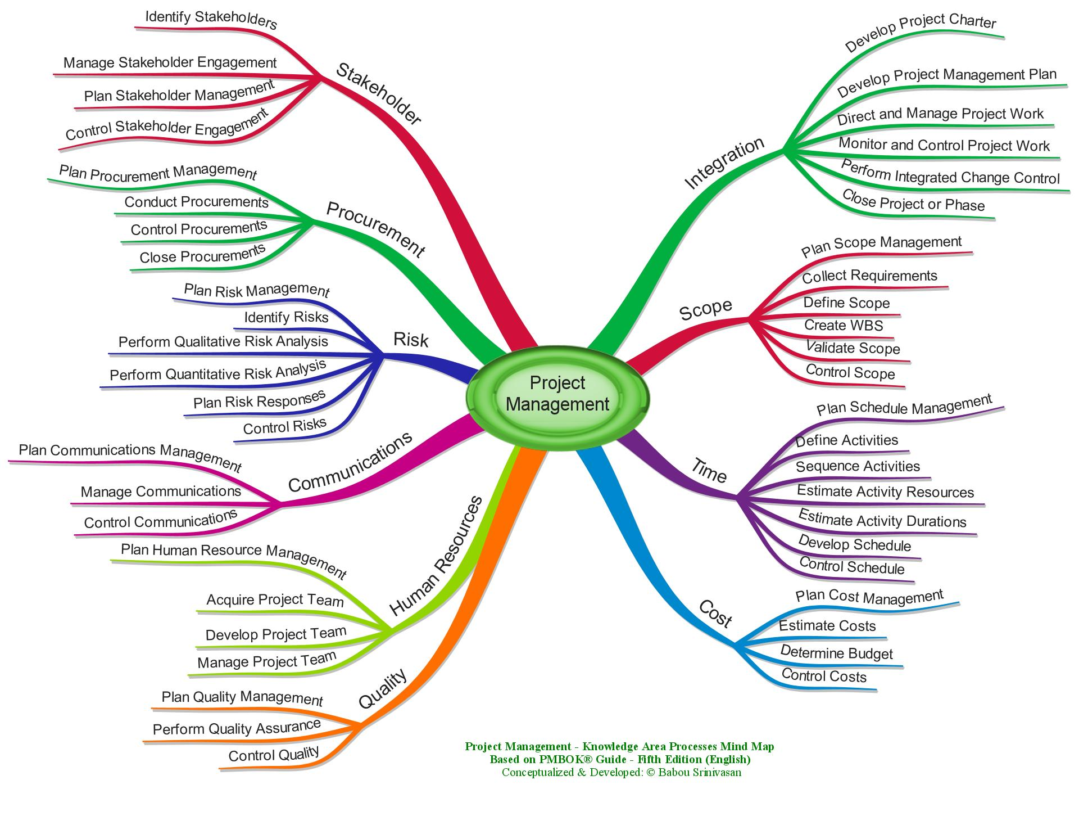
Project Management Body of Knowledge Areas

Slide 26
Careers for IT Project Managers
Job Categories | Total Current Employees Rank | Growth Rank
Big Data / Analyst | 6 | 1
Business/Systems Analyst | 3 | 3 (tie)
Database Admin / Analyst | 7 | 3 (tie)
Networks / Security | 5 | 5
Project Management | 4 | 2
Software Development | 2 | 6
Other IT Skills( Primarily Help Desk) | 1 | 7
In a 2012 survey, IT executives listed the “nine hottest skills” they planned to hire for in 2013
Project management was second only to programming and application development

Slide 27
Nine Hottest Skills*
Skill |  | Percentage of Respondents
Programming and application development |  |  | 60%
Project management |  |  | 44%
Help desk/technical support |  |  | 35%
Networking |  |  | 35%
Business intelligence |  |  | 23%
Data center |  |  | 18%
Web 2.0 |  |  | 18%
Security |  |  | 17%
Telecommunications |  |  | 9%
*Source: Rick Saia, “9 Hot IT Skills for 2012,” Computerworld, September 26, 2011.

Slide 28
The Project Management Profession
The profession of project management is growing at a very rapid pace
It is helpful to understand the history of the field, the role of professional societies like the Project Management Institute, and the growth in project management software

Slide 29
Project Management Software
There are hundreds of different products to assist in performing project management
Three main categories of tools:
Low-end tools
Midrange tools
High-end tools
Various software includes:
BaseCamp
Clarizen
Collabtive (open source)
dotProject (open source)
OneDesk
Genius Inside
PlanBox

Slide 30
Summary
Introduction to Project Management
Definition of a Project
IT PM
Success/Failures
PMI and Knowledge Areas
PM Software
Next Class:
Read Chapter 2: Conceptualizing/Initializing
the IT Project

