Slide 1
Agile Approach: Case Study
Chapter 3
Information Technology Project Management, Seventh Edition

Slide 2
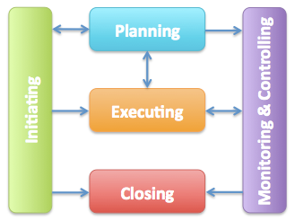
Project Management Process Groups
Project management process groups include
initiating processes
planning processes
executing processes
monitoring and controlling processes
closing processes

Slide 3
Process Groups & Knowledge Areas
Process groups vs. knowledge areas
Knowledge areas cross the various process groups including some key distinctions

Slide 4
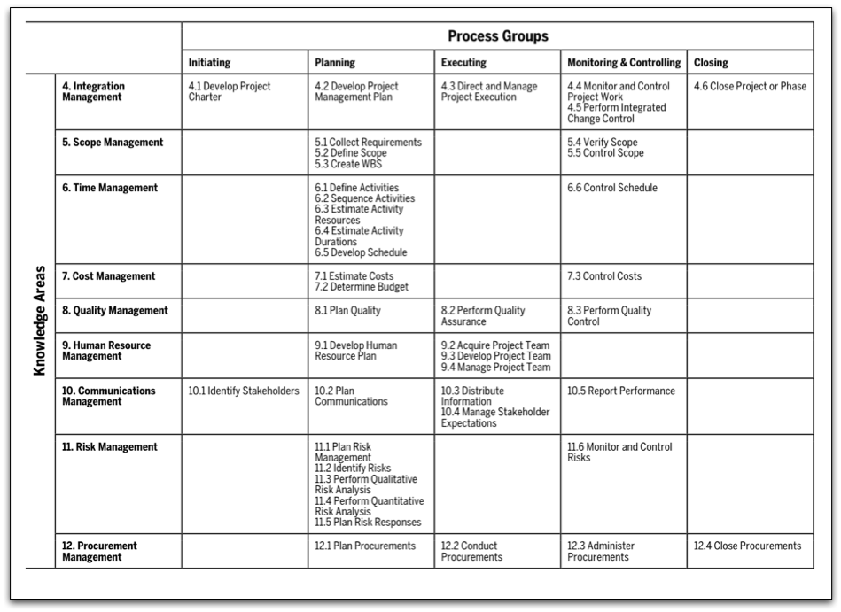
Project Management Process Groups and Knowledge Area Mapping*

Slide 5
Global Issues – India and Agile
A 2011 study of organizations across India included the following findings:
Agile Adoption Increasing
Significant Cultural shift for Agile
Paired Programming and Open Workspace are not popular

Slide 6
An Informed Decision
It is not a snap decision whether to use an agile approach or not, just like flying or driving somewhere on a trip
The approach has to fit the culture, project, etc. at the organization to be successful.

Slide 7
PM Network: A Philosophical Makeover
Impact of Agile PM
Challenges of starting Agile
Best Practice?
Support

Slide 8
PM Network: The Sweet Spot
Beyond Software Development
Is it the right fit?

Slide 9
Agile Approach: JWD Consulting’s Project Management Intranet Site
An agile project team typically uses several iterations or deliveries of software instead of waiting until the end of the project to provide one product.

Slide 10
Traditional Approach: JWD Project Management Intranet Site
Pre-Initiation
Generate Business Case (includes high level estimates on scope, cost, time, etc.)
Identify Sponsor and PM
Initiation
Project Charter
Stakeholder Identification

Slide 11
Traditional Approach: JWD Project Management Intranet Site
Planning
Team Contract
Scope Statement
WBS
Gantt chart
Risks
Execution
PM acquires team then directs and manages work
Milestone reporting
Update progress (handle human resource issues)
Manage Communications
Ensure stakeholders remain engaged

Slide 12
Traditional Approach: JWD Project Management Intranet Site
Monitor and Controlling
Change Control
Validate/Control Scope
Scheduling (forecasts)
Progress Reports
Closing
Final report and presentation
Client sign-off
Lessons-learned

Slide 13
Scrum Roles & Artifacts
Scrum Roles
Product owner
ScrumMaster
Scrum team or development team
Artifacts
Product backlog
Sprint backlog
Burndown chart

Slide 14
Scrum Ceremonies
Sprint planning session
Daily Scrum
Sprint reviews
Sprint retrospectives

Slide 15
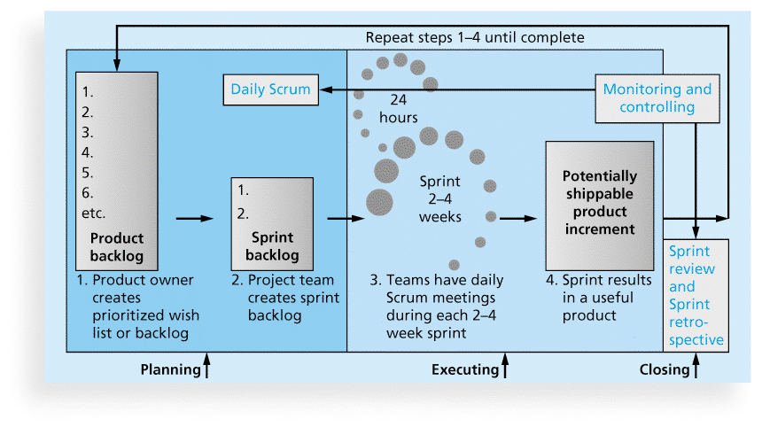
Scrum Framework and the Process Groups

Slide 16
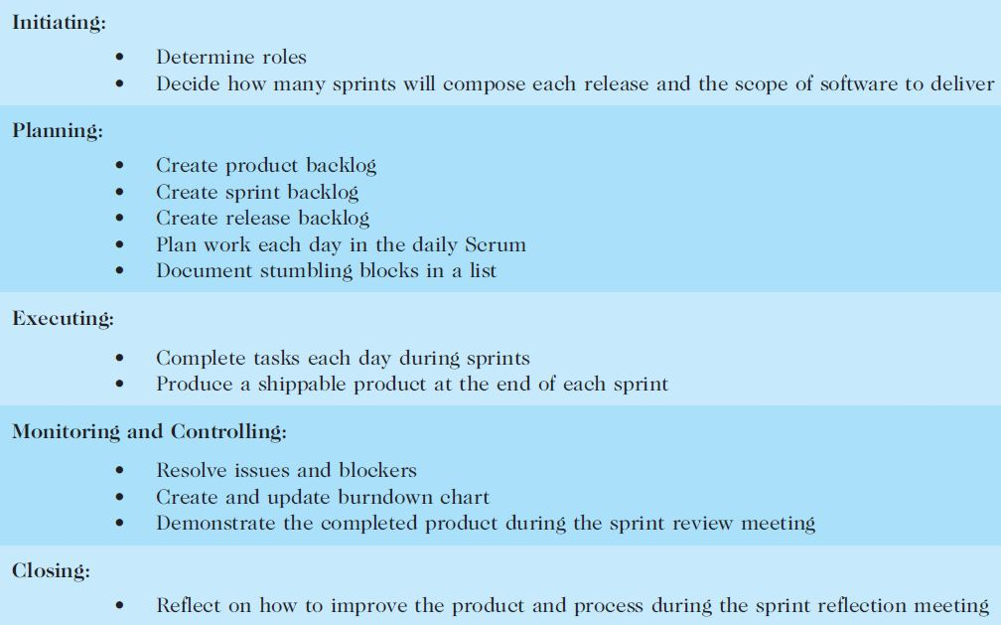
Unique Scrum Activities by Process Group

Slide 17
Pre-Initiation and Initiation
Pre-Initiation and Initiation major tasks
# of releases and functionality by release
Sprints in release
Charter
Stakeholder Register
Kick-off Meetings

Slide 18
Planning
Similar to Traditional Process Groups
Differences

Slide 19
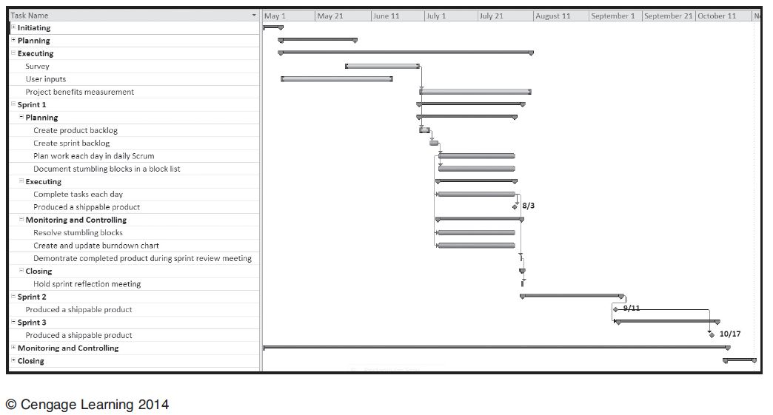
JWD Intranet Site Project Baseline Gantt Chart Using Scrum Approach
3 releases vs.
1 release

Slide 20
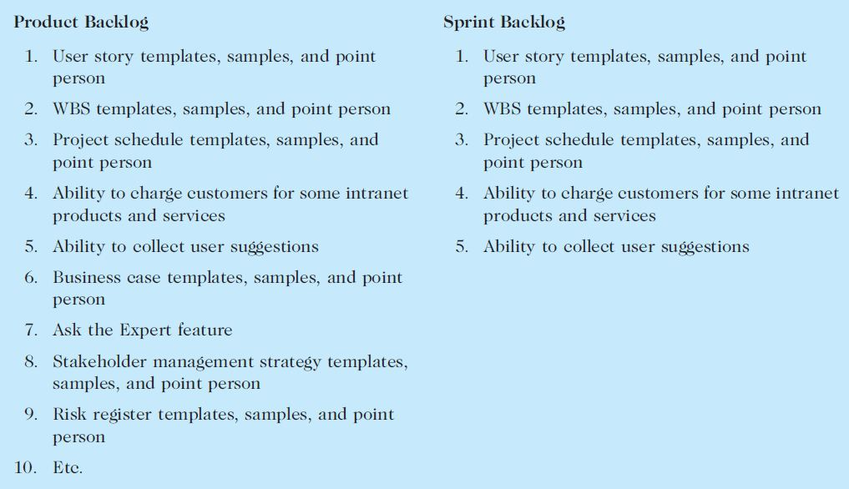
JWD Product and Sprint Backlogs

Slide 21
Executing
Similarities to Traditional Process Groups
Differences

Slide 22
Monitoring and Controlling
Similarities to Traditional Process Groups
Differences

Slide 23
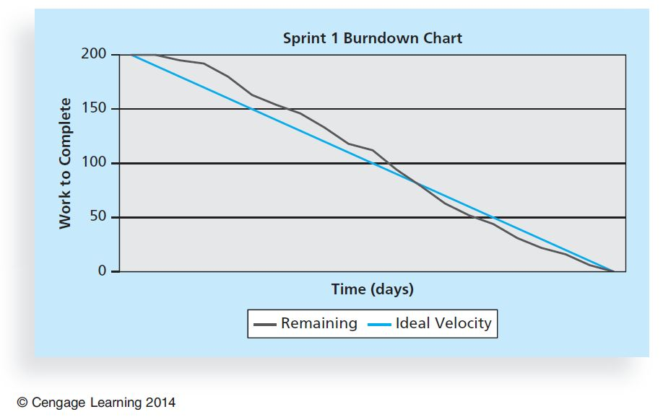
Figure 3-7. Burndown Chart

Slide 24
Closing
Similarities to Traditional Process Groups
Differences:

Slide 25
Chapter Summary
Project Management Process Groups
Main activities of each process group mapped to knowledge areas
Information technology project management methodologies
JWD Consulting – Predictive vs. Agile
Biggest Difference: providing three releases of useable software versus just one

