Slide 1
Project Scope Management
Chapter 5

Slide 2
Announcements
Exercise 1 due Wednesday
(upload to Entropy as an Excel file)
Project Integration Assignment due Friday
(Upload as a zip/compressed file)
Career Day tomorrow
GE Leadership Program Sessions (4:50 & 5:25)

Slide 3
Project Integration Management Processes
Process Group | Integration Management Process | Major Output
Initiating | Developing the project charter | Project Charter
Planning | Developing the project management plan | Project Management Plan
Executing | Directing and managing project work | Deliverables, work performance info, change requests
Monitoring and Controlling | (1) Monitor/Control Project Work (2) Perform Integrated Change Control | (1) Change Requests (2) Status updates
Closing | Close Project/Phase | Product Transition

Slide 4
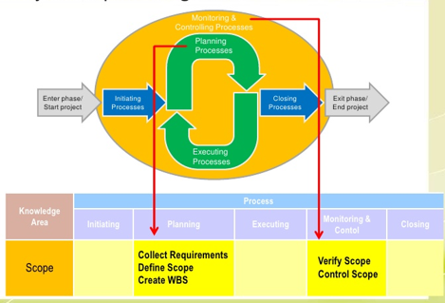
What is Project Scope Management?
Scope refers to all the work involved in creating the products of the project and the processes used to create them

Slide 5
Project Scope Management Processes
Process Group | Integration Management Process | Major Output
Planning | P1: Plan Scope Management | Scope Mgmt Plan Requirement Mgmt Plan
 | P2: Collect Requirements | Req. Documentation Req. Traceability Matrix
 | P3: Define Scope | Project Scope Stmt Project Docs Update
 | P4: Create WBS | Scope Baseline Project Docs Update
Monitoring and Controlling | MC1: Validate Scope | Accept Deliverables Change Requests Work Performance Info
 | MC2: Control Scope | Change Requests Project Mgmt Plan Updates Org, Process Asset Updates

Slide 6
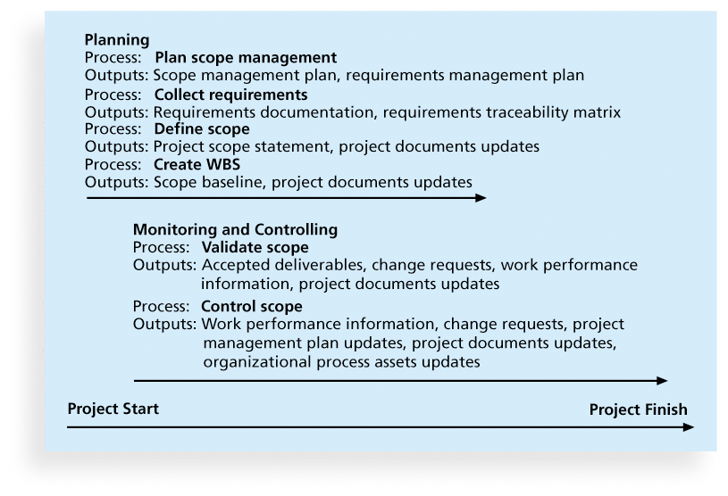
Project Scope Management Processes
Planning scope
Collecting requirements
Defining scope
Creating the WBS
Validating scope
Controlling scope

Slide 7
P1: Planning Scope Management
The project team uses expert judgment and meetings to develop two important outputs
The scope management plan is a subsidiary part of the project management plan

Slide 8
P1: Scope Management Plan Contents
How to prepare a detailed project scope statement
How to create a WBS
How to maintain and approve the WBS
How to obtain formal acceptance of the completed project deliverables
How to control requests for changes to the project scope
Example A Example B

Slide 9
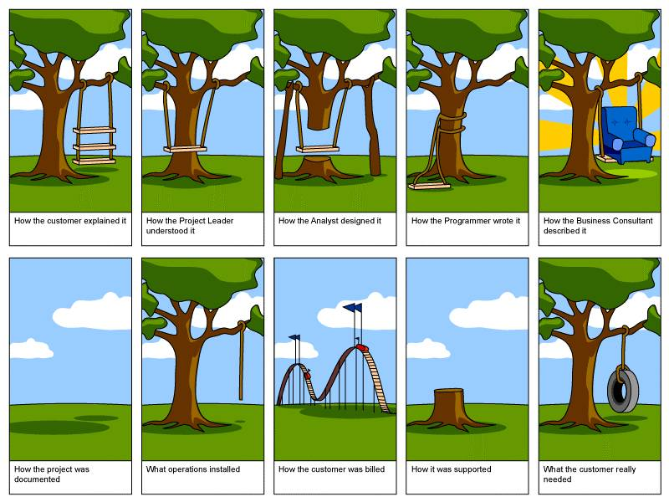
P1: Requirements Management Plan
“conditions or capabilities that must be met by the project or present in the product, service, or result to satisfy an agreement or other formally imposed specification*”
*The PMBOK® Guide, Fifth Edition

Slide 10
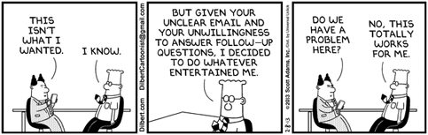
P2: Collecting Requirements
For some IT projects, it is helpful to divide requirements development into categories called elicitation, analysis, specification, and validation
http://www.certified-re.de/en/home.html

Slide 11
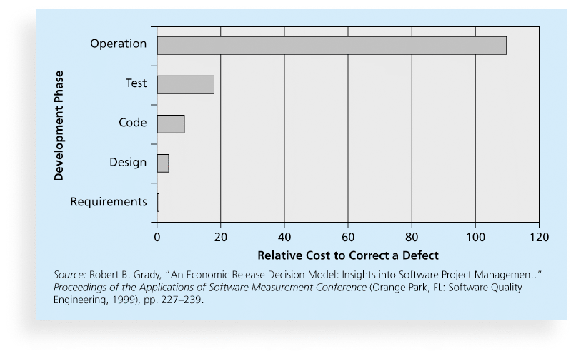
Relative Cost to Correct a Software Requirement Defect

Slide 12
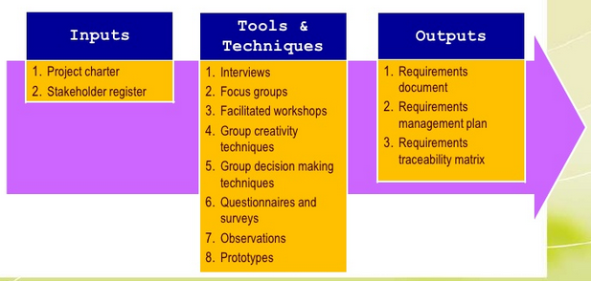
P2: Methods for Collecting Requirements
Interviewing
Prototyping
Benchmarking

Slide 13
Statistics on Requirements for Software Projects *
88% of the software projects involved enhancing existing products instead of creating new ones
86% said that customer satisfaction was the most important metric for measuring the success of development projects
83% of software development teams still use MS Office applications (e.g. Word and Excel) as their main tools to communicate requirements
*John Simpson, “2011: The State of Requirements Management” (2011).

Slide 14
PM Network: The Blame Game
Surrender the pipe dream
Always assume initial reqs. are wrong
Accept that all requirements change
Simplify your change management approach

Slide 15
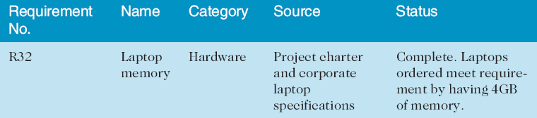
P2:Requirements Traceability Matrix
A requirements traceability matrix (RTM) is a table that lists requirements, various attributes of each requirement, and the status of the requirements to ensure that all requirements are addressed
Another Example

Slide 16
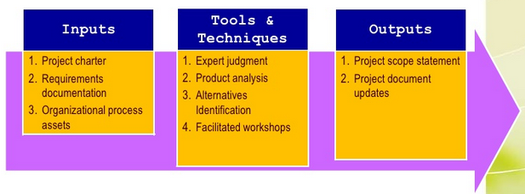
P3: Defining Scope
Project scope statements should include at least:
a product scope description
product user acceptance criteria
detailed information on all project deliverables.

Slide 17
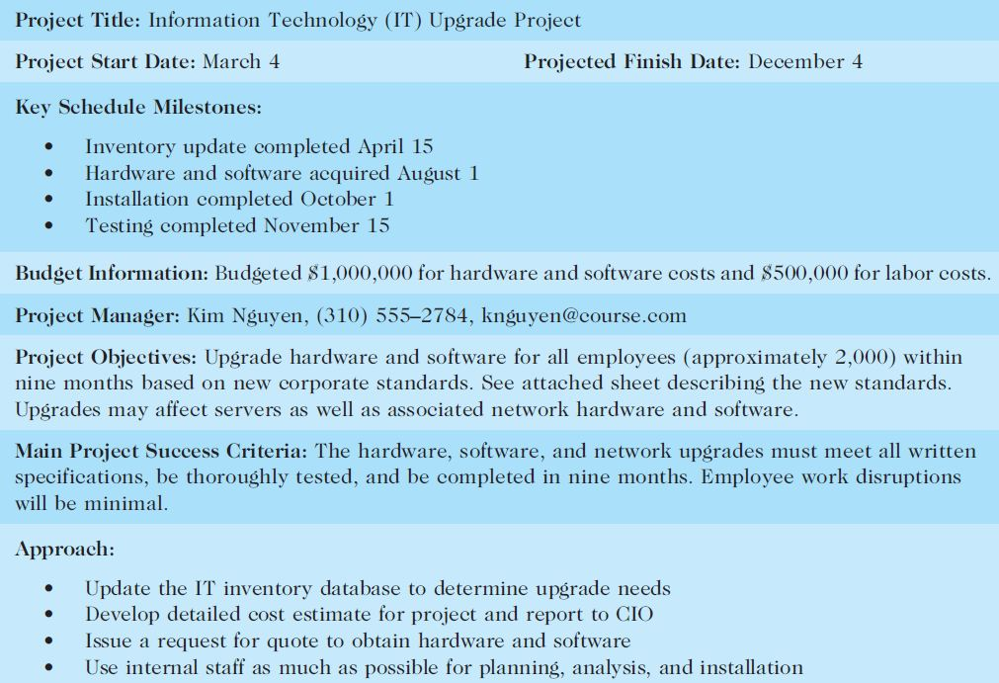
Sample Project Charter (partial)

Slide 18
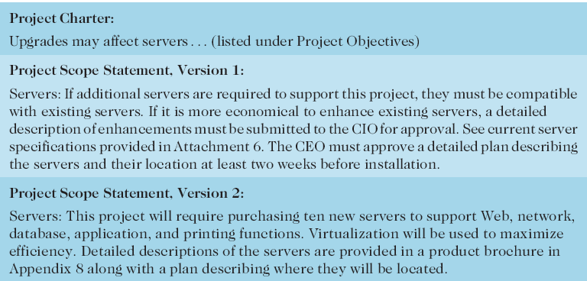
Refining Project Scope

Slide 19
Example Scope Statements
Example 1
Example 2
Example 3

Slide 20
Project Scope Statement - Exercise
POQ Organization – Online Shoe Store
Review the exercise and answer the questions at the bottom of the sheet
We will discuss each of these questions and then create the scope statement

