Slide 1
Project Time Management
PMI Knowledge Areas

Slide 2
Announcements
Project Deliverables
Project – Integration Mgmt
Project – Scope Mgmt (due Friday)
Exercise 2 – available Friday
Midterm Next Monday

Slide 3
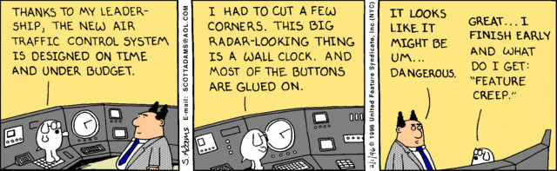
Importance of Project Schedules
Managers often cite delivering projects on time as one of their biggest challenges
Schedule issues are the main reason for conflicts on projects, especially during the second half of projects

Slide 4
Project Time Management Processes
Process Group | Integration Management Process | Major Output
Planning | P1: Defining Activities | Activity List
 | P2: Sequence Activities | Project Schedule Network Diagram
 | P3: Estimate Activity Resources | Activity Resource Reqs.
 | P4: Estimate Activity Duration | Activity Duration Estimates
 | P5: Develop Schedule | Project Schedule
Monitoring and Controlling | MC1: Control Schedule | Work Performance Measuerments

Slide 5
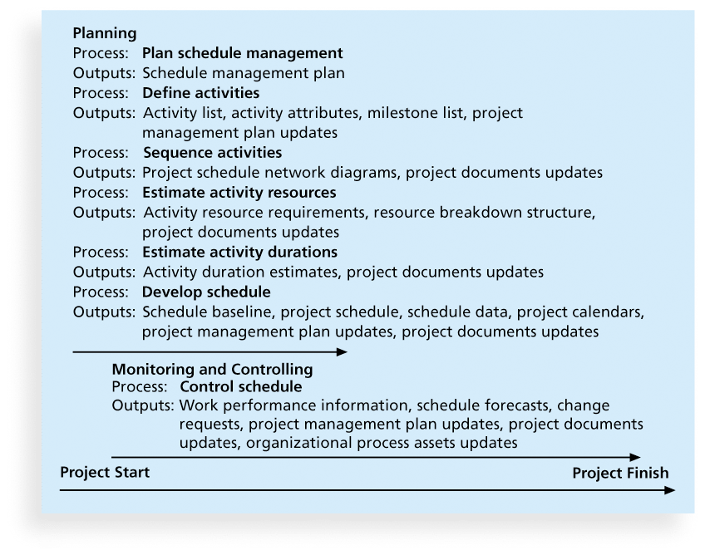
Project Time Management Summary

Slide 6
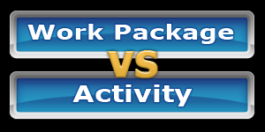
P1: Defining Activities
An activity or task is an element of work normally found on the work breakdown structure (WBS) that has an expected duration, a cost, and resource requirements
Input
1) Scope Baseline 2) Enterprise Environment Factors 3) Organizational Process Assets
Tools/Techniques
1) Decomposition 2) Component Planning 3) Templates 4) Expert Judgment
Output
1) Activity List 2) Activity Attributes 3) Milestone List

Slide 7
Activity Lists, Attributes & Milestones
An activity list is a tabulation of activities to be included on a project schedule that includes
Activity attributes
A milestone is a significant event that normally has no duration
Examples include obtaining customer sign-off on key documents or completion of specific products

Slide 8
P2: Sequencing Activities
Involves reviewing activities and determining dependencies
A dependency or relationship is the sequencing of project activities or tasks
You must determine dependencies in order to use critical path analysis
Input
1) Activity List & Attributes 2) Milestone List 3) Scope Statement 4) Org Process Assets
Tools/Techniques
1) Determine Dependency 2) PDM 3) Apply Leads/Lags 4) Schedule Network templates
Output
1) Project Schedule Network Diagrams 2) Update Project Docs

Slide 9
Network Diagrams
A network diagram is a schematic display of the logical relationships among, or sequencing of, project activities
Two main formats are the arrow and precedence diagramming methods

Slide 10
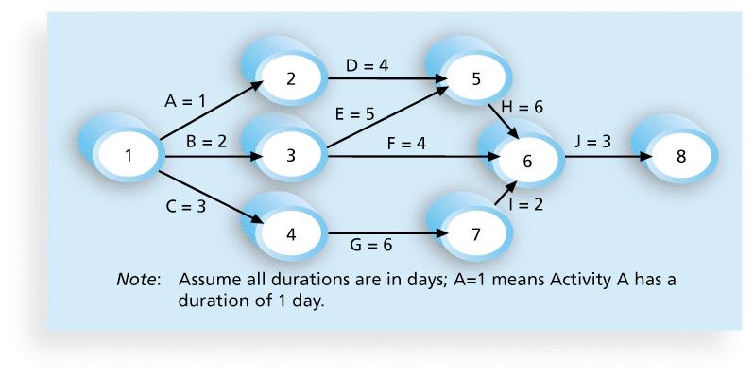
Activity-on-arrow (AOA) or Arrow Diagramming Method (ADM)
Activities are represented by arrows
Nodes or circles are the starting and ending points of activities
Can only show finish-to-start dependencies

Slide 11
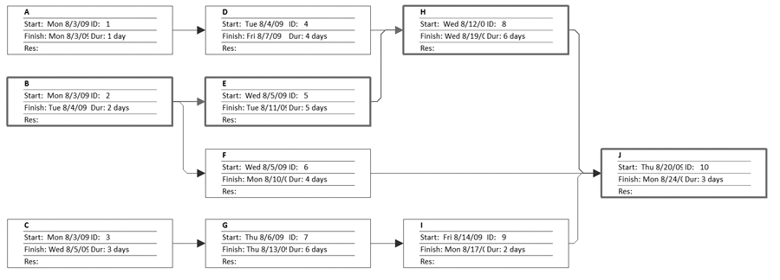
Precedence Diagramming Method (PDM)
Activities are represented by boxes
Arrows show relationships between activities
More popular than ADM method and used by project management software
http://csb.uncw.edu/people/cummingsj/classes/MIS492/Exercises/SampleTime.mpp

Slide 12
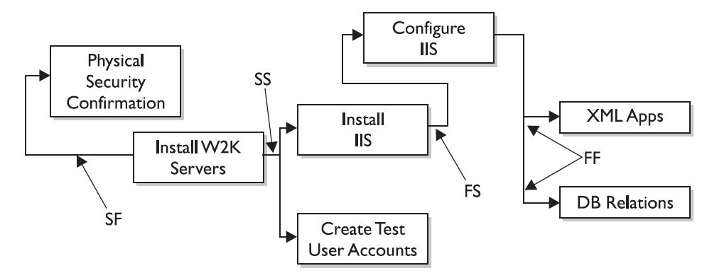
Figure 6-3. Task Dependency Types

Slide 13
Reasons for Creating Dependencies
Mandatory dependencies (hard logic)
Discretionary dependencies (soft logic)
External dependencies

Slide 14
P3: Estimating Activity Resources
A resource breakdown structure is a hierarchical structure that identifies the project’s resources by category and type
Determine the resource requirements for each activity
Input
1) Activity List & Attributes 2) Resource Calendars 3) Enterprise Factors 4) Org Process Assets
Tools/Techniques
1) Alternative Analysis 2) Bottom-up Estimating 3) Expert Judgment 4) PM Software 5) Estimating Data
Output
1) Activity Resource Req 2) Resource Breakdown Structure 3) Updates to Project Docs

Slide 15
Estimating Activity Resources
Consider important issues in estimating resources
How difficult will it be to do specific activities on this project?
What is the organization’s history in doing similar activities?
Are the required resources available?

Slide 16
P4: Activity Duration Estimating
Duration vs. Effort
People doing the work should help create estimates, and an expert should review them
Instead of providing activity estimates as a discrete number, such as four weeks, it’s often helpful to create a three-point estimate

Slide 17

In Reality…This is quite challenging
Stable Activities
straightforward estimating
Dependent Activities
amount needed for testing is dependent on a successful test or unsuccessful test.
3-point estimates or analogous work well.
Uncertain Activities
No previous precedence (complex projects)
Start with 3-point estimate to set boundaries then use analogous to set actual estimate

Slide 18
P5: Developing the Schedule
Ultimate goal is to create a realistic project schedule that provides a basis for monitoring project progress for the time dimension of the project
Input
1) Activity List & Attributes 2) Activity Resource Reqs 3) Resource Calendars 4) Schedule Diagrams 5) Duration Estimate 6) Scope Statement 7) Enterprise Factors 8) Org Process Assets
Tools/Techniques
1) Schedule Network analysis 2) Critical Path Method 3) Schedule Compression 4) What-if Scenarios 5) Resource Leveling 6) Critical Chain Method 7) Applying Leads/Lags 8) PM Software
Output
1) Project Schedule 2) Schedule baseline 3) Schedule data 4) Updates to Project Docs

Slide 19
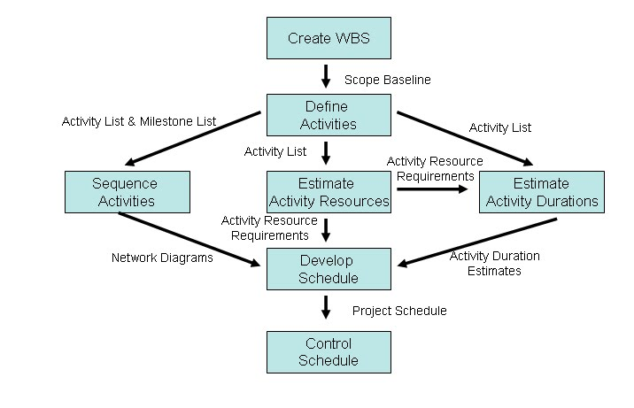
Project Time Management Processes

Slide 20
Gantt Charts
Gantt charts provide a standard format for displaying project schedule information by listing project activities and their corresponding start and finish dates in a calendar format
Symbols include:
A black diamond: a milestones
Thick black bars: summary tasks
Lighter horizontal bars: durations of tasks
Arrows: dependencies between tasks

Slide 21
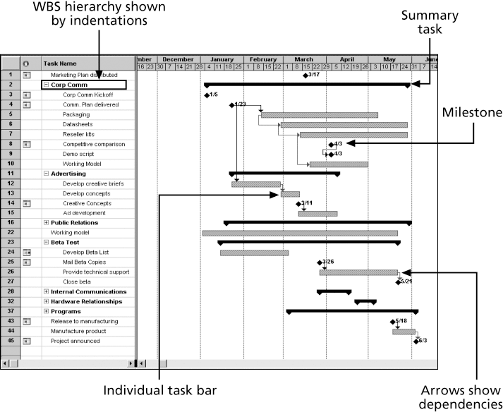
Gantt Chart for Software Launch Project

Slide 22
Milestones and Gantt Charts
Many people like to focus on meeting milestones, especially for large projects
Normally create milestone by entering tasks with a zero duration, or you can mark any task as a milestone
Milestones should follow the SMART Criteria
1. Define milestones early and include in Gantt chart
2. Keep milestones small and frequent
3. The set of milestones must be all-encompassing
4. Each milestone must be binary (either complete or incomplete)
5. Carefully monitor the critical path

Slide 23
Project Time Management Techniques
Critical Path Method
Critical Chain Scheduling
PERT

Slide 24
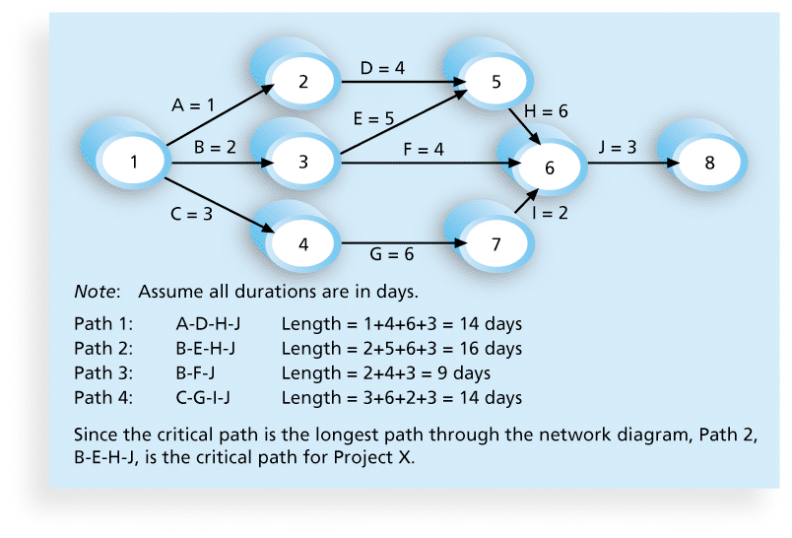
Critical Path Method (CPM)
CPM is a network diagramming technique used to predict total project duration
A critical path for a project is the series of activities that determines the earliest time by which the project can be completed
Slack/float

Slide 25
Determining the Critical Path

Slide 26
Draw the Network (Arrow)
Activity | Initial Node | Final Node | Estimated Duration
A | 1 | 2 | 2
B | 2 | 3 | 2
C | 2 | 4 | 3
D | 2 | 5 | 4
E | 3 | 6 | 2
F | 4 | 6 | 3
G | 5 | 7 | 6
H | 6 | 8 | 2
I | 6 | 7 | 5
J | 7 | 8 | 1
K | 8 | 9 | 2
How long will it take to complete each path (how many?)
Which path is the critical path?

Slide 27
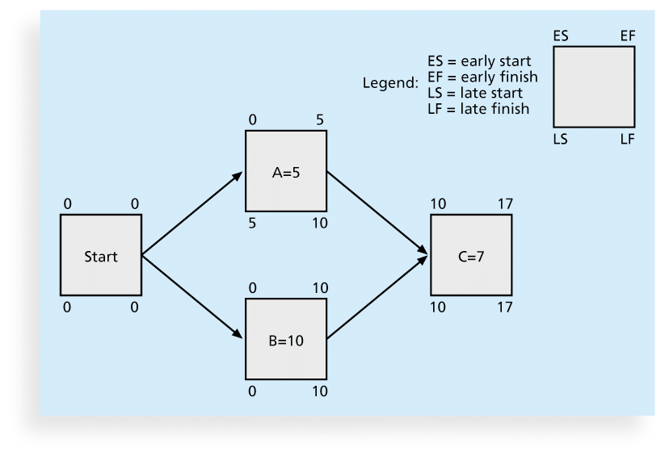
Using Critical Path Analysis to Make Schedule Trade-offs
Free slack or free float
Total slack or total float
Forward pass
Backward pass

Slide 28
Changes to the critical path
Techniques for shortening schedules
Crashing Activities
Fast tracking Activities
Updating Critical Path
Continually update project schedule information to meet time goals for a project
Critical path can change as you enter actual start and finish dates
If you know the project completion date will slip, negotiate with the project sponsor

Slide 29
PM Network: On the Right Track
Fast tracking almost always results in increased risk
Ask yourself questions
Probability of producing expected benefits
Resource Availability & complexity
Buy-in – Is Everyone on Board?
Can the PM manage it?

Slide 30
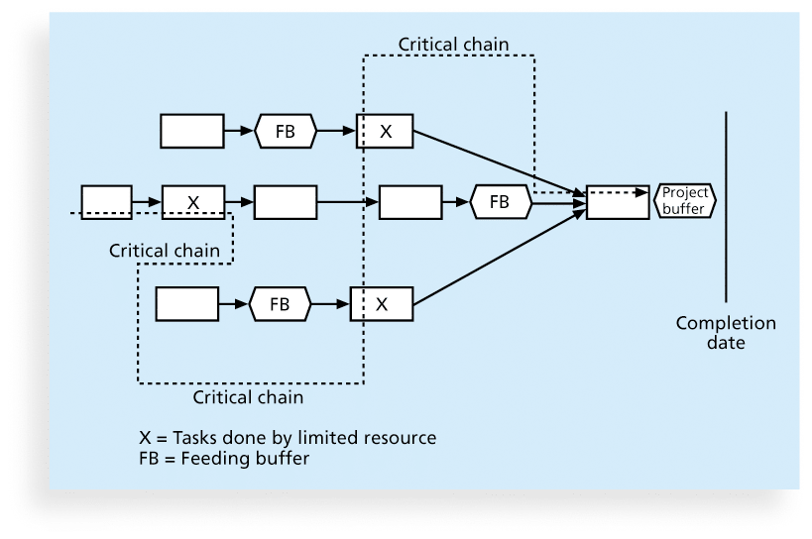
Critical Chain Scheduling
Critical chain scheduling
a method of scheduling that considers limited resources when creating a project schedule and includes buffers to protect the project completion date

Slide 31
Buffers and Critical Chain
A buffer is additional time to complete a task
In traditional estimates, people often add a buffer to each task and use it if it’s needed or not
Critical chain scheduling removes buffers from individual tasks and instead creates
a project buffer or additional time added before the project’s due date
feeding buffers or additional time added before tasks on the critical path

Slide 32
Program Evaluation and Review Technique (PERT)
PERT is a network analysis technique used to estimate project duration when there is a high degree of uncertainty about the individual activity duration estimates
PERT weighted average =
optimistic time + 4X most likely time + pessimistic time
6

Slide 33
PERT Example
What days should be included for the following activity:
Activity A:
Optimistic Estimate = 8 days
Most Likely Estimate = 10 days
Pessimistic Estimate = 24 days

Slide 34
Final Notes on Project Schedule Development
Iterative Process
Review and revise the duration and resource estimates
You want to create something that can get approved
Approved schedule will then act as the baseline to track progress

Slide 35
PM Network: Time Tamers
Heathrow Airport
Project control handbook
DOE - $3 billion over 70 projects
Master schedule with critical path
Belleli Energy Srl
Worst case scenarios and impact to critical path

Slide 36
MC1: Schedule Control Suggestions
Perform reality checks on schedules
Allow for contingencies
Don’t plan for everyone to work at 100% capacity all the time
Hold progress meetings with stakeholders and be clear and honest in communicating schedule issues

Slide 37
Controlling the Schedule
Goals are to know the status of the schedule, influence factors that cause schedule changes, determine that the schedule has changed, and manage changes when they occur
Reality Checks on Schedule
First review the draft schedule or estimated completion date in the project charter
Prepare a more detailed schedule with the team
Make sure the schedule is realistic and followed
Alert top management well in advance if there are schedule problems

Slide 38
Using Software to Assist in Time Management
Software for facilitating communications helps people exchange schedule-related information
Decision support models help analyze trade-offs that can be made
Project management software can help in various time management areas

Slide 39
Words of Caution on Using Project Management Software
Many people misuse project management software because they don’t understand important concepts and have not had training
You must enter dependencies to have dates adjust automatically and to determine the critical path
You must enter actual schedule information to compare planned and actual progress

Slide 40
Chapter Summary
Project time management is often cited as the main source of conflict on projects, and most IT projects exceed time estimates
Main processes include
Plan schedule management
Define activities
Sequence activities
Estimate activity resources
Estimate activity durations
Develop schedule
Control schedule

Slide 41
CAPM Questions
You know from a network diagram that Activity B cannot start until Activity A is finished. Which of the following are true:
Activities A and B have a start to finish dependency
Activities A and B have a finish to start dependency
Activity B has a mandatory dependency on Activity A
Activities A and B are on a critical path

Slide 42
CAPM Questions
What is the crashing technique used for?
Network Diagramming
Duration Compression
Cost Reduction
Activity Sequencing

