Slide 1
Project Quality Management
PMI Knowledge Areas

Slide 2
The Importance of Project Quality Management
Scope
Time
Cost

Slide 3
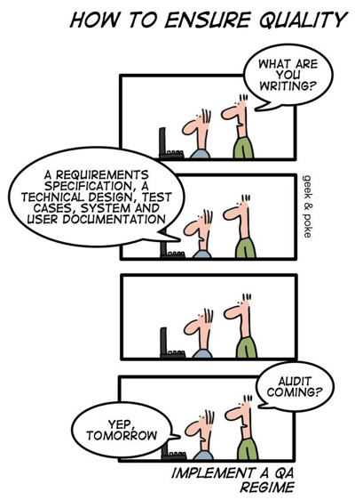
The Importance of Project Quality Management
People seem to accept systems being down occasionally or needing to reboot their PCs
But quality is very important in many IT projects

Slide 4
What Is Project Quality?
The International Organization for Standardization (ISO) defines quality as “the degree to which a set of inherent characteristics fulfils requirements” (ISO9000:2000)
Who ultimately decides if quality is acceptable?

Slide 5
The Cost of Quality
The cost of quality is the cost of conformance plus the cost of nonconformance
Conformance
Cost of nonconformance
Cost Categories Related to Quality
Prevention cost
Appraisal cost
Internal failure cost
External failure cost
Measurement and test equipment costs

Slide 6
Project Quality Management
Software bugs account for about 40% computer systems failure
Software horror stories
www.risks.org
http://www.cs.tau.ac.il/~nachumd/horror.html
In 2008, software glitch was the reason for London Stock Exchange (LSE) failure
In 2003, software failure caused blackout in the Northeast corridor of the U.S. and parts of Canada
6

Slide 7


Major software defects
What will top 2013?
http://blog.inthewildtesting.com/the-top-10-software-bugs-of-2012/2012/12/

Slide 8
What Is Project Quality Management?
Project quality management ensures that the project will satisfy the needs for which it was undertaken
Processes include:
Planning quality management (Planning)
Performing quality assurance (Executing)
Performing quality control (Control/Monitor)

Slide 9
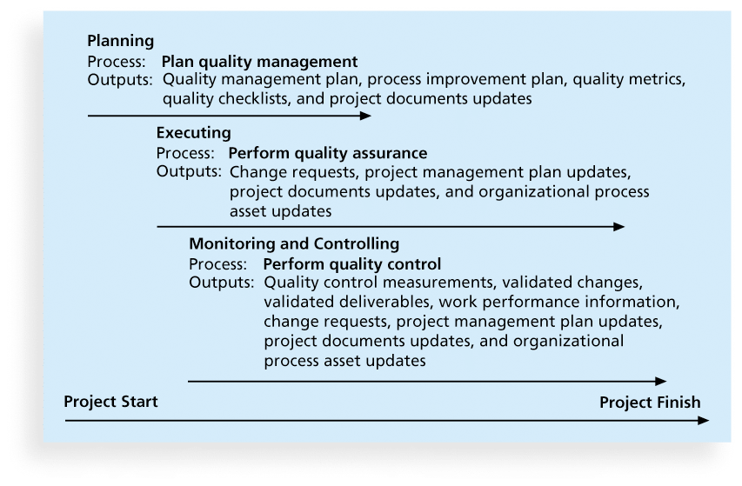
Project Quality Management Summary

Slide 10
Planning Quality
Implies the ability to anticipate situations and prepare actions to bring about the desired outcome
Important to prevent defects by:
Selecting proper materials
Training and indoctrinating people in quality
Planning a process that ensures the appropriate outcome

Slide 11
Quality and IT Projects
Customers have difficulty explaining exactly what they want in an IT project.
What are the important scope aspects of IT projects that impact quality?

Slide 12
Who’s Responsible for the Quality of Projects?
Project managers are ultimately responsible for quality management on their projects
Several organizations and references can help project managers and their teams understand quality
International Organization for Standardization (www.iso.org)
IEEE (www.ieee.org)

Slide 13
2) Performing Quality Assurance
Quality assurance includes all the activities related to satisfying the relevant quality standards for a project
Another goal of quality assurance is continuous quality improvement
Performing Quality Assurance through:
Benchmarking
Quality audits

Slide 14
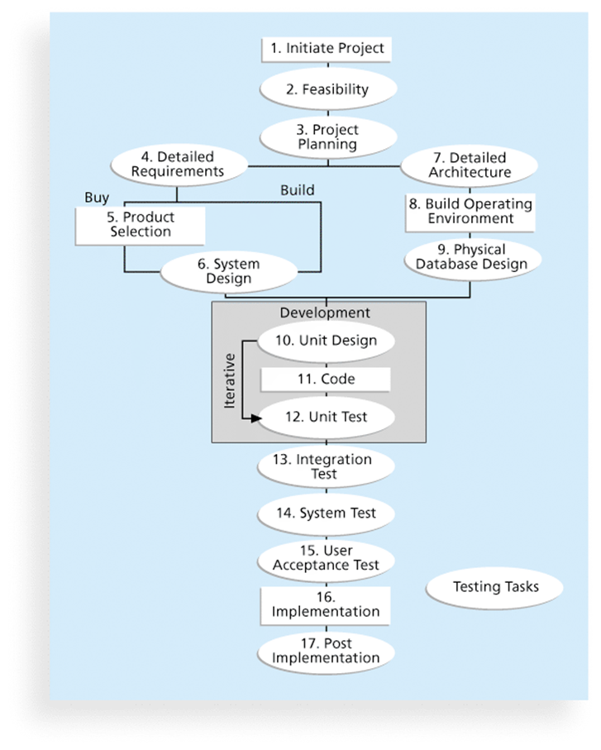
Testing
Many IT professionals think of testing as a stage that comes near the end of IT product development

Slide 15
Types of Tests
Unit testing
Integration testing
System testing
User acceptance testing

Slide 16
Testing Alone Is Not Enough
Watts S. Humphrey, a renowned expert on software quality, defines a software defect as anything that must be changed before delivery of the program
Testing does not sufficiently prevent software defects because
Why?

Slide 17
Program inspections
These are peer reviews where engineers examine the source of a system with the aim of discovering anomalies and defects.
Inspections do not require execution of a system so may be used before implementation.

Slide 18
Inspection checklists
Checklist of common errors should be used to drive the inspection.
Examples: Initialisation, Constant naming, loop termination, array bounds, etc.

Slide 19
An inspection checklist (a)
Fault class | Inspection check
Data faults | Are all program variables initialized before their values are used? Have all constants been named? Should the upper bound of arrays be equal to the size of the array or Size -1? If character strings are used, is a delimiter explicitly assigned? Is there any possibility of buffer overflow?
Control faults | For each conditional statement, is the condition correct? Is each loop certain to terminate? Are compound statements correctly bracketed? In case statements, are all possible cases accounted for? If a break is required after each case in case statements, has it been included?
Input/output faults | Are all input variables used? Are all output variables assigned a value before they are output? Can unexpected inputs cause corruption?

Slide 20
An inspection checklist (b)
Fault class | Inspection check
Interface faults | Do all function and method calls have the correct number of parameters? Do formal and actual parameter types match? Are the parameters in the right order? If components access shared memory, do they have the same model of the shared memory structure?
Storage management faults | If a linked structure is modified, have all links been correctly reassigned? If dynamic storage is used, has space been allocated correctly? Is space explicitly deallocated after it is no longer required?
Exception management faults | Have all possible error conditions been taken into account?

Slide 21
3) Controlling Quality
The main outputs of quality control are:
Acceptance decisions
Rework
Process adjustments
Seven Basic Tools of Quality
Flowchart
Run Chart
Scatter Diagram
Histogram
Pareto Diagram
Control Chart
Cause and Effect Diagram

Slide 22
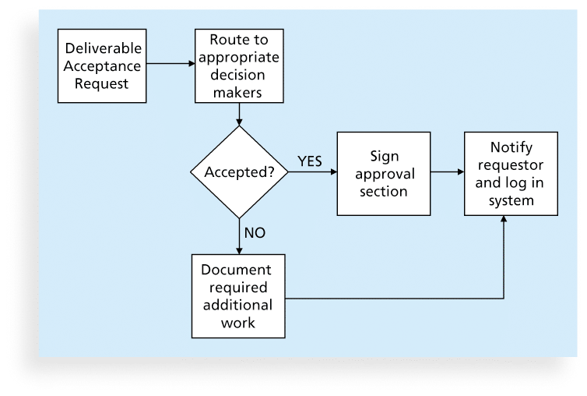
Flowcharts
Flowcharts are graphic displays of the logic and flow of processes that help you analyze how problems occur and how processes can be improved

Slide 23
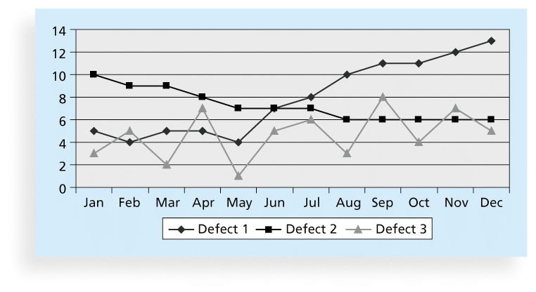
Run Charts
A run chart displays the history and pattern of variation of a process over time.

Slide 24
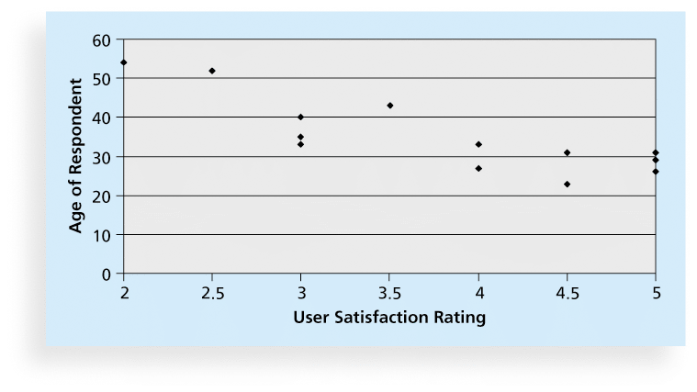
Scatter diagram
A scatter diagram helps to show if there is a relationship between two variables

Slide 25
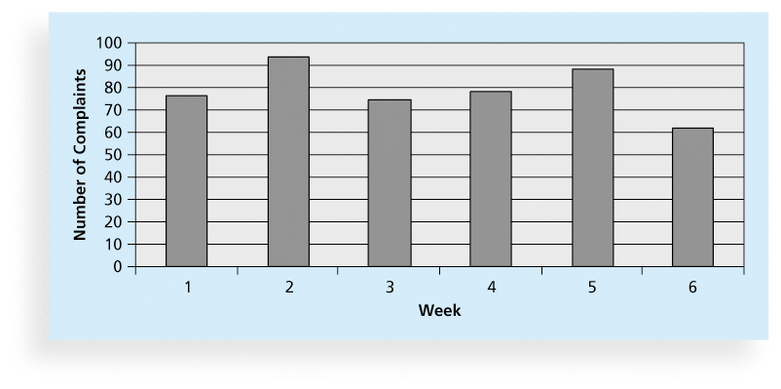
Histograms
A histogram is a bar graph of a distribution of variables

Slide 26
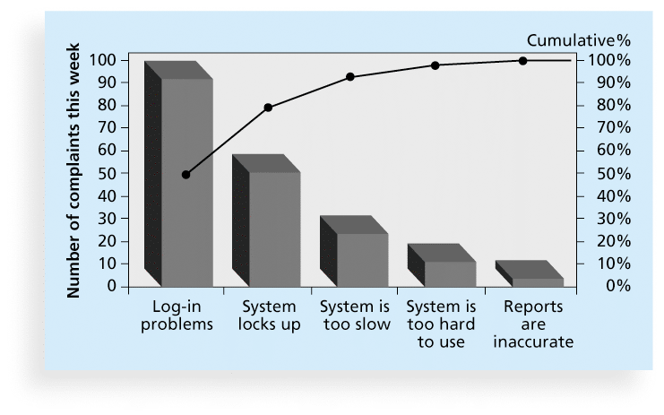
Pareto Charts
A Pareto chart is a histogram that can help you identify and prioritize problem areas

Slide 27
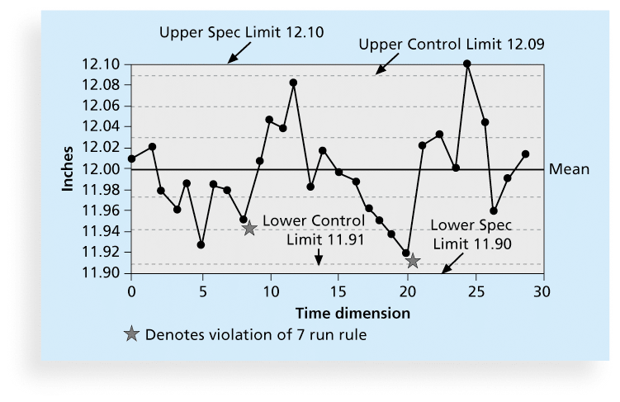
Quality Control Charts
A control chart is a graphic display of data that illustrates the results of a process over time
The main use of control charts is to prevent defects, rather than to detect or reject them

Slide 28
The Seven Run Rule
You can use quality control charts and the seven run rule to look for patterns in data
The seven run rule states that if seven data points in a row are all below the mean, above the mean, or are all increasing or decreasing, then the process needs to be examined for non-random problems

Slide 29
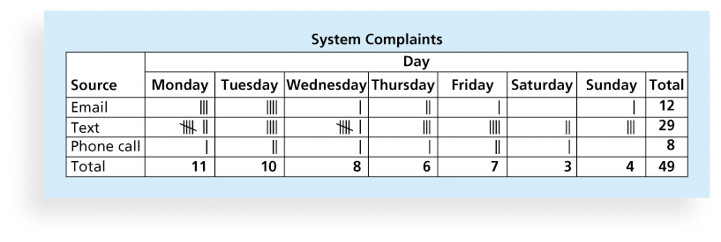
Checksheet
used to collect and analyze data

Slide 30
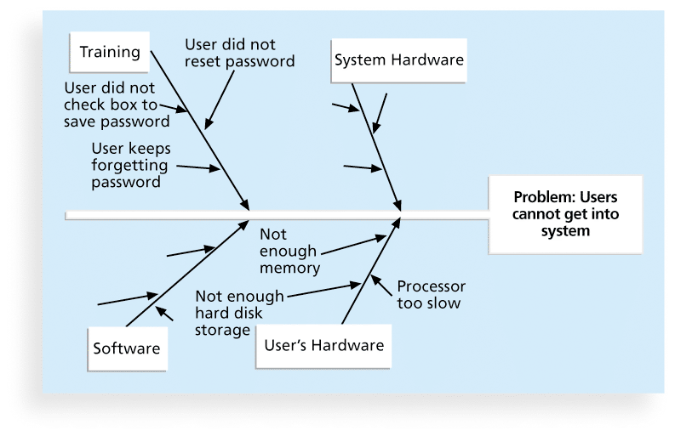
Cause-and-Effect Diagrams
Cause-and-effect diagrams
They help you find the root cause of a problem
aka fishbone or Ishikawa diagrams

