Slide 1
Risk Management
PMI Knowledge Areas

Slide 2
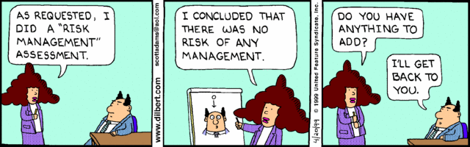
Importance of Project Risk Management
The art and science of identifying, analyzing, and responding to risk throughout the life of a project and in the best interests of meeting project objectives
Risk management is often overlooked in projects
Notes:
, but it can help improve project success by helping select good projects, determining project scope, and developing realistic estimates
Many people around the world suffered from financial losses as various financial markets dropped in the fall of 2008, even after the $700 billion bailout bill was passed by the U.S. Congress
According to a global survey of 316 financial services executives, over 70 percent of respondents believed that the losses stemming from the credit crisis were largely due to failures to address risk management issues
They identified several challenges in implementing risk management, including data and company culture issues

Slide 3
Project Management Maturity by Industry Group and Knowledge Area*
KEY: 1 = LOWEST MATURITY RATING 5 = HIGHEST MATURITY RATING
Knowledge Area | Engineering/ Construction | Telecommunications | Information Systems | Hi-Tech Manufacturing
Scope | 3.52 | 3.45 | 3.25 | 3.37
Time | 3.55 | 3.41 | 3.03 | 3.50
Cost | 3.74 | 3.22 | 3.20 | 3.97
Quality | 2.91 | 3.22 | 2.88 | 3.26
Human Resources | 3.18 | 3.20 | 2.93 | 3.18
Communications | 3.53 | 3.53 | 3.21 | 3.48
Risk | 2.93 | 2.87 | 2.75 | 2.76
Procurement | 3.33 | 3.01 | 2.91 | 3.33

Slide 4
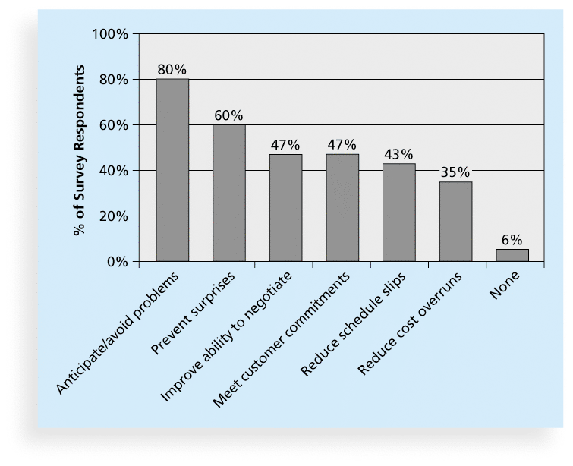
Benefits from Software Risk Management Practices*
*Source: Kulik and Weber, KLCI Research Group

Slide 5
Risk Can Be Negative & Positive
Negative risk: understanding potential problems that might occur in the project and how they might impede project success
Positive risks: risks that result in good things happening (opportunities)
Notes:
A dictionary definition of risk is “the possibility of loss or injury”
Negative risk management is like a form of insurance; it is an investment
A general definition of project risk is an uncertainty that can have a negative or positive effect on meeting project objectives
The goal of project risk management is to minimize potential negative risks while maximizing potential positive risks
Some organizations make the mistake of only addressing tactical and negative risks when performing project risk management
David Hillson, (www.risk-doctor.com) suggests overcoming this problem by widening the scope of risk management to encompass both strategic risks and upside opportunities, which he refers to as integrated risk management

Slide 6
CGI Case
What are the negative and positive risks associated with the project CGI was taking on?

Slide 7
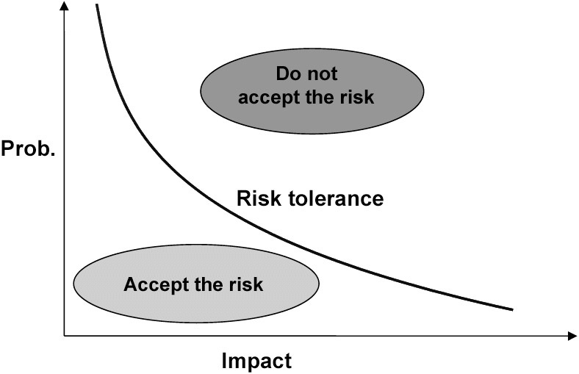
Risk Utility
Risk utility or risk tolerance is your willingness to accept or avoid risk.
What is your risk tolerance?
Notes:
Risk averse
Risk Neutral
Risk seeking

Slide 8
Risk Utility
You are on a TV game show and can choose one of the following. Which would you take?
$1,000 in cash
A 50% chance at winning $5,000
A 25% chance at winning $10,000
A 5% chance at winning $100,000
You have just finished saving for a "once-in-a-lifetime" vacation. Three weeks before you plan to leave, you lose your job. You would:
Cancel the vacation
Take a much more modest vacation
Go as scheduled, reasoning that you need the time to prepare for a job search
Extend your vacation, because this might be your last chance to go first-class
Notes:
Risk averse
Risk Neutral
Risk seeking

Slide 9
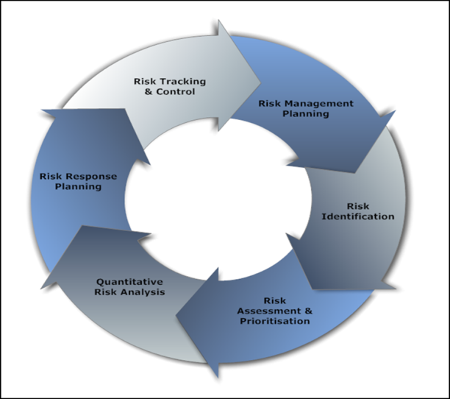
Project Risk Management Processes
It is all about planning
Planning risk management
Identifying risks
Performing qualitative risk analysis
Performing quantitative risk analysis
Planning risk responses
Controlling and Monitoring
Controlling risk
Notes:
Planning risk management : Deciding how to approach and plan the risk management activities for the project
Identifying risks: Determining which risks are likely to affect a project and documenting the characteristics of each
Performing qualitative risk analysis: Prioritizing risks based on their probability and impact of occurrence
Performing quantitative risk analysis: Numerically estimating the effects of risks on project objectives
Planning risk responses: Taking steps to enhance opportunities and reduce threats to meeting project objectives
Controlling risk: Monitoring identified and residual risks, identifying new risks, carrying out risk response plans, and evaluating the effectiveness of risk strategies throughout the life of the project

Slide 10
Planning Process Group: Planning Risk Management
The main output of this process is a risk management plan—a plan that documents the procedures for managing risk throughout a project
Key Parts to Plan:
Budget and schedule
Risk categories
Risk probability and impact
Revised stakeholders’ tolerances
Tracking
Notes:
The project team should review project documents and understand the organization’s and the sponsor’s approaches to risk
The level of detail will vary with the needs of the project

Slide 11
Contingency and Fallback Plans, Contingency Reserves
Contingency plans
Fallback plans
Contingency reserves or allowances
Notes:
Contingency plans are predefined actions that the project team will take if an identified risk event occurs
Fallback plans are developed for risks that have a high impact on meeting project objectives, and are put into effect if attempts to reduce the risk are not effective
Contingency reserves or allowances are provisions held by the project sponsor or organization to reduce the risk of cost or schedule overruns to an acceptable level; management reserves are funds held for unknown risks

Slide 12
Common Sources of Risk in Information Technology Projects
The Standish Group developed an IT success potential scoring sheet based on potential risks
Notes:
Several studies show that IT projects share some common sources of risk
Other broad categories of risk help identify potential risks

Slide 13
Broad Categories of Risk
Market risk
Financial risk
Technology risk
People risk
Structure/process risk

Slide 14
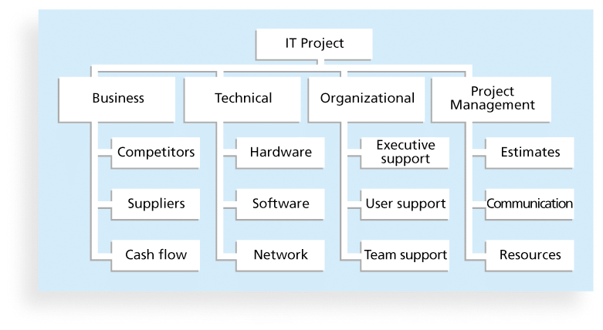
Risk Breakdown Structure
A risk breakdown structure is a hierarchy of potential risk categories for a project
Similar to a work breakdown structure but used to identify and categorize risks
Notes:
Run through this risk breakdown with cgi

Slide 15
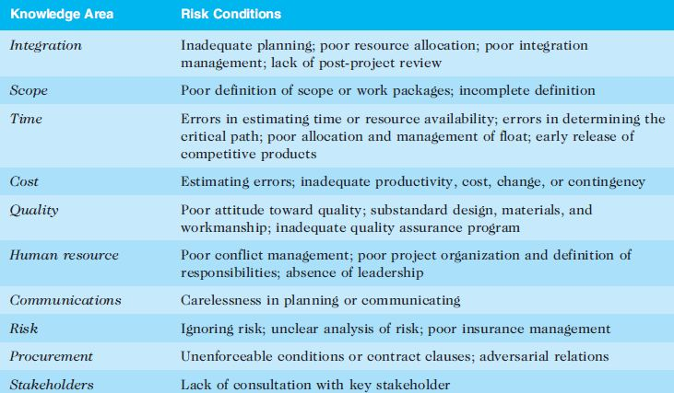
Potential Negative Risk Conditions Associated With Each Knowledge Area

Slide 16
Planning Process Group: Identifying Risks
Identifying risks is the process of understanding what potential events might hurt or enhance a particular project
Risk identification tools and techniques include:
Brainstorming
The Delphi Technique
Interviewing
SWOT analysis
Notes:
Brainstorming is a technique by which a group attempts to generate ideas or find a solution for a specific problem by amassing ideas spontaneously and without judgment (don’t overuse – can lead to group think and fewer ideas)
The Delphi Technique is used to derive a consensus among a panel of experts who make predictions about future developments
Provides independent and anonymous input regarding future events
Interviewing is a fact-finding technique for collecting information in face-to-face, phone, e-mail, or instant-messaging discussions
Interviewing people with similar project experience is an important tool for identifying potential risks

Slide 17
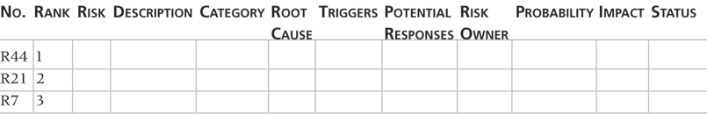
Risk Register
A risk register is:
A document that contains the results of various risk management processes and that is often displayed in a table or spreadsheet format
A tool for documenting potential risk events and related information
Risk events refer to specific, uncertain events that may occur to the detriment or enhancement of the project
Notes:
The main output of the risk identification process is a list of identified risks and other information needed to begin creating a risk register

Slide 18
Risk Register Contents
An identification number for each risk event
A rank for each risk event
The name of each risk event
A description of each risk event
The category under which each risk event falls
The root cause of each risk

Slide 19
Risk Register Contents (cont’d)
Triggers for each risk; triggers are indicators or symptoms of actual risk events
Potential responses to each risk
The risk owner or person who will own or take responsibility for each risk
The probability and impact of each risk occurring.
The status of each risk

Slide 20
Risk Identification Exercise
Identify the risks associated with our discussion on CGI
Complete a risk register by ranking the risks and filling out the subsequent information
Notes:
A recent article in PMI’s Virtual Library explains how to avoid “the Titanic factor” in your projects by analyzing the interdependence of risks
For example, the probability of one risk event occurring might change if another one materializes, and the response to one risk event might affect another

