Slide 1


Human Resource Strategies
Subject: IT Project management
Lecturer: Chan Sophal
Student: TOUCH Sopheak

Slide 2
Content
A little bit about Apple Inc.
Human resources strategies of Apple
Conclusion

Slide 3
A little bit about Apple Inc.
Apple Inc.: an American multinational technology company
Founder: Steve Jobs, Steve Wozniak, Ronald Wayne
Founded: April 1, 1976, Los Altos, California, United States
Headquarters: Cupertino, California, United States
Products: iPhone, Apple Watch, iPad, Apple TV, iOS, macOS, MORE
CEO: Tim Cook (Aug 24, 2011–)
Number of Employees (2022): 164,000
source: Wikipedia

Slide 4
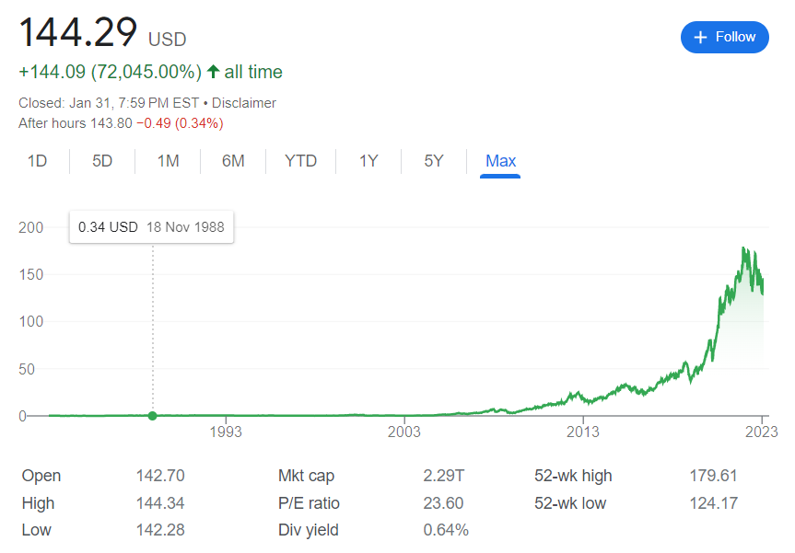

Slide 5


Slide 6
Human resources strategies of Apple
HR strategies of Apple emphasizes investing human capitals, approval or disapproval of group members and participation in decision making committing to team development (Lordkipanidze, 2019).
Apple focuses on the candidate who is hardworking, loyal and derives every precise detail perfectly.
source: https://sourceessay.com/hr-strategy-at-apple-make-their-employees-creative-and-innovative/

Slide 7
Human resources strategies of Apple
Organizational Innovation
Organization work in dynamic environment adopts innovation approaches that were later refined into selective hiring, performance reward, and 360-degree evaluation (Fedorova, 2019).
Apple’s organization esteem includes openness, condition, incorporation, provider obligation and decent variety.
source: https://sourceessay.com/hr-strategy-at-apple-make-their-employees-creative-and-innovative/

Slide 8
Human resources strategies of Apple
Human Resources Strategies
The HR strategies of Apple always seem to hire a diverse, independent, talented employee who doesn’t need direction.
Apple’s most of the employee provided with training once they joined the company.
The company makes sure employee prepare themselves not only physically but also mentally to jump over from one bigger project to another.
source: https://sourceessay.com/hr-strategy-at-apple-make-their-employees-creative-and-innovative/

Slide 9
Human resources strategies of Apple
Cultural Values And Employee Growth
As per Andres Vourakis, apple is becoming talent magnets offering high salaries cultural environment.
Company offers adequate opportunities to its employees and looks over if employee shares company’s vision and must be fully committed or not.
source: https://sourceessay.com/hr-strategy-at-apple-make-their-employees-creative-and-innovative/

Slide 10
Conclusion
HR Strategy At Apple Make Their Employees Creative And Innovative

