Slide 1
Histogram As a tool of quality
TOUCH Sopheak​

Slide 2
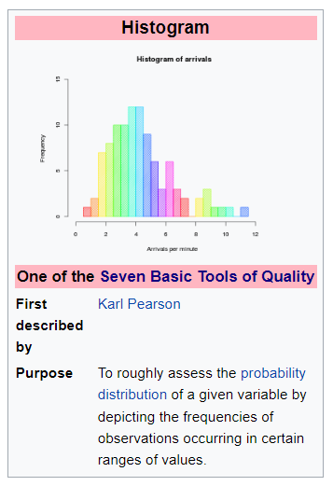
Introduction
Wikipedia: A histogram is an approximate representation of the distribution of numerical data. The term was first introduced by Karl Pearson.^{[1]} To construct a histogram, the first step is to "bin" (or "bucket") the range of values—that is, divide the entire range of values into a series of intervals—and then count how many values fall into each interval. The bins are usually specified as consecutive, non-overlapping intervals of a variable. The bins (intervals) must be adjacent and are often (but not required to be) of equal size.^{[2]}

Slide 3
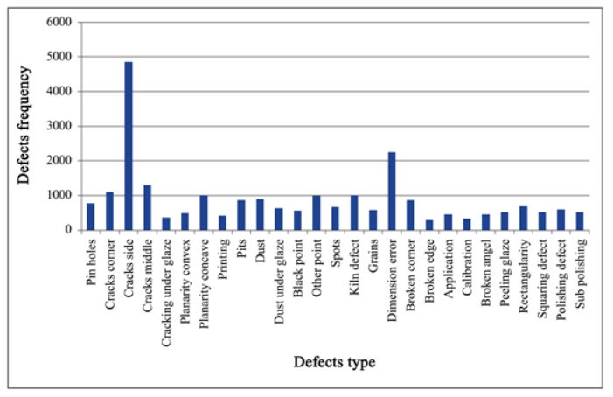
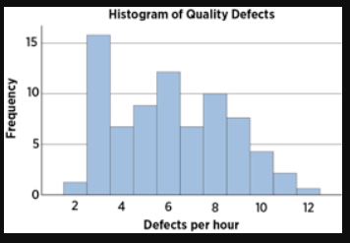

Slide 4
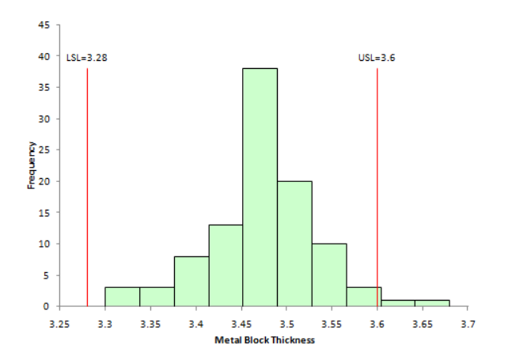
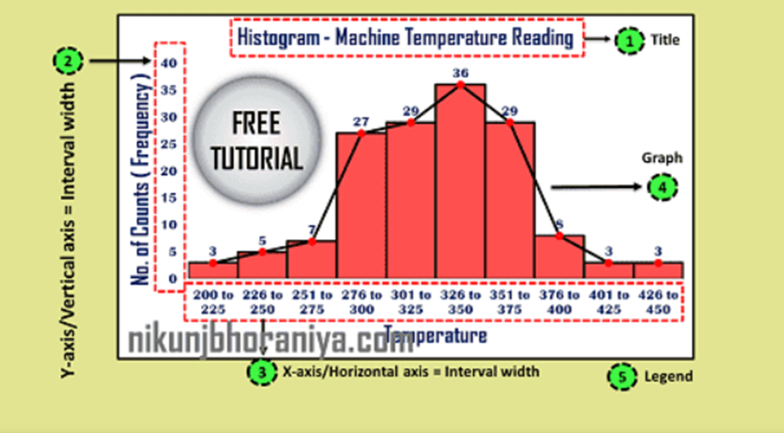

Slide 5
Conclusion
Histograms are a valuable tool in quality management. By using a histogram, you can see accurate data trends, compare groups of data, and identify outliers. These features can help in identifying and quantifying quality issues in a process.

Slide 6
User acceptance testing
TOUCH Sopheak​

Slide 7
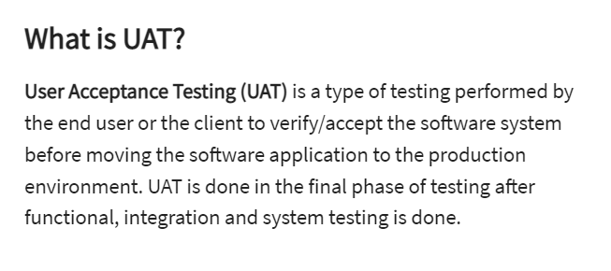
Reference: https://www.guru99.com/user-acceptance-testing.html

Slide 8
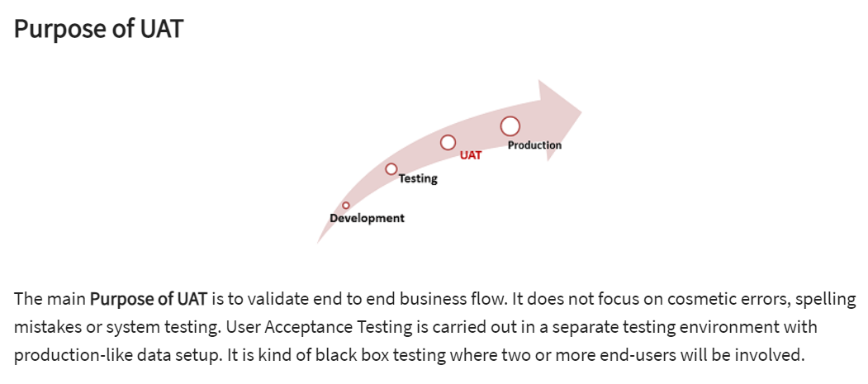

Slide 9
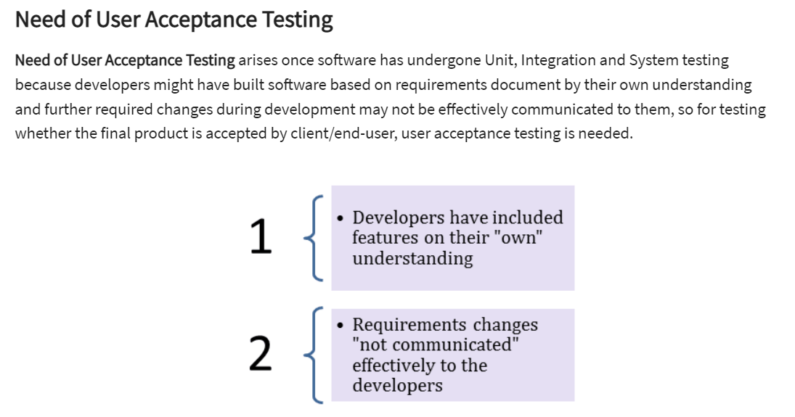

Slide 10


Slide 11
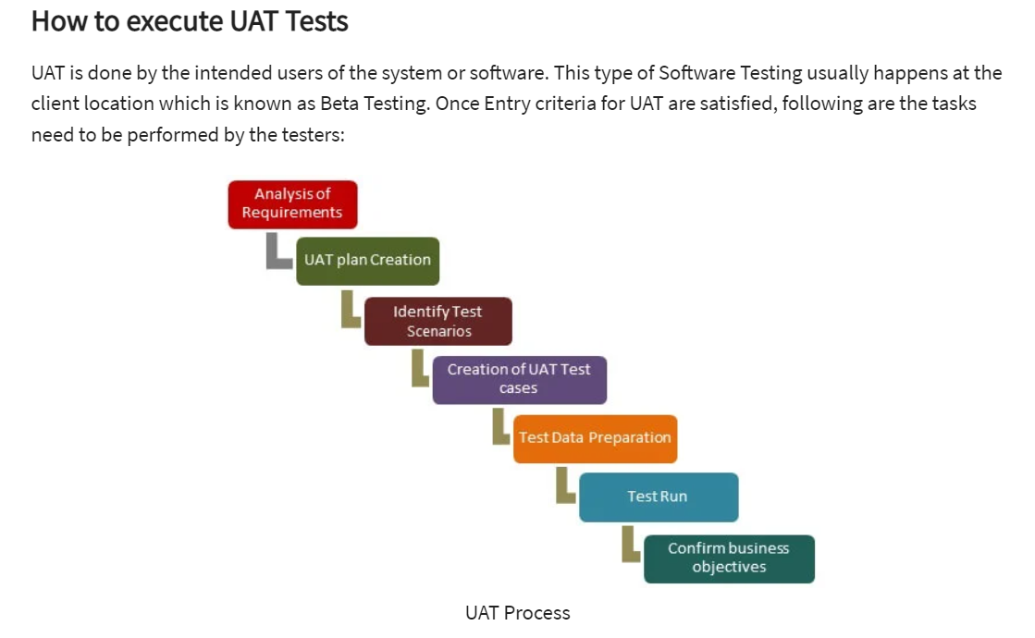

Slide 12
Grey Box Testing
TOUCH Sopheak​

Slide 13
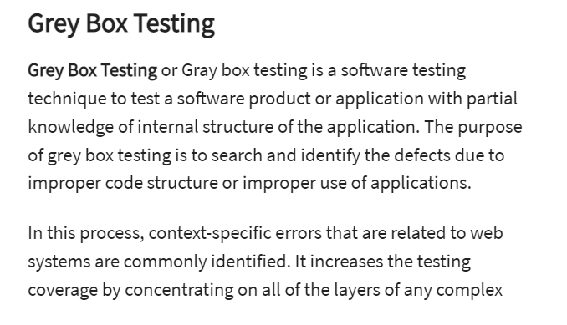
system.
Reference: https://www.guru99.com/grey-box-testing.html

Slide 14
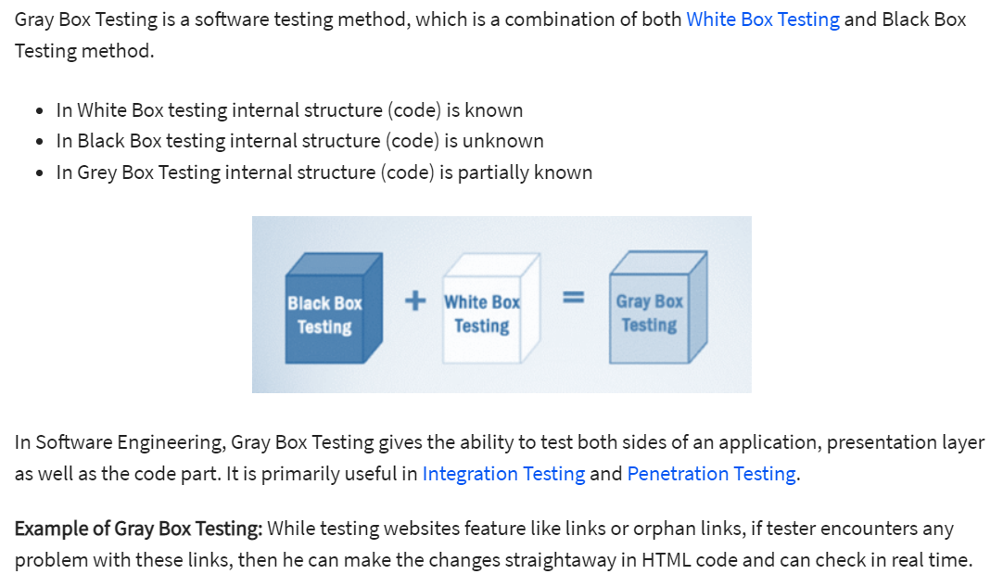

Slide 15
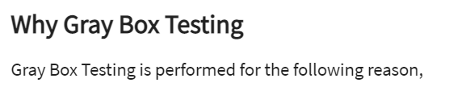
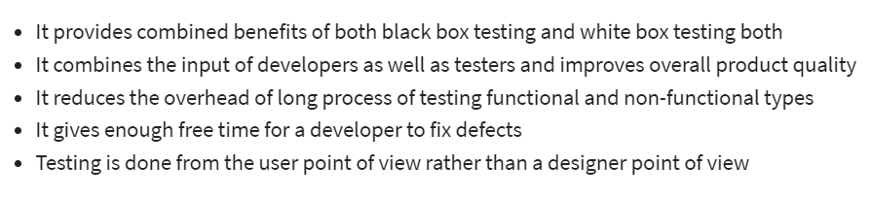

Slide 16
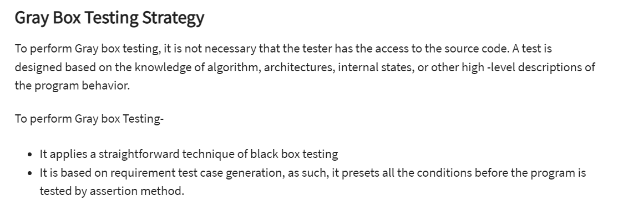

Slide 17
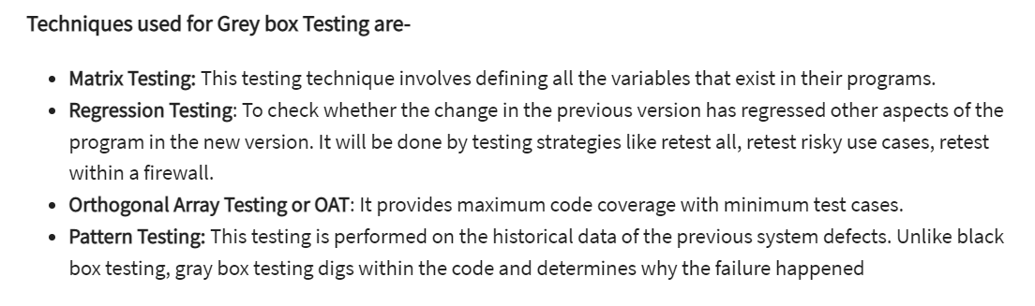

Slide 18
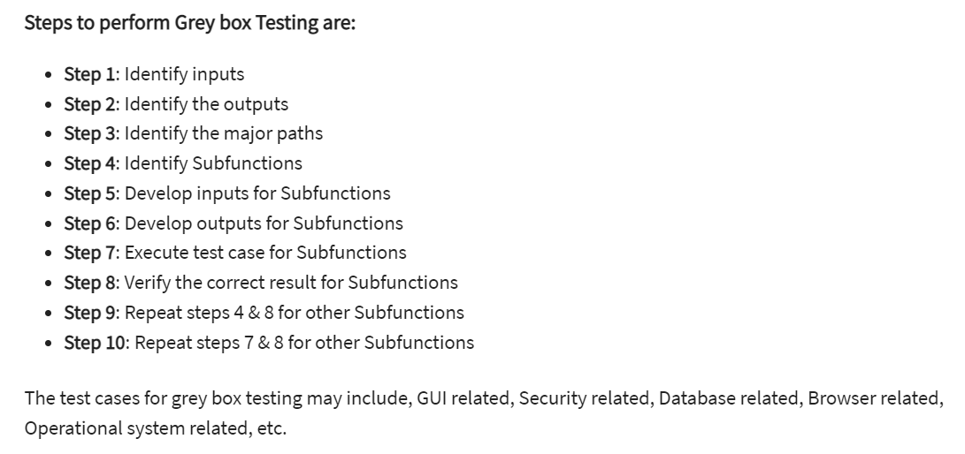

Slide 19
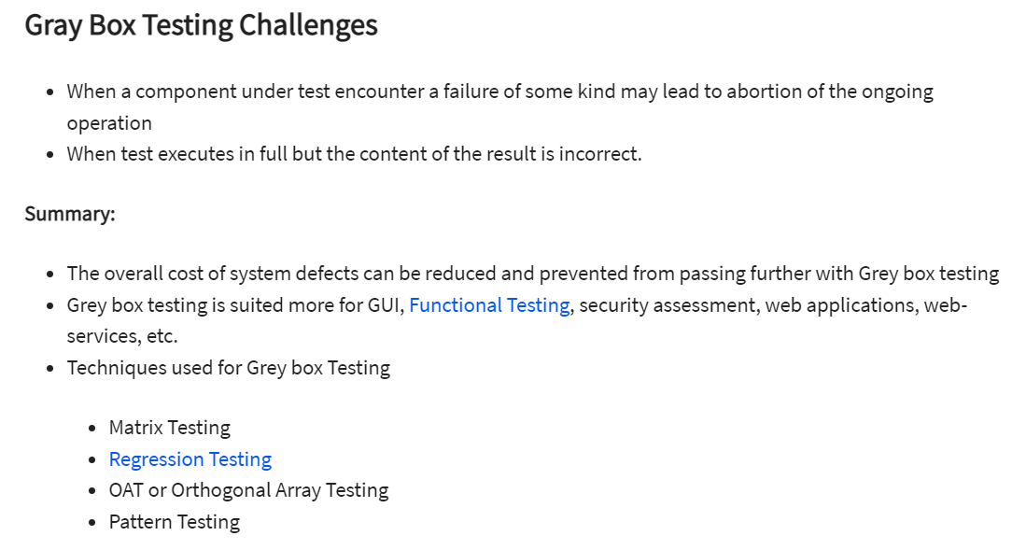

Slide 20
THANK YOU
TOUCH Sopheak​
Sopheak.touch@itc.edu.kh

