Slide 1


Institute of Technology of Cambodia
Master of Data Science
IT Project Management
Scatter and Pareto Diagram and Black Box Testing
Instructed by: M. CHAN Sophal
Present by:
LENG SENG HAK M080102

Slide 2
Outline
Scatter Plot
Pareto Diagram
Black Box Testing Method

Slide 3
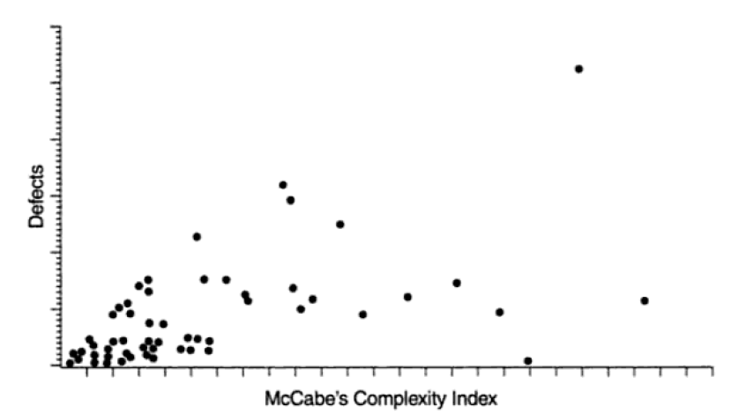
1. Scatter Plot
What is a Scatter Plot (Scatter Diagram)?
Scatter plot is a plot between 2 variables on 2d and the point represents by a dot.
Example of Scatter Plot (Diagram)

Slide 4
1. Scatter Plot (Cont.)
Why Scatter plot is used?
It used to determine whether there is really a relationship between two variables
Fish-bone cause-effect diagram identifies possible causes
scatter plot can show whether the proposed cause and its effect are correlated
Visual plot can show degree of correlation, non-linear correlations
Linear correlations if most points are along a straight line
Poor (linear) correlation if points scattered all over

Slide 5
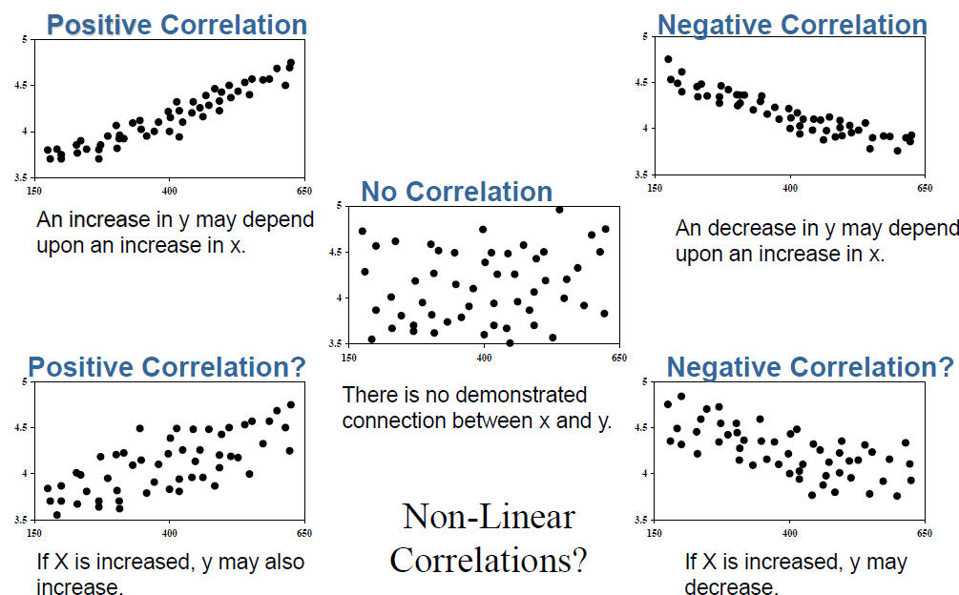
1. Scatter Plot (Cont.)
Example of Correlation Observation Using Scatter Plot

Slide 6
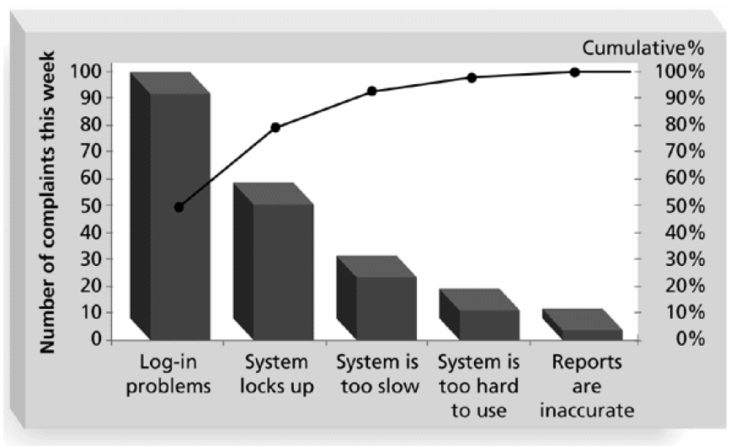
2. Pareto Diagram
What is a Pareto Diagram?
Pareto Diagram is a Frequency Diagram arrange by decreasing frequency.
Example of Pareto Diagram

Slide 7
2. Pareto Diagram (Cont.)
Why use Pareto Diagram?
Pareto Diagram help identify and prioritize problem areas.
- In quality control, Pareto Diagram helps identify the key contributors that account for most quality problem (80/20 rules)
What is Pareto Analysis
- Pareto Analysis is also known as 80/20 rule, meaning that 80 percent of the problem are due to 20 percent of the causes.
- Fixing 20% of causes can reduce 80% of the problems.
- Small problem should be investigated before addressing them.

Slide 8
3. Black Box Testing Method
Software Testing
Software testing is involved in each stage of software life cycle, but the way of testing conducted at each stage of software development is different in nature and it has different objectives
Opacity(or Transparency) in Testing
Opacity means involve making decisions that are visible to everyone involved, like how the app will be designed, and how the project plan is structured.

Slide 9
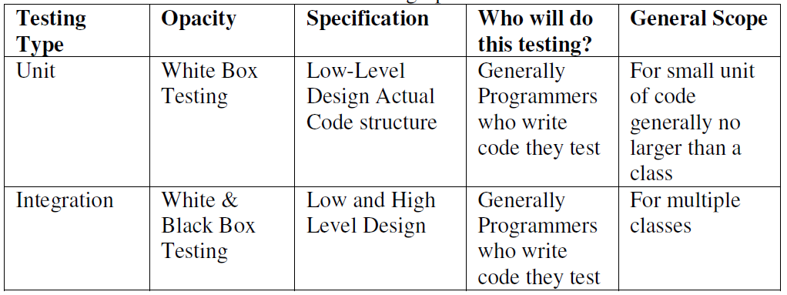
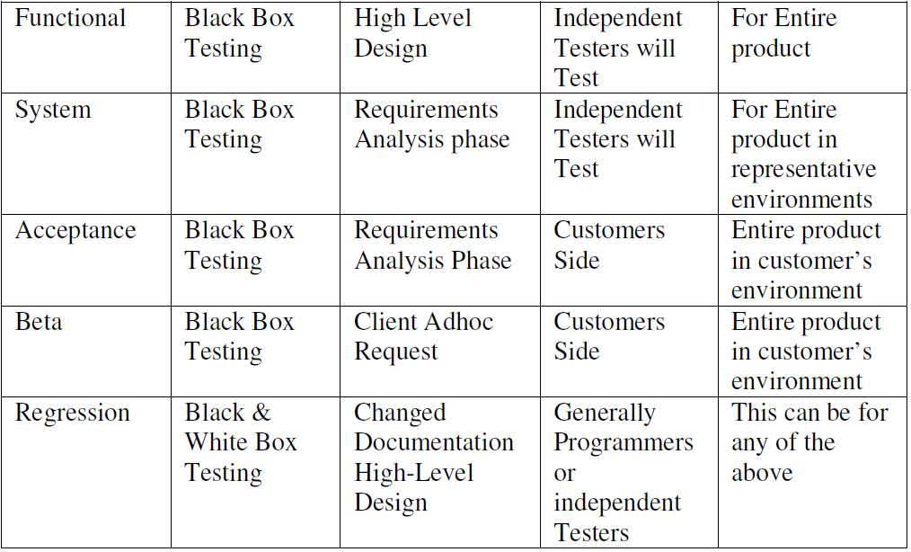
3. Black Box Testing Method (Cont.)

Slide 10
3. Black Box Testing Method (Cont.)
What is Black Box Testing?
Box Testing: it is testing based on the requirements specifications and there is no need to examining the code in black box testing.
This is purely done based on customers view point only tester knows the
set of inputs and predictable outputs.
- Black box testing is done on the completely finished product

Slide 11
3. Black Box Testing Method (Cont.)
Why Black Box Testing?
Black box testing plays a significant role in software testing, it aid in overall functionality validation of the system.
Black box testing is done based on customers’ requirements-so any incomplete or unpredictable requirements can be easily identified and it can be addressed later.
Black box testing is done based on end user perspective. The main importance of black box testing it handles both valid and invalid inputs from customer’s perspective

Slide 12
3. Black Box Testing Method (Cont.)
How about the advantages?
The main advantage of black box testing is that, testers no need to have knowledge on specific programming language, not only programming language but also knowledge on implementation.
In black box testing both programmers and testers are independent of each other.
Testing is done from user’s point of view. The significant advantage of black box testing is that it helps to expose any ambiguities or inconsistencies in the requirements specifications.

Slide 13
3. Black Box Testing Method (Cont.)
What are the Techniques used?
The techniques used in black box testing are:
Equivalence Class Partitioning
Boundary Value Analysis
Decision Tables
State Transition Diagrams (or) State Transition Diagrams
Orthogonal Arrays
All Pairs Technique

Slide 14
Thank you for your Attention!!!
Any Question!?

