Slide 1


Institute of Technology of Cambodia
Master of Data Science
IT Project Management
Spiral Software Development Model
Instructed by: M. CHAN Sophal
Present by:
LENG SENG HAK M080102

Slide 2
Outline
Overview of the Spiral Model
Spiral Model Design
Spiral Model Application
Spiral Model Pros and Cons

Slide 3
1. Overview of Spiral Model
The spiral model combines the idea of iterative development with the systematic, controlled aspects of the waterfall model.
Spiral model is a combination of iterative development process model and sequential linear development model i.e. waterfall model with very high emphasis on risk analysis.
It allows for incremental releases of the product, or incremental refinement through each iteration around the spiral

Slide 4
2. Spiral Model Design
The spiral model has four phases. A software project repeatedly passes through these phases in iterations called Spirals.
Identification: Gathering the business requirements in the baseline spiral. In the subsequent spirals as the product matures, identification of system requirements, subsystem requirements and unit requirements are all done in this phase.
Design: starts with the conceptual design in the baseline spiral and involves architectural design, logical design of modules, physical product design and final design in the subsequent spirals.
Construct or Build: Refers to production of the actual software product at every spiral. In the baseline spiral when the product is just thought of and the design is being developed a POC ProofofConcept is developed in this phase to get customer feedback.
Evaluation and Risk Analysis: includes identifying, estimating, and monitoring technical feasibility and management risks, such as schedule slippage and cost overrun. After testing the build, at the end of first iteration, the customer evaluates the software and provides feedback.

Slide 5
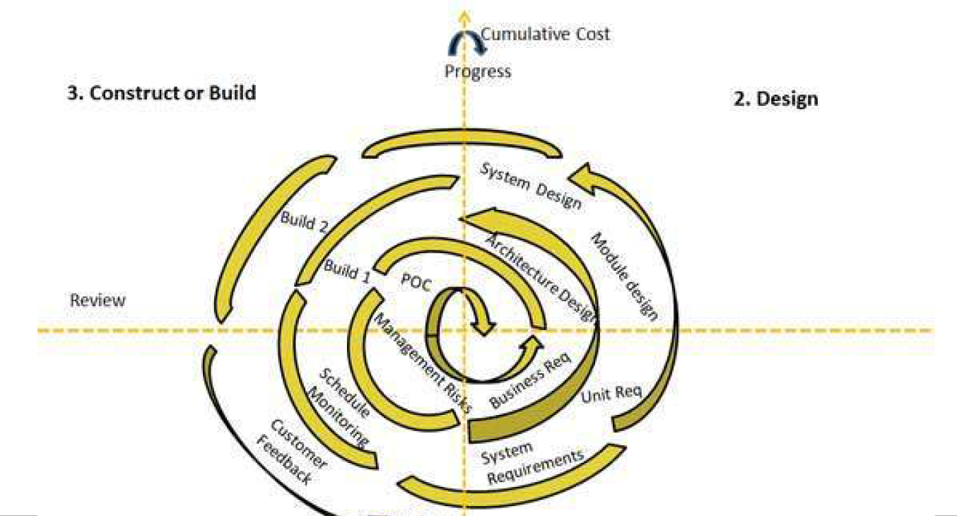
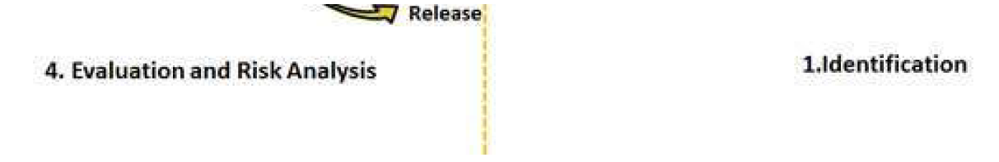
2. Spiral Model Design (Cont.)

Slide 6
3. Spiral Model Application
Spiral Model is very widely used in the software industry as it is in synch with the natural development process of any product. Following are the typical uses of Spiral model:
When costs there is a budget constraint and risk evaluation is important.
For medium to high-risk projects.
Long-term project commitment because of potential changes to economic priorities as the requirements change with time.
Customer is not sure of their requirements which is usually the case.
Requirements are complex and need evaluation to get clarity.
New product line which should be released in phases to get enough customer feedback.
Significant changes are expected in the product during the development cycle.

Slide 7
3. Spiral Model Pros and Cons
Although the spiral model is designed for software development case. However, it is natural for anything to have both pros and cons. Here are the following pros and cons by using spiral model
Pros:
Changing requirements can be accommodated.
Allows for extensive use of prototypes
Requirements can be captured more accurately.
Users see the system early.
Development can be divided into smaller parts and more risky parts can be developed earlier which helps better risk management.

Slide 8
3. Spiral Model Pros and Cons
Cons:
Management is more complex
End of project may not be known early
Not suitable for small or low risk projects and could be expensive for small projects
Process is complex
Spiral may of indefinitely
Large number of intermediate stages requires excessive documentation

Slide 9
Thank you for your Attention!!!
Any Question!?

