Slide 1


Institute of Technology of Cambodia
Master of Data Science
IT Project Management
IT Project Failures, Causes and Cures
Instructed by: M. CHAN Sophal
Present by:
LENG SENG HAK M080102

Slide 2
Background of Research Paper
Topic: IT Project Failures, Causes and Cures
Author: SOREN LAUSEN (Computer Science Department, IT University of Copenhagen, 2300 Copenhagen, Denmark)
Journal: IEEE Access
Published Date: April, 8, 2020

Slide 3
1. Abstract Summary
Problem: The common explanation of how IT project fails are poor management, poor cost estimation and poor requirement, etc.
Project Question: what would we have to teach them that they don't learn today? We have to know what actually took place in the projects, identify the root causes, and ways to prevent them (cures)
Methods: Investigate five accident of large government IT projects in Denmark
Result: Identified 37 root causes, 22 potential cures, 1 of the causes is programming-related.

Slide 4
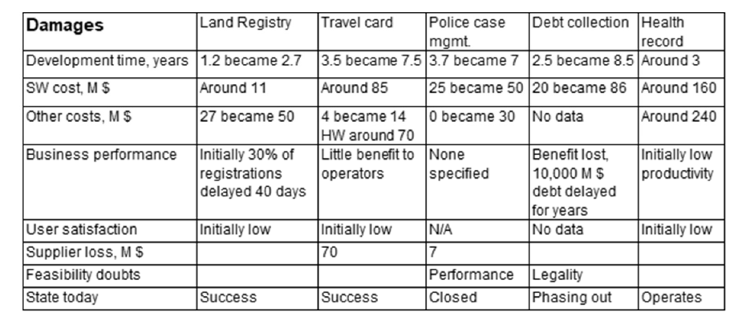
2. The Five Projects and Their Damages
The five damages investigation in the project are: (Damages in the projects. Show the estimated and actual value like this: 3.5 became 7.5. We show that they are almost the same in this way: Around 85.)

Slide 5
2. The Five Projects and Their Damages (cont.)
From The table above, we can summary the following:
4 of the projects had large schedule overruns.
2 had large cost overruns.
All of them had insufficient business results.
2 of them the supplier lost a lot of money.
For 2 of them, it was dubious whether they could ever succeed (feasibility doubts).
2 (maybe 3) became a success although they had damages. Only 1 of them was never deployed (Police case management).

Slide 6
3. Identified What Happened – The Time Line
Normally, the investigation of why project fails, are only from the customer point of view. In this research paper, they also looking from Supplier’s roles. The methodology are:
Contacted key IT staff and asked for an interview and discussion. Explained what the purpose was: To identify damage causes in order that others can learn from them.
Promised to anonymize all sources and allow the informant to review the report.
Gave seminars for experienced developers and project managers, where the author explained the findings.

Slide 7
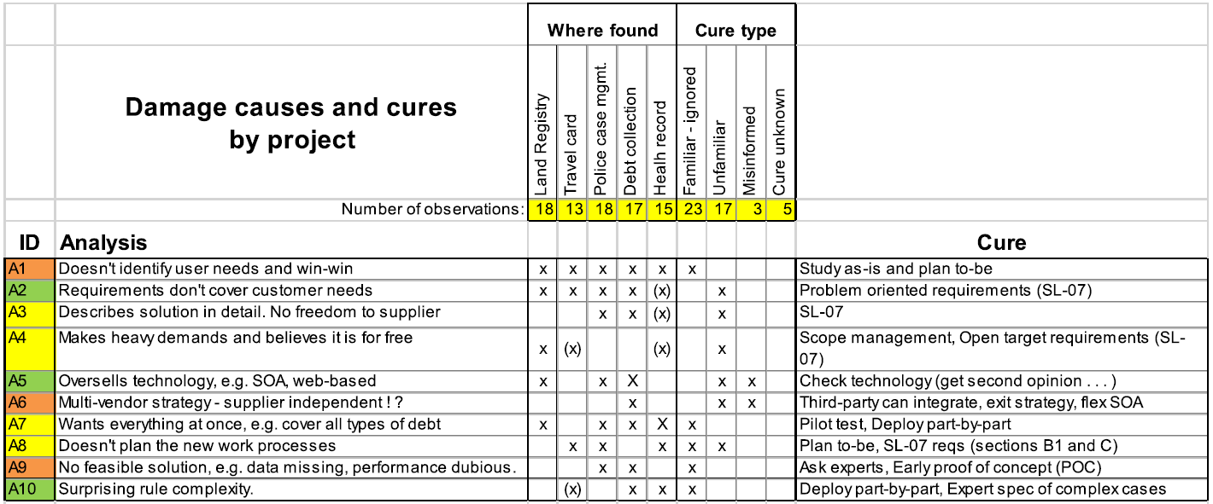
4. Identify the Causes
In total, the research identified 36 root causes Green causes: Covered by common project-failure literature. Yellow: Covered by a Danish investigation, 2001 [1]. Red: Not mentioned in project-failure literature. Guidelines may mention the cure, but not the cause.

Slide 8
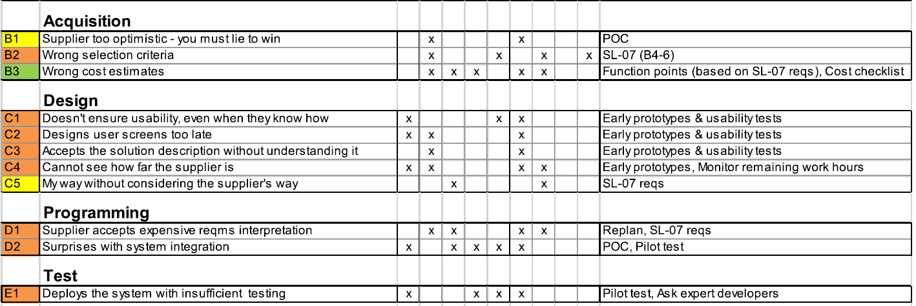
4. Identify the Causes (Cont.)

Slide 9
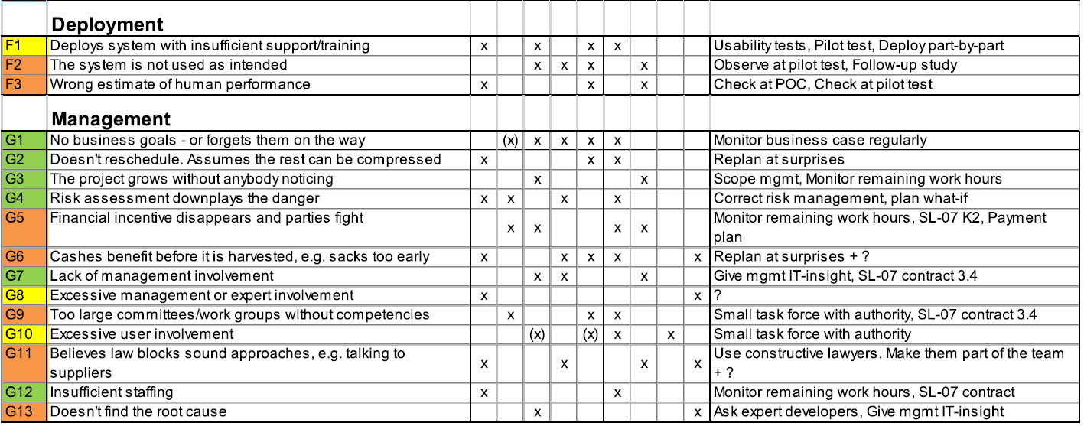
4. Identify the Causes (Cont.)

Slide 10
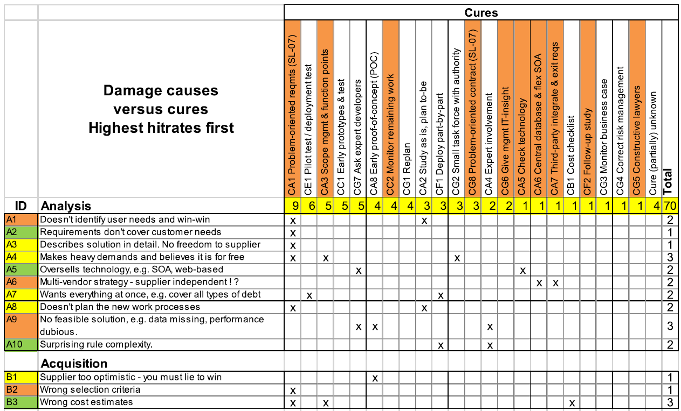
5. Identify the Cures
The table introduce the proposed cures. (Red cures: Unfamiliar techniques. A cause may need more than one cure.

Slide 11
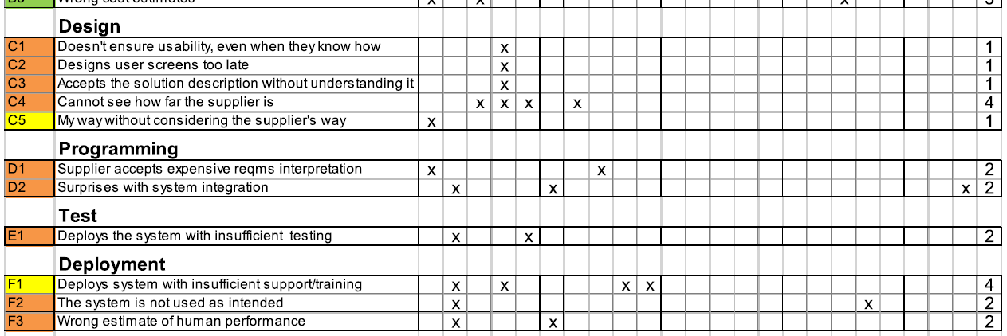
5. Identify the Cures (Cont.)

Slide 12
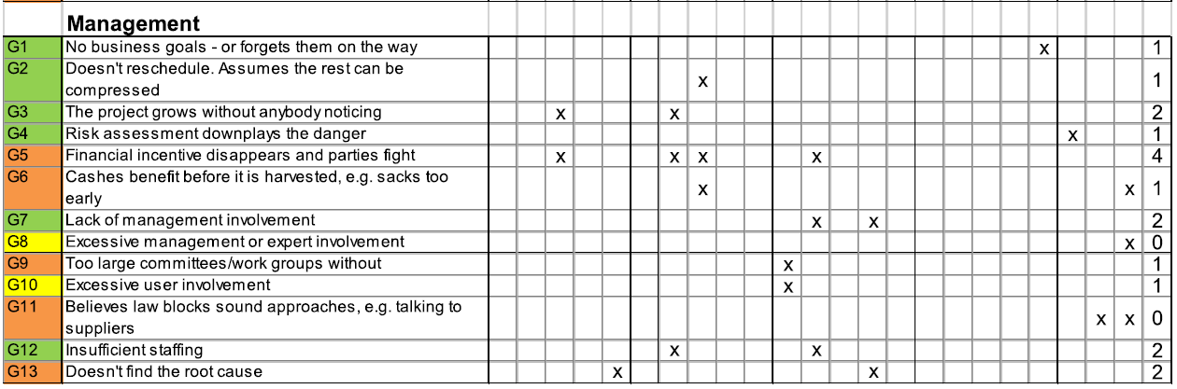
5. Identify the Cures (Cont.)

Slide 13
5. Problem Oriented Requirement and SL-07
SL-07 is an exemplary requirements specification for a health record system.
SL-07 has gradually been improved since then, and now shows realistic examples of all kinds of requirements, including user-task support, data needs, system integration, security, response time, usability, business goals, early-proof-of-concept, exit strategy, development process, etc.
The customer doesn't write what the system shall do, but what he wants to use the system for and the problems he wants to eliminate. The supplier writes the solution he proposes.
SL-07 has been used successfully in more than 100 projects.

Slide 14
6. Conclusion
Accident investigations in 5 damaged (“failing”) IT projects have identified 37 damage causes and 22 potential cures. Each project suffered from around 15 of the causes. The same damage causes and cures apply across projects. As new projects are investigated, the lists of causes and cures will probably grow, but slowly.
Even well-proven cures such as risk management, early prototypes with usability tests and problem-oriented requirements often fail because developers misunderstand them or don't perform them correctly.
A project can use the findings in this way:
1. Apply the cures throughout the project to prevent the damage causes and thus the damage.
2. During and after the project, identify any new damage causes to prevent in the future and any new cure tried or suggested.

Slide 15
Thank you for your Attention!!!
Any Question!?

