Slide 1


Institute of Technology of Cambodia
Master of Data Science
Programming for Data Science
Date Retrieving and Cleaning
Instructed by: M. CHAN Sophal
Present by:
LENG SENG HAK M080102

Slide 2
Outline
Case Study Overview
Overall Structure and Framework
Data Retrieving
Data Rearrangement
Data Cleaning

Slide 3
1. Case Study Overview
Topic: Empirical Investigation of Gold Price Prediction using ARIMA and LSTM Model
Data Needed: Gold Price (Daily or Monthly)
Data Source: Global Gold Price based Website
Research Question: Which machine learning algorithm provide better accuracy for the study case,

Slide 4
2. Overall Structure of Framework (Roadmap)
Define which data is needed
Find reliable source and Retrieve data
Define research objectives
Rearrange Structure and clean
Compare data across multiple source
Model and Analysis
Discuss and Conclude

Slide 5
3. Data Retrieving
Things to consider before retrieving data:
Daily of Monthly
Start time
Is the source reliable
Different techniques can be used for the data retrieving for the gold price are:
Download from open source
Do the web scrapping

Slide 6
4. Data Rearrangement
After retrieving data, the data can be in different format (XML, CSV or HTML…). Therefore, we have to convert the obtained data into one based format and rearrange in the table into a structure type data. The steps involve:
Convert each data into the same format
Arrange the data in the same row and columns for each files (Price, time stamp)
Tool can used are: Pandas and Numpy

Slide 7
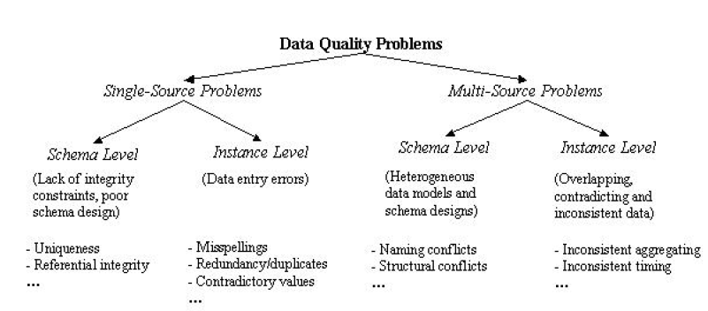
5. Data Cleaning
There are several problem in the retrieved data. The common problems are:

Slide 8
5. Data Cleaning (Cont.)
There are several techniques to deal with the missing value. For example:
KNN Imputer
Replace with Mean Value
Fill use the domain knowledge
Replace with Mode
Delete the whole row
For Time Series data type, the missing value can be deal with several methods as
Autoregressive
Moving Average
Kalman Filter
And so on..

Slide 9
Thank you for your Attention!!!
Any Question!?

