Slide 1
VUE + OPTION API
Step 1 :
Introduction
Step 2 :
Install Project.
Step 3 :
Do exercise with option API.
Step 4 :
Explain more about option API.

Slide 2
Introduction
VUE + OPTION API
A
G
What is Vue OPTION API?
E
How can we use Vue OPTION API?
N
D
What is the benefit of OPTION API?
A

Slide 3
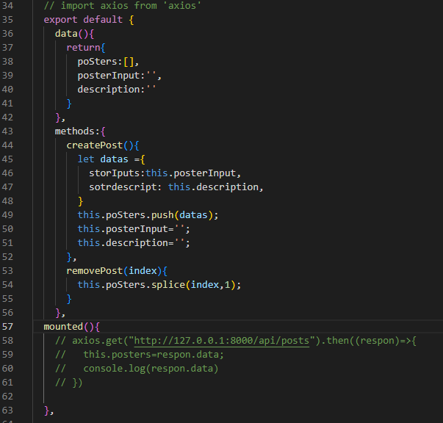
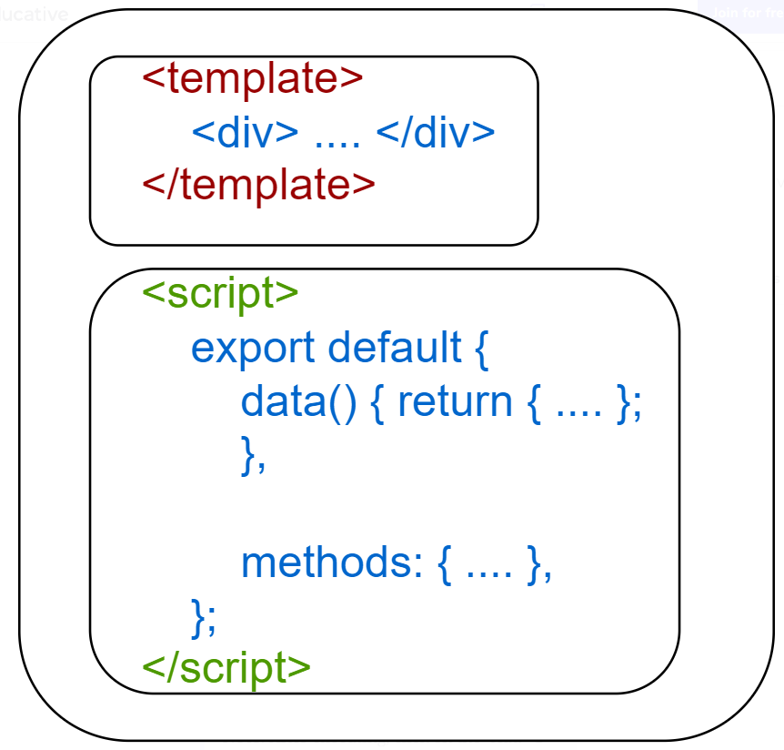
OPTIONS API
Introduction
Option: API is a Vue application to write and define all the data, methods, and mounted in the component.
Syntax of Options API

Slide 4
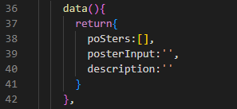
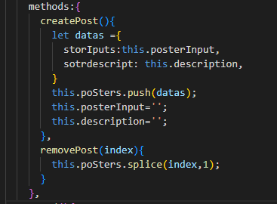
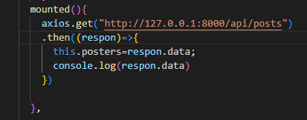

How can we use Option API?
We can use Options API such as data, methods, and mounted.
Use for Data
Use for Method
Use for Mounted

Slide 5
Install project
Step 2 :
Comment :
Vue create <name-projects>
Comment :
Npm init vue@latest <name-projects>

Slide 6
Do exercise with Option API
Let do it together.

Slide 7
What Benefit of Option API?
1, Better code organization and readability.
2, Extracting all the components.
3, Easily use constants and external resources in the component.

Slide 8

Conclusion

