Slide 1
CE2 Instances Scheduler
The severless function to manage stop/start EC2 instances base on the schedule configuration
This solution will reduce aws cost by stopping the EC2 resources when they are not in use and starting the resources when their capacity is needed.
This tool is build by CDK Tool kit
The lambda functions have been written with java and python script

Slide 2








Architecture Overview
Workflow:
Setup cronjob scheduler to run every 15min to trigger Lambda EC2-scheduler(java)
The lambda fetch the records from dynamodb (stop/start scheduler record)
The lambda process the records above to find the match scheduler , if found the record it will push the data record into SQS
SQS will trigger another lambda stop/start EC2 python
The lambda will do the action stop/start EC2 received from SQS
CloudWatch Event will listen to any instances changes state (stop, running, shutdown, or terminate)
When Cloudwatch Event happen, it will trigger the send notification MS-Team lambda
Lambda process the logic to get the all information and send to MS
The end user will receive the message
EventBridge
Cron job
1
Ec2-scheduler
java
3
4
Stop/start
EC2
python
SQS
2
5
6
7
send notification
MS-Team
DynamoDB
EC2
EventBridge (cloudwatch Event)
Listening any change EC2 state
8
Team Group channel

Slide 3



Architecture Overview (future)
Workflow:
Setup cronjob scheduler to run every 15min to trigger Lambda EC2-scheduler(java)
The lambda fetch the records from dynamodb (stop/start scheduler record)
The lambda process the records above to find the match scheduler , if found the record it will push the data record into SQS
SQS will trigger another lambda stop/start EC2 python
The lambda will do the action stop/start EC2 received from SQS
CloudWatch Event will listen to any instances changes state (stop, running, shutdown, or terminate)
When Cloudwatch Event happen, it will trigger the send notification MS-Team lambda
Lambda process the logic to get the all information and send to MS
The end user will receive the message
EventBridge
Cron job
1
Ec2-scheduler
java
3
4
Stop/start
EC2
python
SQS
2
5
6
7
send notification
MS-Team
8
DynamoDB
EC2
EventBridge (cloudwatch Event)
Listening any change EC2 state
SNS
9
10
Team Group channel

Slide 4

Architecture Overview (future2)
Workflow:
Setup cronjob scheduler to run every 15min to trigger Lambda EC2-scheduler(java)
The lambda fetch the records from dynamodb (stop/start scheduler record)
The lambda process the records above to find the match scheduler , if found the record it will push the data record into SQS
SQS will trigger another lambda stop/start EC2 python
The lambda will do the action stop/start EC2 received from SQS
CloudWatch Event will listen to any instances changes state (stop, running, shutdown, or terminate)
When Cloudwatch Event happen, it will trigger the send notification MS-Team lambda
Lambda process the logic to get the all information and send to MS
The end user will receive the message
Stop/start EC2 instances scheduler
EventBridge
Cron job
1
Ec2-scheduler
java
3
4
Stop/start
EC2
python
SQS
2
5
6
7
send notification
MS-Team
8
DynamoDB
EC2
EventBridge (cloudwatch Event)
Listening any change EC2 state
SNS
9
10
stack channel
Team Group channel
Infra team

Slide 5
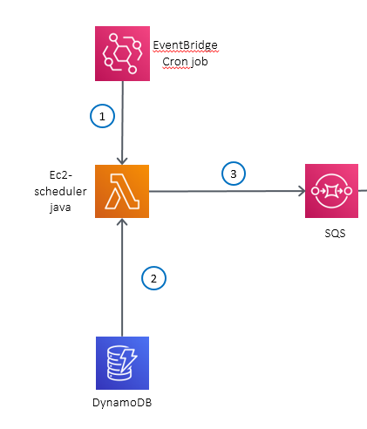
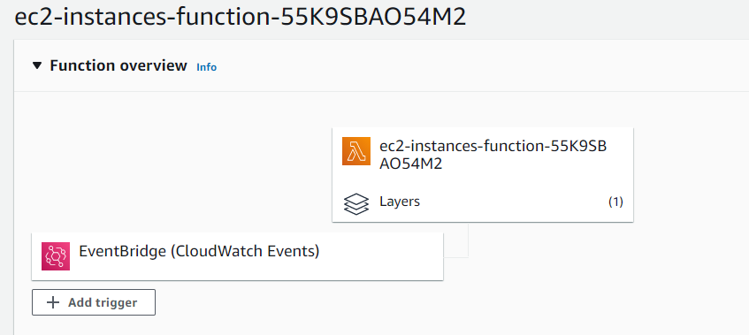
Micro service instances lambda
Workflow:
Setup cronjob scheduler to run every 15min to trigger Lambda EC2-scheduler(java)
The lambda fetch the records from dynamodb (stop/start scheduler record)
The lambda process the records above to find the match scheduler , if found the record it will push the data record into SQS
SQS will trigger another lambda stop/start EC2 python

Slide 6
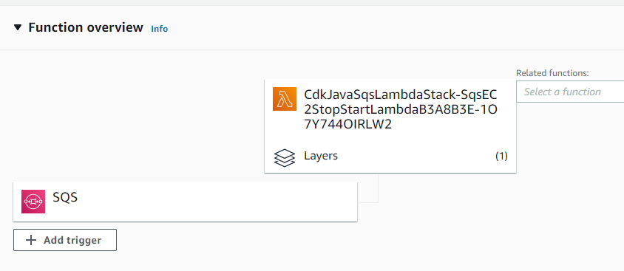
Micro-services - stop/start EC2 instances lambda
Workflow:
The message will pull from SQS and trigger lambda stop/start EC2
The lambda will do the action stop/start EC2 received from SQS
1
Stop/start
EC2
python
SQS
2
EC2

Slide 7
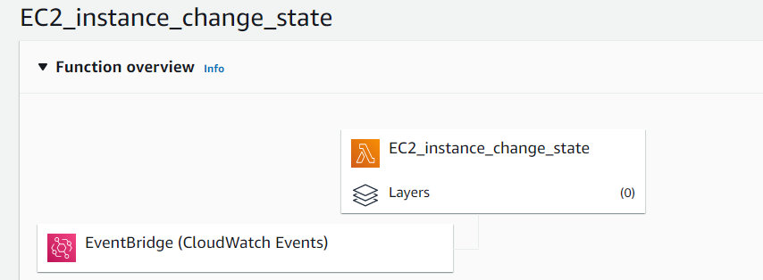
Micro-services – send-notification MS-Team lambda
Workflow:
CloudWatch Event will listen to any EC2 instances changes state (stop, running, shutdown, or terminate)
When Cloudwatch Event happen, it will trigger the send notification MS-Team lambda
Lambda process the logic to get the all information and send to MS
The end user will receive the message
send notification
MS-Team
python
1
2
EC2
EventBridge (cloudwatch Event)
Listening any change EC2 state
Team Group channel

Slide 8
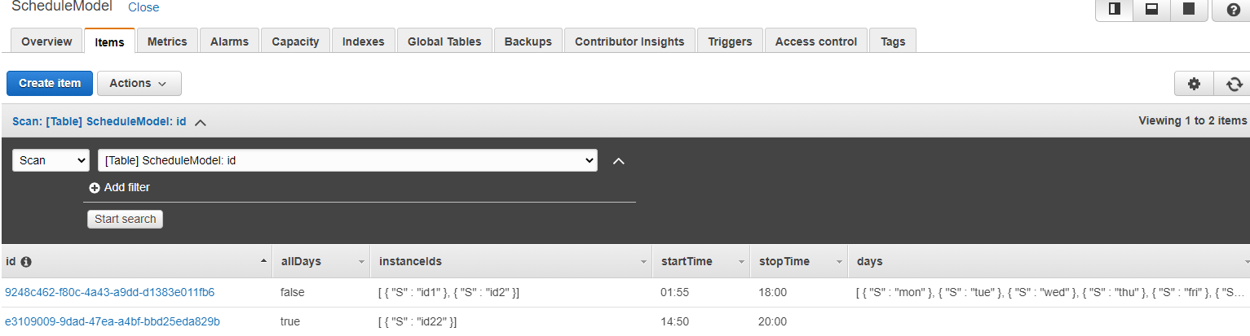
Dynamodb
Instance-Schedule (id, name, days, allDays, instanceIds, stopTime, StartTime)

Slide 9
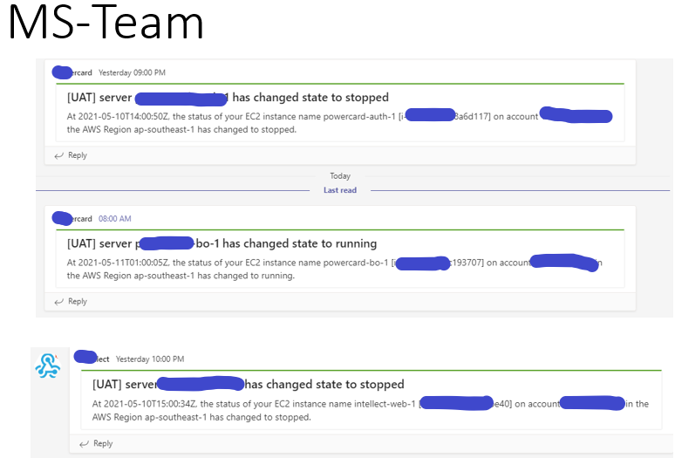

Slide 10
Billing estimation
AWS service | Dimensions | Cost (per month)
Lambda function | run every 15min - 96 run / 24hours ( under free quota) | 0
AWS DynamoDB | 1,080,000 (Read/ month)($0.5 per million requests) Under free quota less 1000 read / month as 5-10 records | 0
AWS DynamoDB | <1GB(First 25 GB is free) | 0
SQS | Standard Queue: 1000 request / month | 0
AWS EventBridge | Free quota - if 1.00/million custom events published | 0

Slide 11
How to manage Schedule Model?
Workflow:
Option 1 : it is current solution for now
Option build a web portal UI : later version but it is trad-off do we really need this tool just populate the schedule model?
1
Schedule Model json
{
"allDays": false,
"days": [
"mon",
"tue",
"wed",
"thu",
"fri"
],
"stopTime": "00:00",
"startTime": "08:00",
"instanceIds": [
"i-0c462d535xxxx",
"i-0d62303xxxx",
"i-0af520axxxxx"
]
}
Infra team
DynamoDB
2
3
Web Portal

