Slide 1

ReactJS
A JavaScript library for building user interfaces
Prepared by Web Team

Slide 2
Contents
Overview
Environment Setup & Initialize
JSX & Components
State & Props
Component API
Component Life Cycle
Events
Lists & Keys
React Hooks
Router
Redux Pattern

Slide 3
Overview

Slide 4
Overview
Introduction
ReactJS is JavaScript library used for building reusable UI components.
It is a language for user interfaces, can be compared to Angular & Vue.
Can be used on client as well as with other frameworks like bootstrap…...
Features
JSX : JSX is JavaScript XML. It isn't necessary to use JSX in React development, but it is recommended.
Components: React is all about components. You need to think of everything as a component. This will help you maintain the code when working on larger scale projects.

Slide 5
Overview
Features (Continue)
One-way Data Binding: React implements one-way data flow which makes it easy to passed data in your app.
Performance: It used virtual dom to display virtual components.
React Advantage
Uses virtual DOM which is a JavaScript object. This will improve apps performance, since JavaScript virtual DOM is faster than the regular DOM.
Can be used on client and server side as well as with other frameworks.
Component and data patterns improve readability, which helps to maintain larger apps.

Slide 6
Environment Setup & Hello World

Slide 7
What do you need to run ReactJS ?
ReactJS requires NodeJS to run
Install NodeJS and npm (Node.js)
NPM stands for Node Package Manager
You will need to install some node package through npm.
You can also use yarn for installing Package.
Visit: https://yarnpkg.com/en/docs/install#windows-stable for more detail.

Slide 8
Initialize a Project
There are many ways to create React App Project but we will use Create React App package.
Install Create-React-App Package:
Create app for your project:
Navigate to project directory:
Start running app:
npm install -g create-react-app
create-react-app my-app
cd my-app
npm start

Slide 9
JSX & Components

Slide 10
JSX
React used JSX for templating instead of regular of regular JavaScript. It is not necessary to use it, however, following are some pros that come with it.
It is faster because it performs optimization while compiling code to JavaScript.
It is also type-safe and most of the errors can be caught during compilation.
It makes it easier and faster to write templates, if you are familiar with HTML.

Slide 11
JSX (How to)
It’s very similar to HTML except…
If we want to return more elements, we need to wrap it with one container element.
We can use our own custom attributes in addition to regular HTML properties and attributes by using data- prefix
JavaScript expressions can be used inside of JSX by wrapping it with curly brackets {}
We cannot use if else statements inside JSX, instead we can use conditional (ternary) expressions.

Slide 12
JSX (How to)
Example
let myVal = 2
export default class Home extends Component {
render() {
return (
<div>
{myVal} : {myVal == 2 ? 'two' : 'not two'}
</div>
)
}
}

Slide 13
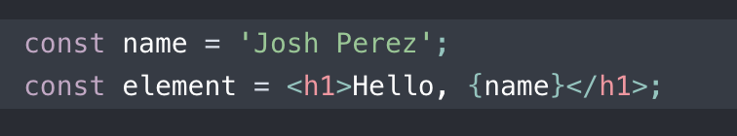
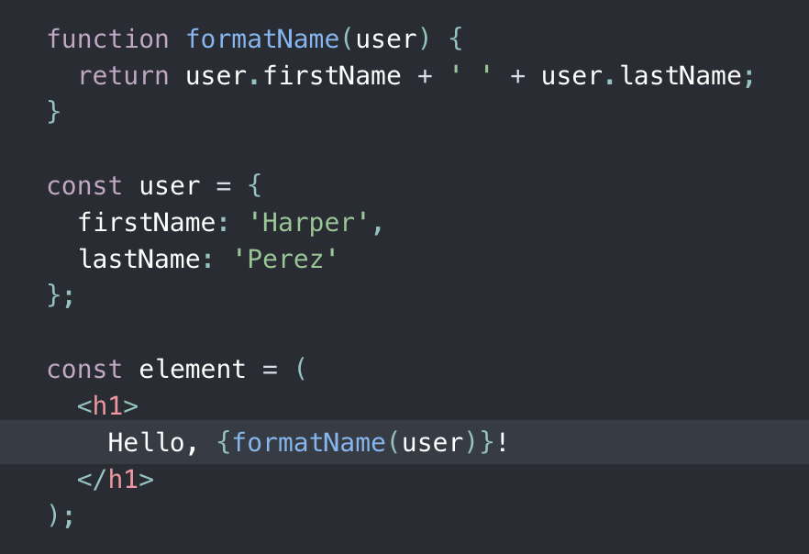
JSX
Embedding Expressions in JSX
You can put any valid JavaScript expression inside the curly braces in JSX.
For example, 2 + 2,
user.firstName, or
formatName(user) are all valid JavaScript expressions.
Notes:
const name = 'Josh Perez';
const element = <h1>Hello, {name}</h1>;
* Specifying Attributes with JSX

Slide 14
StyleSheet
Inline Stylesheet
return (
<div>
<h1 style={{color: 'yello', backgroundColor: 'green'}}>Welcome to ReactJS</h1>
</div>
)
Object Stylesheet
const headingStyle = {
color: 'red',
textAlign: 'center'
}
<h1 style={headingStyle}>Welcome</h1>

Slide 15
StyleSheet
External Stylesheet
In style.css:
.heading{
color: red;
text-align: center;
}
<h1 className=”heading”>Welcome</h1>

Slide 16
StyleSheet
Bootstrap
Installation: npm install react-bootstrap bootstrap
In App.js => import 'bootstrap/dist/css/bootstrap.min.css';
Usage:
<Container fluid>
<Row>
<Col xs={6} md={4} lg={4}>
<Image src={logo} rounded />
</Col>
<Col xs={6} md={4} lg={4}>
<Image src={logo} roundedCircle />
</Col>
<Col xs={6} md={4} lg={4}>
<Image src={logo} thumbnail />
</Col>
</Row>
</Container>

Slide 17
Components
Components let you split the UI into independent, reusable pieces, and think about each piece in isolation.
Conceptually, components are like JavaScript functions
Where props of a component are like arguments of a function
There’s numerous ways to define a component
JavaScript function
ES6 class
export function Home(props) {
return <h1>Welcome{props.course}</h1>
}
export class Home extends Component {
render() {
return <h1>Hello, {this.props.course}</h1>
}
}
Notes:
Automatically update our UI whenever data changes. Building dynamic sites is good UI/UX. (setState every data change automatic update)

Slide 18
Components
We had created a component named Home with props values.
In this example, we use only a props named course to create a element with <h1>
ReactDOM.render(
<Home course="React JS" />,
document.getElementById('root')
);

Slide 19
State & Props

Slide 20
State
What is state?
By default, a component has no state.
State are only seen on the inside of the component definitions.
In short, state can be considered as private data.
Stateless Component
Sometimes a component doesn’t need any states to keep track information between rendering the component.
function Welcome(props){
return <h1>Hello {props.name}</h1>
}

Slide 21
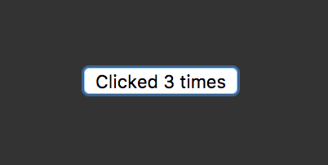
State
So when to use state?
When a component needs to keep track of information between renderings the component itself can create, update and use state.
class Button extends React.Component {
constructor() {
super();
this.state = {
count: 0,
};}
updateCount() {
this.setState((prevState, props) => {
return { count: prevState.count + 1 }
});}
render() {
return (<button onClick={() => this.updateCount()}>
Clicked {this.state.count} times
</button>);}
}

Slide 22
State
- Warning 1:
Do not do this:
this.state.count = this.state.count + 1 //**Note: Always use setState
React can not listen to the state getting updated in this way, component will not re-render automatically.
- Warning 2:
Do not do this:
this.setState({ count: this.state.count + 1 });
This does not take into account the asynchronous nature of setState. This might cause errors with out of sync state data.
Notes:
**Note: Always use setState

Slide 23
State vs Props
Going deeper (State vs Props)
State is created in the component
This is where state gets its initial data. The initial data can also from props. But if you want to make change of that data you can’t use props because props is immutable (unchangeable).
State is changeable
constructor() {
super();
this.state = {
count: 0,
};
}
updateCount() {
this.setState((prevState, props) => {
return { count:prevState.count + 1 }
});}
}
Notes:
We change the state to keep track of the total number of clicks. The important bit is setState. First off, notice that setState takes a function, that’s because setState can run asynchronously. It needs to take a callback function rather than updating the state directly. You can see we have access to prevState within the callback, this will contain the previous state, even if the state has already been updated somewhere else.
But React goes one step better, setState updates the state object and re-renders the component automagically.

Slide 24
Props
What are props?
Props is short for “properties”
Props make React Component to be more dynamic that’s mean to change content of component.
Props are similar to arguments in functions
Also similar to HTML attributes.
Ex: class Welcome extends React.Component{
render(){
return <h1>Hello {this.props.name}</h1>;
}
}
const element = <Welcome name = “John” />;

Slide 25
Props(Con.)
Props can have their default values, in case props isn’t passed through it can still be set.
Ex: We can make the name property optional by adding defaultProps to the Welcome class:
class Welcome extends React.Component{
render(){
return <h1>Hello {this.props.name}</h1>;
}
}
Welcome.defaultProps ={
name : “world”
};

Slide 26
Props(Con.)
Props should not change
Consider props as immutable
Since props are passed in and they cannot change , any React component that only uses props as “pure”, it will always render the same output given the same input.
If you are trying to change the props like
Keep in mind, props are read only.
function MyComponent(props){
props.name = “Jerry”;
}

Slide 27
Props(Con.)
Props with children
Children are content or element within a parent that can be used to display further content
Use Child content or elements to display dynamic data.
Syntax: {this.props.children}
Ex:
var YourComponent = React.createClass({
render(){
<div>
<h1>{this.props.text}</h1>
<p>{this.props.children}</p>
</div>
}})
ReactDOM.render(
<YourComponent text = “Hello World” >
I am the child of YourComponent
</YourComponent>,
document.getElementById(‘root’);)

Slide 28
State and Props review
While props and state both hold information relating to the component, they are used differently and should be kept separate.
props contains information set by the parent component (although defaults can be set) and should not be changed.
state contains “private” information for the component to initialize, change, and use on it’s own.

Slide 29
Component API

Slide 30
Component API
Instances of a React Component are created internally in React when rendering.
These instants can be accessed in your component methods as this keyword
setState
method is used to update the state of the component. This method will not replace the state, but only add changes to the original state.
this.setState(object newState)
forceUpdate
Sometimes we might want to update the component manually. This can be achieved using the forceUpdate() method.
Notes:
All instance of component can access by this keyword

Slide 31
Component Life Cycle

Slide 32
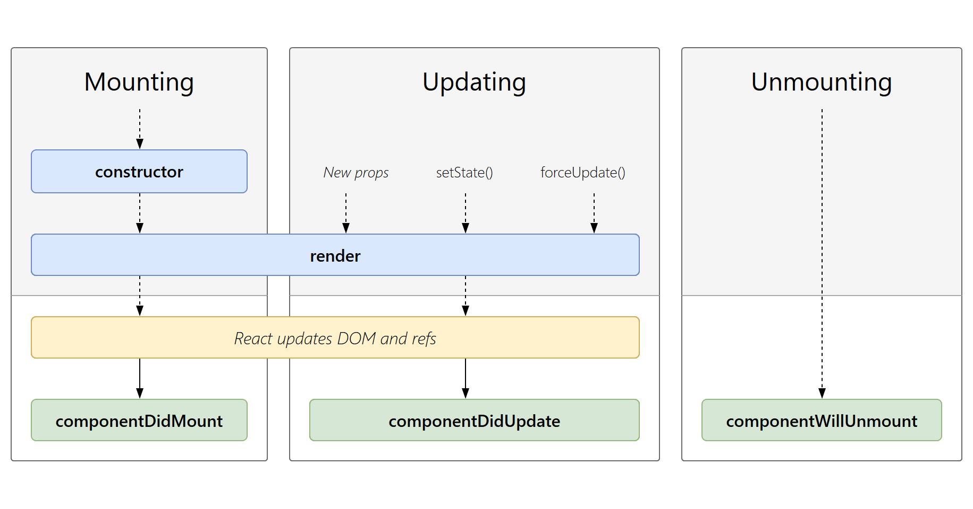
Component Life Cycle
Lifecycle Phase
Each component has several “lifecycle methods”that you can override to run code at particular times in the process.

Slide 33
Mounting
These methods are called in the following order when an instance of a component is being created and inserted into the DOM:
constructor()
static getDerivedStateFromProps()
render()
componentDidMount
Note : These methods are considered legacy and you should avoid them in new code:
UNSAFE_componentWillMount()

Slide 34
Updating
An update can be caused by changes to props or state. These methods are called in the following order when a component is being re-rendered:
static getDerivedStateFromProps()
shouldComponentUpdate()
render()
getSnapshotBeforeUpdate()
componentDidUpdate()
Note : These methods are considered legacy and you should avoid them in new code:
UNSAFE_componentWillUpdate()
UNSAFE_componentWillReceiveProps()

Slide 35
Unmounting
componentWillMount()
It is invoked immediately before a component is unmounted and destroyed. Perform any necessary cleanup in this method, such as invalidating timers, canceling network requests, or cleaning up any subscriptions that were created in componentDidMount().
You should not call setState() in componentWillUnmount() because the component will never be re-rendered. Once a component instance is unmounted, it will never be mounted again.

Slide 36
Event & Validation

Slide 37
Event
Handling events with React elements is very similar to handling events on DOM elements. There are some syntactic differences:
React events are named using camelCase, rather than lowercase.
With JSX you pass a function as the event handler, rather than a string.
For example, the HTML : Is slightly different in React :
<button onclick=“activateLasers()”> Activate Lasers
</button>
<button onclick= {activateLasers}> Activate Lasers
</button>

Slide 38
Event
Another difference is that you cannot return false to prevent default behavior in React. You must call preventDefault explicitly.
For example, with plain HTML, to prevent the default link behavior of opening a new page, you can write:
In React, this could instead be:
<form action=”#” onsubmit=”console.log(‘form is being submitted’) return false”>
Click Me </form>
submitData = (event) => { event.preventDefault() console.log(“form is being submitted”) }

Slide 39
Event
<form className=”App” onSubmit={this.submitData}>
<input value={this.state.term} onChange={this.onChange} /> <button>Submit</button> </form>

Slide 40
Event
Binding Event in React
When we bind the this of the event handler to the component instance in the constructor, we can pass it as a callback without worrying about it losing its context or undefined. Arrow functions are exempt from this behavior because they use lexical this binding which automatically binds them to the scope they are defined in.
Binding Event in Constructor
constructor(props) {
super(props);
// This binding is necessary to make `this` work in the callback to prevent undefined in event
this.handleClick = this.handleClick.bind(this);
}
<button onClick={this.handleClick}>
Click Me
</button>

Slide 41
Event
Binding Event using arrow syntax
<button onClick={(e) => this.callOnClick(e)}>
Click
</button>

Slide 42
Validation
Validation in ReactJS
We can use regex to validate data in ReactJS or Library
Example:
export default class App extends Component {
constructor() {
super()
this.state = {
username: "",
password: "",
isNameValide: false,
isPasswordValide: false,
usernameError: "",
passwordError: "",
}
}

Slide 43
Validation
inputChange = (e) => {
this.setState({
[e.target.name] : e.target.value
})
}
formSubmit = (e) => {
e.preventDefault();
var username = this.state.username
var password = this.state.password
var isNameValid = true
var isPasswordValid = true
var usernameError = ""
var passwordError = ""
let pattName = /[^a-z]/gi;
if (username === "") {
usernameError = "Username can't be empty."
isNameValid = false
}else if(username.match(pattName) != null){
usernameError = "Invalid Username"
isNameValid = false
}else {
usernameError = ""
isNameValid = true
}

Slide 44
Validation
if (password === "") {
passwordError = "Password can't be empty."
isPasswordValid = false
}else {
passwordError = ""
isPasswordValid = true
}
this.setState({
usernameError,
passwordError
})
if (isPasswordValid && isNameValid){
alert("Success")
}else{
alert("Error")
}
}

Slide 45
Validation
render() {
return (
<div className="container">
<h1 className="my-4">Validate Form</h1>
<Form onSubmit={this.formSubmit}>
<FormGroup className="my-2">
<FormLabel>Username</FormLabel>
<FormControl type="text" placeholder="username" name="username" onChange={this.inputChange}/>
<FormText className="text-danger">{this.state.usernameError}</FormText>
</FormGroup>

Slide 46
Validation
<FormGroup className="my-2">
<FormLabel>Password</FormLabel>
<FormControl type="password" placeholder="password" name="password" onChange={this.inputChange} />
<FormText className="text-danger">{this.state.passwordError}</FormText>
</FormGroup>
<Button variant="primary" type="submit">Submit</Button>
</Form>
</div>
)
}
}

Slide 47
List and Keys

Slide 48
List
For example, we want to render a batch of item using data from an array.
We can use method map() with callback function to render.
const numbers = [1, 2, 3, 4, 5];
const doubled = numbers.map((number) => number * 2);
console.log(doubled);
// This code logs [2, 4, 6, 8, 10] to the console.
Rendering Multiple Components
const numbers = [1, 2, 3, 4, 5];
const listItems = numbers.map((number) =>
<li>{number}</li>
);
Notes:
https://reactjs.org/docs/lists-and-keys.html

Slide 49
List
Then Render it to DOM
ReactDOM.render(
<ul>{listItems}</ul>,
document.getElementById('root')
);
Notes:
https://reactjs.org/docs/lists-and-keys.html

Slide 50
Key
Keys help React identify which items have changed, are added, or are removed.
const numbers = [1, 2, 3, 4, 5];
const listItems = numbers.map((number) =>
<li key={number.id}>
{number.name}
</li>
);
Notes:
Crud with api in reactjs https://www.truecodex.com/course/react-js/crud-4-create-insert-delete-update-in-react-js-using-api

Slide 51
React Hooks

Slide 52
Introduction to Hooks
Hooks are the new feature introduced in the React 16.8 version. It allows you to use state and other React features without writing a class. Hooks are the functions which "hook into" React state and lifecycle features from function components. It does not work inside classes.
Hooks are backward-compatible, which means it does not contain any breaking changes. Also, it does not replace your knowledge of React concepts.

Slide 53
When to use a Hooks
If you write a function component, and then you want to add some state to it, previously you do this by converting it to a class. But, now you can do it by using a Hook inside the existing function component.

Slide 54
Rule of Hooks
Hooks are similar to JavaScript functions, but you need to follow these two rules when using them. Hooks rule ensures that all the stateful logic in a component is visible in its source code. These rules are:
Only call Hooks at the top : level There’s are numerous ways to define a component such as JavaSscript function and ES6 class.
Only call Hooks from React functions : You cannot call Hooks from regular JavaScript functions. Instead, you can call Hooks from React function components. Hooks can also be called from custom Hooks.

Slide 55
Rule of Hooks
Pre-requisites for React Hooks
Node version 6 or above
NPM version 5.2 or above
Create-react-app tool for running the React App

Slide 56
Basic usage of Hooks
Most of Hooks return array of 2 elements. First element is a value from what we have initialized, second element is a function that we can use to update that value.
Here we use array destructuring to get Hooks value.
import React, { useState } from 'react';
function Example() {
const [count, setCount] = useState(0);
const [person, setPerson] = useState({
“username”: “ABC”,
“age”: 20
});
}

Slide 57
Using the State Hooks
useState is a Hook that lets you add React state to function components.
As a reminder, function components in React look like this:
or this:
function Example() {
// You can use Hooks here!
return (
<div></div>
);
}
const Example => () {
// You can use Hooks here!
return (
<div></div>
);
}

Slide 58
Using the State Hooks
You might have previously known these as “stateless components”. We’re now introducing the ability to use React state from these, so we prefer the name “function components”.
Hooks don’t work inside classes. But you can use them instead of writing classes.
Our new example starts by importing the useState Hook from React:
import React, { useState } from ‘react’
const [value, setValue] = useState(initialization)

Slide 59
Using the State Hooks
What is a Hook?
A Hook is a special function that lets you “hook into” React features. For example, useState is a Hook that lets you add React state to function components. We’ll learn other Hooks later.
When would I use a Hook?
If you write a function component and realize you need to add some state to it, previously you had to convert it to a class. Now you can use a Hook inside the existing function component. We’re going to do that right now!

Slide 60
Using the State Hooks
Declaring a State Variable
In a class, we initialize the count state to 0 by setting this.state to { count: 0 } in the constructor:
Instead, we call the useState Hook
class Example extends React.Component {
constructor(props) {
super(props);
this.state = {
count: 0
};
}
}
import React, { useState } from 'react';
function Example() {
// Declare a new state variable, which we'll call "count"
const [count, setCount] = useState(0);
}

Slide 61
Using the State Hooks
What does calling useState do?
It declares a “state variable”. Our variable is called count but we could call it anything else, like banana.
What do we pass to useState as an argument?
The only argument to the useState() Hook is the initial state. We can keep a number or a string in useState() if that’s all we need.
What does useState return? It returns a pair of values: the current state and a function that updates it.

Slide 62
Using the State Hooks
Reading State
When we want to display the current count in a class, we read this.state.count
<p>You clicked {this.state.count} times</p>
In a function, we can use count directly
<p>You clicked {count} times</p>

Slide 63
Using the State Hooks
Updating State
In a class, we need to call this.setState() to update the count state
<button onClick={() => this.setState({ count: this.state.count + 1 })}>Click me</button>
In a function, we have setCount and count as variables so we don’t need this:
<button onClick={() => setCount(count + 1)}>Click me</button>

Slide 64
Using the State Hooks
Tip: What Do Square Brackets Mean?
You might have noticed the square brackets when we declare a state variable:
const [fruit, setFruit] = useState(‘banana’);
This JavaScript syntax is called “array destructuring”. It’s equivalent to
var fruitStateVariable = useState('banana'); // Returns a pair
var fruit = fruitStateVariable[0]; // First item in a pair
var setFruit = fruitStateVariable[1]; // Second item in a pair

Slide 65
Using the State Hooks
Tip: Using Multiple State Variables
It lets us give different names to different state variables if we want to use more:
function ExampleWithManyStates() {
// Declare multiple state variables!
const [age, setAge] = useState(42);
const [fruit, setFruit] = useState('banana');
const [todos, setTodos] = useState([{ text: 'Learn Hooks' }]);

Slide 66
Using the Effect Hooks
useEffect is similar to componentDidMount and componentDidUpdate in class components.
Effects Without Cleanup: Sometimes, we want to run some additional code after React has updated the DOM. Network requests, manual DOM mutations, and logging are common examples of effects that don’t require a cleanup.
Effects with Cleanup: Some effects do require clean up. For example, we might want to set up a subscription to some external data source. In that case, it is important to clean up so that we don’t introduce a memory leak!

Slide 67
Using the Effect Hooks
Effects Without Cleanup
import React, { useState, useEffect } from 'react';
function Example() {
const [count, setCount] = useState(0);
useEffect(() => {
document.title = `You clicked ${count} times`;
});
return (
<div>
<p>You clicked {count} times</p>
<button onClick={() => setCount(count + 1)}>Click me</button>
</div>
);
}
Notes:
Effects without Cleanup
It is used in useEffect which does not block the browser from updating the screen. It makes the app more responsive. The most common example of effects which don't require a cleanup are manual DOM mutations, Network requests, Logging, etc.

Slide 68
Using the Effect Hooks
Effects With Cleanup
useEffect(() => {
function handleStatusChange(status) {
setIsOnline(status.isOnline);
}
ChatAPI.subscribeToFriendStatus(props.friend.id, handleStatusChange);
// Specify how to clean up after this effect:
return function cleanup() {
ChatAPI.unsubscribeFromFriendStatus(props.friend.id, handleStatusChange);
};
});
Notes:
Effects with Cleanup
Some effects require cleanup after DOM updation. For example, if we want to set up a subscription to some external data source, it is important to clean up memory so that we don't introduce a memory leak. React performs the cleanup of memory when the component unmounts. However, as we know that, effects run for every render method and not just once. Therefore, React also cleans up effects from the previous render before running the effects next time.

Slide 69
Using the Effect Hooks
What does useEffect do?
By using this Hook, you tell React that your component needs to do something after render.
Why is useEffect called inside a component?
Placing useEffect inside the component lets us access the count state variable.
Does useEffect run after every render?
Yes! By default, it runs both after the first render and after every update.

Slide 70
Using the Effect Hooks
Tip: Use Multiple Effects to Separate Concerns
const [count, setCount] = useState(0);
useEffect(() => {
document.title = `You clicked ${count} times`;
});
const [isOnline, setIsOnline] = useState(null);
useEffect(() => {
function handleStatusChange(status) {
setIsOnline(status.isOnline);
}
ChatAPI.subscribeToFriendStatus(props.friend.id, handleStatusChange);
return () => { ChatAPI.unsubscribeFromFriendStatus(props.friend.id, handleStatusChange); };
});

Slide 71
Using the Effect Hooks
Tip: Optimizing Performance by Skipping Effects
You can tell React to skip applying an effect if certain values haven’t changed between re-renders.
If the count is 5, and then our component re-renders with count still equal to 5, React will compare [5] from the previous render and [5] from the next render. Also, (5 === 5), React would skip the effect. That’s our optimization.
useEffect(() => {
document.title = `You clicked ${count} times`;
}, [count]); // Only re-run the effect if count changes

Slide 72
Using the Effect Hooks
Tip: Optimizing Performance by Skipping Effects
You can tell React to skip applying an effect if certain values haven’t changed between re-renders.
If the count is 5, and then our component re-renders with count still equal to 5, React will compare [5] from the previous render and [5] from the next render. Also, (5 === 5), React would skip the effect. That’s our optimization.
useEffect(() => {
document.title = `You clicked ${count} times`;
}, [count]); // Only re-run the effect if count changes

Slide 73
Custom Hooks
A custom Hook is a JavaScript function. The name of custom Hook starts with "use" which can call other Hooks. A custom Hook is just like a regular function, and the word "use" in the beginning tells that this function follows the rules of Hooks. Building custom Hooks allows you to extract component logic into reusable functions.
Let us understand how custom Hooks works in the following example.
import React, { useState, useEffect } from 'react';
const useDocumentTitle = title => {
useEffect(() => {
document.title = title;
}, [title])
}
function CustomCounter() {
const [count, setCount] = useState(0);
const incrementCount = () => setCount(count + 1);
useDocumentTitle(`You clicked ${count} times`);
// useEffect(() => {
// document.title = `You clicked ${count} times`
// });

Slide 74
Custom Hooks
In the above snippet, useDocumentTitle is a custom Hook which takes an argument as a string of text which is a title. Inside this Hook, we call useEffect Hook and set the title as long as the title has changed. The second argument will perform that check and update the title only when its local state is different than what we are passing in.
return (
<div>
<p>You clicked {count} times</p>
<button onClick={incrementCount}>Click me</button>
</div>
)
}
export default CustomCounter;

Slide 75
Router

Slide 76
What is React-Router? And How?
React-Router is a popular module to build web-application using ReactJS
It allows us to create single-paged web application.
First, to use react-router you have to install react-router package or react-router-dom package
npm install react-router
npm install react-router-dom

Slide 77
React Router
Components
There are three primary categories of components in React Router:
routers, like <BrowserRouter> and <HashRouter>
route matchers, like <Route> and <Switch>
and navigation, like <Link>, <NavLink>, and <Redirect>
A <BrowserRouter> uses regular URL paths. These are generally the best-looking URLs, but they require your server to be configured correctly.
A <HashRouter> stores the current location in the hash portion of the URL so the URL looks something like http://example.com/#/your/page. Since the hash is never sent to the server, this means that no special server configuration is needed.
Notes:
https://reacttraining.com/react-router/web/guides/primary-components
ប្រសិនបើយើងចង់ handle dynamic request យើងប្រើ BrowserRouter ហើយបើយើងចង់ serve static request យើងប្រើ HashRouter

Slide 78
React Router
Route Matchers
If your app have multiple routes. You need to wrap the routes with <Switch>
Without <Switch> you probably would end up with following error
Uncaught Error: A <Router> may have only one child element
<Switch> <Route exact path="/" component={App} /> <Route exact path="/about" component={About} /> </Switch>
Notes:
https://reacttraining.com/react-router/web/guides/primary-components

Slide 79
React Router
Navigation or Route Changers
React Router provides a <Link> component to create links in your application. Wherever you render a <Link>, an anchor (<a>) will be rendered in your HTML document.
The <NavLink> is a special type of <Link> that can style itself as “active” when its to prop matches the current location.
Any time that you want to force navigation, you can render a <Redirect>. When a <Redirect> renders, it will navigate using its to prop.
Notes:
https://reacttraining.com/react-router/web/guides/primary-components

Slide 80
React Router
Navigation or Route Changers
<Link to="/">Home</Link>
// <a href="/">Home</a>
<NavLink to="/react" activeClassName="hurray"> React </NavLink>
// When the URL is /react, this renders:
// <a href="/react" className="hurray">React</a>
// When it's something else: // <a href="/react">React</a>
<Redirect to="/login" />
Notes:
https://reacttraining.com/react-router/web/guides/primary-components

Slide 81
Router
Example
Header.js
{blank} : Home.js
Body.js
/home : Home.js
/user/id : User.js
Root.js
Check: https://github.com/mschwarzmueller/reactjs-basics/tree/11-router

Slide 82
React-Router: V2 vs. V4
V2 (react-router)
<Link>
<Router />
<Route />
<IndexRoute />
<Route />
this.props.params.id
V4 (react-router-dom)
<NavLink>
<Link>
<BrowserRouter>
<Switch>
<Route (with exact attribute) />
<Route />
this.props.match.params.id
(Path Variable)
This.props.location.query.q (Parameter)
Check: https://medium.com/@pshrmn/a-simple-react-router-v4-tutorial-7f23ff27adf

Slide 83

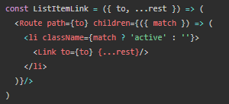
API
There are 3 ways to render something with a <Route>
<Route component> : Render component with props in match
<Route render> : Render component with component’s props
<Route children> : Render component based on match value of props
Notes:
https://reacttraining.com/react-router/web/example/auth-workflow : wanna student to clear about redirect switch and url params
https://reacttraining.com/react-router/

Slide 84
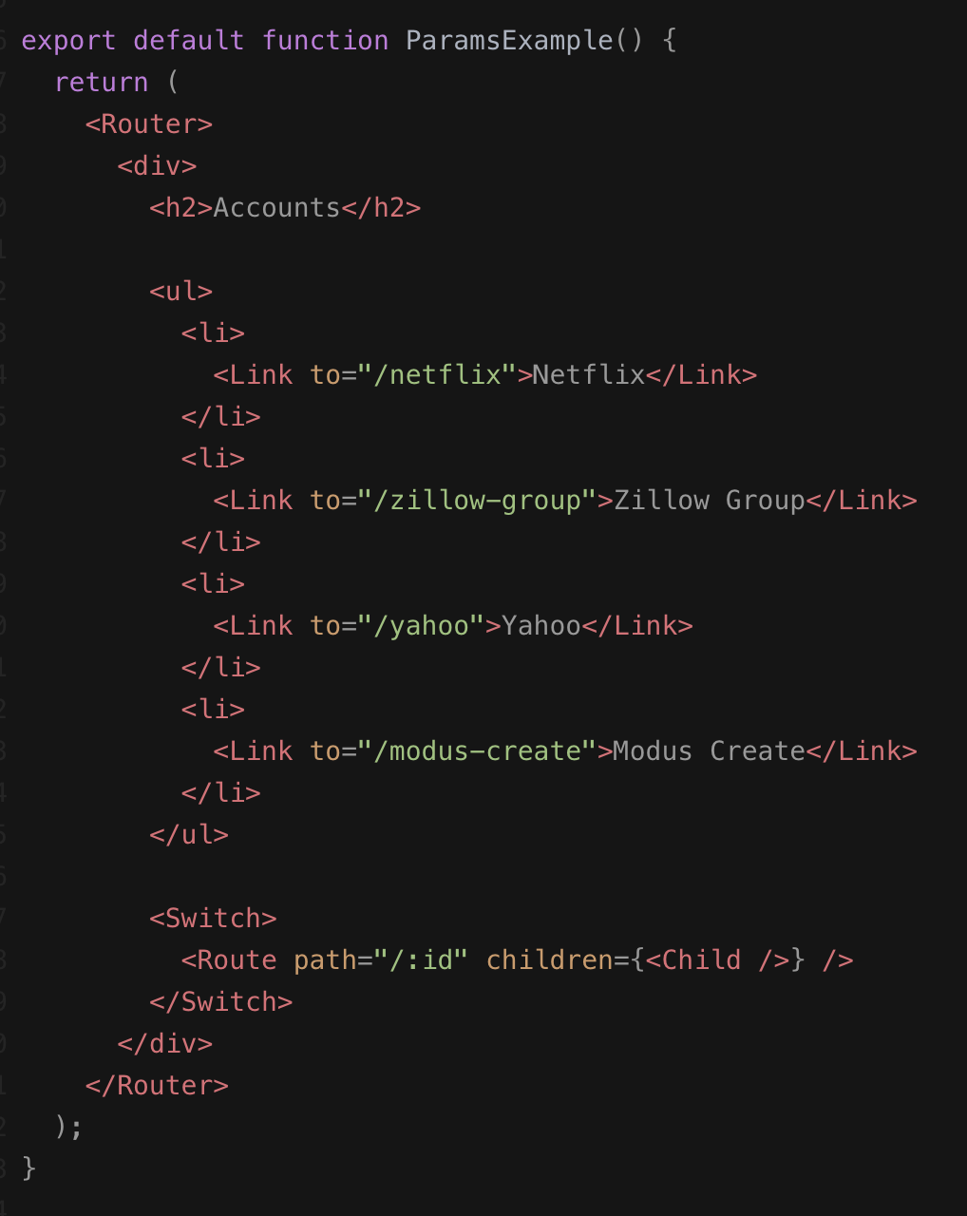
Router
URL Parameters:
Params are placeholders in the URL that begin with a colon, like the `:id` param defined in the route in this example.
Notes:
Reference: https://gitlab.com/React-Source/servercomunication-reactjs/-/tree/master/
https://reacttraining.com/react-router/web/example/no-match

Slide 85
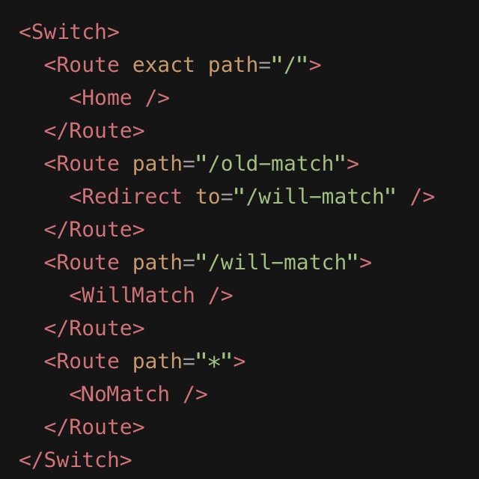
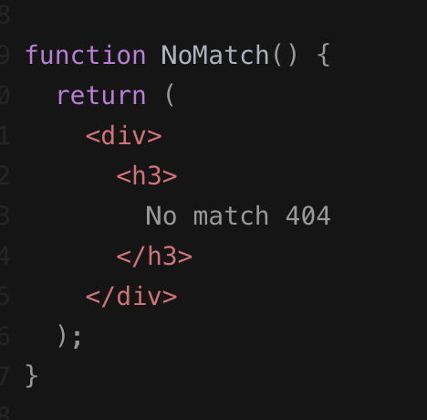
Router
Error Page:
Some page we want to handle when error happens such as 404 not found page, Unauthorize Page, Internal Server Error Page…...
Example: not found 404
Notes:
Reference: https://gitlab.com/React-Source/servercomunication-reactjs/-/tree/master/
https://reacttraining.com/react-router/web/example/no-match

Slide 86
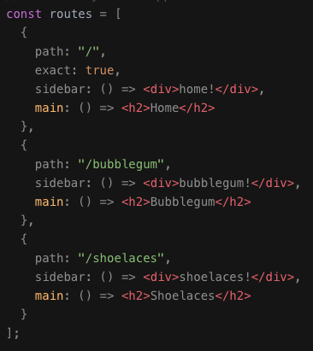
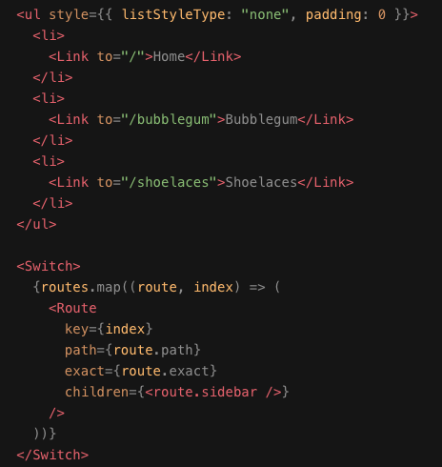
Router
Sidebar
Notes:
Reference: https://gitlab.com/React-Source/servercomunication-reactjs/-/tree/master/
https://reacttraining.com/react-router/web/example/no-match

Slide 87
Server Communication

Slide 88

Server Communication
App
Restful API
When an event occurs…
Create an request
Send request
Internet
Process request
Create a response and send data back to the app
App
Internet
Update the state
Render to DOM

Slide 89
Server Communication
Understand about HTTP
The Hypertext Transfer Protocol (HTTP) is designed to enable communication between clients and servers. HTTP works as a request-response between a client and server.
Request
A request means a message from a client to a server to ask sth - data, file.
Response
After receiving and interpreting a request message, a server responds with an HTTP response message.

Slide 90
Server Communication
Understand about HTTP Request Methods
Http defines a set of request methods to indicate the desired action to be performed for a given resource. These request methods are sometimes referred to as HTTP verbs, despite they can also be nouns.
HEAD : same as GET but returns only HTTP headers and no document body.
GET : this method requests a representation of a specified resource. This request using GET is to retrieve data only
POST : is used to submit data to the specified resource on the server.
PUT : upload to replace all current representation of the specified target resource with the request payload.
DELETE : this method delete data in the specified resource.
OPTIONS : is used to describe the communication options for the target resource.

Slide 91
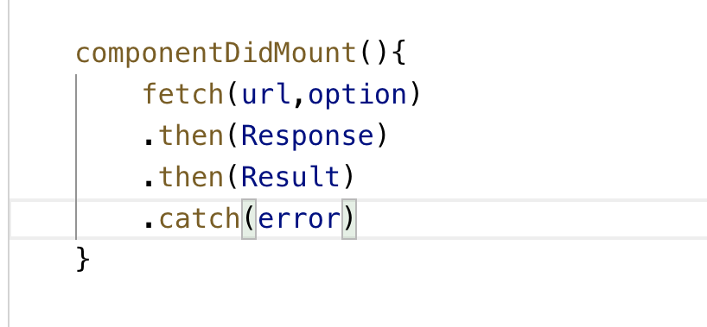
Server Communication
Fetch API
The Fetch API is a simple interface for fetching resources in React. Fetch makes it easier to make web requests and handle responses than with the older XMLHttpRequest, which often requires additional logic (for example, for handling redirects). The fetch() method takes the path to a resource as input. The method returns a promise that resolves to the Response of that request.
Note: Fetch supports the Cross Origin Resource Sharing (CORS).
Example:

Slide 92
Server Communication
Example:
componentDidMount() {
fetch("http:www.ams.me/api/articles")
.then(res => res.json())
.then(
(result) => {
this.setState({
isLoaded: true,
articles: result.data
})
},
// Note: it's important to handle errors here
// instead of a catch() block so that we don't swallow
// exceptions from actual bugs in components.
(error) => {
console.log(error);
}
)
}

Slide 93
Server Communication
Axios Library:
Axios is a library that helps us make http requests to external resources. In our React applications we often need to retrieve data from external APIs so it can be displayed in our web pages or app. One way to build this feature is to use the Javascript Fetch API.
instrallation:
Features:
Make XMLHttpRequests from the browser
Make http requests from node.js
Supports the Promise API
Intercept request and response
Transform request and response data
Cancel requests
npm install axios

Slide 94
Server Communication
Features:
Automatic transforms for JSON data
Client side support for protecting against XSRF
Example:
import React from 'react'; import axios from 'axios';
export default class PersonList extends React.Component {
state = {persons: []} componentDidMount() {
axios.get(`https://jsonplaceholder.typicode.com/users`)
.then(res => { const persons = res.data;
this.setState({ persons });
})
}
render() {
return (
<ul>
{this.state.persons.map(
person => <li>{person.name}</li>)
}
</ul>
)
}}

Slide 95
Redux

Slide 96
Redux
Introduction
Redux is a library for application state management. It’s generally used with React, Angular etc. The other similar libraries available are Mobx, Apollo, Relay etc.
Components State vs Redux State
Generally component state is stored locally within a component and is not accessible from other components unless it’s explicitly passed as props to it’s sub components. When the number of components increases, the passing of props starts becoming cumbersome.
Where as redux state is a centralised global store which is accessible to any component that subscribes to the store. redux is one of the best option for state management.
Note : We should be careful in deciding when exactly do we need redux. Its only when the same state needs to be shared between multiple components and those components doesn’t belong to the same tree hierarchy and also when the number of props which needs to be passed through multiple components increases drastically.

Slide 97
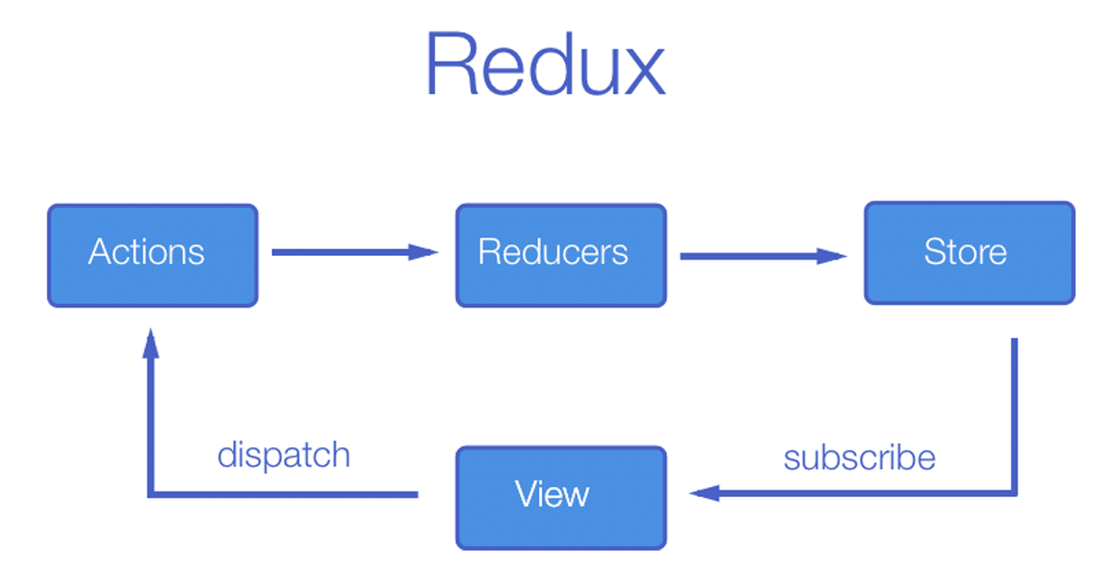
Redux
Understanding about Redux

Slide 98
Redux
Understanding about Redux
View (React Component): When browser creates an interaction (onClick or ………..), it notifies to Actions Module what client side request. Example: when client side want to get list article.
Actions: Create action type according to action from view, then dispatch (data and type)those action to reducer.
Reducers: To check action and state. Then, return the updated state to store.
Store: response updated state to updated view.
Middleware: provides a way to interact with actions that have been dispatched to store before they reach to the store’s reducer.

Slide 99
Redux
Actions:
import { articleAction } from './actionType'
import axios from 'axios' export const getArticles = () => {
return (dp) => {
axios.get(`http://ams.com/api/articles?page=1&size=10`).then(res => {
dp({
type: articleAction.fetchArticle,
payLoad: res.data.data
})
})
}
}

Slide 100
Redux
Reducer:
import { articleAction as actionType } from './../actions/actionType' const initState = {
articles: [],
filterArticle: []
}
const articleReducer = (state = initState, action) => {
switch (action.type) {
case actionType.fetchArticle:
return { ...state, articles: [...action.payLoad] } default:
return state } } export default articleReducer

Slide 101
Redux
Combine Reducer:
import { combineReducers } from 'redux';
import articleReducer from './articleReducer'
import { categoryReducer } from './categoryReducer’;
const rootReducer = combineReducers({
articleR: articleReducer,
categoryR: categoryReducer
});
export default rootReducer;

Slide 102
Redux
Store:
import rootReducer from './../reducer/rootReducer';
import { createStore, applyMiddleware, compose } from 'redux';
import thunk from 'redux-thunk'
const store = createStore(rootReducer, compose(applyMiddleware(thunk)))
export default store

Slide 103
Redux
Globle Store:
ReactDOM.render(
<Provider store={store}>
<App />
</Provider>,
document.getElementById('root')
);

Slide 104
Redux
Subscribe to Store:
const mapStateToProps = (store) => {
return {
articles: store.articleR.articles,
};
};
const mapDispatchToProps = {
getArticles,
};
export default connect(mapStateToProps, mapDispatchToProps)(Article);

Slide 105
Redux
View:
componentDidMount() {
this.props.fetchCategory();
}

Slide 106
Thank You

