Slide 1
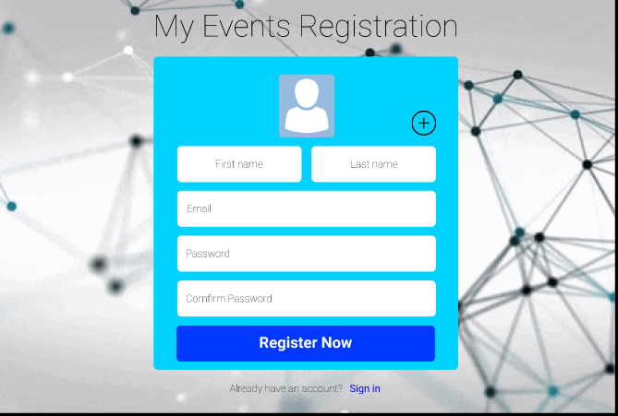
1 – Sign Up Form

Slide 2
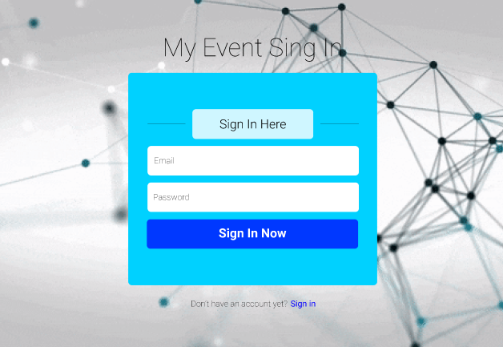
2 – Sign In Form

Slide 3
3 – Menu bar

