Slide 1
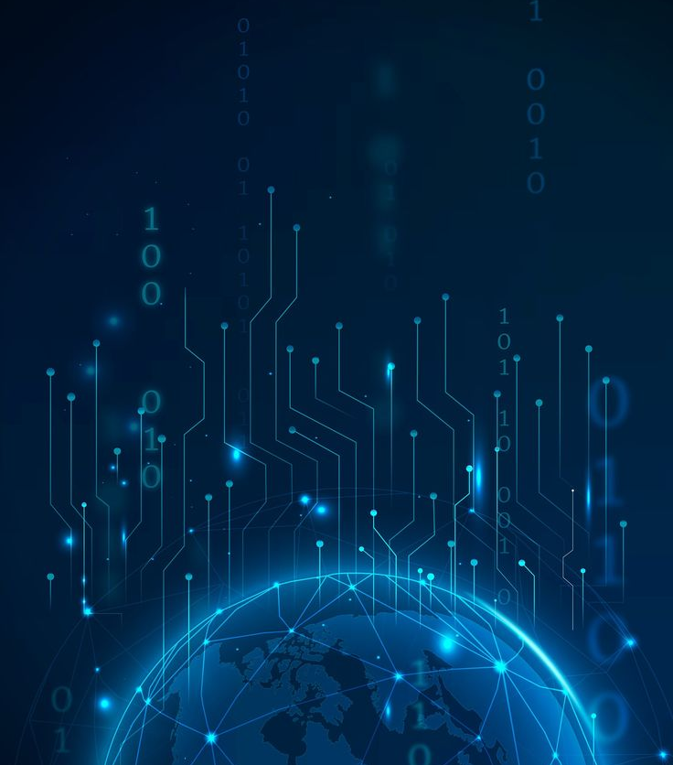
The Internet of Things
A phenomenon to behold

Slide 2
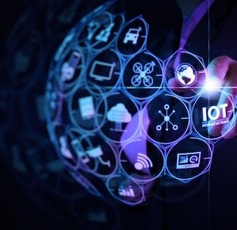
What is the Internet of Things?
The internet is a wondrous place, yet not many how to use it to the best of their advantage. One of the many features in the technology space is the Internet of Things.
The Internet of Things is the technology that enables everything to communicate over the internet through devices without the use of computers to create smarter, more connected environments.
IoT is not separate from the Internet, but an expansion of it - a way of intelligently fusing the real and cyber worlds.

Slide 3

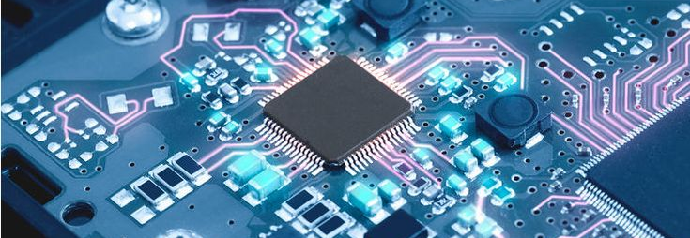
HISTORY: where did the Internet of Things originate?
Early Development
Advancement
The idea of IoT dates back to the late 20th century when researchers and engineers began exploring sensors and how to implement them into everyday objects.
Fast forward to the 90s, some college students decided to modify a vending machine to track its contents remotely, making it the first ARPANET-connected appliance.
The term "Internet of Things" was officially coined by British entrepreneur and computer scientist Kevin Ashton in 1999.
Over the next decade, public interest in IoT technology began taking off. The early 2000s and 2010s saw a significant surge in the adoption of IoT technologies in various industries and the public. The advancements made and decreasing costs only fueled the growth of it’s ecosystem and brought us to where we are today.
The history of the Internet of Things reflects its gradual evolution from early conceptualization to becoming a transformative force in various aspects of the modern world.

Slide 4
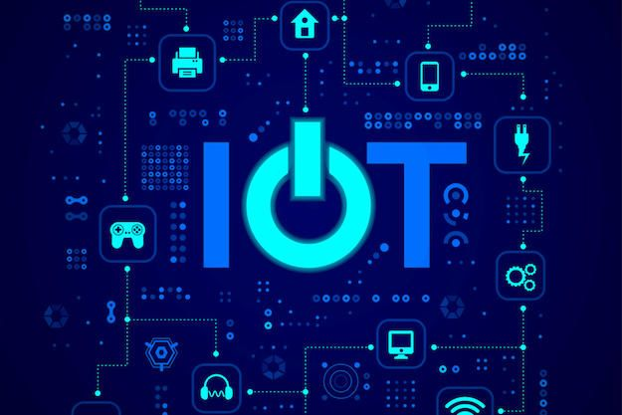
ENABLING TECHNOLOGY: How is IoT able to work?

Slide 5
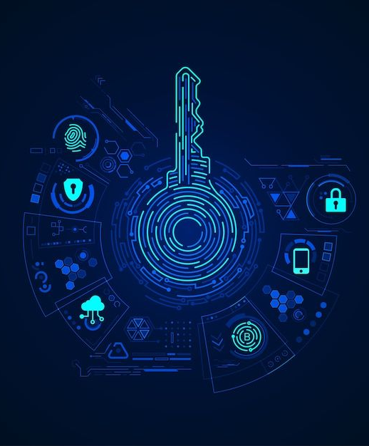
ENABLING TECHNOLOGY: How is IoT able to work?
The Internet of Things relies on a variety of technologies that enable the seamless communication between connected devices.
Here are some key technologies that play a crucial role in making IoT possible: Wireless Sensor Network, Cloud Computing, Big Data Analytics, Communications Protocols, Embedded System, Connectivity, Cellular networks, Security, Artificial Intelligence, RFIDs, RFID tags and more.
These are technologies that track, store, connect and exchange data; they also create efficient and automated systems which work to assess the data and act accordingly in IoT devices.
They all work together to create a robust and interconnected ecosystem that forms the foundation of the Internet of Things.

Slide 6
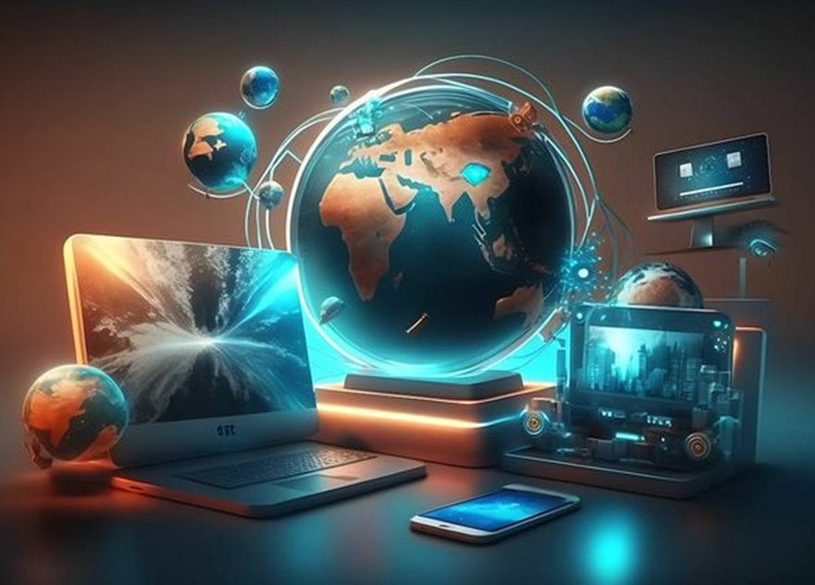
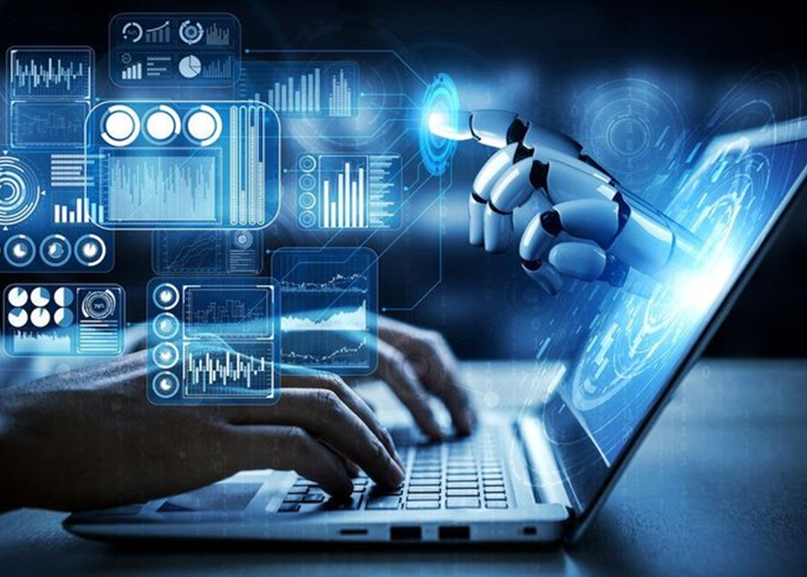
Is the impact as big as it seems?
What does the future look like for IoT?

Slide 7
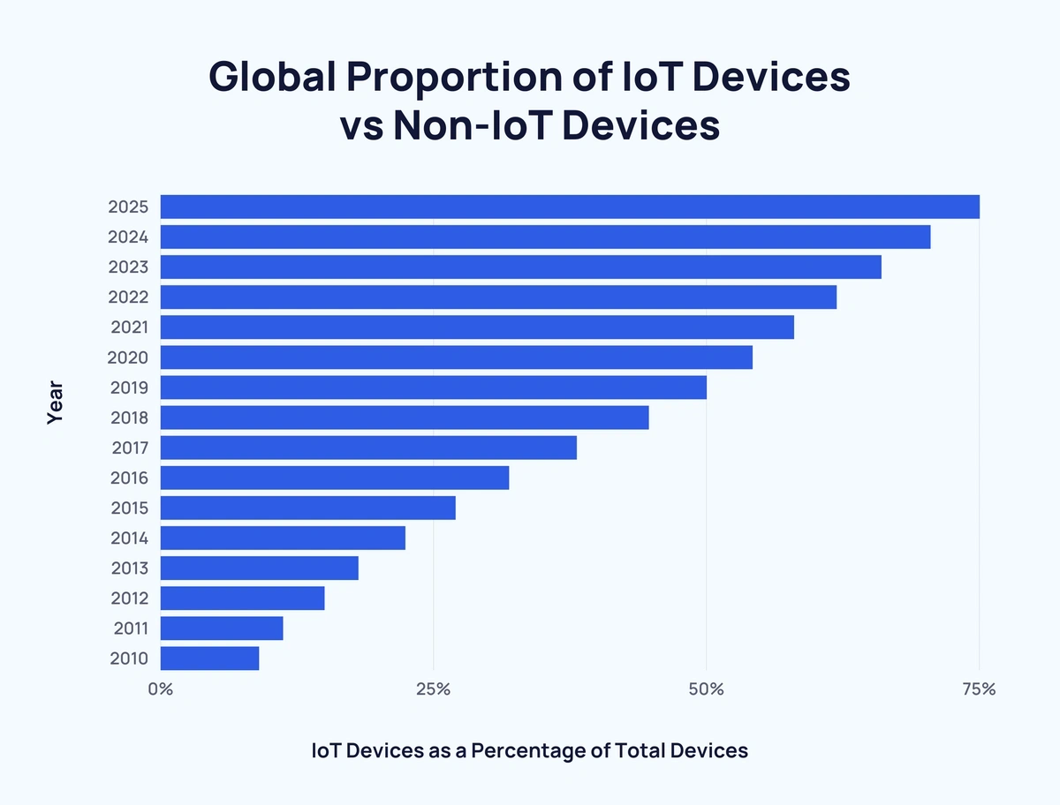
IMPACT: Is the impact as big as it seems?
Globally, the number of IoT devices is expected to reach an astounding 29 billion by 2030, from a mere 17 billion in 2024. The statistics to the right show the growth of IoT devices globally.
It isn’t news that the Internet of Things is revolutionizing our lives – it’s transformation is everywhere. IoT is now portable, wearable, and implantable, creating a connected universe, and transforming physical objects that surround us into an ecosystem of information that is rapidly changing the way we live.
From smart watches that track your pulse to home security systems, IoT has begun making its mark and letting us know it’s here to stay!

Slide 8




FUTURE: What does the future look like for IoT?
By 2025, 41.6 billion devices will be capturing data on how we live, work and move during day. This will bring innovation to the way we interact with the world.
This will lead to enablement of remote and flexible work, creation of smart and connected workplaces and emergence of new skills and roles.
We can expect to see IoT business use cases increase, providing a foundation to support many core business activities across industries.
Improvements in all sectors of the industry, like health and transport, are greatly anticipated. IoT is poised to have a transformative impact on the future.

Slide 9
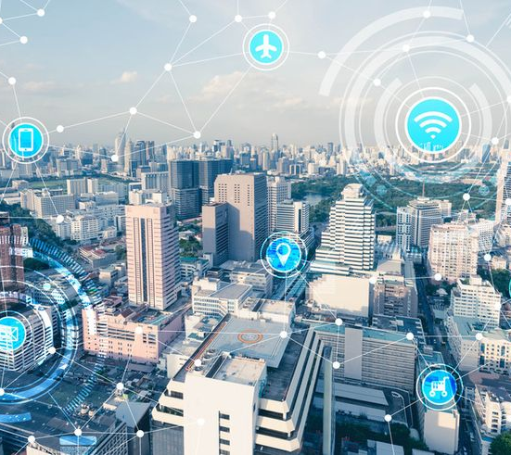
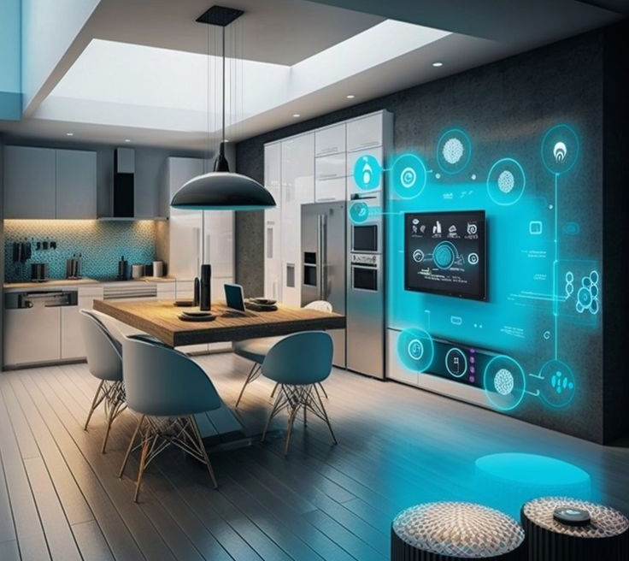
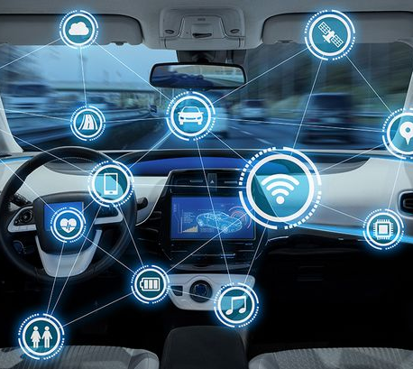
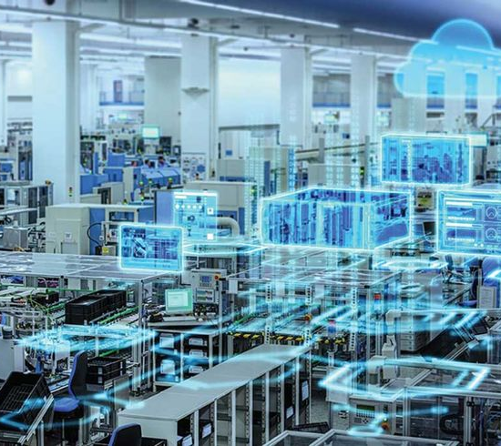
Examples of IoT Devices in the Future
Smart Cities
Smart Houses
Smart Cars
Smart Factories
By harnessing the power of IoT, governments are evolving cities to become ‘smart cities’, meant to improve the lives of residents. Health, public transportation, etc. are all anticipated to evolve into ‘smart’ sectors.
A convenient home setup that uses internet-connected devices to enable the remote monitoring and management of appliances and systems. This includes lighting, heating, security, etc.
A vehicle that uses internet connectivity to communicate with outside systems. These systems that can unlock your car, GPS, smart parking, etc. Predictive maintenance, traffic prediction are also a plus.
A digitized manufacturing facility that uses IoT to continuously collect and share data. This data is then used to improve processes and address any issues that may arise.

Slide 10
Research References
- https://www.geeksforgeeks.org/introduction-to-internet-of-things-iot-set-1/?ref=ml_lbp%20and%20improved%20connectivity
- https://www.geeksforgeeks.org/internet-of-things-iot-enabling-technologies/
- https://imaginovation.net/blog/iot-development-trends-predictions/#current-state-of-iot
- https://www.ness.com/iot-is-everywhere-how-iot-is-changing-our-daily-lives#:~:text=IoT%20has%20changed%20our%20lives,and%20wellness%2C
- https://www.visionofhumanity.org/what-is-the-internet-of-things/

