Slide 1
Wine consumption and consumer in the US
AM10 - Data Visualization and Storytelling
MAM2022 Study Group 12
Notes:
Good morning everyone and welcome to our presentation
For our presentation we decided to take a loot at wine consumptions and wine consumers in the US
So without further due, let us get started

Slide 2



Initial situation and background
Identify customer, product and geographic segment to enter
Situation
Private wine trader from Chile wants to open a wine shop in the US
No prior business knowledge of US wine market
Questions
What influences wine consumption?
How has wine consumption changed over time?
How and where can high wine spenders be targeted?
Data sources
Bureau of Economic Analysis
Wine Institute
Customer Personality Analysis Dataset
Census data
Notes:
Before we dive in, let me give you a 30 second summary of what we tried to do
We imagined that a private vine trader wants to open a shop in the US however lacks any knowledge about the market there
Hence we wanted to answer some key questions such what factors influence wine consumption, how consumption has changed over time and how to identify and target high wine spenders
To answer these questions we used different data sources but you will see that in a second

Slide 3




Economic Indicator Analysis
Wine Consumption Analysis
Customer Data Analysis
Recommendation
Notes:
We organized the presentation in four major parts.
But without further due, let us start with the first part.
(Continue)

Slide 4

Economic Indicator Analysis
Part I
Notes:
Economic indicator analysis…

Slide 5
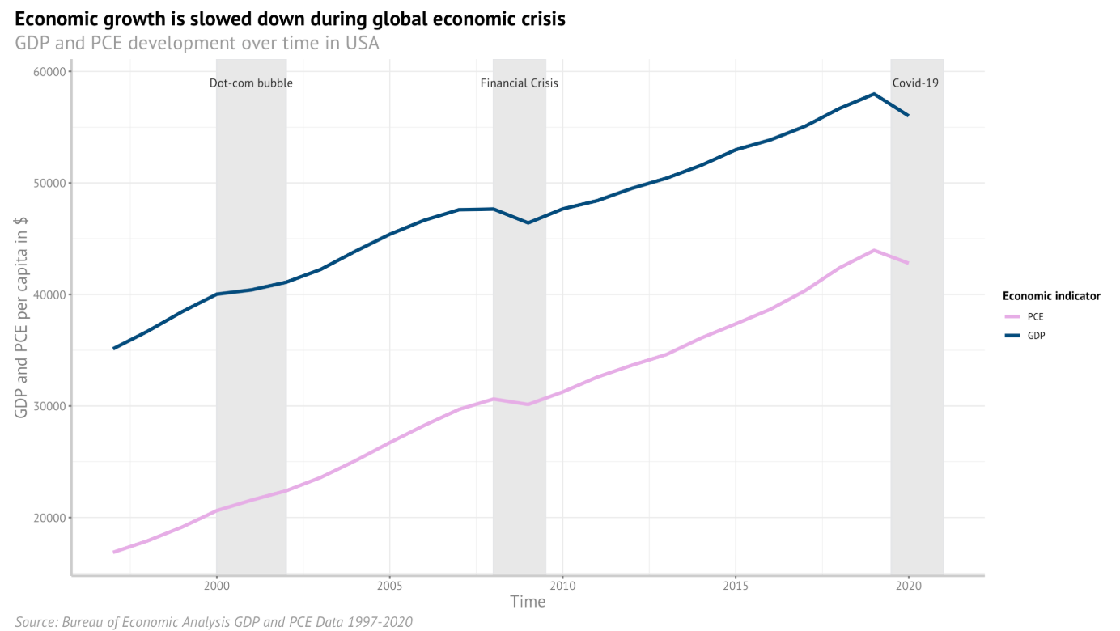
GDP and consumption expenditure
Both indicators follow the same pattern of development
Key Insights
GDP and PCE largely move in sync
Both are growing at approximately same rate
Growth is slowed down in times of crisis
Hence, wealth of a nation is correlated with personal spending
*PCE: Personal consumption expenditure
Notes:
First we wanted to understand the economic situation in the US a little better
GDP of course is a well- known indicator or wealth but more importantly we wanted to see how it is connected to PCE-Personal consumption expenditure to get a feeling of how consumer spending changes
We can see that GDP and PCE largely more in sync and grow approximately at the same rate
Both are slowed down during crisis and hence personal spending is correlated with GDP development

Slide 6
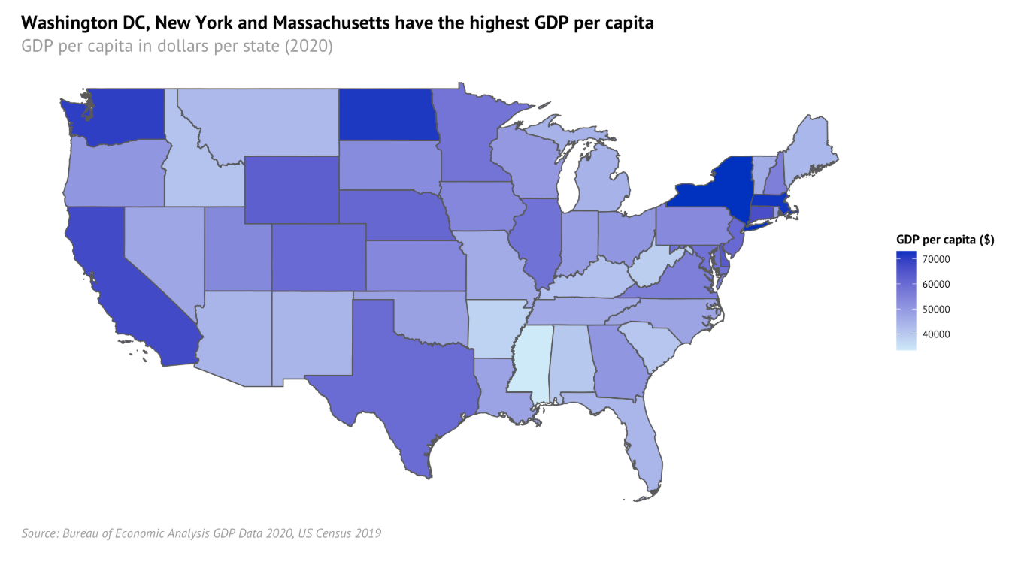
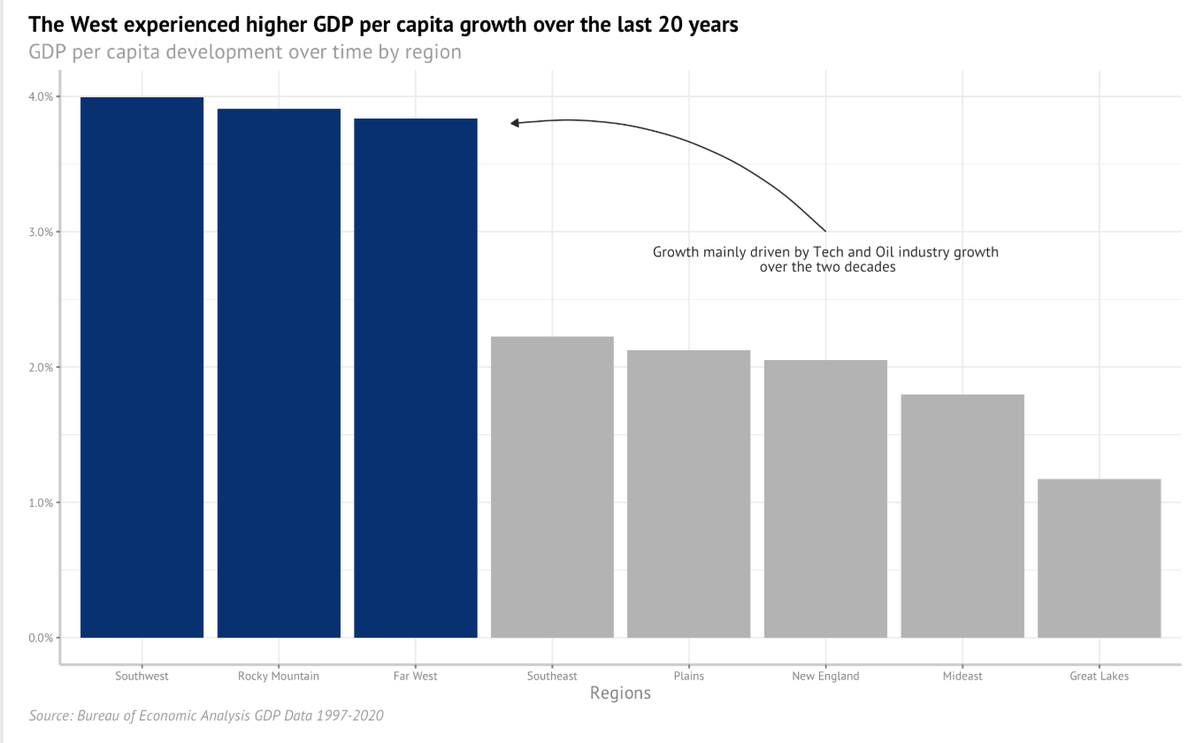
GDP per capita and growth differs by region
While northeastern states have high GDP per capita, western states experience higher growth
Notes:
However, just because a nation is wealthy, does not mean that every region is equally lucrative for business
By going a little deeper, we can see that the per capita GDP greatly differs by state
Moreover, also the growth significantly differs
While for example, north easters state have comparatively high GDP per capita, the western states have actually experiences much higher GDP growth over the last years
These differences in wealth or in growth of wealth are important to keep in mind when deciding which customers or region to target

Slide 7

Wine Consumption Analysis
Part II
Notes:
Let us continue to take a closer look at wine

Slide 8
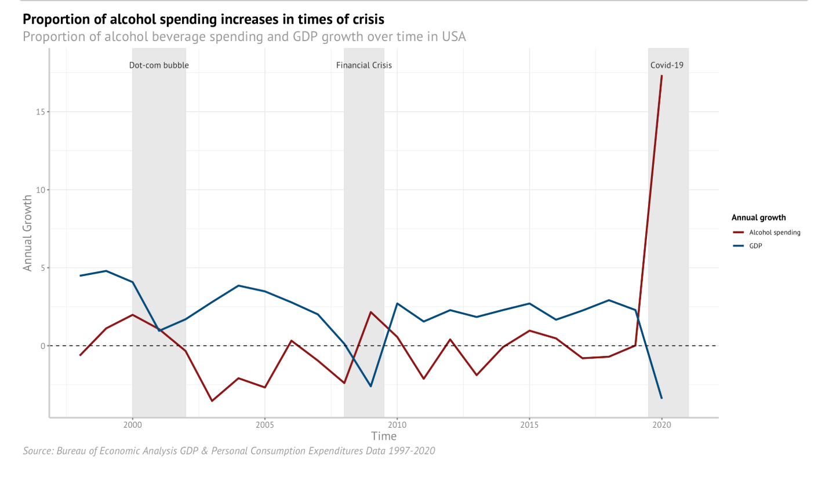
Alcohol spending tends to go up in times of crisis
Covid-19 marked a period of significant alcohol spending increase
Key Insights
GDP and alcohol expenditure follow opposite patterns
In times of economic growth, proportion of alcohol spending is decreasing
In times of crisis, proportion of alcohol spending goes up
Notes:
First we started to look at the alcohol spending in general as a proportion of total consumer expenditure.
If we compare the proportion of alcohol spending growth with annual GDP growth we can see that they tend to move in opposite directions
This is quite interesting, so in times of crisis, although GDP is going down, consumers tend to spend a higher percentage of their total spending on alcohol
Especially if we look at the data points of 2020, we see that Covid appears to have had a significant impact on the proportion of alcohol spending

Slide 9
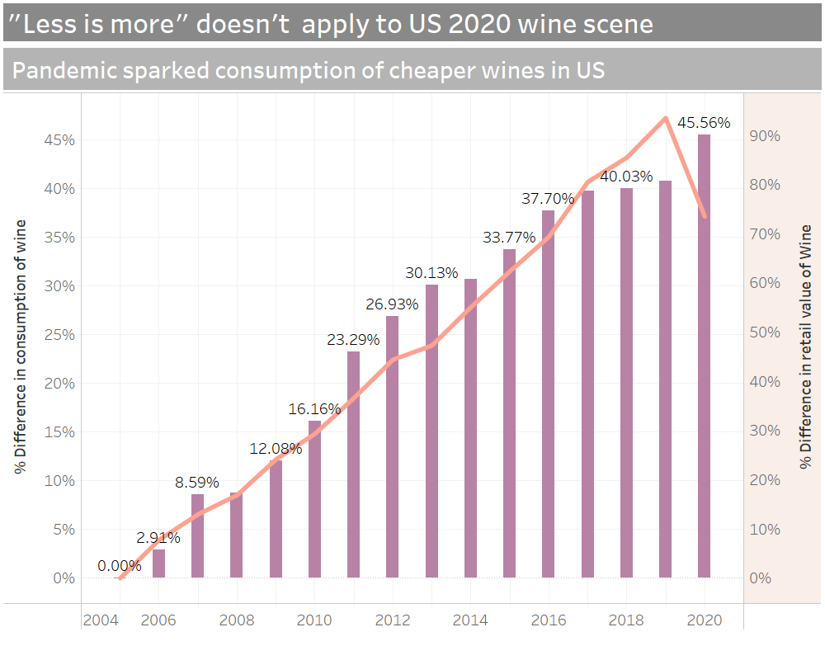
Wine Consumption Growth
Key Insights​
​
Wine consumption grew by over 45% over the last 15 years
In time of the pandemic volume increased but total retail value of wine decreased
Notes:
In general wine consumption has significantly grown over the last years in the US
In the last 15 years wine consumption grew over 45%
However, interestingly, especially last year, the retail value of wine consumed actually sunk
This means that during the Covid-19 lockdown people tend to consume more but cheaper wine

Slide 10
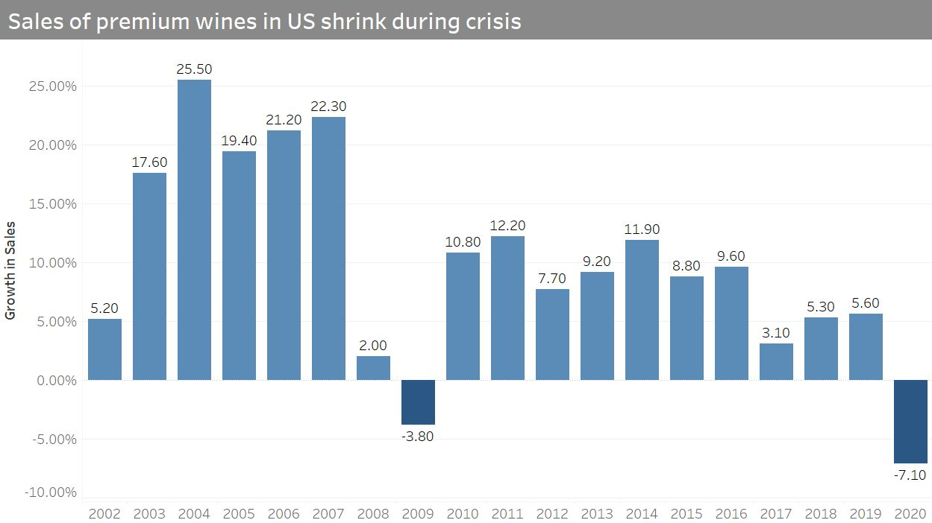
Demand for premium wine
Growing trend of high-end wine is reversed during times of crisis
Notes:
To look at the premium wine market specifically, we can confirm the results from before
In general, wine appears to be growing
However in times of crisis, the demand for premium wine goes down and people tend to substitute quality for volume

Slide 11

Customer Data Analysis
Part III
Notes:
We also wanted to learn more about the actual wine consumer.
Hence we used a dataset of a retailer including wine spending which we used to identify high spenders

Slide 12
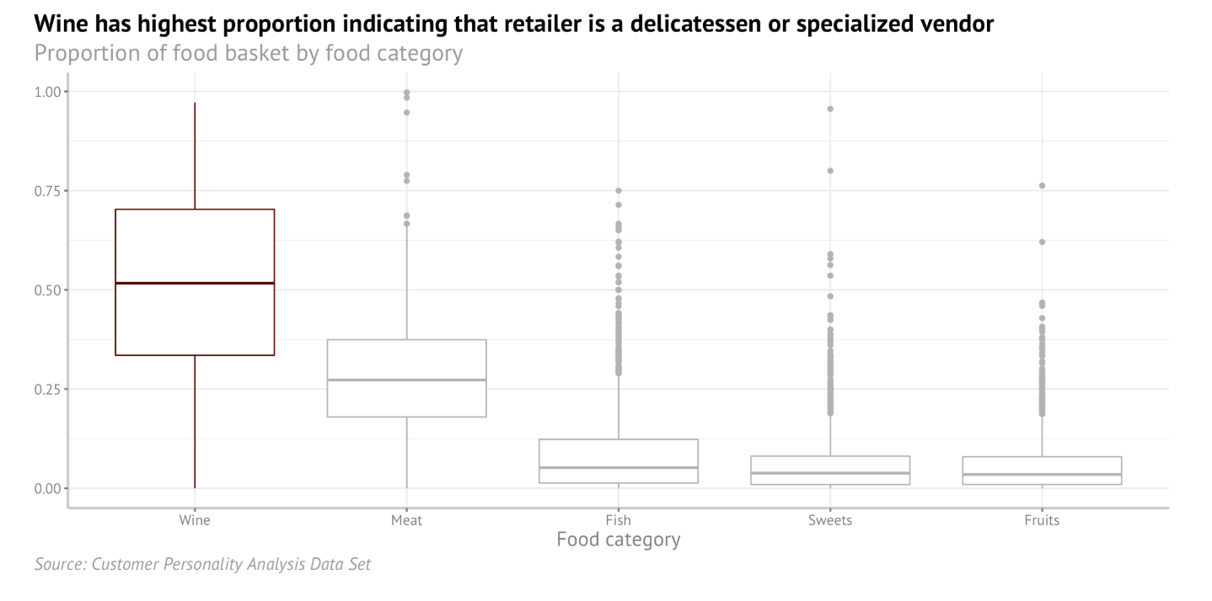
Wine as highest median spending category
Retailer appears to offer high price or quality wine
Key Insights
Most customers appear to spend most of their money on wine
Hence customers either purchase expensive wine or purposefully go to this specific retailer to buy wine
Notes:
Given that the dataset was from an anonymous retailer, we first had to test its applicability to our analysis
We looked at all customers food baskets and calculated the proportion spending per category
We can see that wine dominates the food baskets by proportion
Hence, we concluded that we are not dealing with a discounter but more likely with a specialized vendor focused on wine and delicatessen
We also believe that for that exact reason, we can actually use the data to learn more about high wine spenders

Slide 13
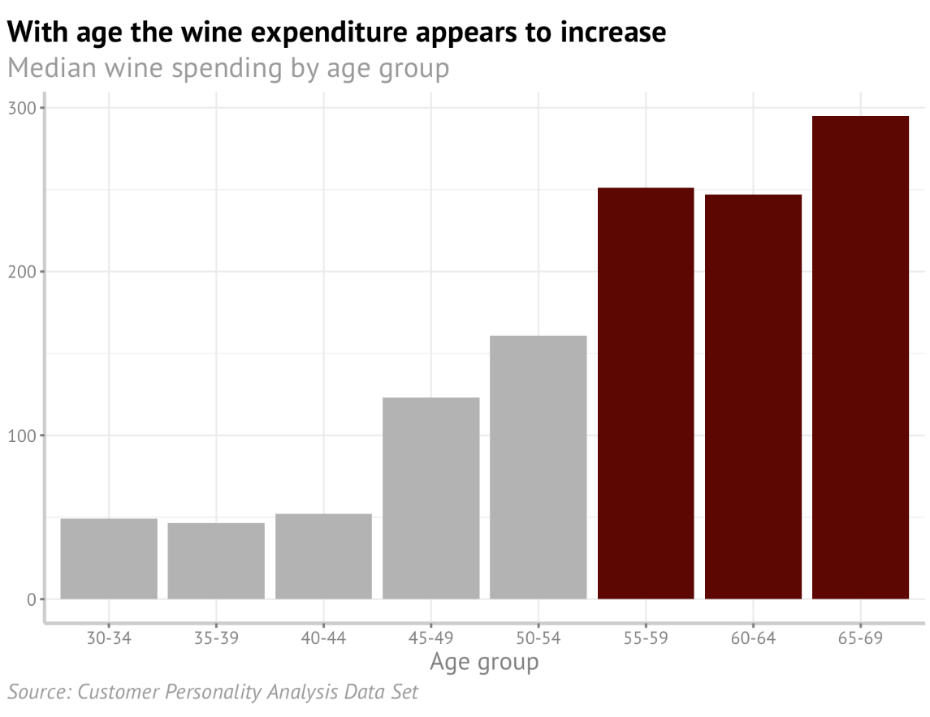
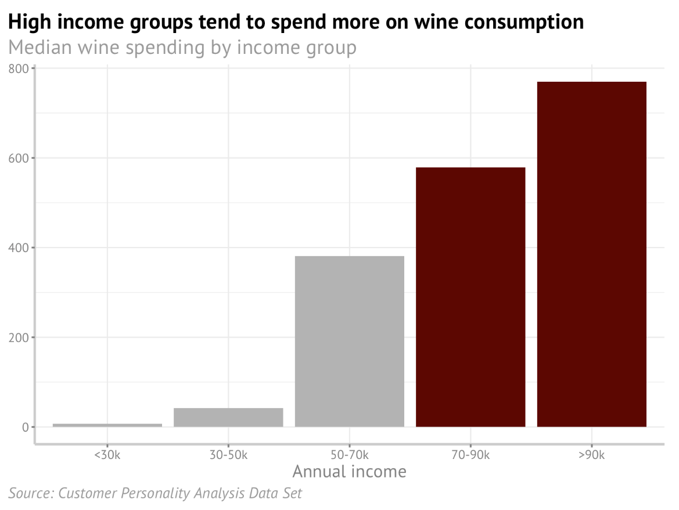
Characteristics influencing wine spending
Age and income positively affects median wine spending
Notes:
We continued to explore the data set to identify characteristics that actually influences high wine spending
While education, number of children and number of children had an impact on spending, age and annual income had the strongest relationship

Slide 14
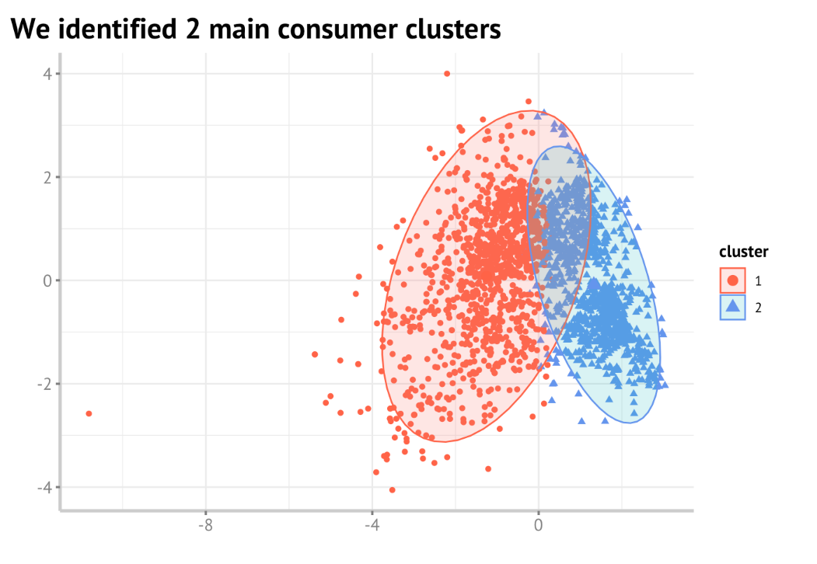
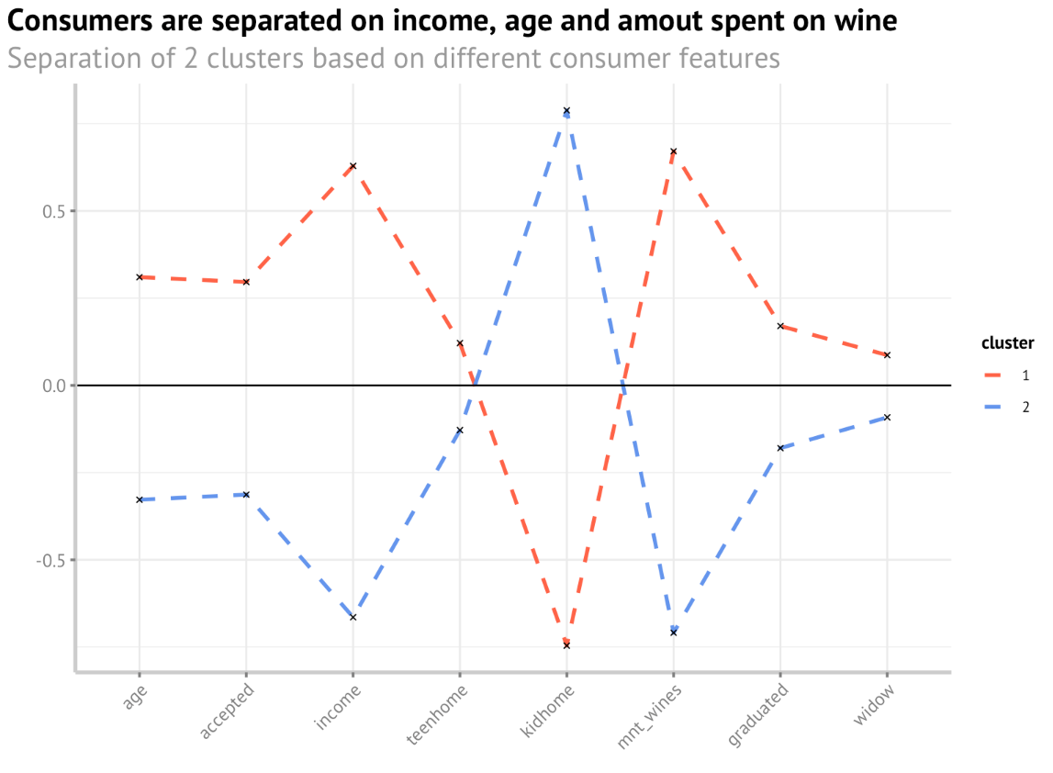
Consumer clusters
There appears to be 2 major groups of customers
Key Insights
We identified 2 clusters: consumers with higher (red) and lower (blue) spending
Amount spent on wine is correlated with income, age, not having small kids at home
Notes:
To take a more thorough approach, we conducted a cluster analysis of customers to identify high spenders
It became visible that
Hence, we want to focus on customers with similar characteristics

Slide 15

Recommendation
Part IV
Notes:
So finally, what is our final recommendation

Slide 16
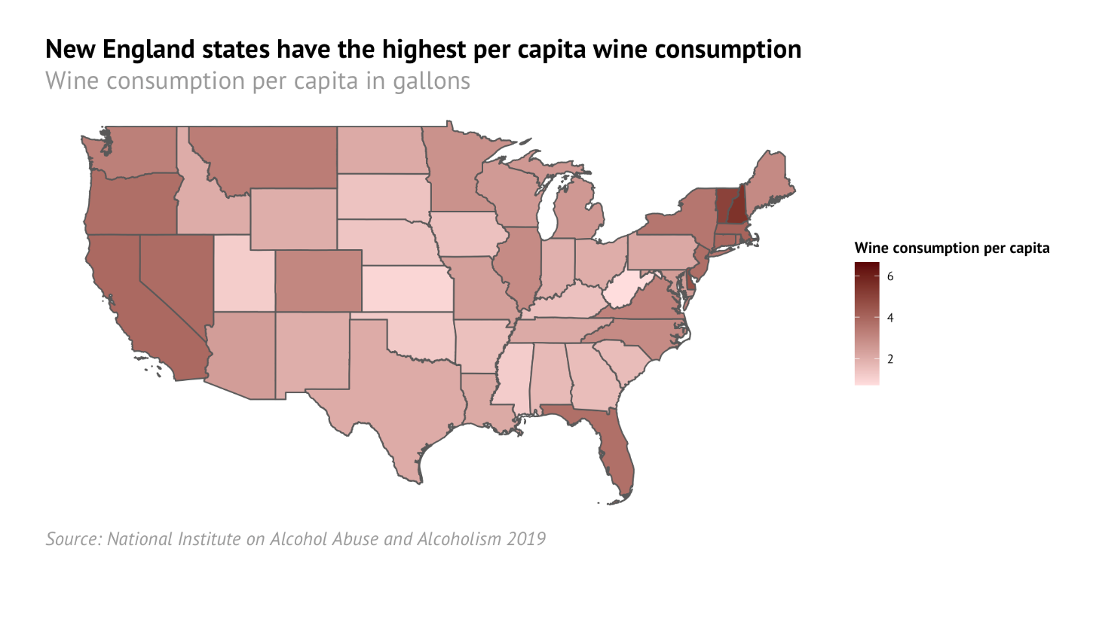
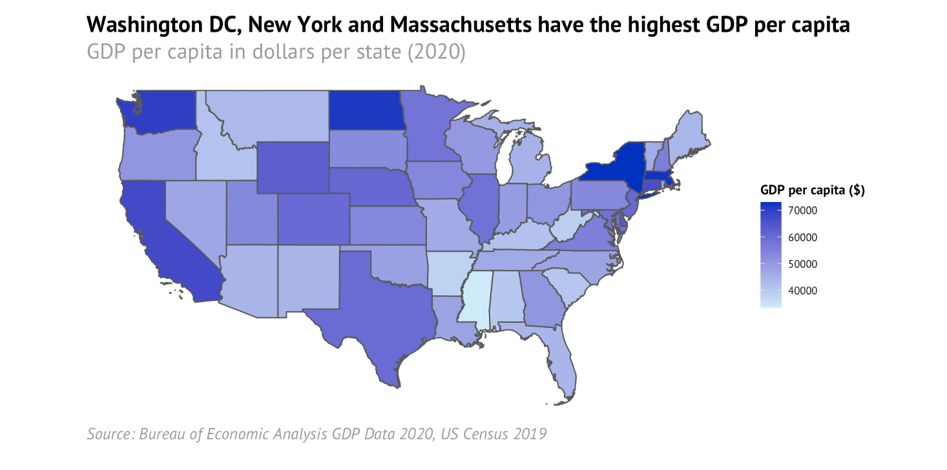
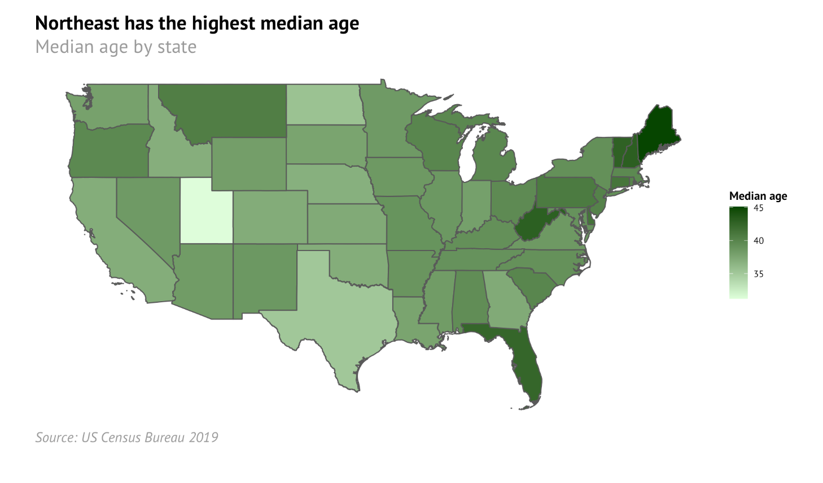
Geographic focus on New England
GDP per capita, wine consumption per capita and age is highest in New England
Notes:
We have learned that income and age is important for wine consumption
When we look at per capita wine consumption, we see that it is relatively high in north eastern states
Moreover GDP per capita and median age is also comparatively high in new England
(click so that pink circles appear → Animation)
Hence, we would suggest to start the wine business in the New England region.

Slide 17


Provide a price competitive product for middle-high income market
Target Customers
Focus on middle-high income
Customers in their 50s and above
No children living at home anymore
Product specification
Mid-market Wine
Price-competitive product with quality

Slide 18
Thank you very much for your attention
AM10 - Data Visualization and Storytelling
MAM2022 Study Group 12
Notes:
Thank you very much for your attention

