Slide 1


Slide 2
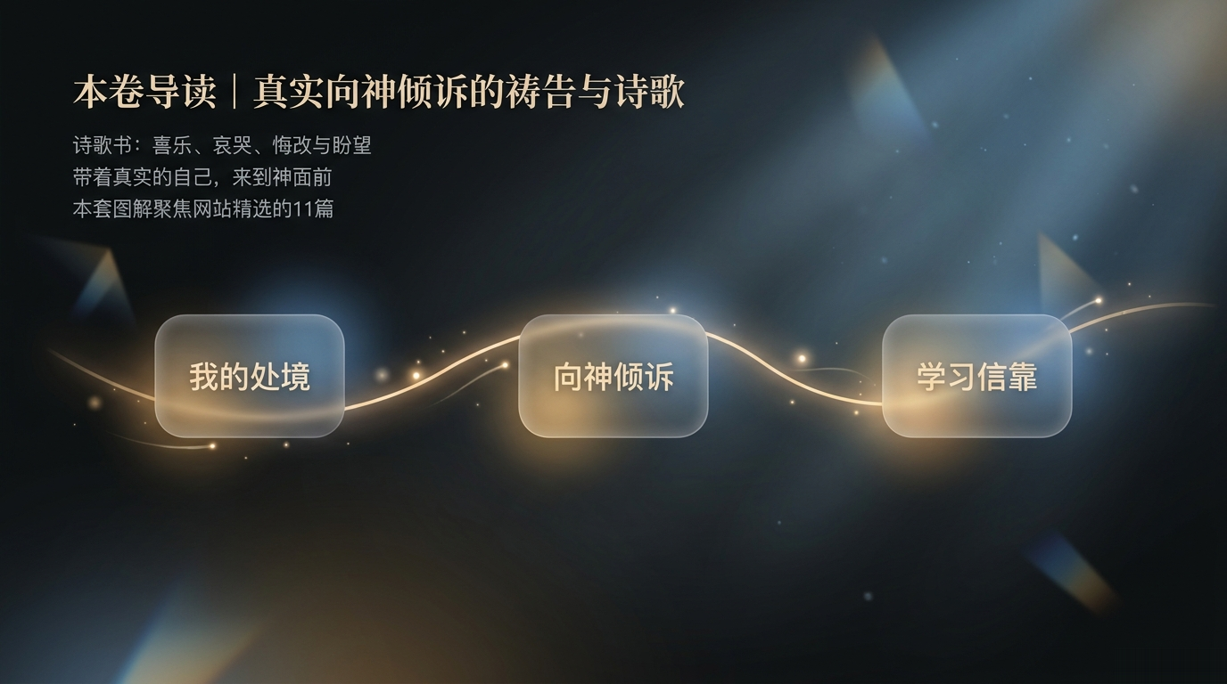

Slide 3
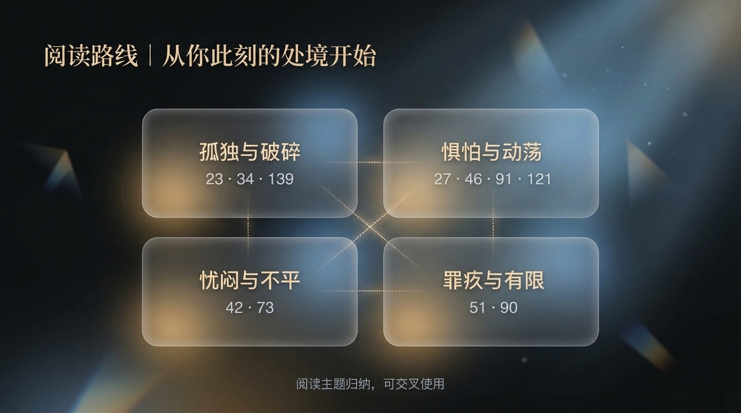

Slide 4


Slide 5
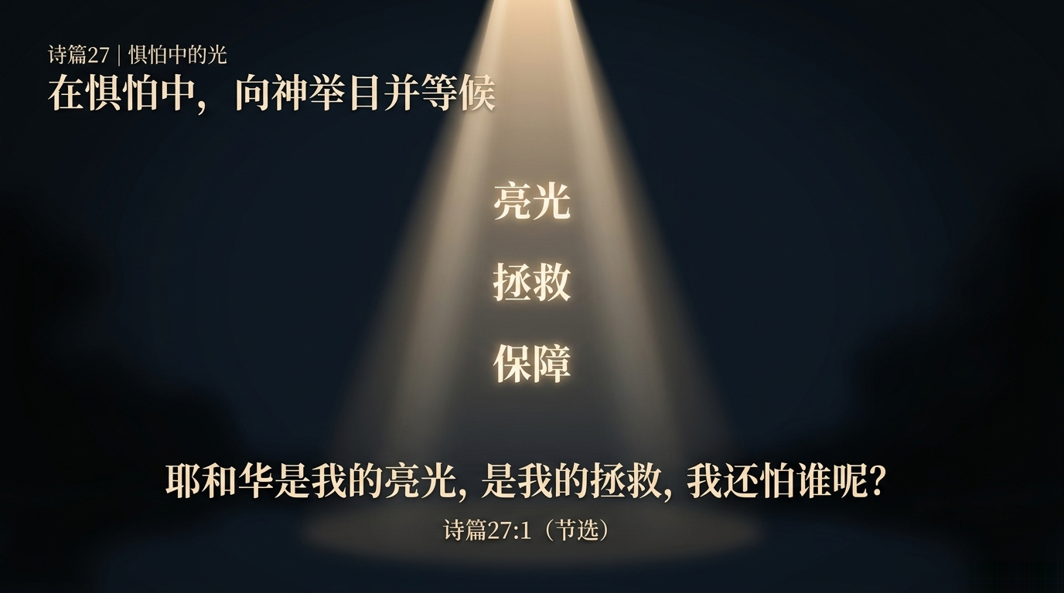

Slide 6


Slide 7
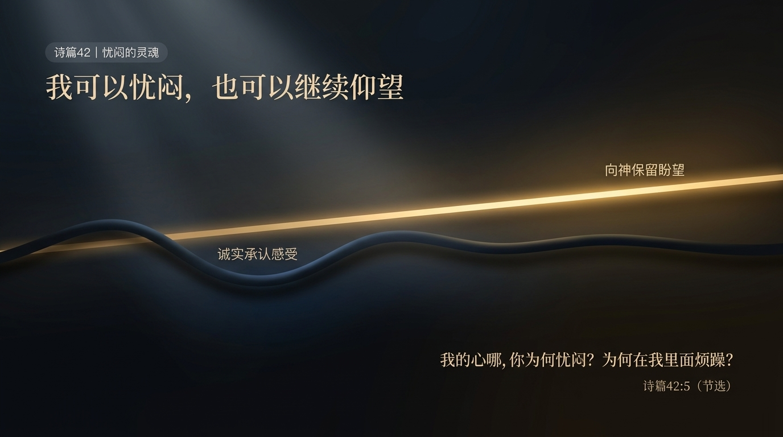

Slide 8


Slide 9
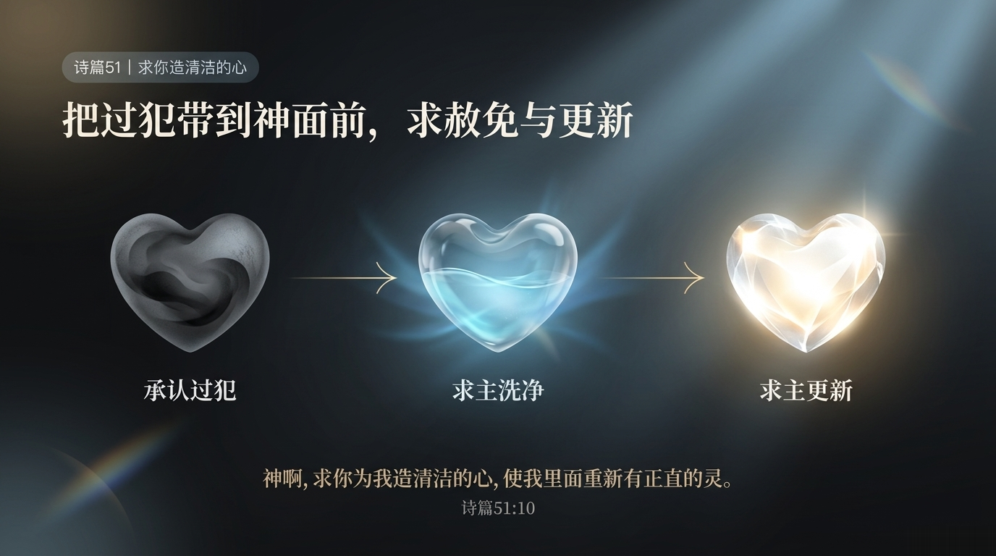

Slide 10


Slide 11


Slide 12
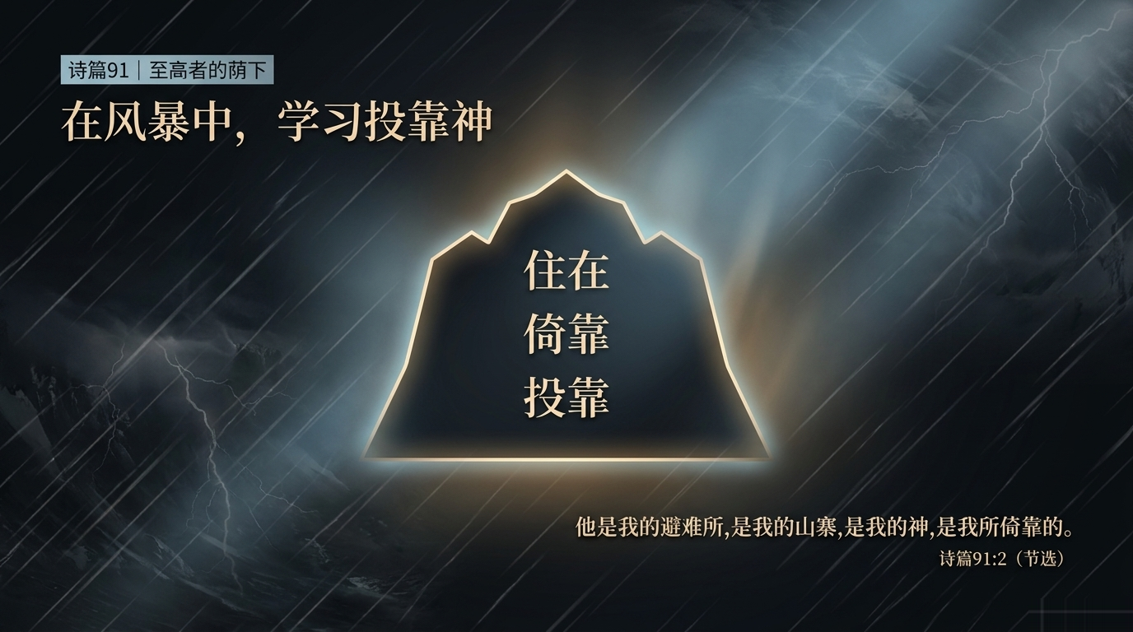

Slide 13


Slide 14


Slide 15
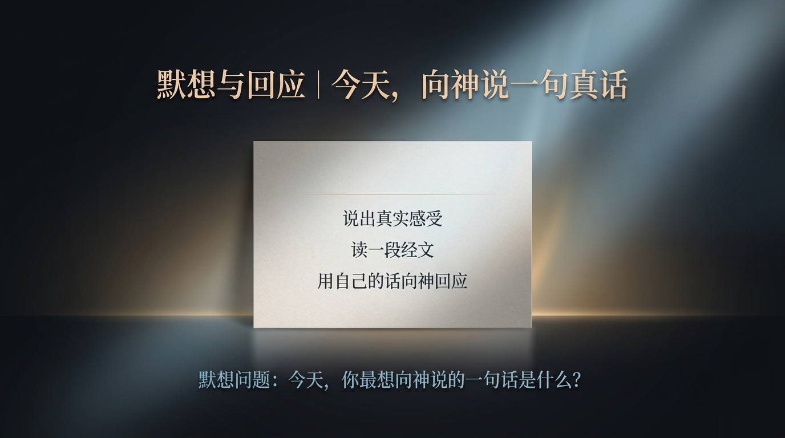

Slide 16

敬拜：用一首诗歌回应所读的经文

Slide 17
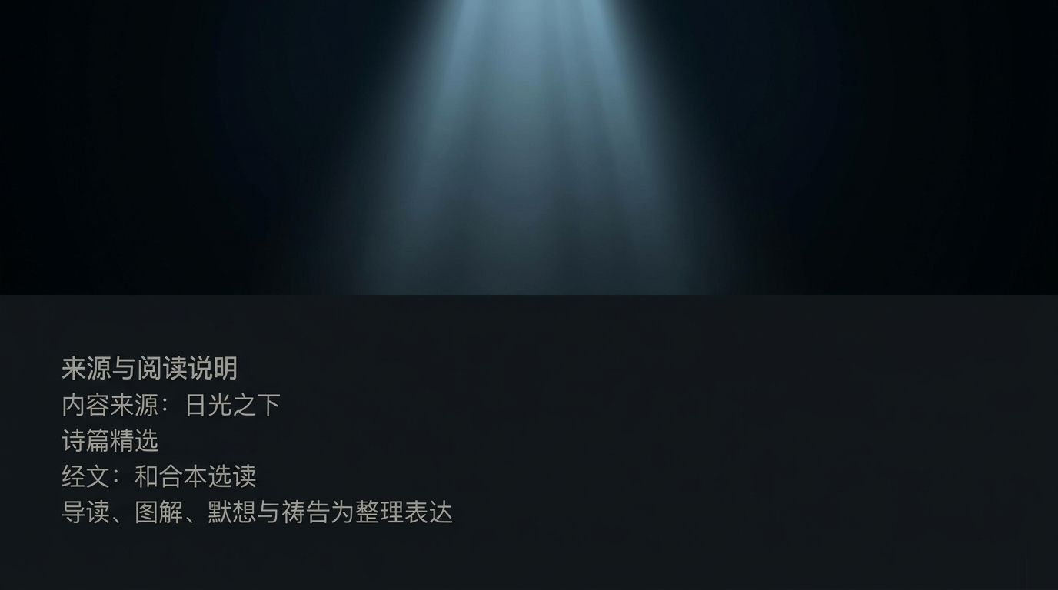
lightoflifebible.org/psalms.html?lang=zh

