Slide 1
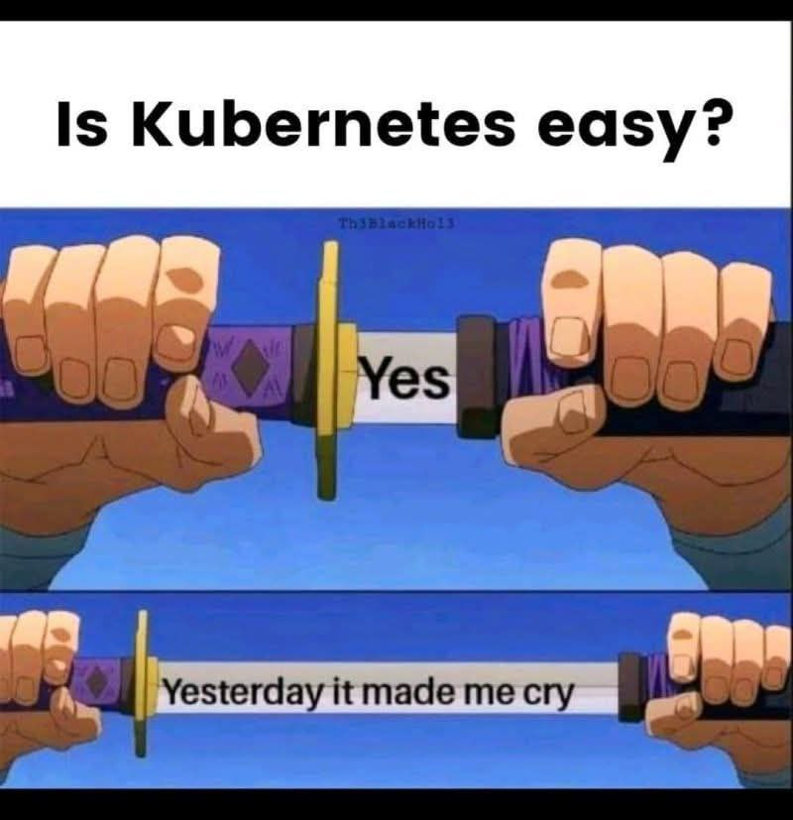
IK2227 – Lab 3: Kubernetes
Slides by: M. Scazzariello

Slide 2
recap on Kubernetes
Kubernetes (in short, K8s) is a production-grade container orchestrator
initially developed by Google
based on 15 years of experience in container orchestration
open-sourced in 2014
maintained by the Cloud Native Computing Foundation
K8s can manage clusters composed of up to 5000 nodes
it can efficiently orchestrate millions of containers

Slide 3
Kubernetes at high-level
K8s resources define the desired state of the cluster
which application to run, number of replicas, etc.
after setting the desired state, the Kubernetes Control Plane ensures that the cluster maintains this state
automatically executes tasks such as launching/restarting containers or scaling the number of replicas as needed
the Kubernetes Control Plane consists of multiple processes running within the cluster
distributed across controller and worker nodes

Slide 4
Kubernetes Controller node
controller
API server
cloud controller manager
scheduler
controller manager
etcd
nodes responsible for managing the cluster
runs several key processes:
API Server: RESTful interface that enables users to modify the cluster's state; manages communication among K8s components
Scheduler: identifies the most appropriate worker node for deploying a given resource, considering factors such as resource utilization and user-defined constraints
Controller Manager: daemon that continuously monitors the system, adjusting its current state to match the desired state based on requests from the API Server
etcd: distributed data store that persistently manages cluster configuration and state
Cloud Controller Manager: connects the cluster to proprietary cloud provider's APIs
only for cloud deployments, not in this lab

Slide 5
Kubernetes Worker node
control plane
cloud controller manager
API server
kube-proxy
Pod
Pod
container 1
container 1
kubelet
container 2
container 2
scheduler
controller manager
etcd
container runtime
worker
node (virtual or physical machine) that host application workloads
executes tasks assigned by the control plane
users do not interact with workers
each worker continuously runs a process called kubelet
responsible for monitoring and ensuring that all containers associated with its assigned K8s resources (from the control plane) are running correctly
containers are managed through a container runtime
not part of K8s but required to manage containers
lastly, each worker runs the kube-proxy
network proxy that forwards and load balances traffic between containers in the cluster

Slide 6
main Kubernetes resources

Slide 7
Pod
containers
volumes
10.10.10.4
Pod IP
smallest deployable unit in Kubernetes
consists of one/more containers sharing the network namespace and storage
allows all containers to communicate using localhost and access common data
if a container binds to a specific port, no other container in the same Pod can bind to that port
containers inside a Pod do not need to be identical
they can run different images
a Pod serves as a logical host, grouping services that often need to share data or communicate closely

Slide 8
example Pod
web application
Redis (in-memory database)
acts as a cache for the application
the web app can connect to Redis using localhost
without additional networking configurations
Redis
web app
web app data

Slide 9
example Pod definition
apiVersion: v1
kind: Pod
metadata:
name: web-app-with-redis
labels:
app: web-app
spec:
containers:
- name: web-app
image: httpd
ports:
- containerPort: 8000
- name: redis
image: redis
ports:
- containerPort: 6379
type of the resource
name of the Pod
user-defined labels to identify the Pod
containers composing the Pod

Slide 10
example Pod definition
apiVersion: v1
kind: Pod
metadata:
name: web-app-with-redis
labels:
app: web-app
spec:
containers:
- name: web-app
image: httpd
ports:
- containerPort: 8000
- name: redis
image: redis
ports:
- containerPort: 6379
name of the first container
first container image
port exposed by the first container
name of the second container
second container image
port exposed by the second container

Slide 11
Deployment
instantiate/manage individual Pods (so-called “naked” Pods) is discouraged
“naked” Pods are not automatically rescheduled if a container crashes or the node fails
leads to potential service downtime
the Deployment object ensures high availability
by managing multiple identical Pod replicas
automatically replaces failing or unresponsive instances
ensures that there is always at least one active service instance to handle user requests
when updating a Deployment, K8s incrementally replaces old Pods with new ones in a controlled manner
prevents downtime and ensures a smooth transition between the two versions

Slide 12
example Deployment
Deployment
“I want three replicas of my web app Pods running”
web app Pod
web app Pod
web app Pod

Slide 13
example Deployment
Deployment
“I want three replicas of my new web app Pods running”
web app Pod
web app Pod
web app Pod
new web app Pod
new web app Pod
new web app Pod

Slide 14
example Deployment definition
apiVersion: apps/v1
kind: Deployment
metadata:
name: web-app-deployment
spec:
selector:
matchLabels:
app: frontend
replicas: 3
template:
metadata:
labels:
app: frontend
spec:
containers:
- name: web-app
image: httpd
ports:
- containerPort: 8000
type of the resource
name of the Deployment
labels that a Pod must have to be managed by the Deployment
desired number of replicas
Pod template (same as a Pod definition)

Slide 15
Service
using Deployments, we have applications running in the cluster
with (optionally) multiple replicas
but applications are still not exposed to end users
the Service object is an abstraction that provides a stable way to expose and access applications running in the cluster
decouple applications from specific Pod instances
by assigning a fixed IP address to a set of Pods
ensures that Pods remain always accessible, even if they are scaled
enables load balancing across multiple Pod replicas
running in different nodes

Slide 16
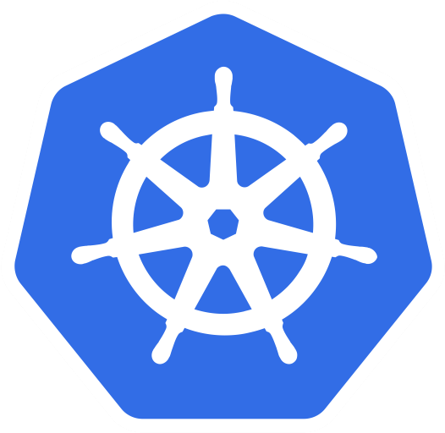



types of Service
ClusterIP: exposes the service internally within the cluster
basically, it is only for Pod-to-Pod communications
default used by K8s when deploying a Service
cluster
port: 80
target port: 8000
user
web app Pod
worker

Slide 17
types of Service
NodePort: exposes a specific port at the node level within K8s
traffic hitting the node port is forwarded to the Service, which routes it to the Pod
cluster
port: 80
node port: 30000
target port: 8000
user
web app Pod
worker

Slide 18
types of Service – NodePort drawbacks
the internal node IP address (inside the data center) must be reachable from outside the cluster
internal IPs are never exposed on the Internet
no load balancing policies
the same port is exposed across all nodes hosting that Service
potential bottlenecks on a single node
usually used for development and testing scenarios

Slide 19
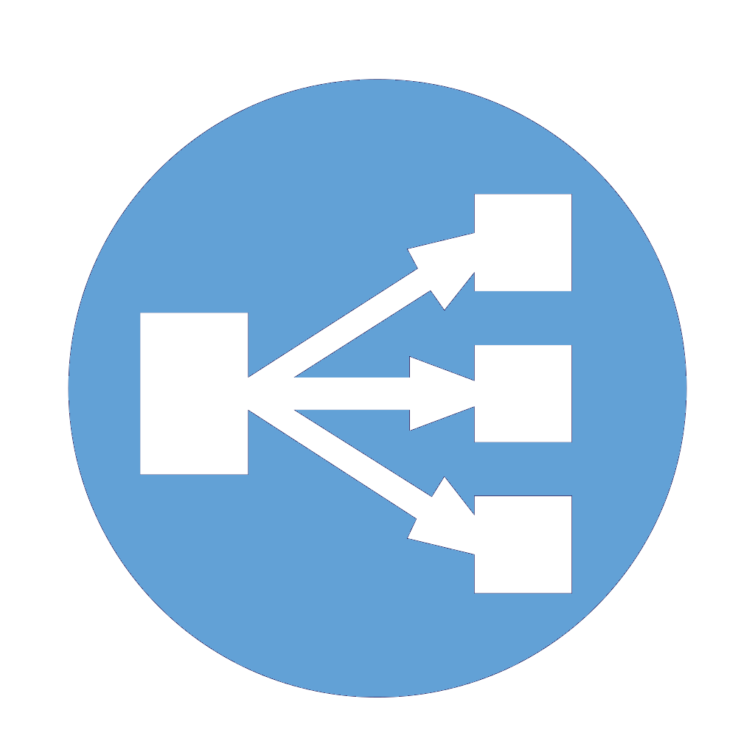
types of Service
LoadBalancer: facilitates user access through an external load balancer
the external load balancer is managed by the cloud provider
the cloud provider has the responsibility of efficiently distributing traffic to the Service
cluster
Service IP
svc 100.0.0.2
… …
port: 80
node port: 30000
target port: 8000
user
web app Pod
cloud load balancer
worker

Slide 20
example Service definition
apiVersion: v1
kind: Service
metadata:
name: web-app-svc
spec:
ports:
- nodePort: 30000
port: 80
targetPort: 8000
protocol: TCP
selector:
app: frontend
type: LoadBalancer
type of the resource
name of the Service
listens for external request on nodeIp:nodePort and forwards the request to port (assigned by K8s if omitted)
listens for incoming request from nodePort and forwards to targetPort
receives the request from port and forwards to this port (exposed by one of the containers in the Pod)
only forwards traffic for this protocol

Slide 21
example Service definition
apiVersion: v1
kind: Service
metadata:
name: web-app-svc
spec:
ports:
- nodePort: 30000
port: 80
targetPort: 8000
protocol: TCP
selector:
app: frontend
type: LoadBalancer
labels that a Pod must have to be associated with the Service
type of the Service

Slide 22
Ingress
routes HTTP(S) paths to Kubernetes services
reduces reliance on multiple LoadBalancer services
offers flexible routing based on paths/domains
it exposes multiple services with a single entrypoint (IP address)
it also provides other features (e.g., SSL termination)
relies on an Ingress Controller to handle traffic
it processes Ingress rules and configures load balancing accordingly

Slide 23

example of Ingress
cluster
Pod
routing rule
Pod
user

Slide 24
example of Ingress
cluster
foo
Pod
routing rule
path: /foo
foo
Pod
user

Slide 25
example of Ingress
cluster
foo
Pod
path: /foo
foo
Pod
user
bar
Pod
path: /bar
bar
Pod

Slide 26
example Ingress definition
apiVersion: networking.k8s.io/v1
kind: Ingress
metadata:
name: web-app-ingress
spec:
ingressClassName: nginx
rules:
- host: website.com
http:
paths:
- pathType: Prefix
path: /foo
backend:
service:
name: web-app-svc
port:
number: 80
type of the resource
name of the Ingress
which Ingress Controller to use (optional, but required in the Kathará lab)
apply rules only to traffic directed to this hostname (optional)
type of match on the path (Prefix or Exact)
matches paths with this prefix
name of the Service to which forward the traffic of this match
port of the Service to which forward the traffic of this match

Slide 27
PersistentVolumeClaim (PVC)
used in stateful workloads
persistent storage for databases, logs, etc.
PVC is a request for storage in a K8s Pod
allows Pods to request storage without knowing the underlying storage details
storage is managed by the cloud provider
binds to a PersistentVolume (PV)
abstraction of the underlying cluster storage (either physical or logical)

Slide 28


example of PersistentVolumeClaim
foo
Pod
foo
Pod
foo
Pod
cloud storage

Slide 29
example PVC definition
apiVersion: v1
kind: PersistentVolumeClaim
metadata:
name: example-pvc
spec:
accessModes:
- ReadWriteOnce
resources:
requests:
storage: 1Gi
storageClassName: standard
type of the resource
name of the PVC
allowed ways that the PVC can be mounted by Pods (e.g., RW by one or many nodes)
the PVC is requesting 1GB of space
storage class requested from the PV (e.g., type and quality), provisioned by the cloud

Slide 30

assign PVC to Pod
spec:
containers:
- name: web-app
image: httpd
ports:
- containerPort: 8000
volumeMounts:
- name: vol-mount
mountPath: /path/to/mount
volumes:
- name: vol-mount
persistentVolumeClaim:
claimName: example-pvc
mount a volume in the container and specify a mount path into the container
assign the PVC (previously defined) to this Pod, name should match the name of the volumeMounts

Slide 31
Namespace
a way to logically isolate resources in a cluster
enables multi-tenant environments
allows multiple projects to share the same cluster without conflicts
allows to organize workloads efficiently
divide resources in different namespaces based on their semantic
allows to enforce access control and quotas/limits on resources
default namespaces:
default: when no namespace is specified for a resource
kube-system: K8s system components (API server, etcd, …)

Slide 32
example of Namespace
namespace A
namespace B
Pod
Pod
Pod
Pod
Pod
Pod
Pod
Pod
no communication

Slide 33
example Namespace definition
apiVersion: v1
kind: Namespace
metadata:
name: namespace-a
type of the resource
name of the Namespace
to apply it to a resource:
apiVersion: v1
kind: Service
metadata:
name: web-app-svc
namespace: namespace-a
spec:
...

Slide 34
lab deep dive

Slide 35
lab pre-conditions
download the VM for your architecture from Canvas!
the VM can be found in the “Labs” page

Slide 36
lab topology
64518
core_1_1
core_1_2
exit PoD
G
H
I
Q
R
S
T
J
64514
64517
spine_1_1
spine_1_2
spine_2_1
spine_2_2
D
B
K
N
L
O
A
E
201.1.3.0/24
201.1.2.0/24
leaf_1_1
64512
64513
leaf_1_2
201.2.1.0/24
leaf_2_1
64515
64516
leaf_2_2
201.1.1.0/24
201.2.2.0/24
U
AA
V
Z
201.2.3.0/24
F
P
3.0.0.0/24
C
AB
dc_exit
AS2
AS1
AC
worker5
controller
worker2
worker4
worker1
worker3
M
as2r1
W
as1r1
client
Internet Connection (through the host)

Slide 37
before starting…
the lab runs K3s, a lightweight Kubernetes distribution
no etcd (replaced with SQLite)
preconfigured CNI (Flannel)
K3s is already configured in the lab
a “cloud load balancer” and the Ingress Controller are also configured
the client device has reachability to the Ingress Controller
and hence, the applications
it can access the Ingress Controller using the datacenter.com hostname

Slide 38
interacting with K8s
kubectl is the CLI-based tool to interact with the API Server
monitor cluster status
deploy/undeploy/edit resources
inspect resources (status, errors, etc.)
troubleshoot issues
kubectl is commonly accessed remotely (from user’s host)
in the lab, we will access kubectl through the controller node

Slide 39
goal of the lab
we want to deploy two microservices
word: retrieves 5 random words
words are taken from a PostgreSQL db
the service should be accessible by sending an HTTP request to /word
weather: tomorrow’s weather forecast of European cities
forecasts are taken from a PostgreSQL db
the service should be accessible by sending an HTTP request to /weather

Slide 40

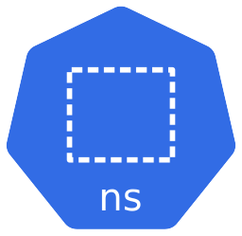
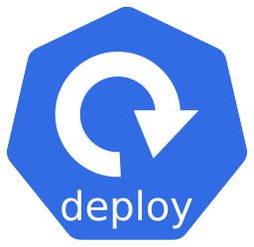
overview of the deployment
path: /word
word
word-ns
word-dply
worddb
Ingress Controller
worddb-dply
worddb-pvc
load balancer
(managed by the lab)
weather
weather-ns
path: /weather
weather-dply
weatherdb
weatherdb-dply
weatherdb-pvc

Slide 41
overview of the deployment
images of the two microservices are already provided
ik2227/words for the word microservice
ik2227/weather for the weather microservice
we will use the postgresql image for the databases
the application connects and populates the db automatically
you don’t have to configure it! ☺
more information in each task

Slide 42
start the lab
open a terminal
enter the lab directory (cd lab_directory)
run sudo kathara lstart --privileged
Kathará requires sudo to run in privileged mode
start devices with full root privileges (required by K8s)

Slide 43
task 1: verify K8s status
focus on the controller device
suggestion: connect into it instead of using the xterm
from the lab directory terminal: kathara connect controller
override the startup message by pressing [ENTER]
let’s check that all the workers have joined the cluster
kubectl get nodes
you should see the controller and 5 workers
if not, to update the status live:
watch "kubectl get nodes"

Slide 44
task 1: verify K8s status
K8s requires some time to boot up the control plane
let’s check the status of the control plane services
kubectl get pods -A
-A shows resources from all the namespaces
wait that all the Pods are in Running or Completed state
to update the status live:
watch "kubectl get pods -A"

Slide 45
task 2: create Namespaces
once the control plane is ready, we create our resources
create the two namespaces required by the microservices
word-ns
weather-ns
create a YAML file ns.yaml with the Namespaces specification
hint: from now on, create files into the shared folder on your host (with any text editor), so that they are accessible in the /shared folder of the controller device

Slide 46
task 2: create Namespaces
hint: you can specify multiple resources in the same YAML file, by separating them with triple dashes
example for the Namespaces:
ns.yaml
apiVersion: v1
kind: Namespace
metadata:
name: word-ns
---
apiVersion: v1
kind: Namespace
metadata:
name: weather-ns
separates resources specifications

Slide 47
task 2: deploy Namespaces
after filling the ns.yaml file, let’s deploy it in K8s
from the controller device
kubectl apply -f /shared/ns.yaml
you can now check if the two Namespaces are created:
kubectl get namespaces
or
kubectl get ns

Slide 48
task 3: create PersistentVolumeClaims
create a YAML file pvc.yaml with the PVC specification
create the worddb-pvc PersistentVolumeClaim
it should be assigned to the Namespace word-ns
the access mode is ReadWriteOnce
we request 1MB of storage (specified as 1Mi)
storage class is ssd
this PV is already allocated in the lab

Slide 49
task 3: create PersistentVolumeClaims
create the weatherdb-pvc PersistentVolumeClaim
it should be assigned to the Namespace weather-ns
the access mode is ReadWriteOnce
we request 1MB of storage (specified as 1Mi)
storage class is ssd
this PV already allocated in the lab

Slide 50
task 3: deploy PersistentVolumeClaims
after filling the pvc.yaml file, let’s deploy it in K8s
from the controller device
kubectl apply -f /shared/pvc.yaml
you can now check if the two PVCs are created:
kubectl -n word-ns get pvc
or
kubectl -n weather-ns get pvc
specifies the Namespace to query

Slide 51
task 4: create Services
create a YAML file svc.yaml
create the word Service
it should be assigned to the Namespace word-ns
the Service should forward traffic from port=5001 to container port=5000 with protocol TCP
do not assign a node port
the Service must be associated with Pods having the label
app: word
do not specify a Service type
it will be ClusterIP by default
we rely on the Ingress Controller to expose the Service

Slide 52
task 4: create Services
create the worddb Service
it should be assigned to the Namespace word-ns
the Service should forward traffic from port=5432 to container port=5432 with protocol TCP
do not assign a node port
the Service must be associated with Pods having the label
app: worddb
do not specify a Service type
it will be ClusterIP by default
the database must be only accessible within the cluster
by the word Service

Slide 53
task 4: create Services
create the weather Service
it should be assigned to the Namespace weather-ns
the Service should forward traffic from port=5001 to container port=5000 with protocol TCP
do not assign a node port
the Service must be associated with Pods having the label
app: weather
do not specify a Service type
it will be ClusterIP by default
we rely on the Ingress Controller to expose the Service

Slide 54
task 4: create Services
create the weatherdb Service
it should be assigned to the Namespace weather-ns
the Service should forward traffic from port=5432 to container port=5432 with protocol TCP
do not assign a node port
the Service must be associated with Pods having the label
app: weatherdb
do not specify a Service type
it will be ClusterIP by default
the database must be only accessible within the cluster
by the weather Service

Slide 55
task 4: deploy and inspect Services
after filling the svc.yaml file, let’s deploy it in K8s
from the controller device
kubectl apply -f /shared/svc.yaml
you can now check several things:
the Services are created
kubectl -n word-ns (or weather-ns) get svc -o wide
the type should be ClusterIP
it has a “CLUSTER-IP” assigned, which is the Service IP reachable within the cluster
no “EXTERNAL-IP” should be assigned (the Service is not exposed to the outside)
is the port mapping correct?
is the selector working? is it associated with the correct Pod label?
detailed output

Slide 56
task 5: create database Deployments (1)
create a YAML file deploy_db.yaml
create the worddb-dply Deployment
it should be assigned to the Namespace word-ns
we want 1 Pod replica
Pod containers must use the image postgres
Pod containers must expose port 5432
Pod containers must mount a volume in /var/lib/postgresql/data
give the volume a name of your choice (e.g, worddb-storage)
in containers’ definition, give the container a name of your choice
e.g., worddb-container
the volume is connected to the PVC worddb-pvc
the Deployment should match Pod containers with the label
app: worddb

Slide 57
task 5: create database Deployments (2)
the postgres image requires some environment variables to work
into the Pod container definition, after defining the port, add the following
deploy_db.yaml
...
ports:
- containerPort: 5432
env:
- name: POSTGRES_DB
value: worddb
- name: POSTGRES_USER
value: root
- name: POSTGRES_PASSWORD
value: root

Slide 58
task 5: create database Deployments (3)
create the weatherdb-dply Deployment
it should be assigned to the Namespace weather-ns
we want 1 Pod replica
Pod containers must use the image postgres
Pod containers must expose port 5432
Pod containers must mount a volume in /var/lib/postgresql/data
give the volume a name of your choice (e.g, weatherdb-storage)
in containers’ definition, give the container a name of your choice
e.g., weatherdb-container
the volume is connected to the PVC weatherdb-pvc
the Deployment should match Pod containers with the label
app: weatherdb

Slide 59
task 5: create database Deployments (4)
into the Pod container definition, after defining the port, add the following
deploy_db.yaml
...
ports:
- containerPort: 5432
env:
- name: POSTGRES_DB
value: weatherdb
- name: POSTGRES_USER
value: root
- name: POSTGRES_PASSWORD
value: root

Slide 60
task 5: deploy and inspect Deployments
after filling the deploy_db.yaml file, let’s deploy it in K8s
from the controller device
kubectl apply -f /shared/deploy_db.yaml
we will dig into the Deployments later

Slide 61
task 5: create app. Deployments
create a YAML file deploy_app.yaml
create the word-dply Deployment
it should be assigned to the Namespace word-ns
we want 2 Pod replicas
the Pod containers must use the image ik2227/word
the Pod containers must expose port 5000
in containers’ definition, give the container a name of your choice
e.g., word-container
the Deployment should match Pod containers with the label
app: word

Slide 62
task 5: create app. Deployments
create the weather-dply Deployment
it should be assigned to the Namespace weather-ns
we want 2 Pod replicas
the Pod containers must use the image ik2227/weather
the Pod containers must expose port 5000
in containers’ definition, give the container a name of your choice
e.g., weather-container
the Deployment should match Pod containers with the label
app: weather

Slide 63
task 5: deploy and inspect Deployments
after filling the deploy_app.yaml file, let’s deploy it in K8s
from the controller device
kubectl apply -f /shared/deploy_app.yaml
you can now check several things:
the Deployments are created
kubectl -n word-ns (or weather-ns) get deploy -o wide
check the number of replicas and how many are ready
the Deployment is healthy when “READY” and “AVAILABLE” are the same number
check the container image and if the label selector matches what you defined in the specification

Slide 64
task 5: deploy and inspect Deployments
check the Pods composing the Deployment
kubectl -n word-ns (or weather-ns) get pods -o wide
are the Pods healthy (status should be “Running”)?
is the number of Pods matching the number of replicas of each Deployment?
extra: from the “IP” and “NODE” columns, you can get information about the IP of the Pod in the Pod subnet and the worker node where the Pod is running!

Slide 65
task 5: deploy and inspect Services
we can now inspect the connection between Services and Deployments
get detailed information of a Service of your choice
kubectl -n word-ns (or weather-ns) describe svc <name>
for example: kubectl -n word-ns describe svc word
the command will show detailed information of the Service
check the “Endpoints” row
is the number of listed endpoints correct (it is connected to the number of replicas of the Deployment)?
to which entities are the IPs listed associated?

Slide 66
task 6: create Ingress
create a YAML file ing.yaml
create the word-ing Ingress rule
it should be assigned to the Namespace word-ns
the rule must match the host datacenter.com
the rule must match the prefix /word and forward to the service word on port=5001
set ingressClassName to nginx
it’s the Ingress Controller deployed in the lab

Slide 67
task 6: create Ingress
create a YAML file ing.yaml
create the weather-ing Ingress rule
it should be assigned to the Namespace weather-ns
the rule must match the host datacenter.com
the rule must match the prefix /weather and forward to the service weather on port=5001
set ingressClassName to nginx
it’s the Ingress Controller deployed in the lab

Slide 68
task 6: deploy Ingress
after filling the ing.yaml file, let’s deploy it in K8s
from the controller device
kubectl apply -f /shared/ing.yaml
you can now check if the Ingress is created:
kubectl -n word-ns (or weather-ns) get ingress -o wide

Slide 69
task 6: inspect Ingress
get detailed information of the Ingress
kubectl -n word-ns (or weather-ns) describe ingress <name>
for example:
kubectl -n word-ns describe ingress word-ing
you can check all the rules under the “Rules” entry
are the rules correct?
is each path pointing to the right backend? to the right port?
are the IP addresses listed correct (for each Service)?

Slide 70
task 7: testing!
the services are now correctly deployed and exposed
focus on the client device
run: curl http://datacenter.com/word
a JSON list of 5 words will be printed on screen!
run: curl http://datacenter.com/weather?location=Rome
a JSON with the weather forecast for Rome will be printed on screen!

Slide 71
task 8: Deployment update
let’s assume that we want to roll an update for the word service
we want to swap it with the drow service
retrieves 5 random reversed words from the db
create a file deploy_app_rev.yaml
copy the word-dply from the deploy_app.yaml
change the image to ik2227/drow

Slide 72
task 8: Deployment update
in another terminal connect to the controller
kathara connect controller
monitor the resources of the word-ns namespace:
watch "kubectl -n word-ns get all -o wide"
update the Deployment (without stopping the watch):
kubectl apply -f /shared/deploy_app_rev.yaml
monitor the word-dply Deployment and the associated Pods
is the new Deployment rolling incrementally?
you can check the status of the rollout by checking the replicaset.apps section
look at the “IMAGES” column to distinguish the two Deployment versions

Slide 73
task 8: Deployment update
when the new Deployment is ready, focus on client
run: curl http://datacenter.com/word
a JSON list of 5 reversed words will be printed on screen!

Slide 74
stop the lab
open a terminal
enter the lab directory (cd lab_directory)
run kathara lclean

