Slide 1
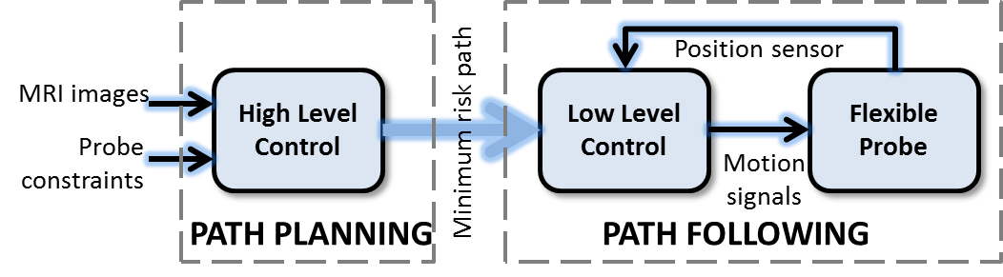
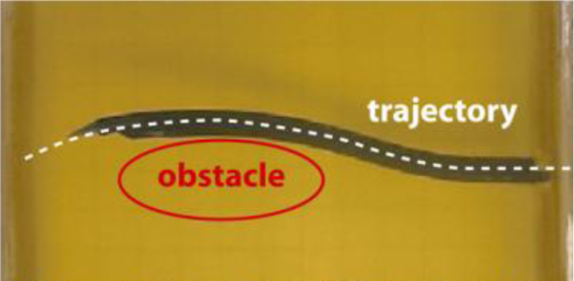
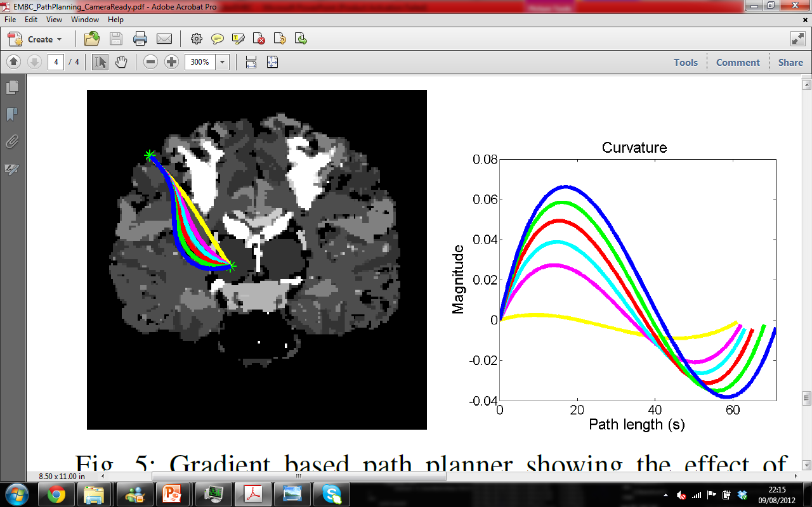
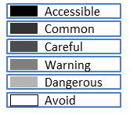
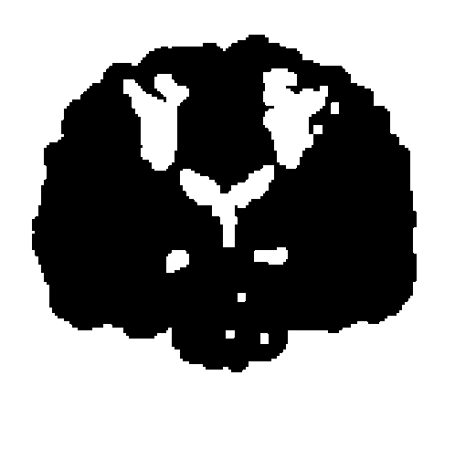
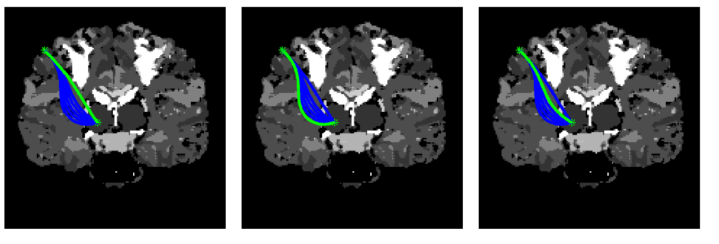



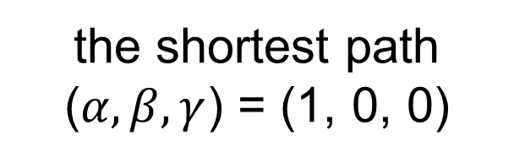

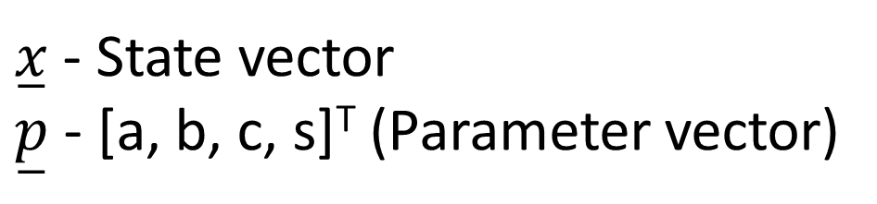
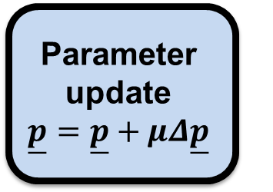
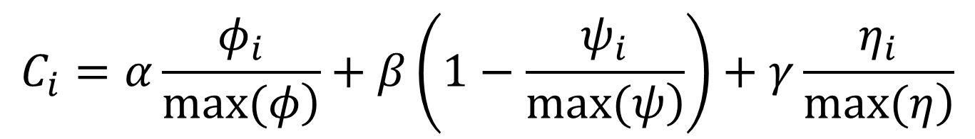

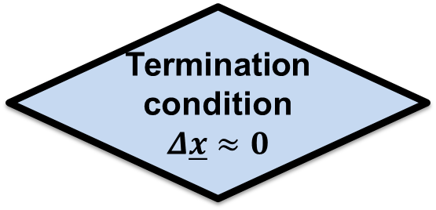
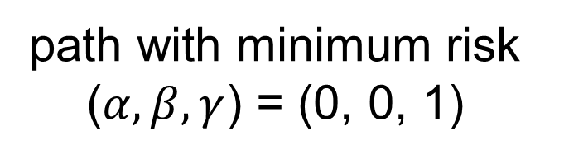

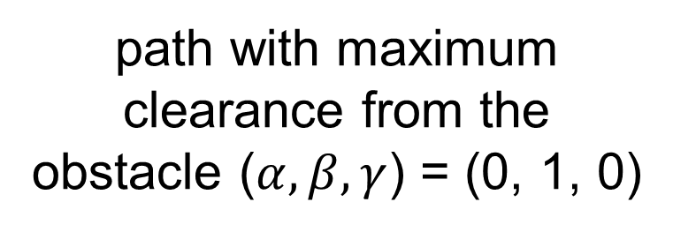
Smooth Path Planning for a Biologically-Inspired Neurosurgical Probe
Sophia Bano
Queen Mary, University of London, UK
sophia.bano@eecs.qmul.ac.uk
Seong Young Ko, Member, IEEE
Chonnam National University, Gwangju, South Korea
sko@chonnam.ac.kr
Ferdinando Rodriguez y Baena, Member, IEEE
Imperial College, London, UK
f.rodriguez@imperial.ac.uk
1. Introduction
2. Objective
In recent years, percutaneous interventions have become the preferred choice of many neurosurgeons, due to several benefits over open neurosurgery. They require the insertion of probes or needles inside the brain, precisely targeting lesions, based on CT/MRI images. A bio-inspired neurosurgical flexible probe named STING (Soft-Tissue Intervention and Neurosurgical Guide) [1, 2] is currently being developed at Imperial College London, the aim of which is to access deep brain lesions, with reduced risk to the patient.
The bio-inspired neurosurgical flexible probe is capable of steering in 2D space and is modelled as a nonholonomic system. Mechanical constraints of the flexible probe impose a minimum radius of curvature bound on the path. Further, for the probe’s closed loop control, the curvature must be continuous and smooth.
The aim of this work is to find an optimal path for the neurosurgical flexible probe, from a given start point to a lesion on a 2D risk-map of the brain, while respecting its mechanical constraints.
System architecture of the flexible probe
3. Continuous Curvature Path Planner
A path planning algorithm for generating pre-operative paths for the neurosurgical flexible probe (STING) is developed using a gradient-based method [3]. The approach is deterministic and generates a bounded and continuous path by means of an optimization of the curvature (cubic polynomial) model.
Flexible probe in gelatine
4. Simulation Results
$$\overset{̲}{x}=\left[\begin{matrix}\left.x(s\right) \\ \left.y(s\right) \\ \left.θ(s\right) \\ \left.κ(s\right)\end{matrix}\right]=\left[ \begin{matrix}x_{0}+\int_{0}^{s}{cos(θ(τ))dτ} \\ y_{0}+\int_{0}^{s}{sin(θ(τ))dτ} \\ θ_{0}+\int_{0}^{s}{κ\left(τ\right)dτ \text{​​​​​ ​}} \\ κ_{0}+as+bs^{2}+cs^{3}\end{matrix}\text{​​​​ }\right]$$
$\overset{̲}{x}$ - State vector
$\overset{̲}{p}$ - [a, b, c, s]^{T} (Parameter vector)
State equation solution
Curvature polynomial
Start and target posture of the probe
Parameter initialization
Linearization
$$Δ\overset{̲}{x}=\left[\frac{∂}{∂\overset{̲}{p}}\overset{̲}{x}\right]Δ\overset{̲}{p}$$
Parameter update
$$\overset{̲}{p}=\overset{̲}{p}+μΔ\overset{̲}{p}$$
Termination condition
$$Δ\overset{̲}{x}≈0$$
True
Continuous curvature path
Gradient-based path planner showing the effect of varying target orientation (left) and curvature (right) on the optimal path
State update
False
A risk-map divides the segmented brain structure into six different regions. The configuration space is formed by dilating the highest risk-value (AVOID) by the thickness of the flexible probe.
Gradient-based method for optimization of the curvature
Configuration space
5. Path Optimization
The optimal path is the one having the minimum value for the following
cost function [4]:
$$C_{i}=α\frac{φ_{i}}{\left.max(φ\right)}+β\left(1−\frac{ψ_{i}}{\left.max(ψ\right)}\right)+γ\frac{η_{i}}{\left.max(η\right)}$$
$C_{i}$ - ith path’s cost
$φ_{i}$ - length of path
$ψ_{i}$ - minimum distance
from an obstacle
$η_{i}$ - accumulated risk
along the path
the shortest path ($α, β, γ$) = (1, 0, 0)
path with maximum clearance from the obstacle ($α, β, γ$) = (0, 1, 0)
path with minimum risk ($α, β, γ$) = (0, 0, 1)
6. Conclusions and Future Work
7. References
A gradient-based method for the continuous and smooth path planning of a steerable probe has been successfully developed, satisfying its specific mechanical constraints. A path optimization scheme is also reported, which computes an optimum path based on predefined criteria.
Future work involves incorporation of soft tissue deformation during insertion to reduce placement error and extension of the path planner to 3D, since the neurosurgical flexible probe design will allow it to steer in 3D space.
[1] L. Frasson, S. Ko, A. Turner, T. Parittotokkaporn, J. Vincent, and F. Rodriguez y Baena, “STING: a soft-tissue intervention and neurosurgical guide to access deep brain lesions through curved trajectories,” Proceedings of the Institution of Mechanical Engineers, Journal of Engineering in Medicine, vol. 224, no. 6, pp. 775-788, 2010.
[2] S. Ko, L. Frasson, and F. Rodriguez y Baena, “Closed-loop planar motion control of a steerable probe with a“programmable bevel”inspired by nature,” IEEE Transactions on Robotics, vol 27, pp. 970-983, 2011.
[3] S. Thompson and S. Kagami, “Continuous curvature trajectory generation with obstacle avoidance for car-like robots,” International Conference on Computational Intelligence for Modelling, Control and Automation and International Conference on Intelligent Agents, 2005.
[4] C. Caborni, S. Ko, E. Momi, G. Ferrigno, and F. Rodriguez y Baena, “Optimization of rapidly-exploring random trees (rrt)-based path planning for a neurosurgical steerable probe,” in Proceedings of The Hamlyn Symposium on Medical Robotics, 2011.
Acknowledgement
The research leading to these results was funded by the European Research Council under the European Union’s FP7 programme / ERC grant agreement nº 258642-STING.

