Slide 1
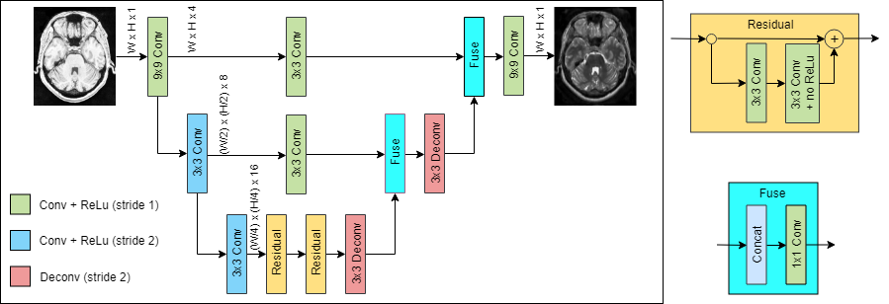
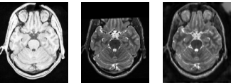
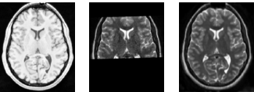
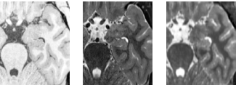
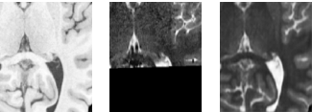




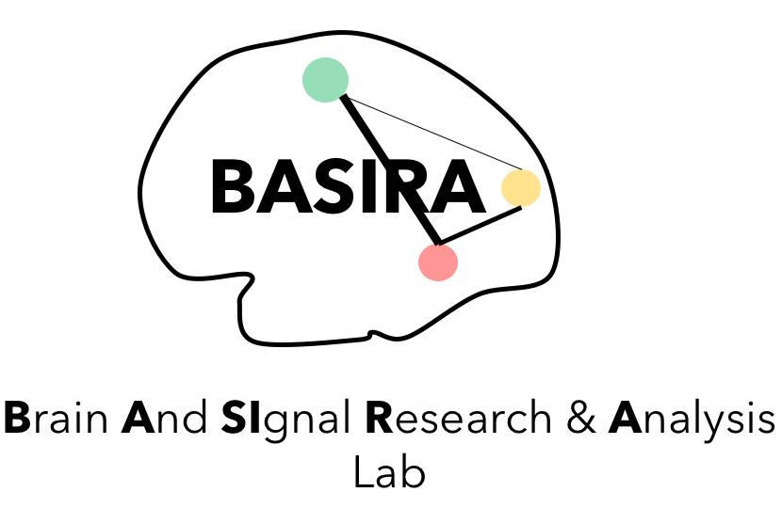
XmoNet: a Fully Convolutional Network for Cross-Modality MR Image Inference
Sophia Bano¹, Muhammad Asad², Ahmed E. Fetit³, and Islem Rekik⁴
¹ Wellcome/EPSRC Centre for Interventional and Surgical Sciences (University College London), ² Imagination Technologies,
³ Biomedical Image Analysis Group (Imperial College London), ⁴ BASIRA Lab, Computer Vision & Image Processing Group (University of Dundee),
United Kingdom
Introduction
Magnetic Resonance (MR) modalities, e.g. T1-, T2-, and diffusion-weighted imaging, offer complementary contrast mechanisms for capturing visual characteristics of tissues of interest. In research settings and imaging clinical trials, factors such as cost, availability of scanning time, and patient discomfort impede the acquisition of multimodal scans. Cross-modality generation (synthesising a target modality given a separate source) may provide solutions to such challenges.
2. Architecture
We propose XmoNet, a deep learning architecture inspired by fully convolutional networks (FCNs) [1, 3]. XmoNet utlilises parallel pathways to encode low- and high-frequency visual features, thereby capturing rich hierarchies of feature representations. We present a preliminary study illustrating the utility of XmoNet in learning the mapping between heterogeneous T1- and T2-weighted MR scans rapidly and accurately.
Fig 1. The proposed XmoNet deep learning architecture.
3. Experimental Analysis
Dataset
We used the publicly available MNI-HISUB25 dataset [2] of MR brain scans of 25 subjects. The data is heterogeneous as a few T2-weighted scans show missing regions.
Observations
XmoNet resulted in accurate and sharp MR image generation: (a) synthesised images better capture overall brain structures w.r.t source images. (b) regions with missing T2 signal successfully synthesised.
Limitations
The analysis requires a baseline, a thorough assessment by medical experts, and studying generalisation of the network under different acquisition settings.
T1 (input) T2 (groundtruth) T2 (predicted)
T1 (input) T2 (groundtruth) T2 (predicted)
PSNR: 30.75, SSIM: 0.76
PSNR: 34.13, SSIM: 0.91
Complete image synthesis
Complete image synthesis
T1 (input) T2 (groundtruth) T2 (predicted)
T1 (input) T2 (groundtruth) T2 (predicted)
PSNR: 27.78, SSIM: 0.60
PSNR: 31.71, SSIM: 0.73
Hippocampus sub-region synthesis
Hippocampus sub-region synthesis
Fig 2. Experimental results for predicting T2-w from T1-w image. Scans with missing frontal lobe part in T2-w image (left). Section with missing frontal and parietal lobe parts in T2-w image (right).
4. Conclusion and Future Work
We designed a deep learning network for the cross-modality MR image inference, utilising a fully convolutional architecture. Preliminary analysis illustrated the utility of XmoNet for accurate and realistic synthesis of T2-weighted images from source T1-weighted data.
Future work involves validating XmoNet on larger datasets, comparison with the existing methods, adaptation to incorporate non-MR based modalities and extension to 3D image inference.
References
[1] Badrinarayanan, V., Kendall, A., Cipolla, R.: SegNet: A deep convolutional encoder-decoder architecture for image segmentation. IEEE TPAMI, 2017.
[2] Kulaga-Yoskovitz, J., Bernhardt, B.C., Hong, S.J., Mansi, T., Liang, K.E., et al.: Multi-contrast submillimetric 3 tesla hippocampal subfield segmentation protocol and dataset. Scientic data 2, 2015.
[3] Long, J., Shelhamer, E., Darrell, T.: Fully convolutional networks for semantic segmentation. IEEE CVPR, 2015.

