Slide 1
Capstone Project IBM Data Science
Dr Sofia Korsavva

Slide 2
Introduction
We have been asked to write a python program that will explore the City of Birmingham in the UK for a customer who is interested in purchasing a property for his family. The customer would like to know where in Birmingham he should start looking for properties based on the following requirements:
The customer has a budget of between 400-500K in GBP
He would like the property to be quite central in the city of Birmingham as him and his family enjoy city life.
He would like to know what type of venues exist within 10-15 minutes of the property
He would like to know what type of facilities exist within 10-15 of the property, such as supermarkets, other shops and hospitals.
The customer is also very worried about the safety of his family so he would like to know in those areas that we are going to recommend to him, the crime rates as officially reported by West Midlands Police, for the past month.

Slide 3
Data
To address all the customer requirements we shall develop a python program that will explore some datasets from official sources and will come up with some recommendations for our customer.
In the UK there is an official land registry database that contains information about England and Wales with prices per post code and street name.
The official website is:
https://www.gov.uk/government/organisations/land-registry

Slide 4
Data cont.
We shall download the UK csv file that contains all the post codes and maps them to their corresponding latitude and longitudes.
From the website https://www.freemaptools.com/download-uk-postcode-lat-lng.htm
We shall then process the file as a pandas framework and extract all the Birmingham post codes that we have identified as per above that we within our customer’s price range. We shall merge the two data sets and map them nicely on a folium map so our customer can have a good visual representation of the information we give him.

Slide 5
Data cont.
We shall then connect to foursquare and extract information for these post codes about venues and facilities in those identified postcodes and present them to our customer so can make an informed decision.
We shall use a k-means clustering algorithm to classify and cluster the selected areas of interest where the customer is now looking to buy property. The customer is mostly interested in the types of facilities around those areas that are not too far away (10-15 minutes). As the customer has a family, he is interested in nearby schools, hospitals, supermarkets etc.

Slide 6
Data cont.
Finally we shall download the csv from the west midlands police website from http://www.ukcrimestats.com/Police_Force/West_Midlands_Police#
that contains all the information about the crimes that have occurred in those areas for the past year so our customer can evaluate how safe a particular selection may be.

Slide 7
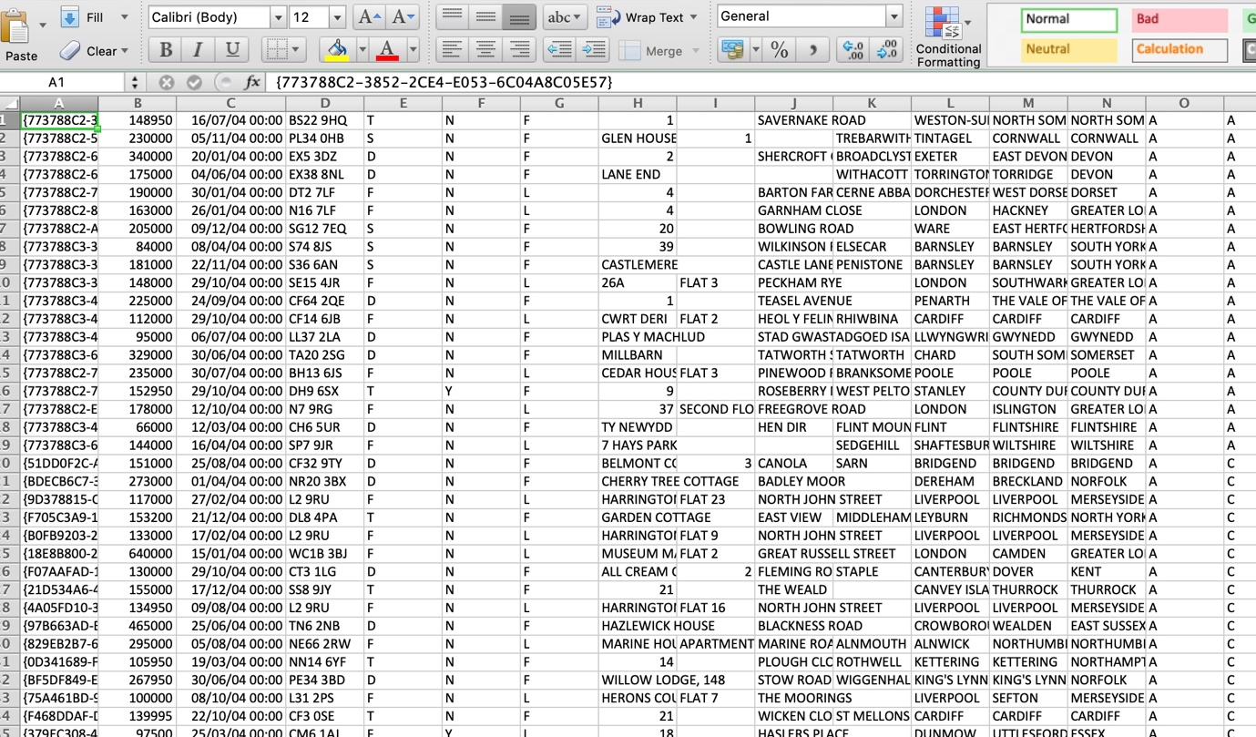
UK land registry csv file

Slide 8
Birmingham Postcodes csv file
UK postcodes, latitudes and longitudes. A snapshot of the file is shown below:
Postcode | Latitude | Longitude
B1 1AA | 52.47666 | -1.90354
B1 1AD | 52.47666 | -1.90354
B1 1AG | 52.47453 | -1.90216
B1 1AH | 52.47639 | -1.90426
B1 1AQ | 52.47453 | -1.90216
B1 1AT | 52.47639 | -1.90426
B1 1AY | 52.47592 | -1.90539
B1 1AZ | 52.47666 | -1.90354
B1 1BA | 52.47543 | -1.90021
B1 1BB | 52.48078 | -1.9041
B1 1BD | 52.47892 | -1.90294
B1 1BE | 52.47757 | -1.90175

Slide 9
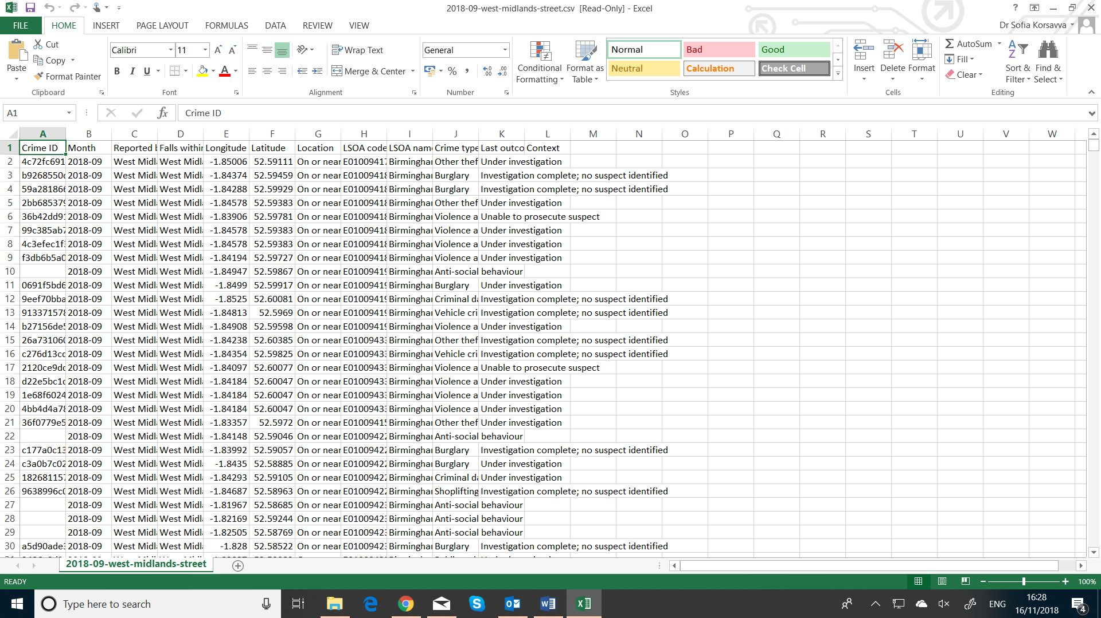
West Midlands Police Crime Data Birmingham UK, September 2018

Slide 10
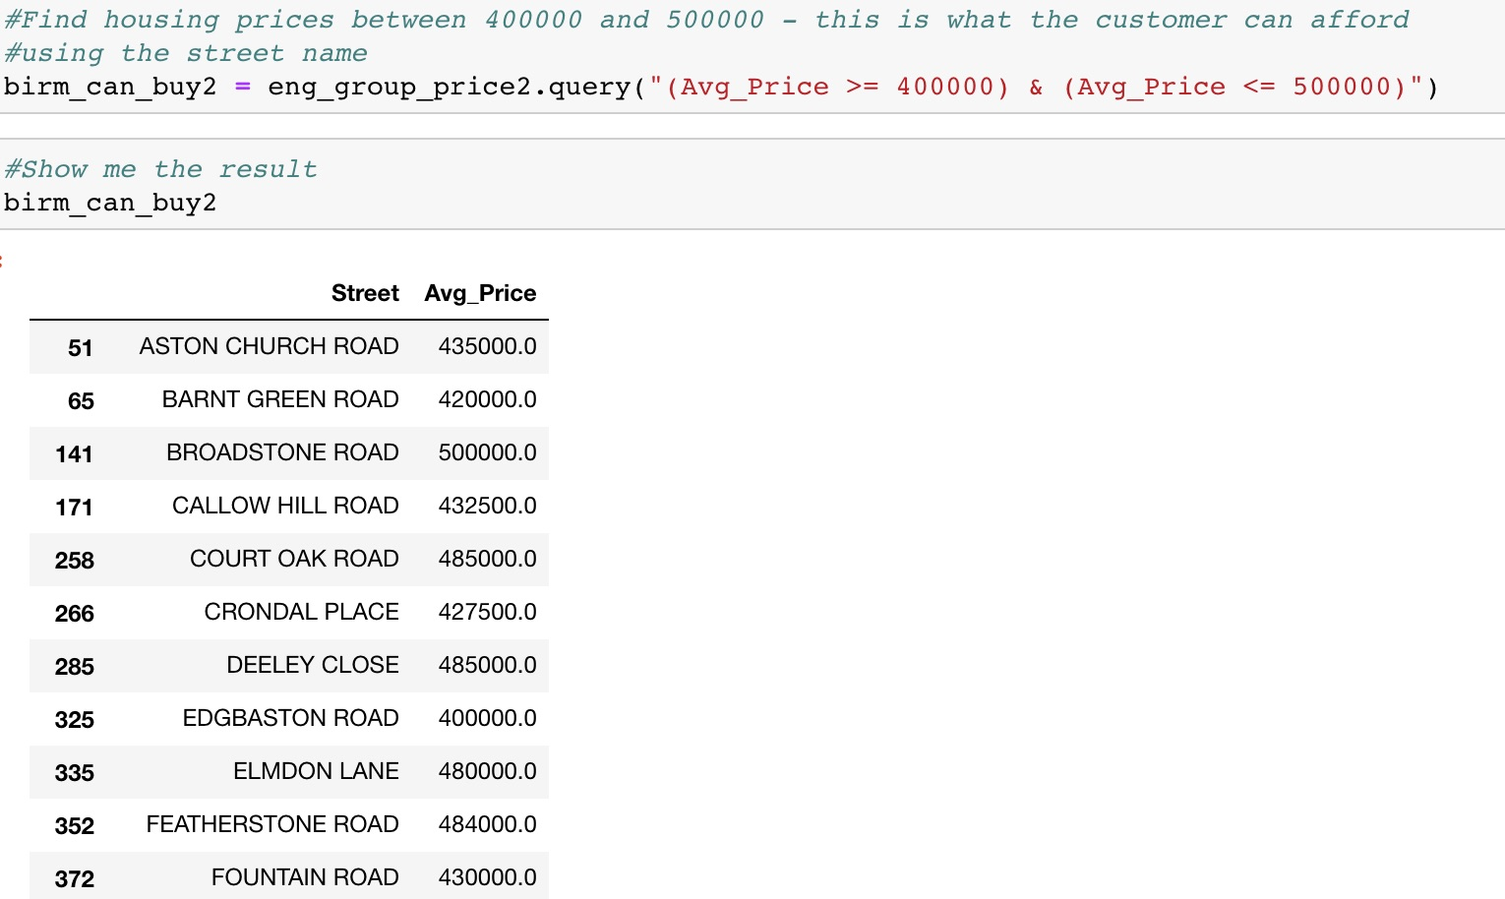
Areas where customer can buy based on requirements: 40

Slide 11
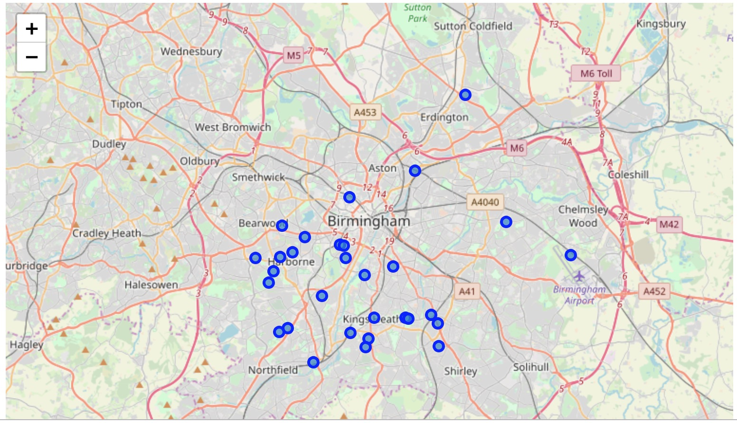
Folium Map of Birmingham UK, with identified areas

Slide 12
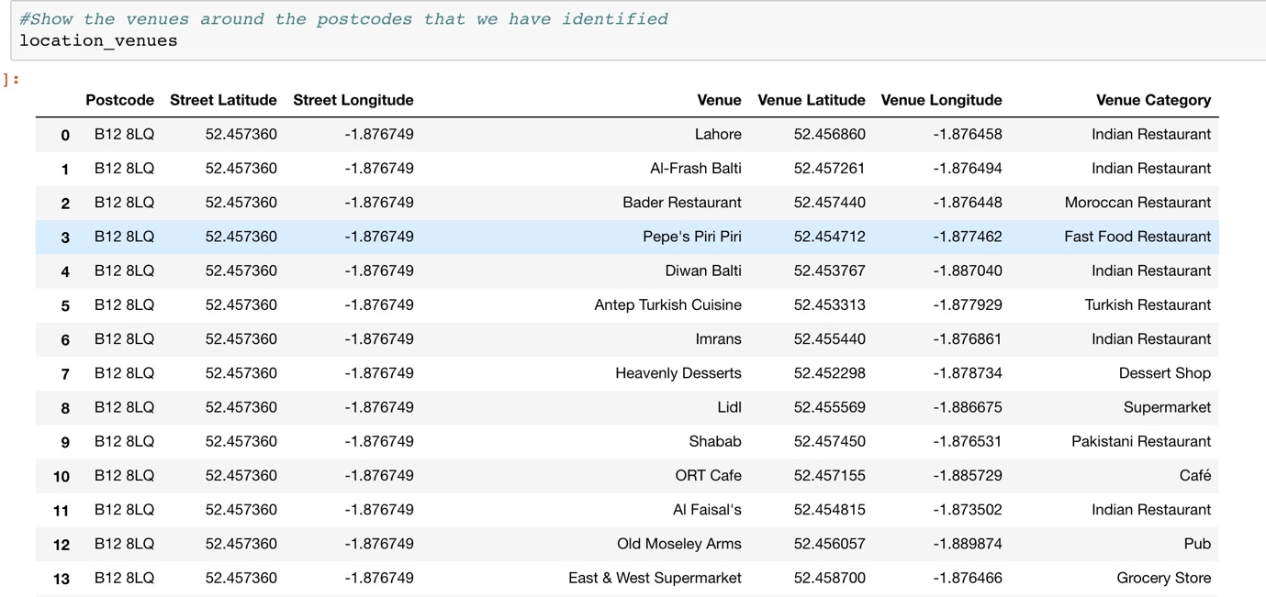
Venues in those areas with Foursquare data

Slide 13
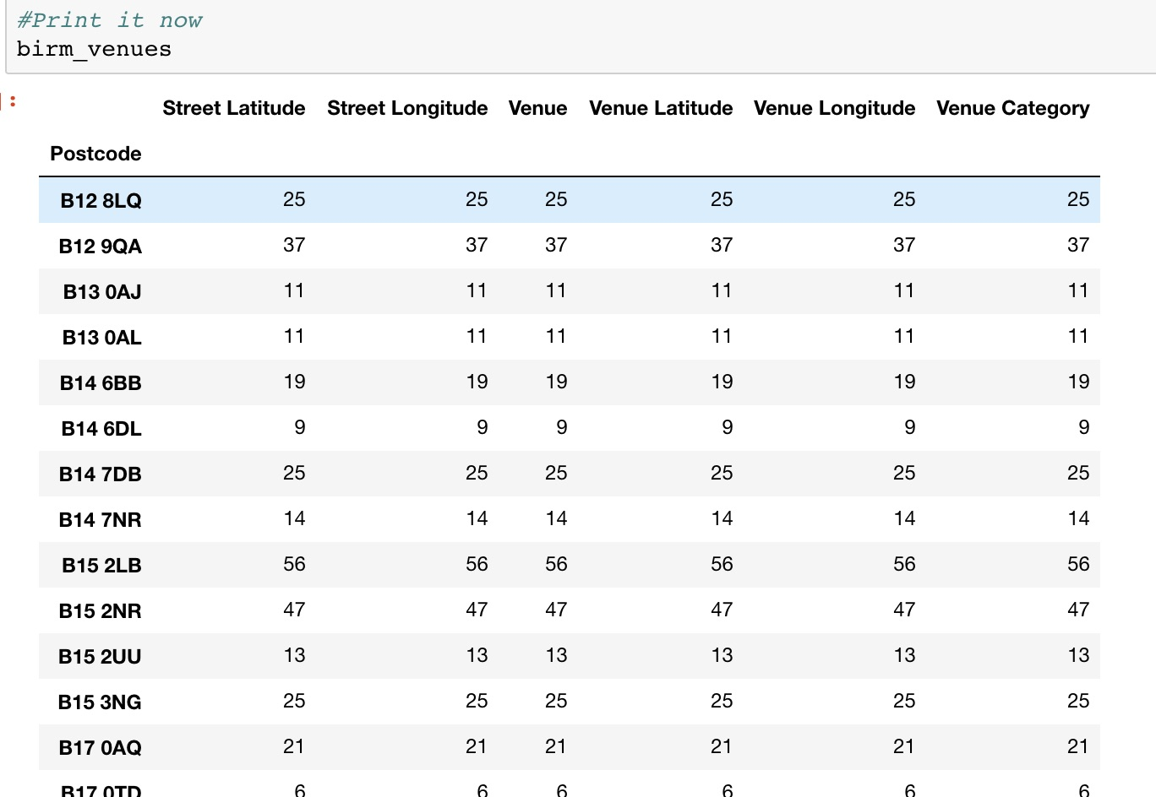
Number of venues in those areas

Slide 14
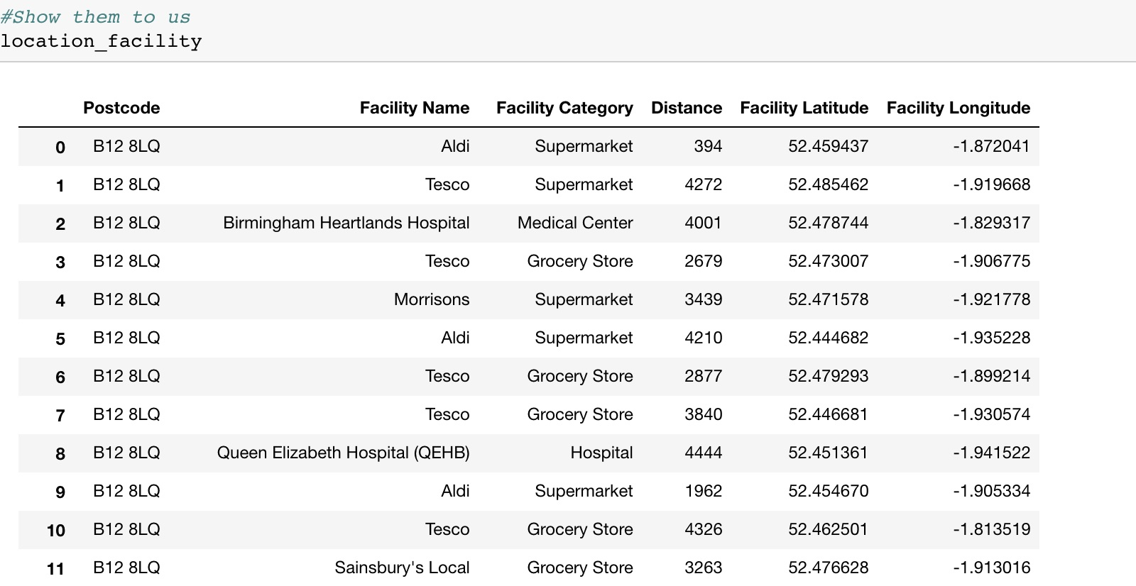
Facilities from Foursquare for selected areas

Slide 15
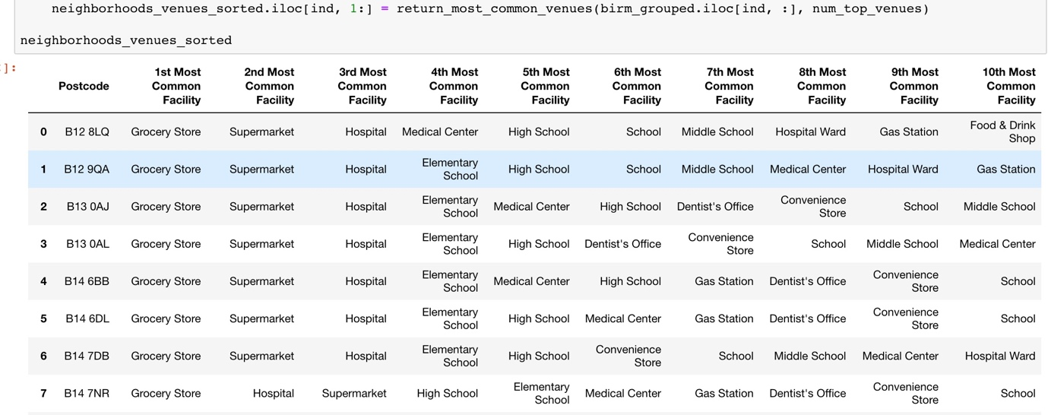
The 10 most common facilities in those areas

Slide 16
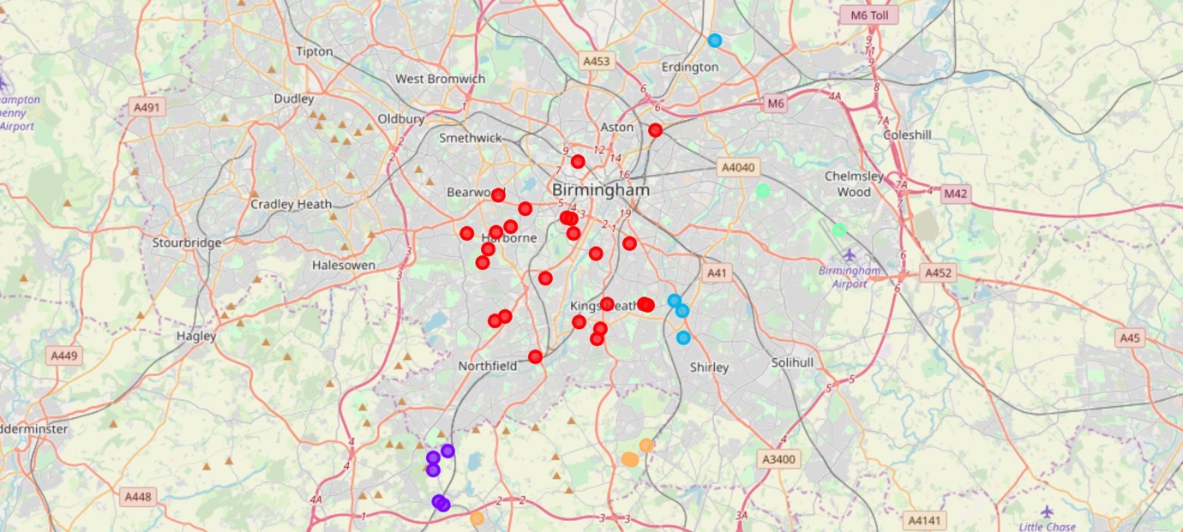
Folium Map with k-means clustering for selected Birmingham areas and facilties

Slide 17
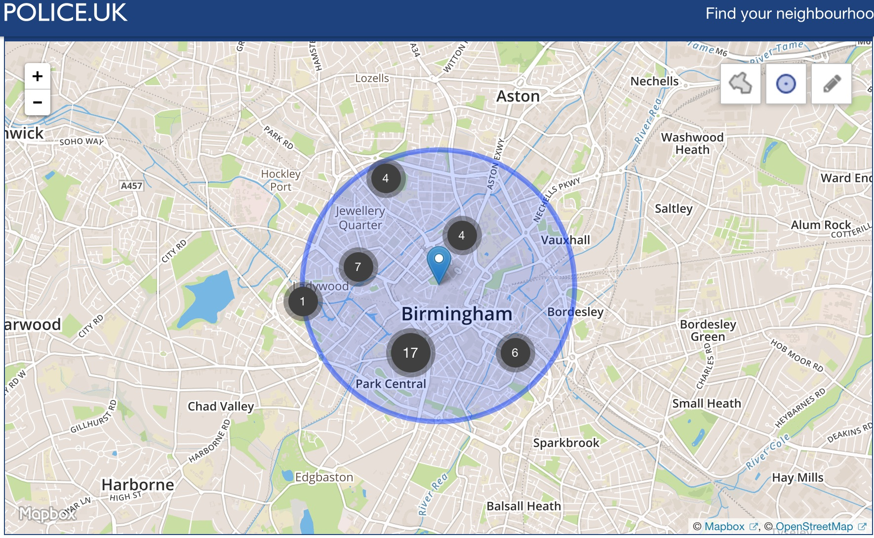
Birmingham Crime hotspots, September 2018, official police data

Slide 18
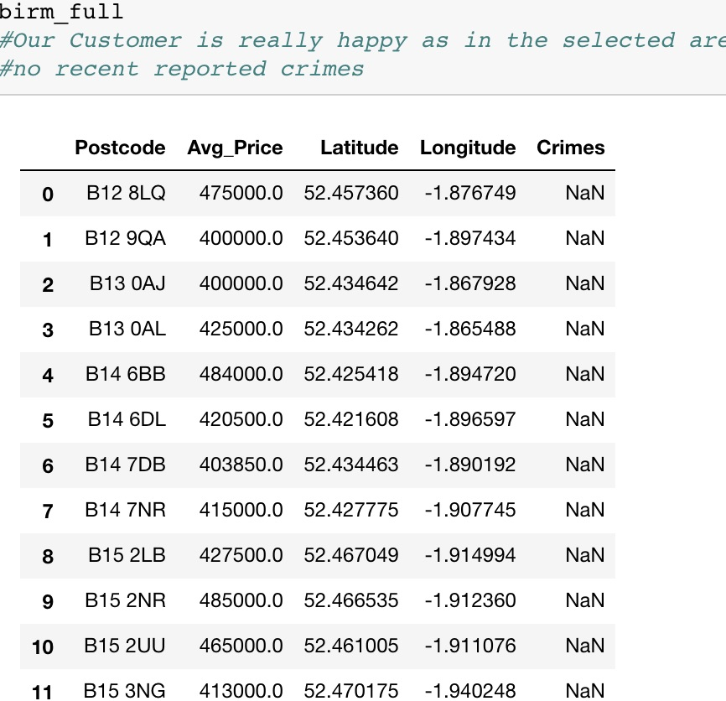
Crime reports in those areas based on Official Police data

Slide 19
Conclusion
In the selected areas there were no official crimes reported to the West Midlands Police, so these areas are safe
The customer has a selection of 40 neighbourhoods where he can look to buy a property for his family
The customer has all the information he requested for these areas, such as price ranges, crime rates, number and types of venues and facilities
Finally he has some recommendations based on the types of facilities that are available in these areas.

