Slide 1
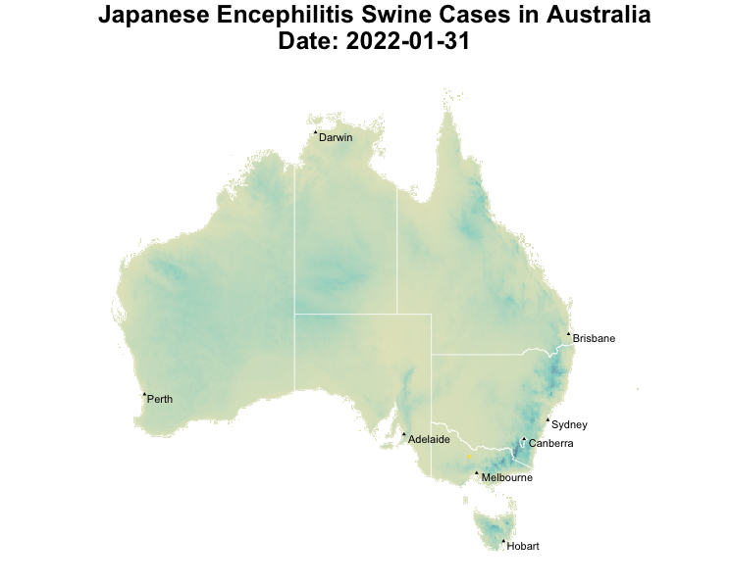

Data Source: World Organization for Animal Health

