Slide 1
Bat disease metapop figs

Slide 2
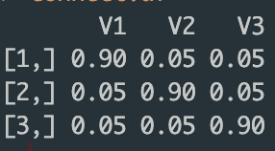
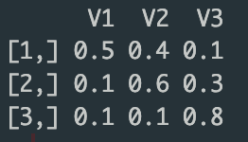

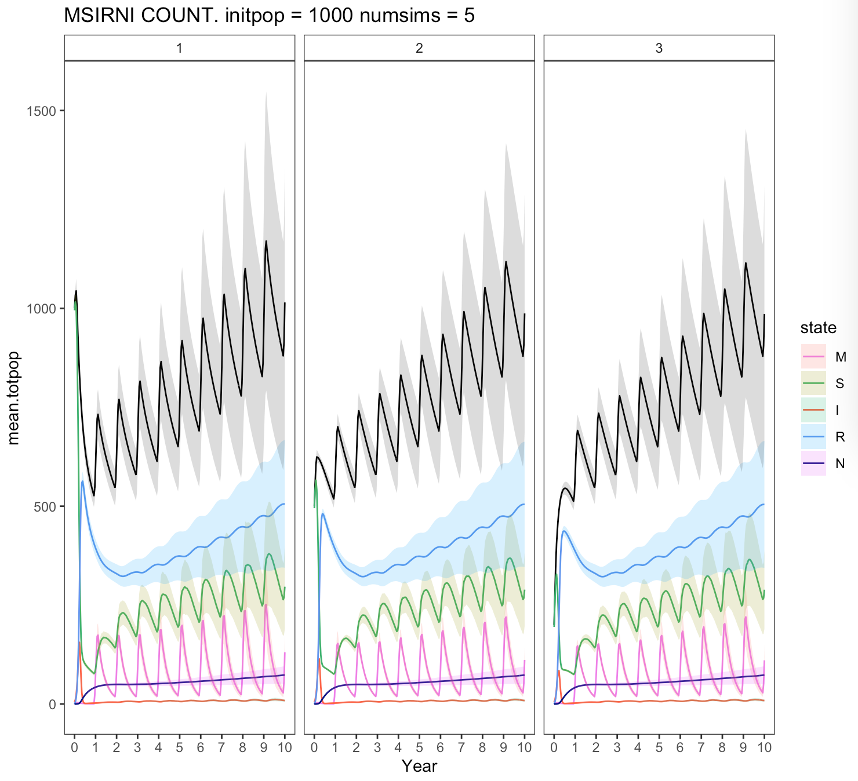
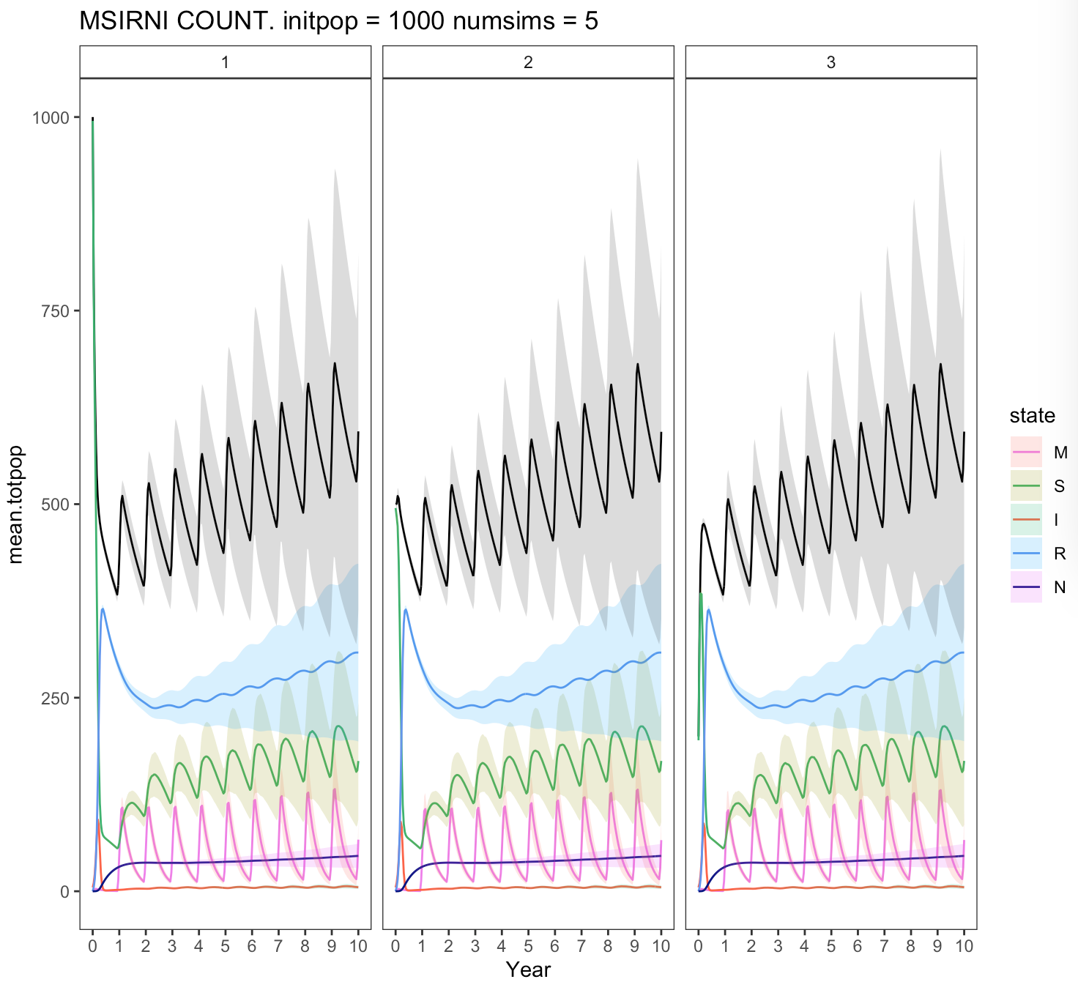
Dispersal – low, equal
Dispersal – high, not equal

Slide 3
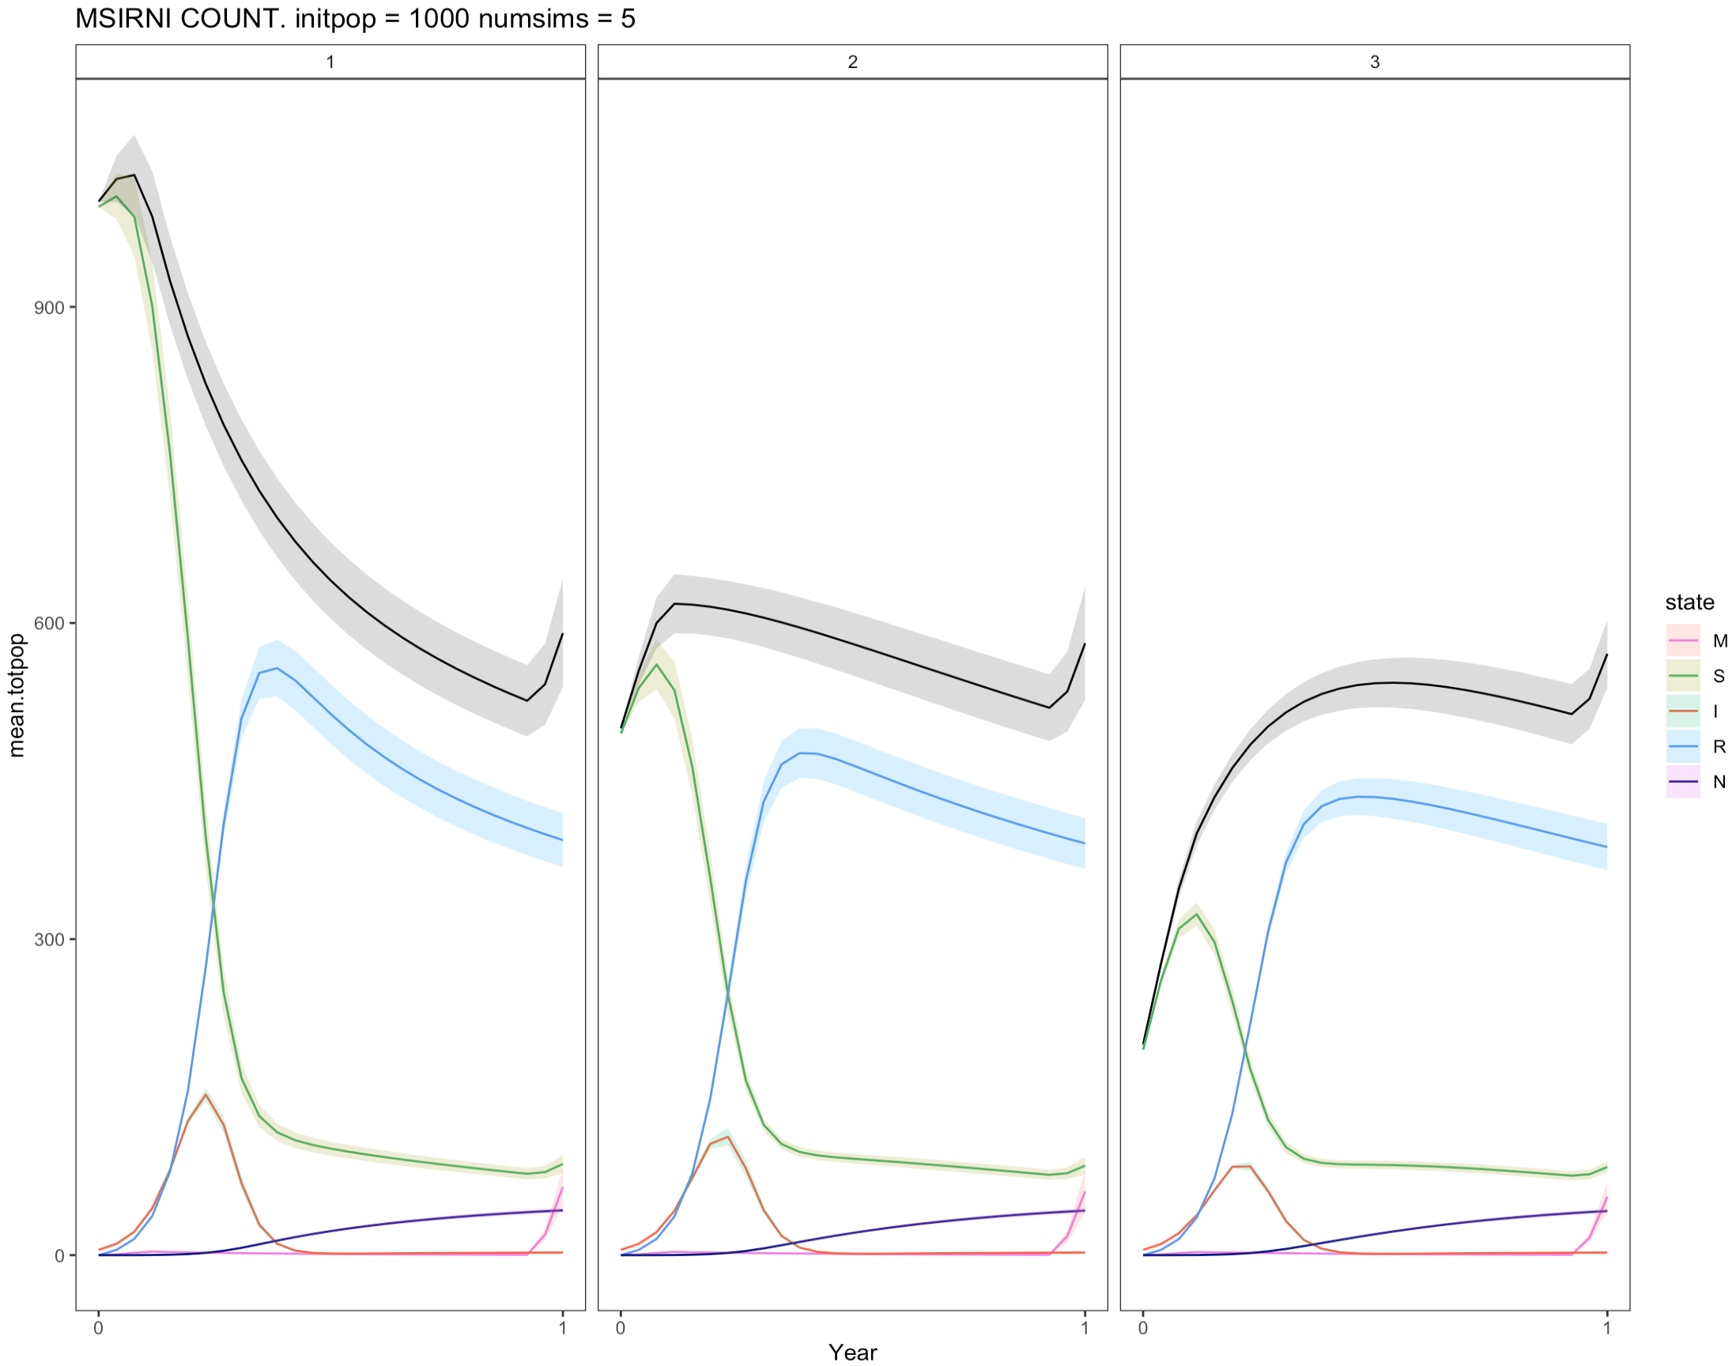
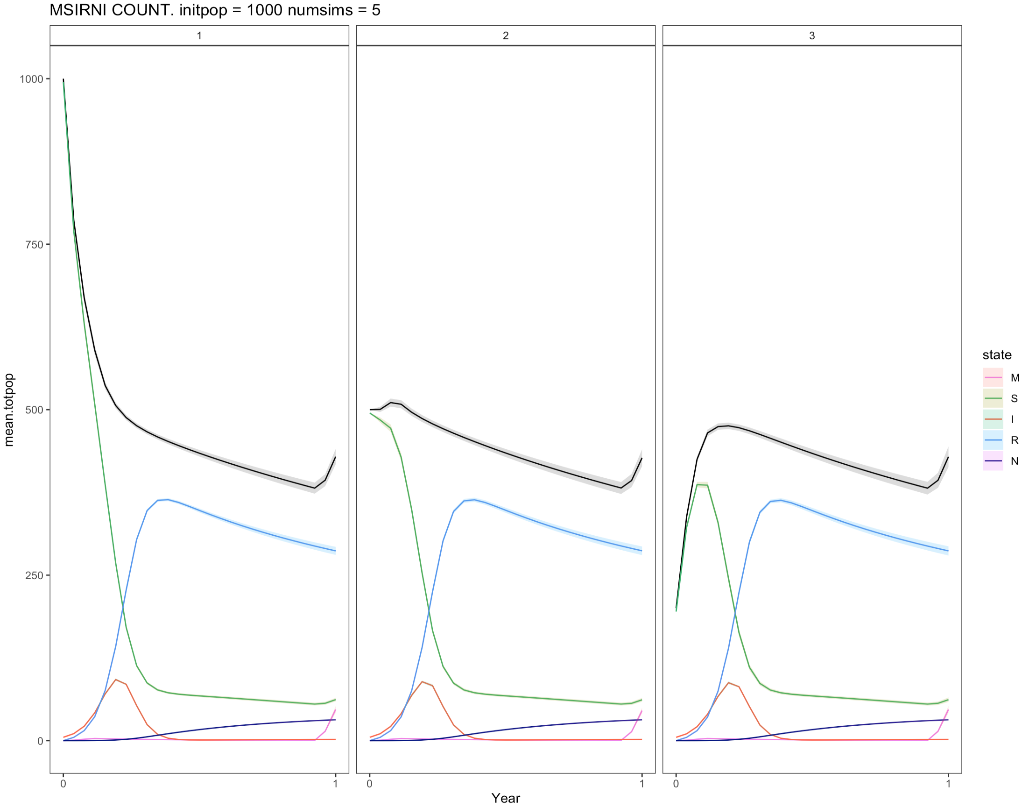
Same thing, just within 1 year

Slide 4
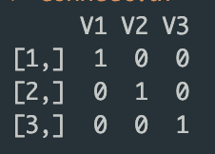
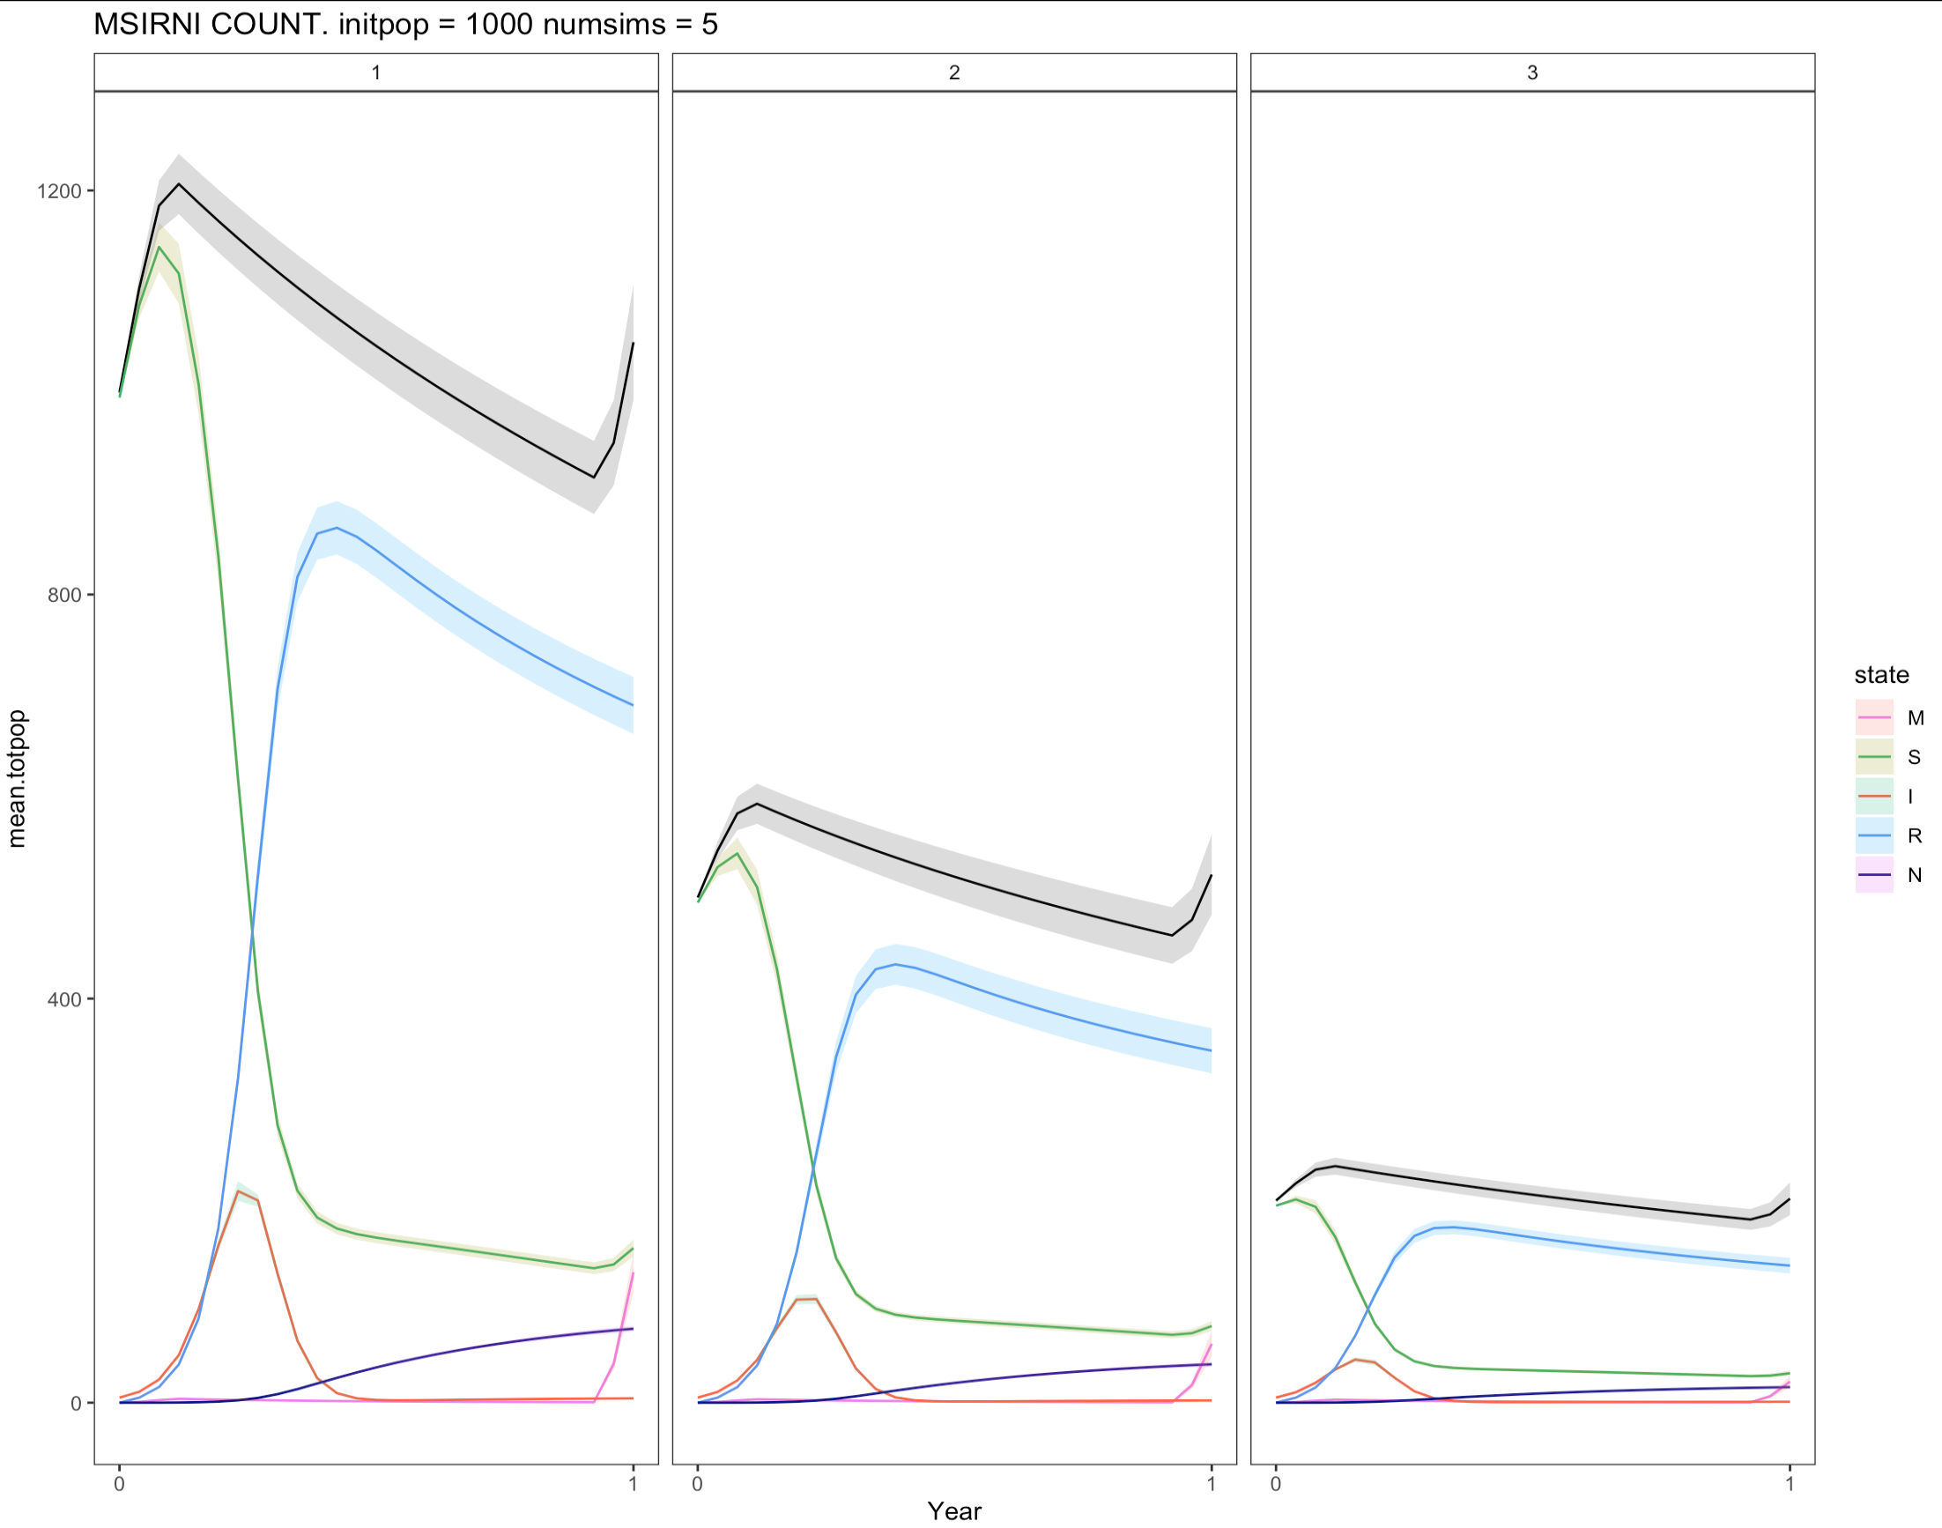
Okay, going to check something…
This is good this makes sense..
No dispersal keeps populations at similar starting densities

Slide 5
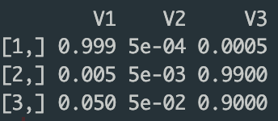
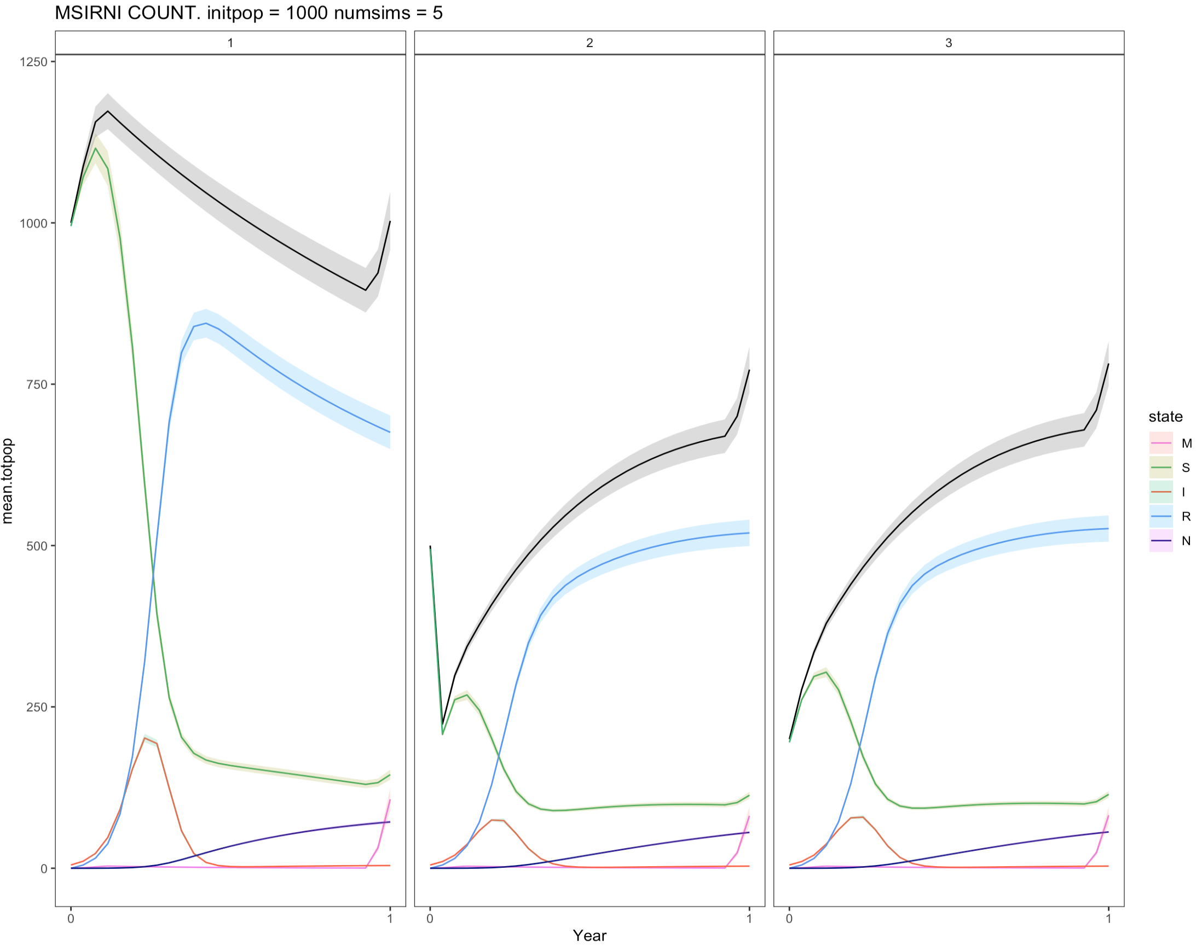
So my idea of ‘low’ dispersal really wasn’t that low at all apparently. Let’s try extra low.
* This also makes sense. Subpop1 has very little dispersal, and subpops 2 and 3 have a bit more. They also started with more similar population sizes, so it makes sense that they end up at a similar population size.

Slide 6
The question then becomes .. How many bats out of 100 disperse each biweek? And does that change throughout the year? And, how do I determine this from the telemetry data?

Slide 7
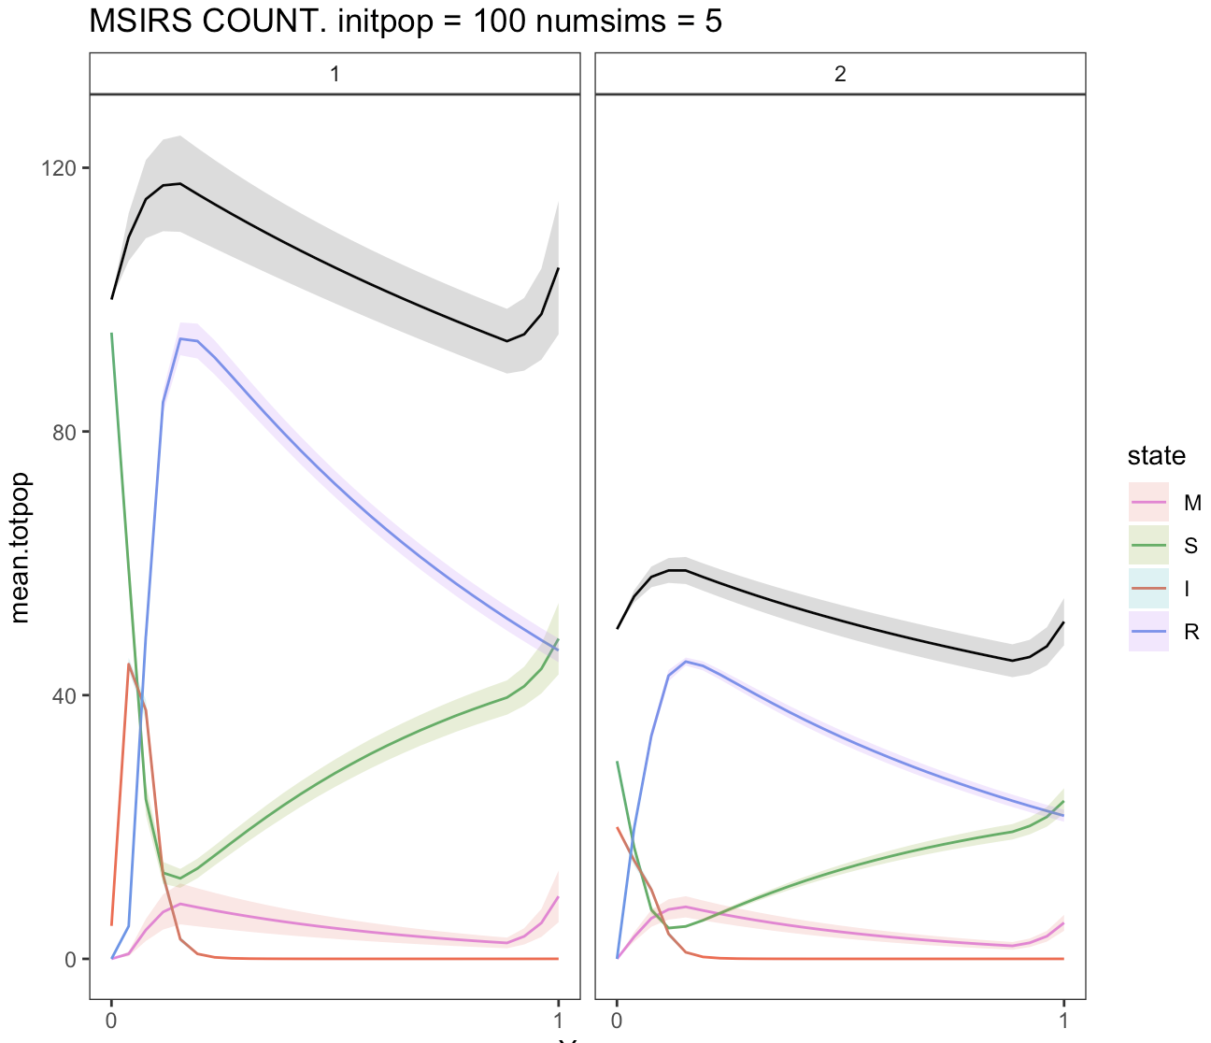
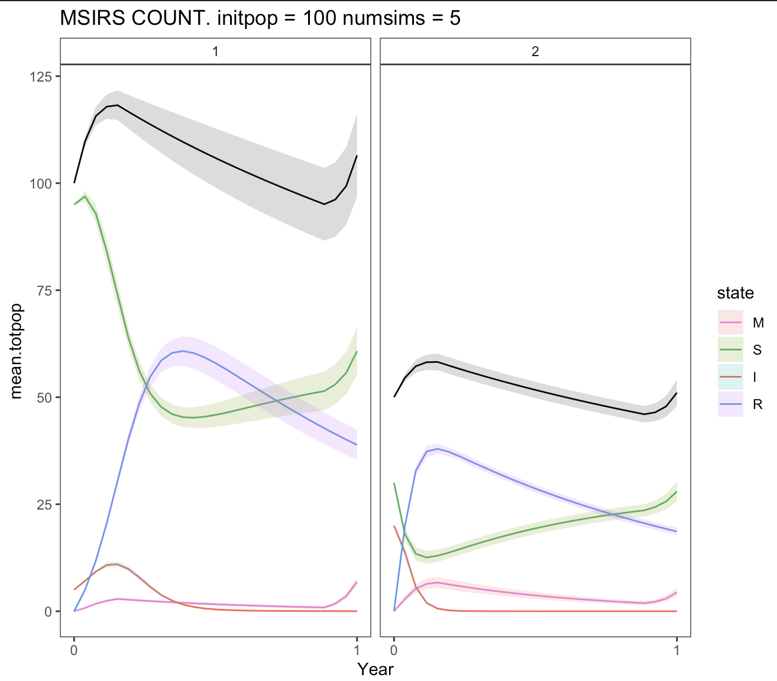
Proof of concept : intermingling
Init S = 100
Init I = 5
Init S = 50
Init I = 20
Init S = 100
Init I = 5
Init S = 50
Init I = 20
Much more infection w/o an increase in individuals
No intermingling
Strong intermingling

