Slide 1


Predicting responses to anti-TNF treatments in rheumatoid arthritis patients from genetic and clinical data using a machine learning approach
Sophia Ju, Marie Hudson, Inés Colmegna, Sasha Bernatsky, Yue Li

Slide 2

Disclosures
We have no conflicts of interest to disclose.
Picture/screenshot taking is NOT ALLOWED during my presentation (including presented slides)

Slide 3




Introduction
Biologic treatments for RA
Anti-TNFs generally preferred first-line
About 30% fail anti-TNF
How could we personalize treatment decisions?
Treatment with anti-TNFs
Responders
Non-responders
Notes:
We now have access to many different biologics to choose from to treat RA, but among them, anti-TNFs are the first therapies that are tried. However, about 30% of patients do not respond well to anti-TNF treatments, and these treatments can be expensive and can also increase the risk of infection. Finding a way to predict response to anti-TNFs would benefit patient health and save money and time.

Slide 4
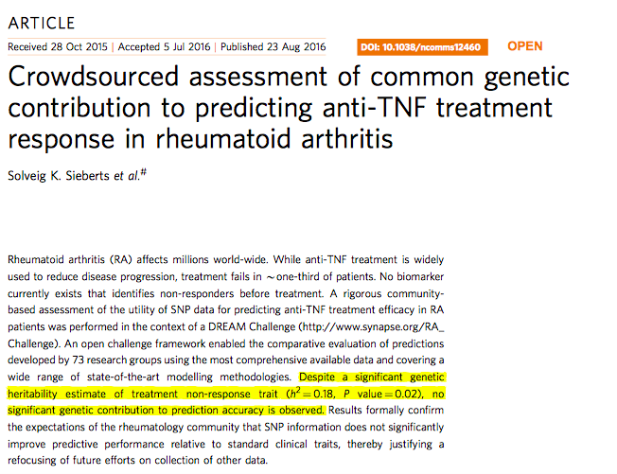
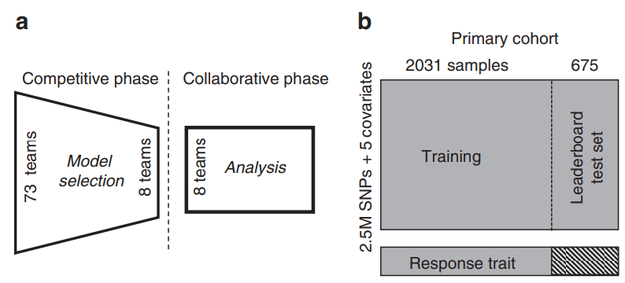
DREAM RA Challenge Review
Sieberts, S. K., Zhu, F., García-García, J., Stahl, E., Pratap, A., Pandey, G., ... & Mangravite, L. M. (2016). Crowdsourced assessment of common genetic contribution to predicting anti-TNF treatment response in rheumatoid arthritis. Nature communications, 7(1), 1-10.
Notes:
In 2014, The Dialogue for Reverse Engineering Assessments and Methods (DREAM) held the RA Responder Challenge. Research teams from around the world were given access to clinical and genomic data and asked to create the best model to predict response to antiTNF therapy. The main conclusions of the challenge were that, despite a significant heritability estimate for the trait of treatment nonresponse, adding genetic data to clinical variables did not improve the prediction accuracy of the various models submitted (7).

Slide 5
Methods
Accessed Dream Challenge data (www. synapse.org)
Rheumatoid Arthritis Responder Challenge - syn1734172 - Wiki (synapse.org)
Updated genome wide assessment toolkits such as PLINK1.9
Test both linear and non-linear machine learning models
Notes:
Our goal was to try to improve upon the results of the competition by using a different approach to selection of genetic data and novel computational methods. We applied and were granted access to the same DREAM CHALLENGE data. Instead of choosing genetic data by looking at existing literature, we used updated genome wide assessment tools, such as PLINK1.9,. to find possible genetic contributors to the TNF non-response trait. We then tested the performance of both linear and non-linear machine learning models.

Slide 6
DREAM RA Challenge Dataset
2706 total patients (2118 responders, 588 non-responders)
Training set - 2031 patients
Testing set - 675 patients
Clinical data
Drug (adalimumab, etanercept, or infliximab)
Age
Gender
Methotrexate co-therapy
Baseline DAS
Genetic data: ~2.5 million single nucleotide polymorphisms or SNPs
Dosages
Genotype probabilities
Outcome
Binary: Responder or Non-responder
Continuous: ∆DAS
Notes:
We were provided with the data of 2706 patients with at least moderate disease activity according to their DAS28 scores. The datasets were combined from 13 different cohorts of European ancestry.
Clinical data included age, sex, methotrexate co-therapy and baseline DAS.
Genomic data was given in the form of single nucleotide polymorphism data or SNP data. In the DREAM challenge, data was imputed across all cohorts to a common dataset of about 2.5 million SNPs. We were provided with both SNP dosage data, or estimated counts of the reference allele, as well as genotype probabilities for each variant in chromosomes 1 through 22.
Treatment outcome was provided as a binary responder versus nonresponder classification and as continuous change in DAS28. Patient status was measured before starting antiTNF therapy and 3-12 months after initiation of therapy.

Slide 7
LD-pruning and p-value thresholding using PLINK
Feature selection
2031 training
~2.5M SNPs
LD pruning
Association test
P-value <.001 thresholding
284 SNPs
675 testing
Notes:
We split the patients into the same training (N=2031) and testing (N=675) subsets that the teams had access to during the training period of the DREAM competition. In contrast to the winning team from the DREAM challenge that selected SNPs based on existing literature on RA (13), we utilized the full genome-wide dataset of 2.5 million SNPs to choose the most significant ones for model training. When considering a genomewide map of SNPs, we must also consider linkage disequilibrium (LD), or the tendency for neighboring alleles to correlate (14). For this reason, a single causal mutation could generate statistical significance in other nearby variants (15). To handle this issue we turned to PLINK to do P-value pruning and thresholding, which consists of LD-pruning followed by thresholding snps at a p-value of .001. This process narrowed down the 2.5 million snps to the 284 most significant snps, on which we could train the models.

Slide 8
Training a model to predict response / non-response
Used sklearn:
Least absolute shrinkage and selection operator (LASSO) with alpha = 0.2
Support Vector Regression (SVR) with gamma = ‘scale’
Random Forest Regressor (RF) with 100 estimators
Instead of classification, used regression to predict a continuous outcome
Use area under ROC curve to evaluate predictions with the true binary label
SNPs only
Clinical only
Both SNPs and Clinical
Notes:
We then used the sklearn library to train one linear model, namely least absolute shrinkage and selection operatror, or LASSO, and 2 non-linear models, namely Support vector regression and random forest regression. Instead of predicting a binary outcome of responder or non-responder, we used regression to predict a continuous outcome, the change in DAS28. When training the model, the labels for each patient were the ∆DAS28 values provided in the clinical data. By taking the predicted response scores and evaluating against the true binary response labels for each patient, we could assess performance using AUROC (area under receiver operating characteristic curve).
We trained all models on the clinical data alone, SNP data alone, and combined SNP and clinical data. We also plotted the feature importance of SNPs from the random forest regression model.

Slide 9
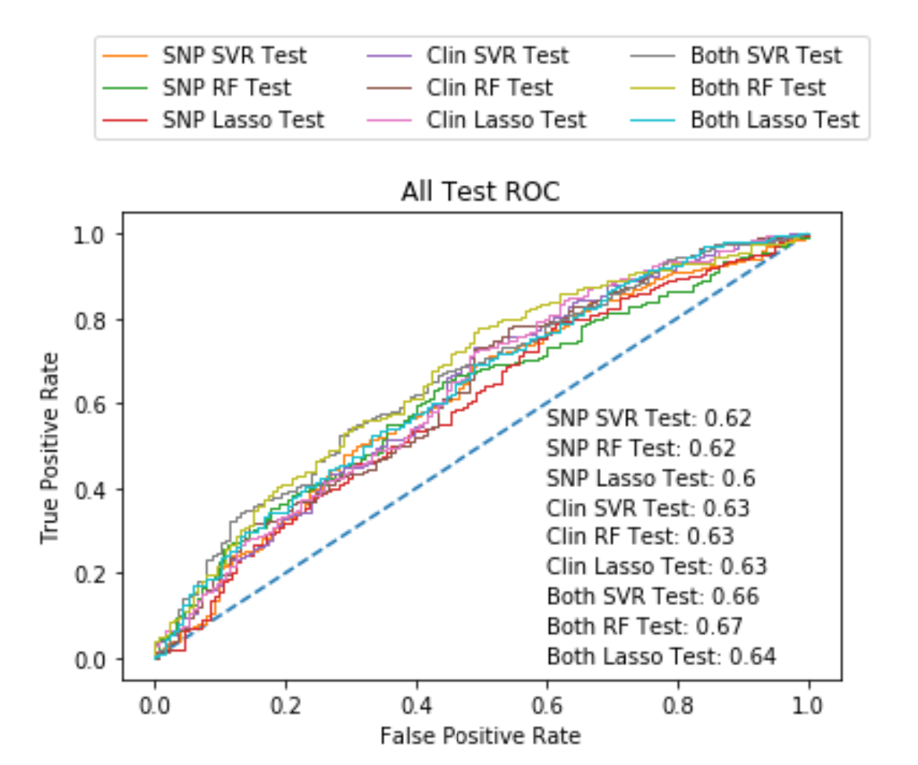


Results
Regression models:
- Linear - Lasso
- Non-linear - Support Vector Regression (SVR) and Random Forest Regression (RF)
SNPs only
Clinical only
Both SNPs and Clinical
Notes:
Here we have plotted the AUROC of all the different models. Contrary to the results of the DREAM challenge, we found that adding SNP data to the models improved the prediction accuracy of all models, compared to the clinical only dataset. This was especially true for the non-linear models. In particular, Random forest improved from an area under the receiver operating curve (AUROC) of 0.63 for the clinical data only to 0.67 when adding SNP data.
- Change camera color to red

Slide 10
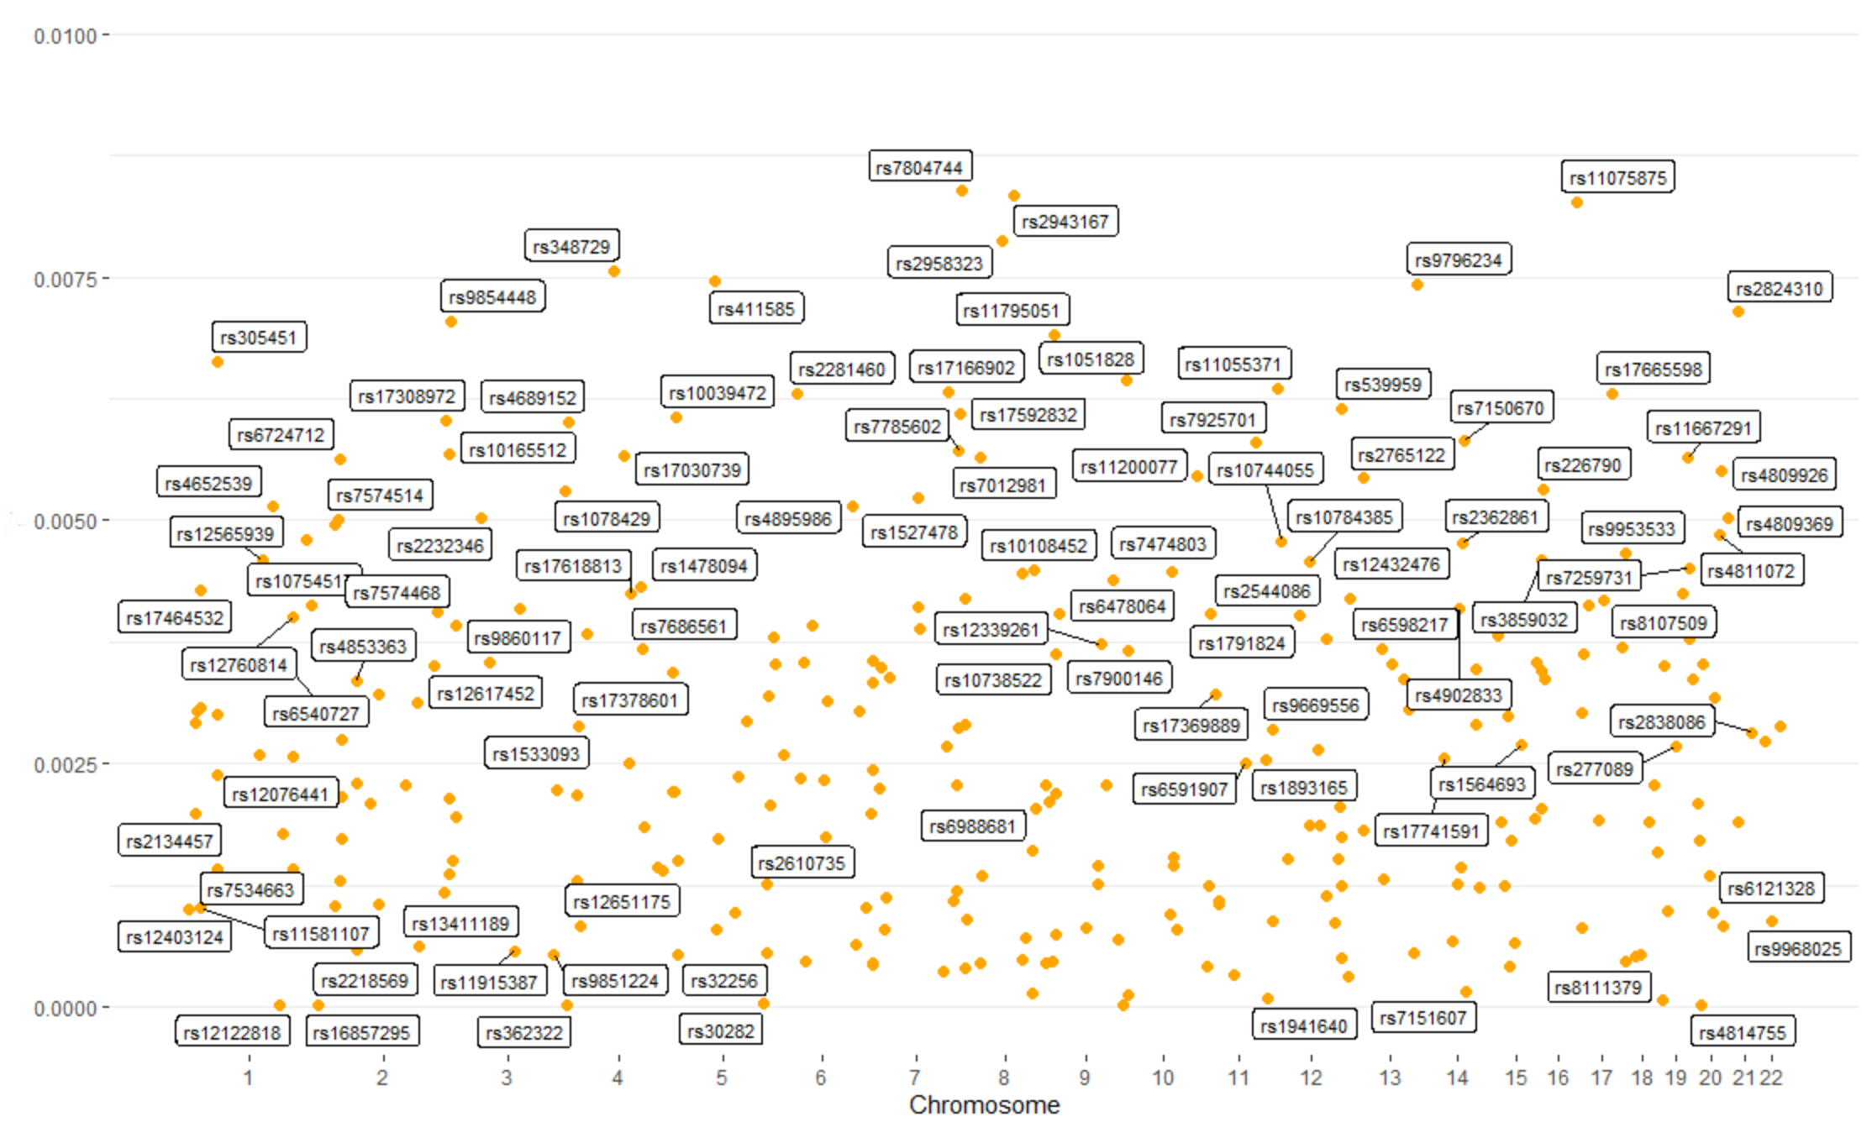
Feature Importance
SNP ID
Related Gene
CNPY1
HYDIN
CNBD1
GRK1
CNTN6
ARHGEF28
Notes:
We linked the 284 SNPs to genes, and among the top genes, found some that have already been implicated in RA (GRK1) and others that require follow up biological exploration
- Camera red

Slide 11
Conclusion
284 SNPs contributed to prediction of RA response to anti-TNF
Superior performance of non-linear methods
Possible interaction between SNPs and clinical variables
An expanded number of clinical variables and exploration of interactions may further improve prediction accuracy
Notes:
In conclusion, we used publicly available clinical and genomic data to generate models to predict RA response to anti-TNF. We identified 284 SNPs that added to the prediction above and beyond basic clinical variables.
Non-linear methods gave larger predictive improvements compared to a linear model. This suggests that there may be interactions between SNPs and clinical covariates.
In the future, we hope to study an expanded number of clinical variables and explore interactions between SNPs and clinical covariates to improve prediction accuracy and answer the important clinical question of predicting RA response to TNF inhibitors.

Slide 12
Acknowledgements

