Slide 1
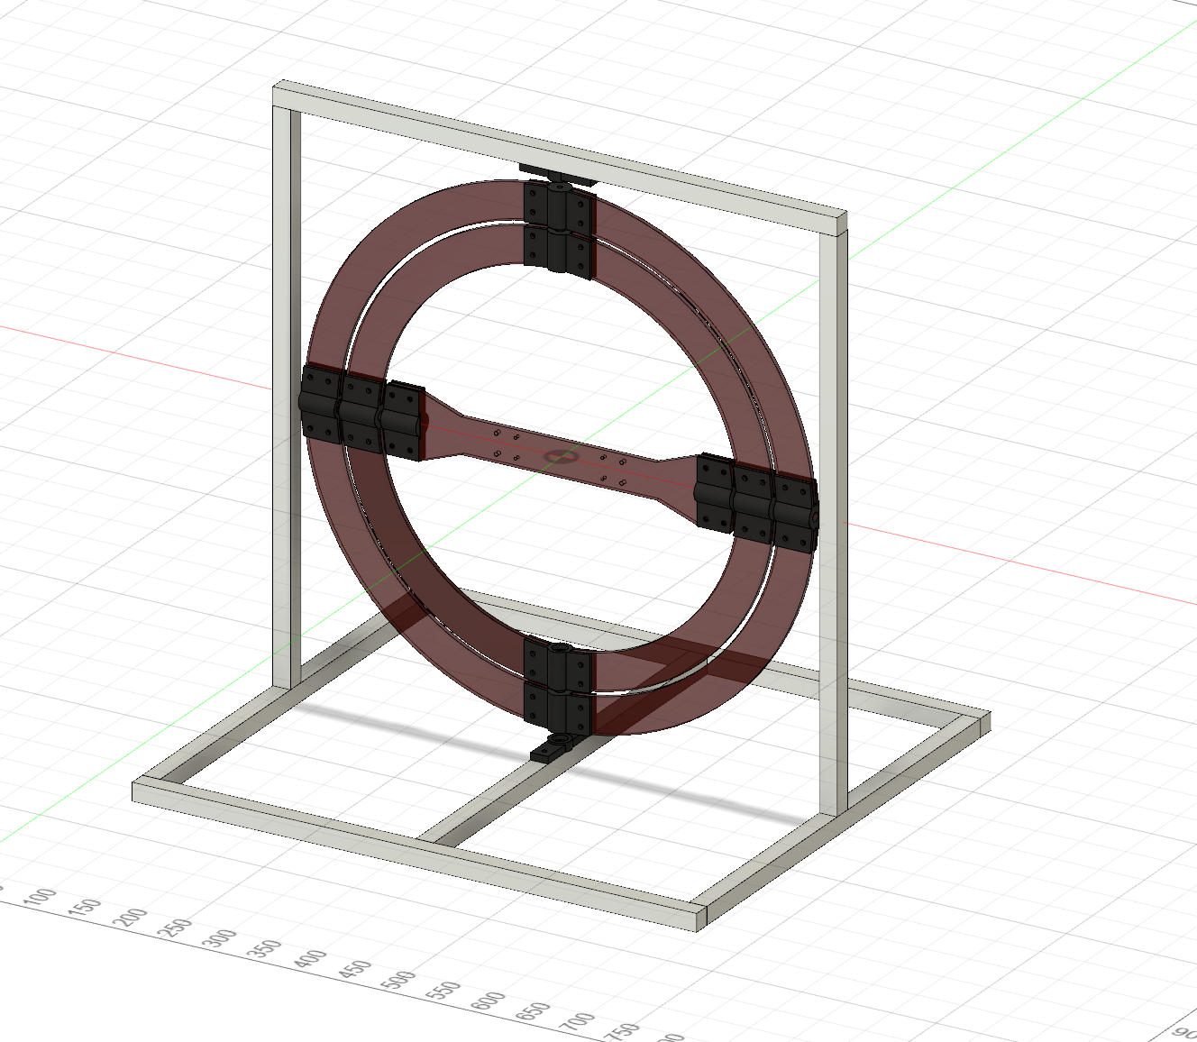
Frame bearing mount
Outer Ring screw mount
Outer ring
Inner Ring screw mount
Inner ring
Outer Ring bearing mount
Inner Ring bearing mount
Drone mount
Drone screw mount
Drone screw mount
Inner Ring bearing mount
Outer Ring bearing mount
Inner Ring screw mount
Outer Ring screw mount
Frame bearing mount

Slide 2
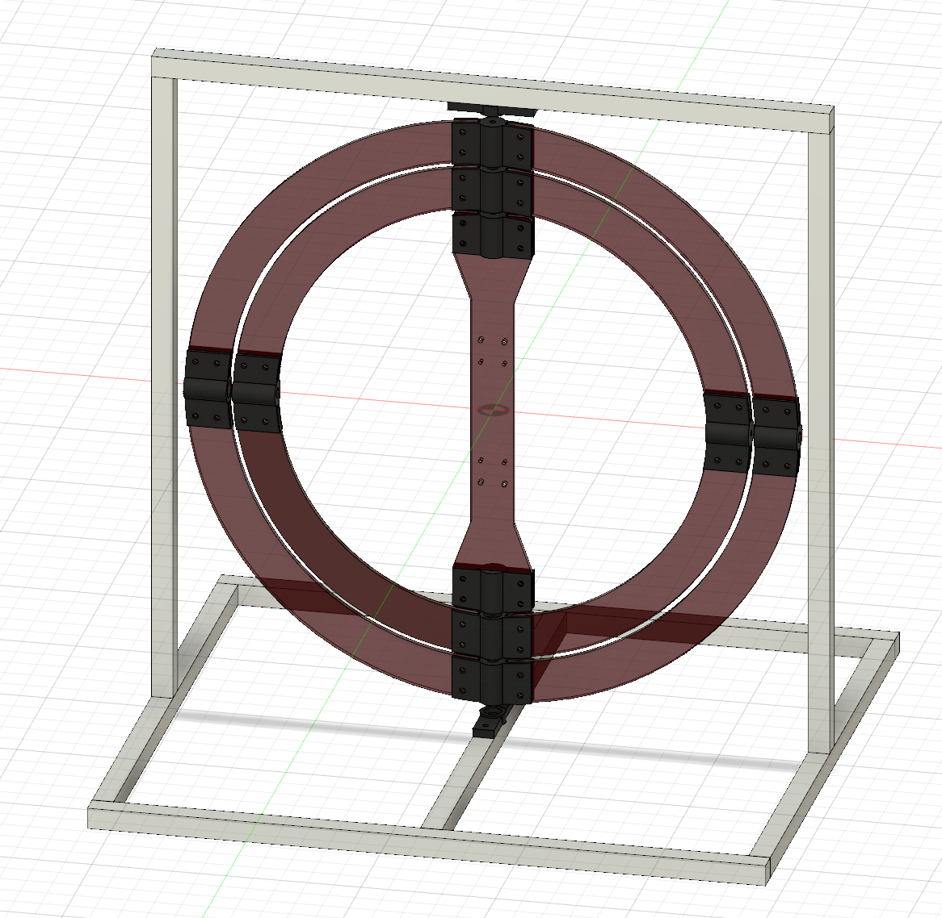
Frame bearing mount
Outer Ring screw mount
Outer ring
Inner Ring bearing mount
Drone screw mount
Inner ring
Drone mount
Inner Ring screw mount
Outer Ring bearing mount
Inner Ring screw mount
Outer Ring bearing mount
Drone screw mount
Inner Ring bearing mount
Outer Ring screw mount
Frame bearing mount

Slide 3
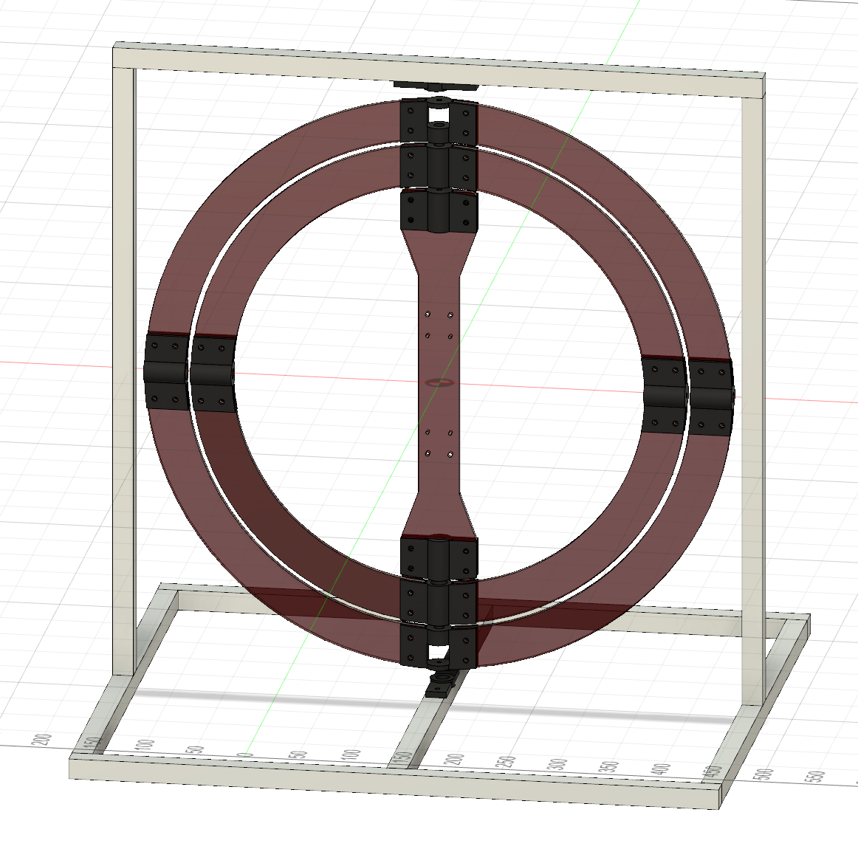
Frame bearing mount
Outer Ring screw mount
Outer ring
Inner Ring bearing mount
Drone screw mount
Inner ring
Drone mount
Inner Ring screw mount
Outer Ring bearing mount
Inner Ring screw mount
Outer Ring bearing mount
Drone screw mount
Inner Ring bearing mount
Outer Ring screw mount
Frame bearing mount

Slide 4
Outer ring
Inner ring
Drone mount

