Slide 1
Analysis of gender stereotypes in personality assessments of recorded speech
Sofia Karamichali – GUID: 2570646K
Supervisor: Dr Evangelia Fringi

Slide 2
Agenda
Project motivation & aims
The corpus
Process
  Statistical Analysis
  Machine Learning
  Within gender assessment
Results & Conclusions
Future work

Slide 3
Motivation/Aims
Personality Perception in social psychology
Analysis of Gender stereotypes in personality perception
  Under zero acquaintace
  Using non-verbal speech

Slide 4
The corpus *
640 audio recordings from a Swiss radio channel
11 non french speaking judges
The Big Five personality triats**
  Openness, Concienciousness, Extraversion, Agreeableness, Neuroticism
  Five scores for every speaker from each judge
Sources:
* G. Mohammadi and A. Vinciarelli. IEEE transactions on affective computing 1 automatic personality perception: Prediction of trait attribution based on prosodic features. 2012.
** R. R. Mccrae and O. P. John. An introduction to the five-factor model and its applications.1992.

Slide 5
Process
Project Aim:
  Analysis of gender stereotype influence on personality percpetion under zero acquiantance using the corpus
Process:
  Statistical analysis
  Machine Learning methodologies
  Within gender assessment

Slide 6
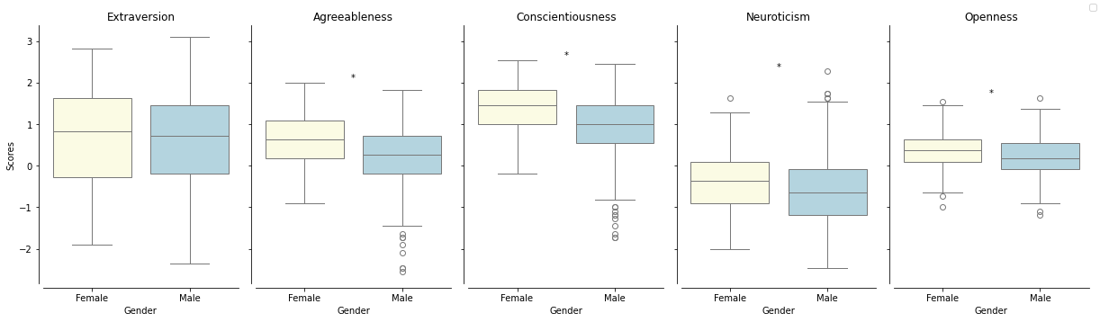
Statistical Analysis
Inter-rater agreement
  Agreement between the 11 judges
  Spearman’s rank correlation & Spearman-Brown reliability
Gender differences
  Student’s t tests
  Imbalanced gender distribution in the dataset
Figure: A series of Box plots illustrating the average personality assessment scores given to audio recordings by the judges. Each plot represents a Big Five personality trait under which the scores were assigned which are separated into the two boxes dedicated to the binary genders. "*" indicators suggest statistical significance according to the t-test results between the genders per trait.

Slide 7
Machine Learning Approach
Used the scikit-learn python library
Five classification algorithms were used
  Features: Big five scores
  Labels: Binary gender
Stratified group k-fold cross validation was used
Hyperparameter tuning was done
Evalutation of the model performance
  Accuracy score & Binomial test
  Student’s t-tests for all performance metrics

Slide 8
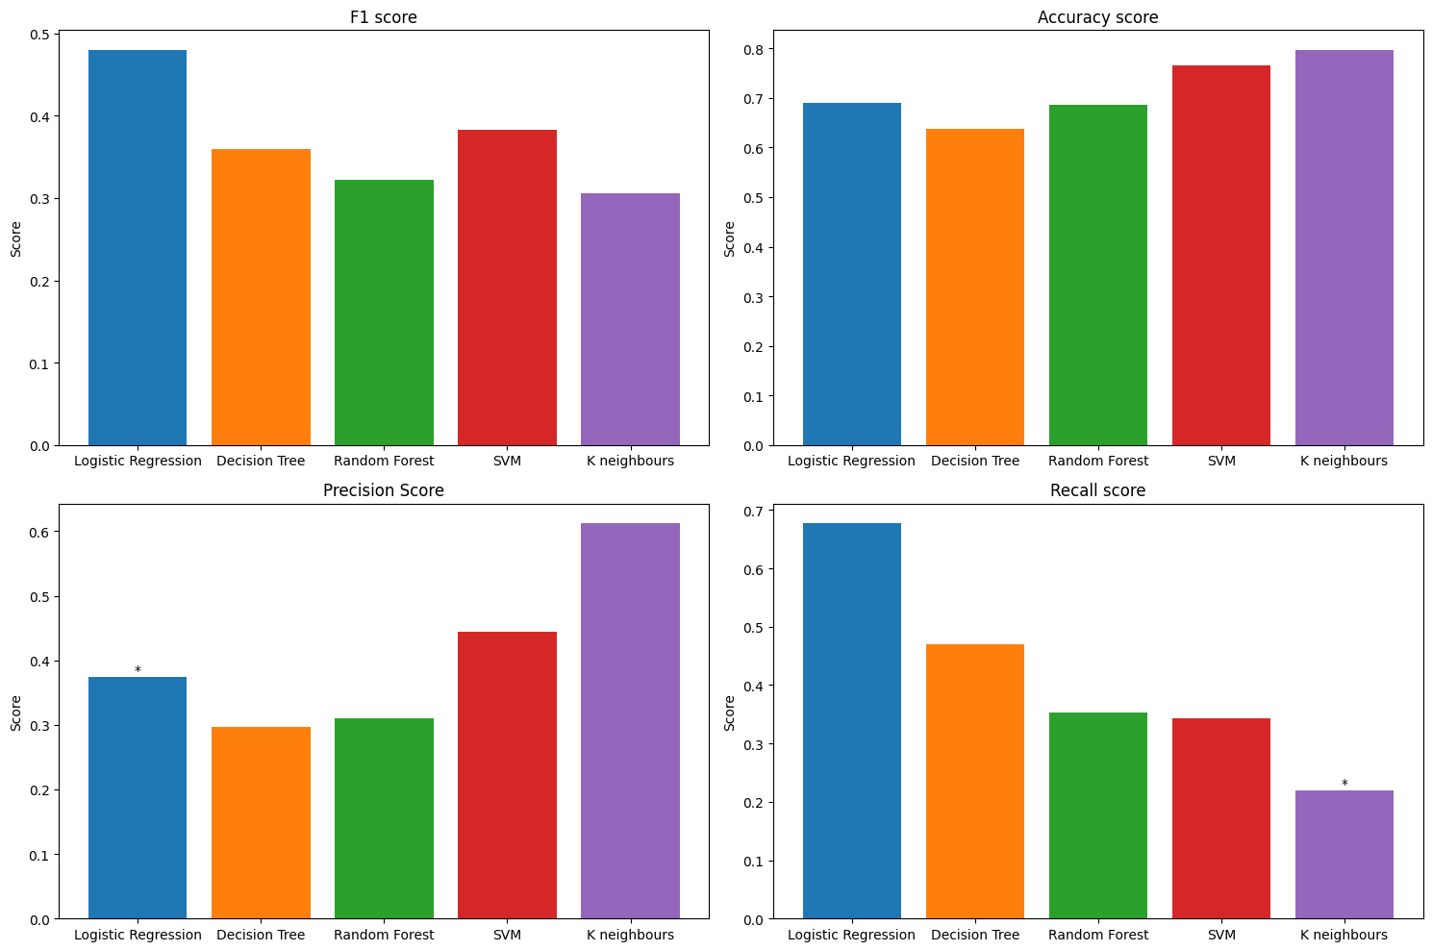
Figure: Bar charts for every performance metric for each classification algorithm's performance post hyperparameter tuning. The "*" indicators suggest statistical significance as a result of Student's t tests between the metric over the k-folds and the prior probability of 66%.

Slide 9
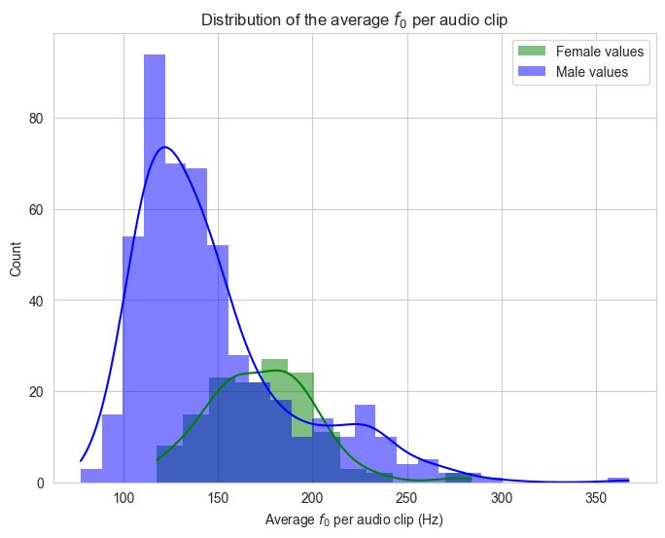
Within gender assessment
Fundamental frequency & gender
Within gender personality perception
Within gender inter-rater agreement
Fundemental frequency extraction using
the openSmile* tool
Spearman’s rank to compare the Big five
scores and fundamental frequency
Sources:
* F. Eyben, M. Wöllmer, and B. Schuller. Opensmile: the munich versatile and fast open-source audio feature extractor. MM ’10, page 1459–1462, New York, NY, USA, 2010. Association for Computing Machinery.
Figure: Distribution of average fundamental frequency 𝑓0 values per audio recording for the two gender groups.

Slide 10
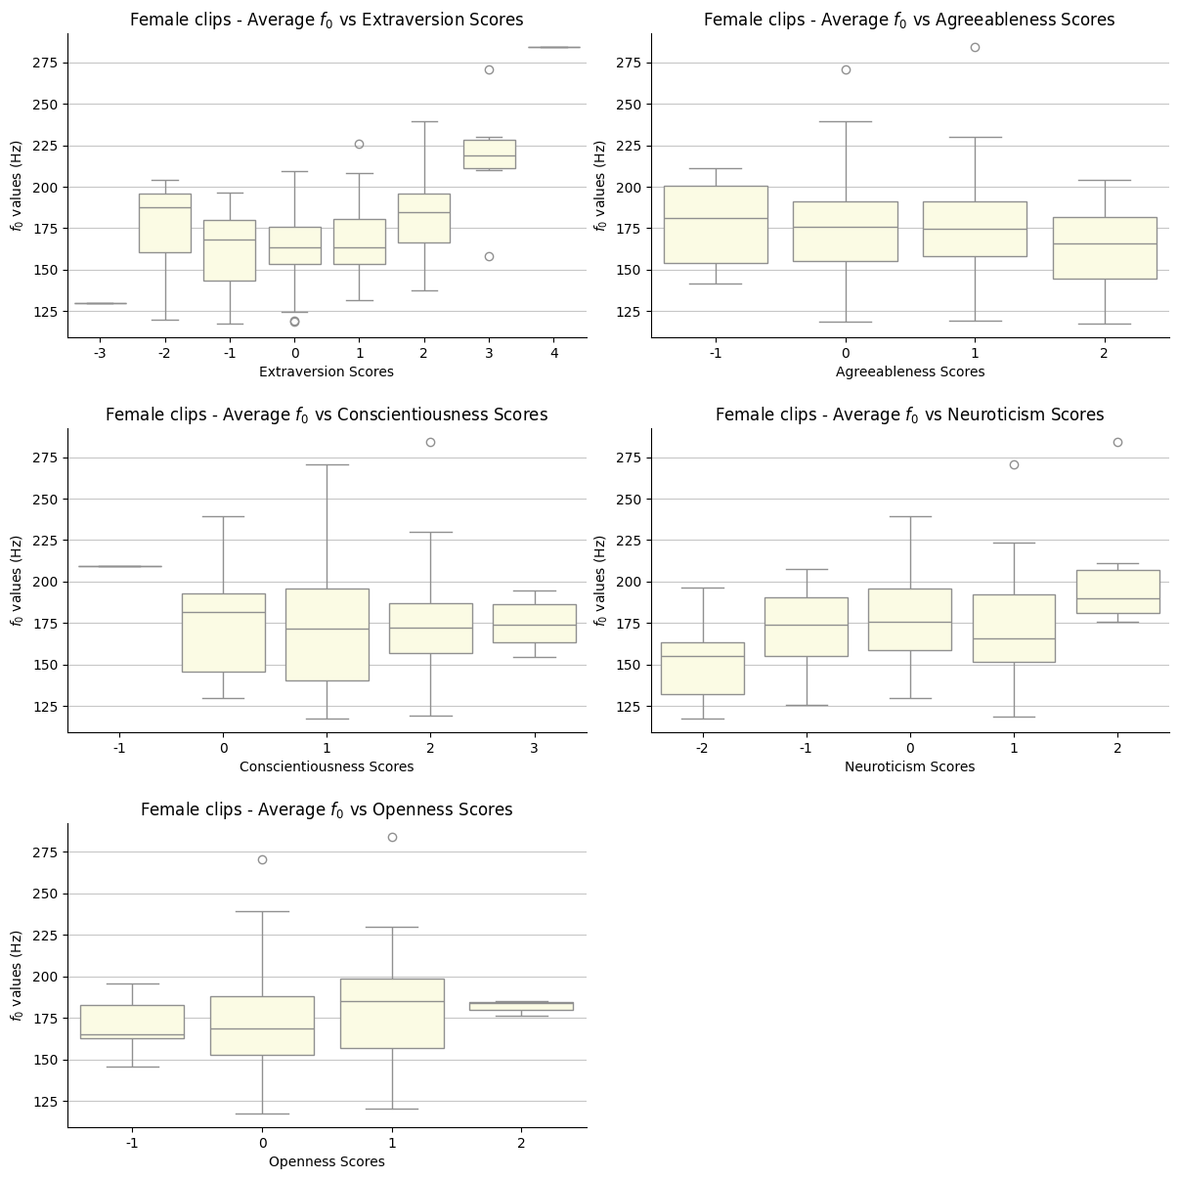
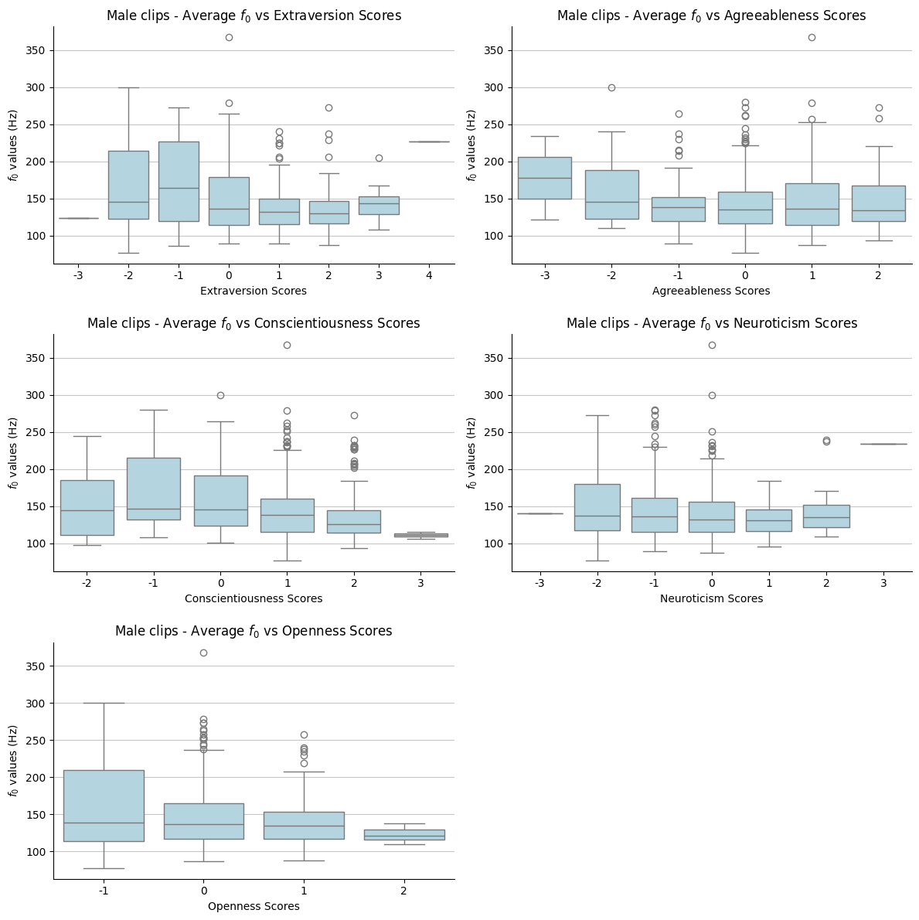
Figure: A series of Box plots illustrating the range of average 𝑓0 values corresponding to each personality perception score for a specific trait assigned to female speakers.
Figure: A series of Box plots illustrating the range of average 𝑓0 values corresponding to each personality perception score for a specific trait assigned to male speakers.

Slide 11
The results & conclusions
Gender stereotypes appear to influence personality perception under zero acquaintance
The impact of gender stereotypes on within gender personality perception remains unclear

Slide 12
Future work
Use of more extensive datasets to establish more conclusive results for the within gender impact of gender bias.
Introduction of more inclusive and representative datasets of the gender spectrum
Further investigation on the adoption of machine learning for the detection of gender stereotypes in datasets.

Slide 13
Thank you

