Slide 1
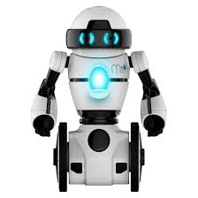
The MiP-App
Remote control for MiP Robots

Slide 2
Description
MiP-App is a mobile application that allows remote control on MiP robots through mobile phone.

Slide 3
Technology and features
NativeScript Framework
Control over bluetooth connection
MiP-BLE-Protocol
Android
iOS

Slide 4
DEMO

