Slide 1
Anti-Money Laundering Detection with Machine Learning
Team Members
Sophia Robles – srobles2@hawk.iit.edu
Nicholas Simpkins – nsimpkins@hawk.iit.edu
Harsh Patel – hpatel100@hawk.iit.edu

Slide 2
Introduction and Motivation
Money laundering is a multi-trillion-dollar international underground market.
It is difficult for various financial institutions across the globe to properly identify ML within their systems.
This is why automated detection systems are important, monitor, flag and review possible ML transactions in real time.
The goal of this project is to develop ML models that can detect fraudulent transactions.

Slide 3
Dataset Overview and Research Goals
Source: IBM AML Dataset (Kaggle)
Size: ~13 million transactions, 1.1GB (combined)
Features: Transaction metadata including bank codes, amounts, currencies, account info, and timestamps
Research Goals (As of now)
Classification: Predict whether a transaction is laundering-related
Anomaly Detection: Flag novel suspicious activity without labels
Modeling: Detect abnormal transaction behavior over time

Slide 4
Supervised Learning
Determine whether an exchange is fishy.
01
By using, Decision Trees, Random Forest, Bagging, XGBoost, SVC, Neural Networks.
02
Evaluation: Accuracy, Precision, Recall, F1, AUC-ROC etc.
03

Slide 5
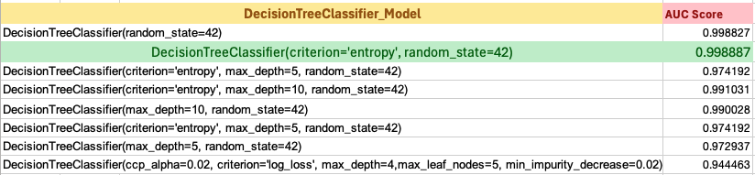
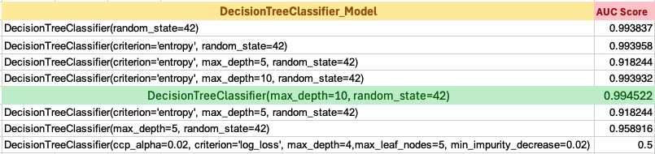
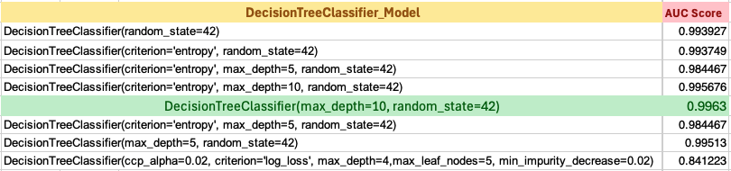
Decision Tree -- USD
Decision Tree -- Bitcoin
Decision Tree -- UKD

Slide 6
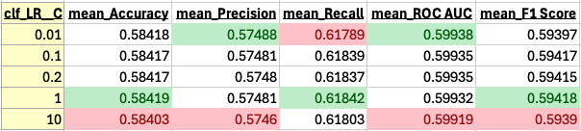
Logistic Regression – Bitcoin Results
Initial Step:
GridSearchCV on the training set only
Multiple C values
Multiple metrics (accuracy, recall, f1, etc.)
STEP-1: Total dataset: 12002394 rows × 11 columns
STEP-2: Filtered Bitcoin dataset:
461347 rows × 11 columns
STEP-3: After applying Normalization and OneHotEncoder: 461347 rows × 38 columns
STEP-4: 75:25 Train:test split
STEP-4 (a): X_train:
346010 rows × 37 cols
y-train: (Imbalanced)
346010 rows × 1 col
(i.e., 0: 345886, 1: 124)
STEP-4 (b): X_test:
115337 rows × 37 cols
y-test:
115337 rows × 1 col
(i.e., 0: 115295, 1: 42)
Second Step:
Retrain the best model using the selected C.
Last Step:
Evaluate on X_test, y_test
The Best Parameters for AUC : {'clf_LR__C’: 0.01}
[TEST DATA] The AUC-ROC Score: 0.6190
[TEST DATA] The accuracy Score: 0.5532
STEP-5 (a): Applying SMOTE
X_train:
691767 rows × 37 cols
y_train: (Balanced now)
691767 rows × 1 col
(i.e., 0: 345886, 1: 345886)
Weights on y_train:
{0: 0.999, 1: 1.000}

Slide 7
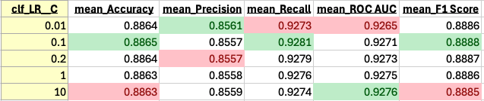
Logistic Regression – UK Pound Results
Initial Step:
GridSearchCV on the training set only
Multiple C values
Multiple metrics (accuracy, recall, f1, etc.)
STEP-1: Total dataset: 12002394 rows × 11 columns
STEP-2: Filtered Bitcoin dataset:
279255 rows × 11 columns
STEP-3: After applying Normalization and OneHotEncoder: 279255 rows × 42 columns
STEP-4: 75:25 Train:test split
STEP-4 (a): X_train:
209441 rows × 41 cols
y-train: (Imbalanced)
209441 rows × 1 col
(i.e., 0: 209312, 1: 129)
STEP-4 (b): X_test:
69814 rows × 41 cols
y-test:
69814 rows × 1 col
(i.e., 0: 69771, 1: 43)
Second Step:
Retrain the best model using the selected C.
Last Step:
Evaluate on X_test, y_test
The Best Parameters for AUC: {'clf_LR__C’: 0.01}
[TEST DATA] The AUC-ROC Score: 0.8475
[TEST DATA] The accuracy Score: 0.8468
STEP-5 (a): Applying SMOTE
X_train:
418615 rows × 37 cols
y_train: (Balanced now)
418615 rows × 1 col
(i.e., 0: 209312, 1: 209303)
Weights on y_train:
{0: 0.999, 1: 1.000}

Slide 8
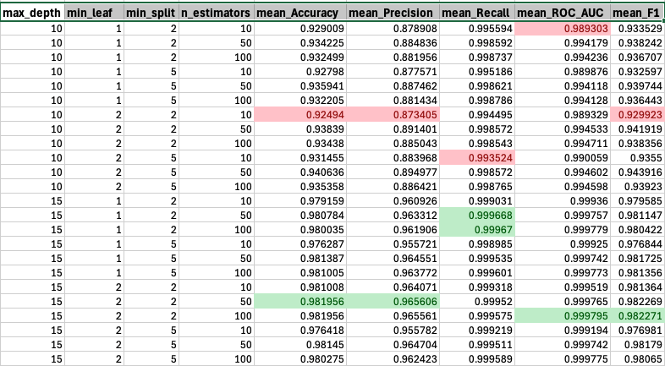
Random Forest – Bitcoin Results
Initial Step:
GridSearchCV on the training set only
Multiple max_depth, min_leaf, min_split, n_estimator values
Multiple metrics (accuracy, precision, recall, ROC_AUC, f1, etc.)
STEP-1: Total dataset: 12002394 rows × 11 columns
STEP-2: Filtered Bitcoin dataset:
461347 rows × 11 columns
STEP-3: After applying Normalization and OneHotEncoder: 461347 rows × 38 columns
STEP-4: 75:25 Train:test split
STEP-4 (a): X_train:
346010 rows × 37 cols
y-train: (Imbalanced)
346010 rows × 1 col
(i.e., 0: 345886, 1: 124)
STEP-4 (b): X_test:
115337 rows × 37 cols
y-test:
115337 rows × 1 col
(i.e., 0: 115295, 1: 42)
Second Step:
Retrain the best model using the selected best parameters.
Last Step:
Evaluate on X_test, y_test
The Best Parameters for AUC :
{'clf_RFC__max_depth': 15, 'clf_RFC__min_samples_leaf': 1, 'clf_RFC__min_samples_split': 5, 'clf_RFC__n_estimators': 100}
[TEST DATA] The AUC-ROC Score: 0.8678
[TEST DATA] The accuracy Score: 0.9733
STEP-5 (a): Applying SMOTE
X_train:
691767 rows × 37 cols
y_train: (Balanced now)
691767 rows × 1 col
(i.e., 0: 345886, 1: 345886)
Weights on y_train:
{0: 0.999, 1: 1.000}

Slide 9
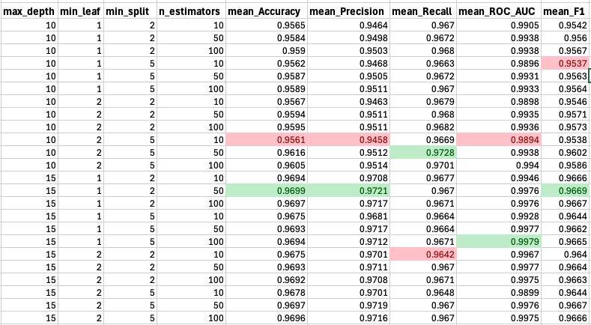
Random Forest – UK Pound Results
Initial Step:
GridSearchCV on the training set only
Multiple max_depth, min_leaf, min_split, n_estimator values
Multiple metrics (accuracy, precision, recall, ROC_AUC, f1, etc.)
STEP-1: Total dataset: 12002394 rows × 11 columns
STEP-2: Filtered Bitcoin dataset:
279255 rows × 11 columns
STEP-3: After applying Normalization and OneHotEncoder: 279255 rows × 42 columns
STEP-4: 75:25 Train:test split
STEP-4 (a): X_train:
209441 rows × 41 cols
y-train: (Imbalanced)
209441 rows × 1 col
(i.e., 0: 209312, 1: 129)
STEP-4 (b): X_test:
69814 rows × 41 cols
y-test:
69814 rows × 1 col
(i.e., 0: 69771, 1: 43)
STEP-5 (a): Applying SMOTE
X_train:
418615 rows × 37 cols
y_train: (Balanced now)
418615 rows × 1 col
(i.e., 0: 209312, 1: 209303)
Weights on y_train:
{0: 0.999, 1: 1.000}
Second Step:
Retrain the best model using the selected best parameters.
Last Step:
Evaluate on X_test, y_test
The Best Parameters for AUC :
{'clf_RFC__max_depth': 15, 'clf_RFC__min_samples_leaf’: 2, 'clf_RFC__min_samples_split’: 2, 'clf_RFC__n_estimators': 100}
[TEST DATA] The AUC-ROC Score: 0.6596
[TEST DATA] The accuracy Score: 0.9565

Slide 10
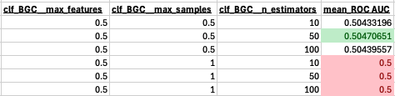
Bagging (Using Naïve Bayes) – Bitcoin Results
STEP-1: Total dataset: 12002394 rows × 11 columns
Initial Step:
GridSearchCV on the training set only
Multiple n_estimator, max_samples and max_feature values
ROC scores.
STEP-2: Filtered Bitcoin dataset:
461347 rows × 11 columns
STEP-3: After applying Normalization and OneHotEncoder: 461347 rows × 38 columns
STEP-4: 75:25 Train:test split
STEP-4 (a): X_train:
346010 rows × 37 cols
y-train: (Imbalanced)
346010 rows × 1 col
(i.e., 0: 345886, 1: 124)
STEP-4 (b): X_test:
115337 rows × 37 cols
y-test:
115337 rows × 1 col
(i.e., 0: 115295, 1: 42)
Second Step:
Retrain the best model using the selected best parameters.
Last Step:
Evaluate on X_test, y_test
The Best Parameters for AUC :
{'clf_BGC__max_features': 0.5, 'clf_BGC__max_samples': 0.5, 'clf_BGC__n_estimators': 50}
[TEST DATA] The AUC-ROC Score: 0.5085
[TEST DATA] The accuracy Score: 0.0138
STEP-5 (a): Applying SMOTE
X_train:
691767 rows × 37 cols
y_train: (Balanced now)
691767 rows × 1 col
(i.e., 0: 345886, 1: 345886)
Weights on y_train:
{0: 0.999, 1: 1.000}

Slide 11
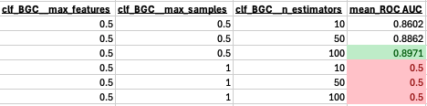
Bagging (Using Naïve Bayes) – UK Pound Results
Initial Step:
GridSearchCV on the training set only
Multiple n_estimator, max_samples and max_feature values
ROC scores.
STEP-1: Total dataset: 12002394 rows × 11 columns
STEP-2: Filtered Bitcoin dataset:
279255 rows × 11 columns
STEP-3: After applying Normalization and OneHotEncoder: 279255 rows × 42 columns
STEP-4: 75:25 Train:test split
STEP-4 (a): X_train:
209441 rows × 41 cols
y-train: (Imbalanced)
209441 rows × 1 col
(i.e., 0: 209312, 1: 129)
STEP-4 (b): X_test:
69814 rows × 41 cols
y-test:
69814 rows × 1 col
(i.e., 0: 69771, 1: 43)
Second Step:
Retrain the best model using the selected best parameters.
Last Step:
Evaluate on X_test, y_test
The Best Parameters for AUC :
{'clf_BGC__max_features': 0.5, 'clf_BGC__max_samples': 0.5, 'clf_BGC__n_estimators': 50}
[TEST DATA] The AUC-ROC Score: 0.7893
[TEST DATA] The accuracy Score: 0.0186
STEP-5 (a): Applying SMOTE
X_train:
418615 rows × 37 cols
y_train: (Balanced now)
418615 rows × 1 col
(i.e., 0: 209312, 1: 209303)
Weights on y_train:
{0: 0.999, 1: 1.000}

Slide 12
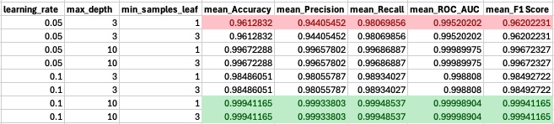
Gradient Boosting Classifier – Bitcoin Results
STEP-1: Total dataset: 12002394 rows × 11 columns
Initial Step:
GridSearchCV on the training set only
Multiple learning_rate, max_depth, and min_samples_leaf values.
Multiple metrics (accuracy, precision, recall, ROC_AUC, f1, etc.)
STEP-2: Filtered Bitcoin dataset:
461347 rows × 11 columns
STEP-3: After applying Normalization and OneHotEncoder: 461347 rows × 38 columns
STEP-4: 75:25 Train:test split
STEP-4 (a): X_train:
346010 rows × 37 cols
y-train: (Imbalanced)
346010 rows × 1 col
(i.e., 0: 345886, 1: 124)
STEP-4 (b): X_test:
115337 rows × 37 cols
y-test:
115337 rows × 1 col
(i.e., 0: 115295, 1: 42)
Second Step:
Retrain the best model using the selected best parameters.
Last Step:
Evaluate on X_test, y_test
The Best Parameters for AUC :
{'clf_GBC__learning_rate': 0.1, 'clf_GBC__max_depth': 10, 'clf_GBC__min_samples_leaf': 1}
[TEST DATA] The AUC-ROC Score: 0.7544
[TEST DATA] The accuracy Score: 0.9991
STEP-5 (a): Applying SMOTE
X_train:
691767 rows × 37 cols
y_train: (Balanced now)
691767 rows × 1 col
(i.e., 0: 345886, 1: 345886)
Weights on y_train:
{0: 0.999, 1: 1.000}

Slide 13
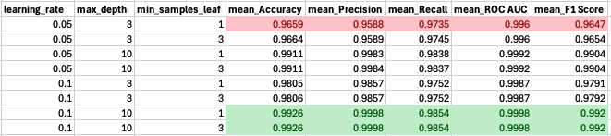
Gradient Boosting Classifier – UK Pound Results
Initial Step:
GridSearchCV on the training set only
Multiple learning_rate, max_depth, and min_samples_leaf values.
Multiple metrics (accuracy, precision, recall, ROC_AUC, f1, etc.)
STEP-1: Total dataset: 12002394 rows × 11 columns
STEP-2: Filtered Bitcoin dataset:
279255 rows × 11 columns
STEP-3: After applying Normalization and OneHotEncoder: 279255 rows × 42 columns
STEP-4: 75:25 Train:test split
STEP-4 (a): X_train:
209441 rows × 41 cols
y-train: (Imbalanced)
209441 rows × 1 col
(i.e., 0: 209312, 1: 129)
STEP-4 (b): X_test:
69814 rows × 41 cols
y-test:
69814 rows × 1 col
(i.e., 0: 69771, 1: 43)
Second Step:
Retrain the best model using the selected best parameters.
Last Step:
Evaluate on X_test, y_test
The Best Parameters for AUC :
{'clf_BGC__max_features': 0.1, 'clf_BGC__max_samples’: 10, 'clf_BGC__n_estimators’: 1}
[TEST DATA] The AUC-ROC Score: 0.8712
[TEST DATA] The accuracy Score: 0.9993
STEP-5 (a): Applying SMOTE
X_train:
418615 rows × 37 cols
y_train: (Balanced now)
418615 rows × 1 col
(i.e., 0: 209312, 1: 209303)
Weights on y_train:
{0: 0.999, 1: 1.000}

Slide 14
SVC – Bitcoin Results
STEP-1: Total dataset: 12002394 rows × 11 columns
Initial Step:
GridSearchCV on the training set only
Multiple learning_rate, max_depth, and min_samples_leaf values.
Multiple metrics (accuracy, precision, recall, ROC_AUC, f1, etc.)
STEP-2: Filtered Bitcoin dataset:
461347 rows × 11 columns
STEP-3: After applying Normalization and OneHotEncoder: 461347 rows × 38 columns
STEP-4: 75:25 Train:test split
STEP-4 (a): X_train:
346010 rows × 37 cols
y-train: (Imbalanced)
346010 rows × 1 col
(i.e., 0: 345886, 1: 124)
STEP-4 (b): X_test:
115337 rows × 37 cols
y-test:
115337 rows × 1 col
(i.e., 0: 115295, 1: 42)
Second Step:
Retrain the best model using the selected best parameters.
Last Step:
Evaluate on X_test, y_test
The Best Parameters for AUC :
{'clf_csv__C': 1, 'clf_csv__kernel': 'linear’}
[TEST DATA] The AUC-ROC Score: 0.5000
[TEST DATA] The accuracy Score: 0.0004
STEP-5 (a): Applying SMOTE
X_train:
691767 rows × 37 cols
y_train: (Balanced now)
691767 rows × 1 col
(i.e., 0: 345886, 1: 345886)
Weights on y_train:
{0: 0.999, 1: 1.000}

Slide 15
SVC – UK Pound Results
Initial Step:
GridSearchCV on the training set only
Multiple learning_rate, max_depth, and min_samples_leaf values.
Multiple metrics (accuracy, precision, recall, ROC_AUC, f1, etc.)
STEP-1: Total dataset: 12002394 rows × 11 columns
STEP-2: Filtered Bitcoin dataset:
279255 rows × 11 columns
STEP-3: After applying Normalization and OneHotEncoder: 279255 rows × 42 columns
STEP-4: 75:25 Train:test split
Second Step:
Retrain the best model using the selected best parameters.
Last Step:
Evaluate on X_test, y_test
The Best Parameters for AUC :
{'clf_csv__C': 1, 'clf_csv__kernel': 'linear’}
[TEST DATA] The AUC-ROC Score: 0.7153
[TEST DATA] The accuracy Score: 0.0396
STEP-4 (a): X_train:
209441 rows × 41 cols
y-train: (Imbalanced)
209441 rows × 1 col
(i.e., 0: 209312, 1: 129)
STEP-4 (b): X_test:
69814 rows × 41 cols
y-test:
69814 rows × 1 col
(i.e., 0: 69771, 1: 43)
STEP-5 (a): Applying SMOTE
X_train:
418615 rows × 37 cols
y_train: (Balanced now)
418615 rows × 1 col
(i.e., 0: 209312, 1: 209303)
Weights on y_train:
{0: 0.999, 1: 1.000}

Slide 16
Unsupervised Learning
To detect anomalies without labeled data (i.e., that set off from predictable trends.)
1
Isolation Forest, One-Class SVM, Autoencoders, and possible clustering.
2
Evaluation: How most identified anomalies that set off from predictable trends.
3

Slide 17
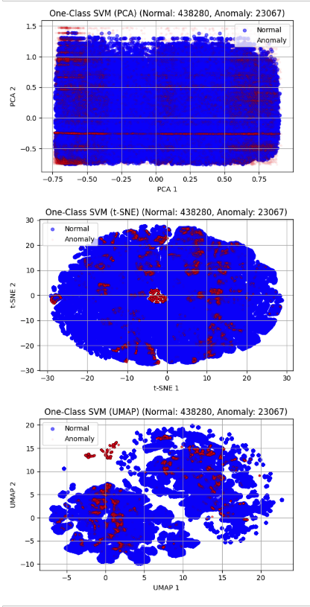
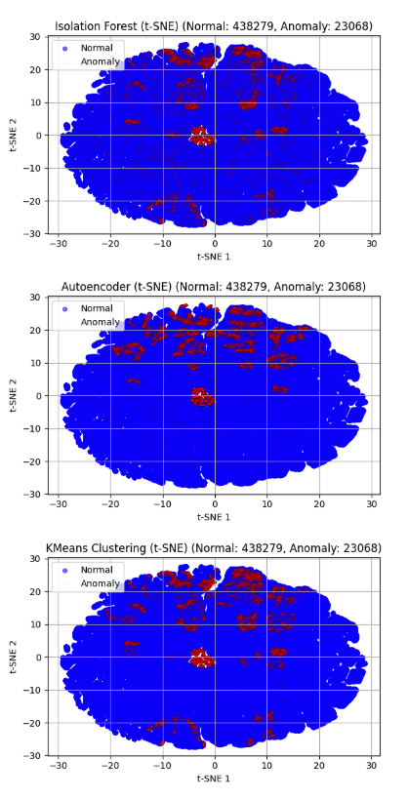
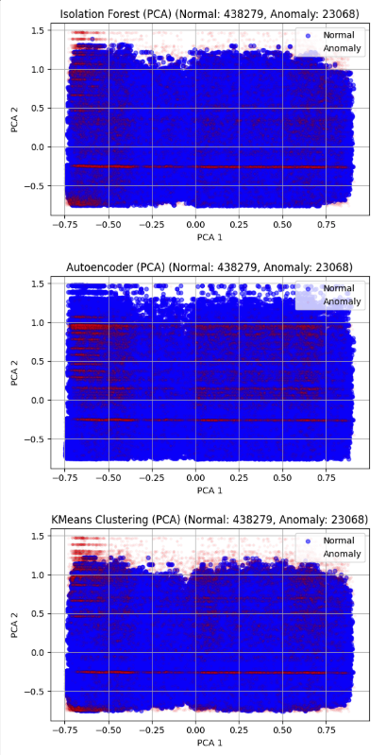
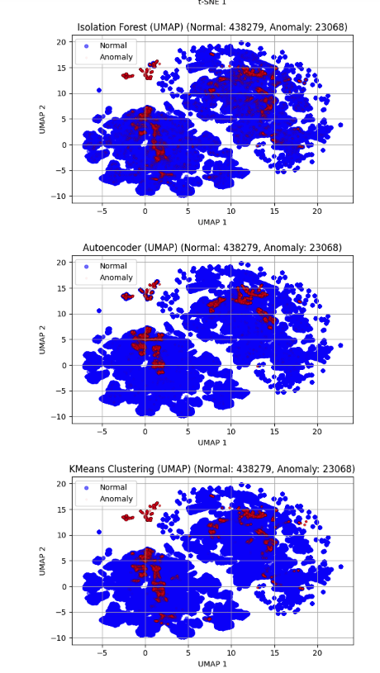
Isolation Forest, Autoencoders, K-means Clustering Results
Bitcoin (Normal: 438279, Anomaly: 23068)

Slide 18
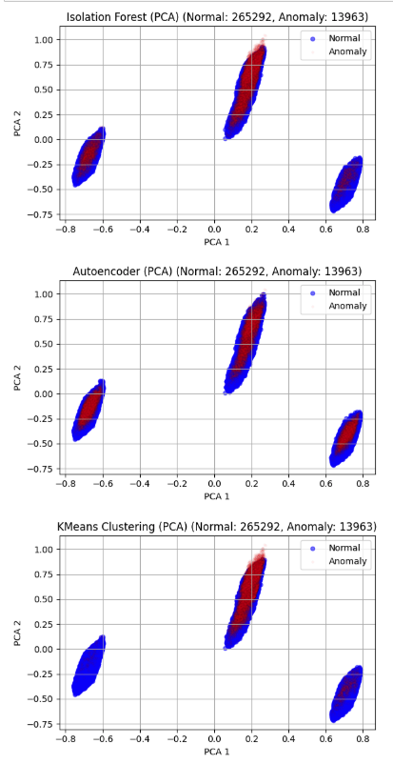
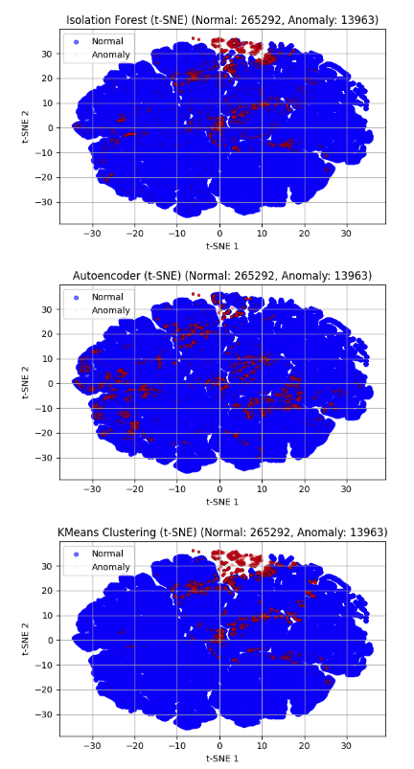
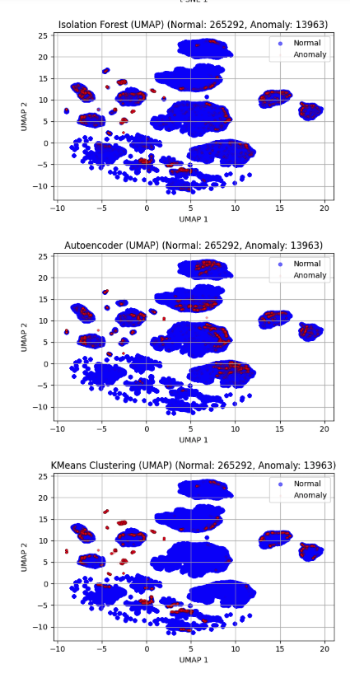
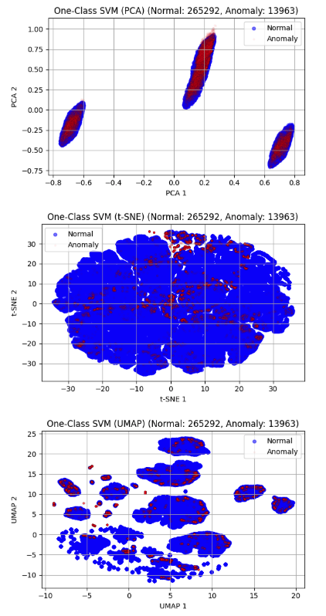
Isolation Forest, Autoencoders, K-means Clustering Results
UK Pound (Normal: 265292, Anomaly: 13963)

Slide 19
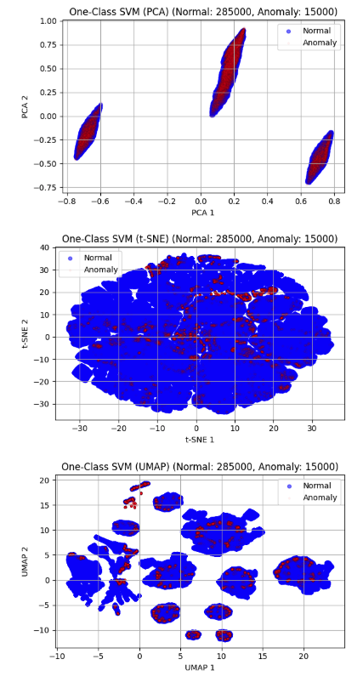
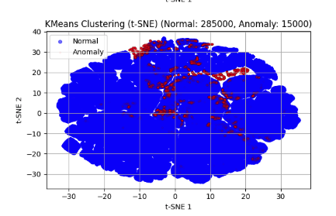
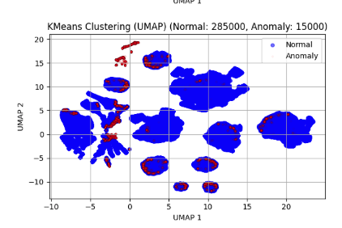
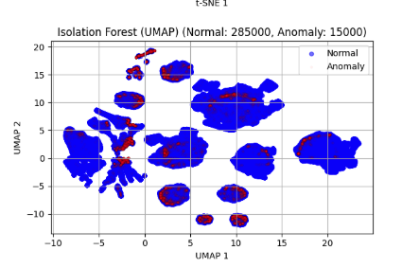
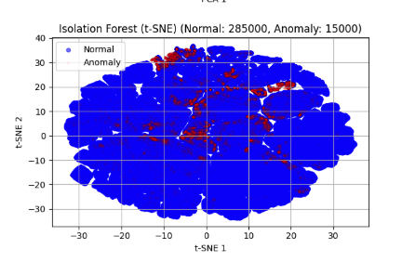
Isolation Forest, Autoencoders, K-means Clustering Results
US Dollar (Normal: 285000, Anomaly: 15000)

Slide 20
Future work – Most promising if huge dataset.
Recurrent Neural Networks (RNN) / LSTM (Long-Short term memory)
Objective: Classify if transaction is fraud (1) or non-fraud (0).
STEP-1: Group by from bank, account number and investigate values by hourly/daily.
STEP-2: Normalized and OneHotEncoding into dataset.
STEP-3: Rolling window into 2 cols -- to sum up last last hour and 24 hours transaction or past N number of transactions (i.e., last N=25 transactions).
STEP-4: Split the dataset into n:100-n train:test split.
STEP-5: build an RNN model
STEP-6: Train on sequence to predict if the next transaction is fraud using the Long-term memory and feeding short-term memory.
STEP-7: RNN: Updated after each transaction, and having problem with long-term memory so we need to use LSTM in that case.
STEP-8: LSTM use gates (Forget → Input → output gates) for pattern input.
STEP-9: So, we can get if the next transaction is fraud or not.

