Slide 1


Java & Object Oriented Programming

Slide 2


Welcome!
J
A
V
A
Java Intro
My 1st Code
Objects In Java
Design using Objects

Slide 3
What’s Java?
I
N
T
R
O
Java is a programming language and computing platform first released by Sun Microsystems in 1995.
Object Oriented language.
Write once, runs everywhere

Slide 4






Who needs it?
I
N
T
R
O
Most popular languages:
#1 Java - #2 C - #3 C++ (src: Mashable.com)
Companies who use Java

Slide 5
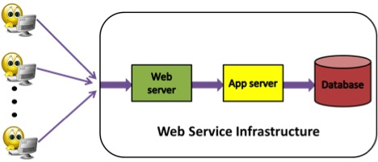
How is Java used?
I
N
T
R
O
Java is mostly used for « Backend » application inside the application server.

Slide 6
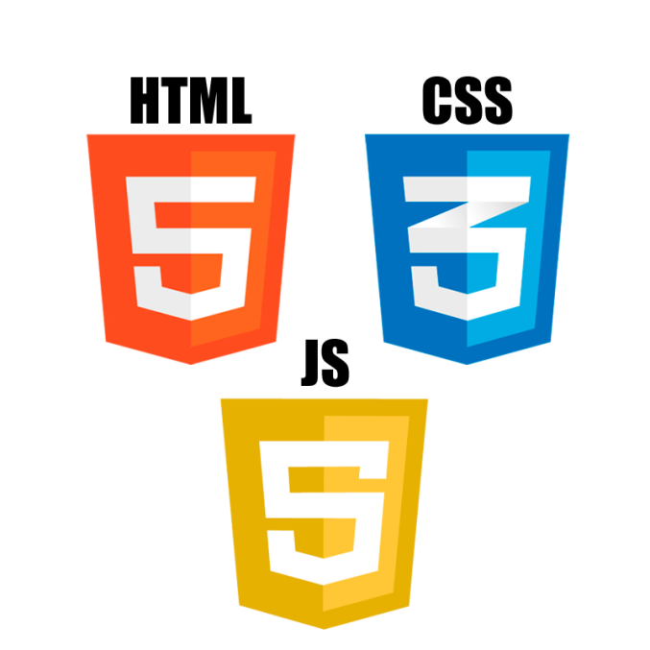
The Webstack – Front End
I
N
T
R
O

Slide 7

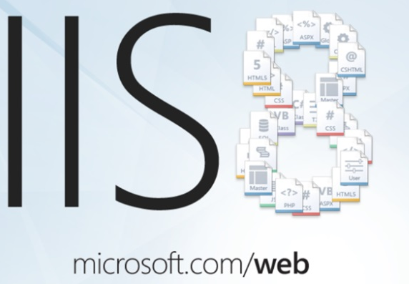
The Webstack – Web Sever
I
N
T
R
O

Slide 8
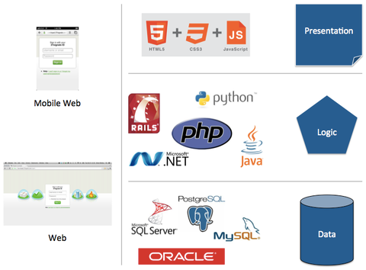
The Webstack – BackEnd
I
N
T
R
O

Slide 9
The Webstack – BackEnd
I
N
T
R
O

Slide 10
My first Java program
1st
C
O
D
E
Download JDK from Oracle.com http://www.oracle.com/technetwork/java/javase/downloads/jdk7-downloads-1880260.html
Download GAJavaIntro folder from GitHub. https://github.com/sophianachiba/GAJavaIntro
Open command prompt
Go to your GAJavaIntro folder
Run command: javac helloworld.java
Run command: java helloworld
Result: « Hello World »

Slide 11
1st
C
O
D
E
What just happened?

Slide 12
1st
C
O
D
E
Human Language
Machine Language
helloworld.java
helloworld.class
‘Javac xx’
Compiles java files into class file.
‘Java xx’
Execute the code
Hello World

Slide 13
Java Data Type
1st
C
O
D
E
Number: int, double (most used)
int myAge = 21; double pie= 3.14;
Character: Char (holds only one)
char myMiddleName = ‘F’;
Text: String
String myName = «Sophian »
Logical: boolean (true or false)
boolean loveCoffee = true;

Slide 14
Exercise – My Name Is
1st
C
O
D
E
Fix MyNameis.java
Replace the XXX
Your program should display: « My name is Sophian I'm 21 and I'm smart.»
Remember to run Javac and Java
Notes:
Exercise for student to fix and display their name, middle name age and if they love coffee

Slide 15
Object Oriented Program
O
B
J
E
C
T
Programming paradigm that represents concepts as “Objects“
Object contains data fields and methods.
A class is an object definition.
Creation of an object is done by:
new myObject();

Slide 16
O
B
J
E
C
T
Class Name
Data Field
class Car{
private int type; //i.e suv
private int mpg = 35;
public int CalcMilesFor(int gallons){
return mpg * gallons;
}
}
Method

Slide 17
O
B
J
E
C
T
Your 1st Object.

Slide 18
Exercise - Travel Agency
O
B
J
E
C
T
Build travel agency applicaton. Use Travel.java as your base.
Capture the From and To in your Object.
Also Capture Number of Passenger
Calculate the total price and print out the trip summary. (Assume a flat rate for all trip)

Slide 19
Object Oriented Program
O
B
J
E
C
T
Inheritance is when an object or class is based on another object or class and inheritate its property.
Encapsulation is mechanism for restricting access to some of the object's components.
Polymorphism is the ability for objects to take many forms.

Slide 20
O
B
J
E
C
T
Inheritance
Encapsulation
class Ferari extends Car{
private String model;
public String getModel(){
return « Ferrari » + model;
}
}

Slide 21
O
B
J
E
C
T
Polymorphism
class Prius extends Car implements Hybrid{
…
}

Slide 22
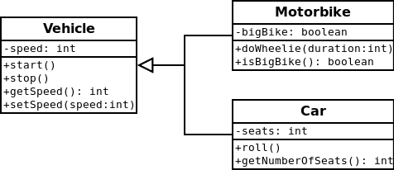
Class Diagram
O
B
J
E
C
T

Slide 23
D
E
S
I
G
N
Let’s Design!

Slide 24
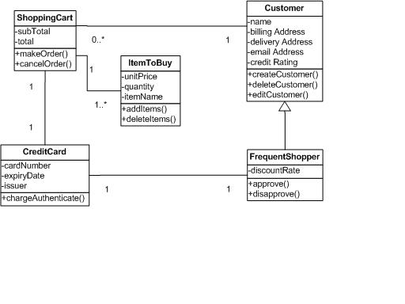
Online Shopping Example
D
E
S
I
G
N

Slide 25
D
E
S
I
G
N
Design Facebook!
Notes:
Creates group of Student and have them present their work

