Slide 1
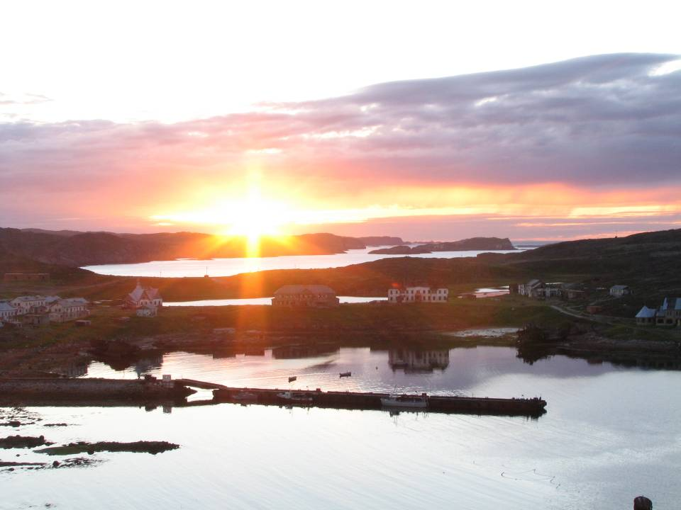



Linear growth of Macoma balthica
(North Atlantic and Arctic Oceans).
Sophia A. Nazarova, Nikolay V. Maximovich
St-Petersburg State University
Russian State Pedagogical University
Floating Marine Research Center

Slide 2
Author data:
Barents Sea, 2007-2008
Hypothesys:
  At the west sites Macoma balthica growth rate is lower then at the east sites, because of smaller impact of the Nordkapp stream.
  At the low tidal level Macoma balthica growth rate is higher than at the middle and high levels, because of more time for feeding.

Slide 3
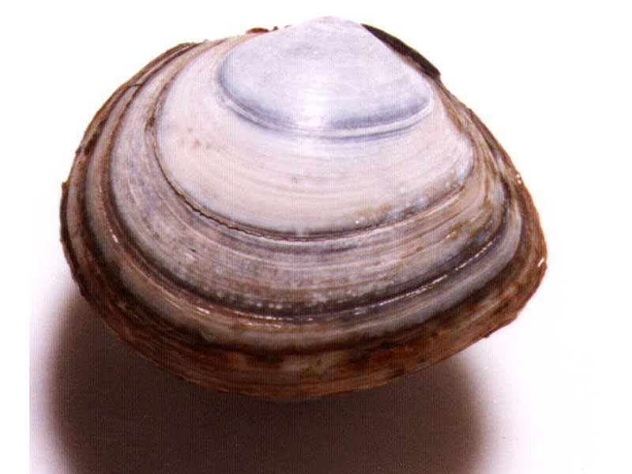
Methods
The growth was described by von Bertalanffy equation:
L=La*(1-exp(k*t-t0))
comparison the growth curves
  analyze residual dispersion (Allen, 1976).
  F/Fcr. ratio — index of distance (Maximovich, 1989).
Www.marlin.co.uk
The growth rate was determined by the width of annual growth ring of the shellls (red arrows)

Slide 4
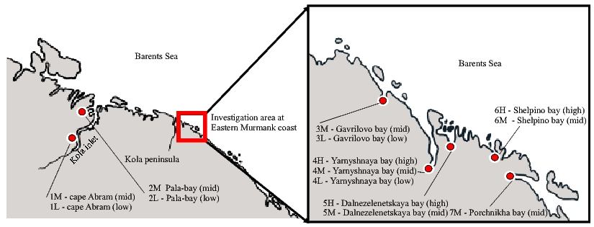
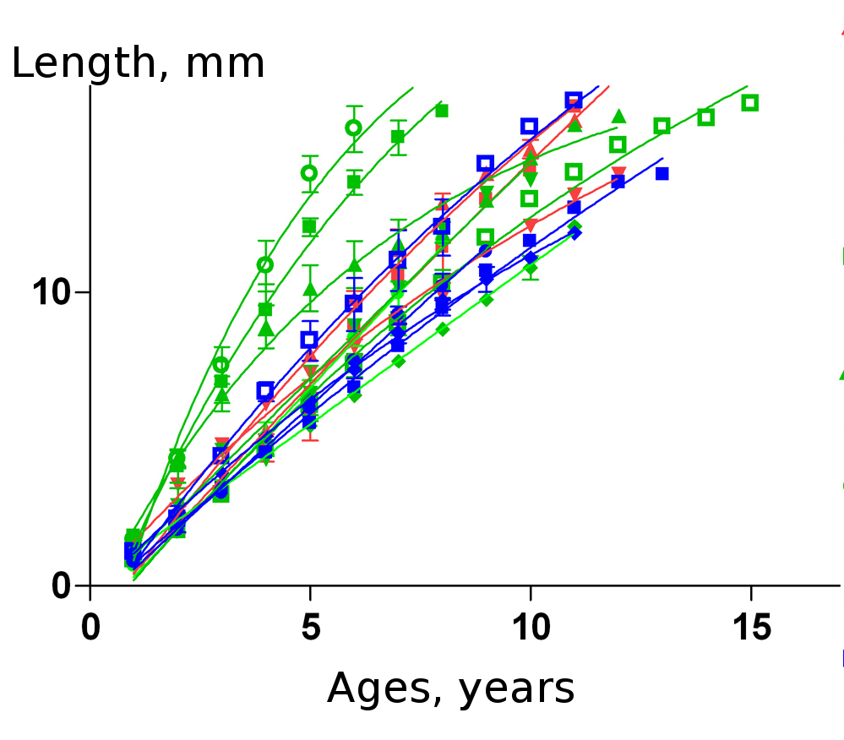
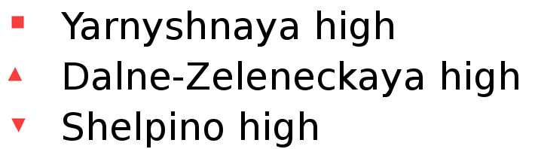
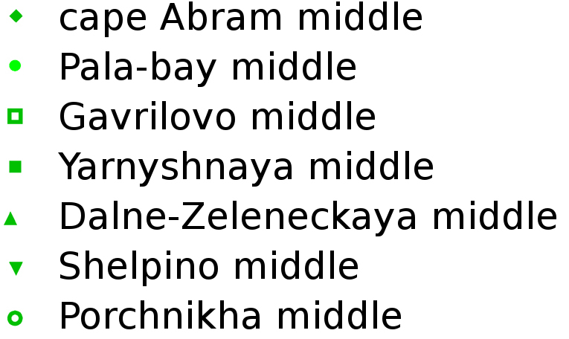
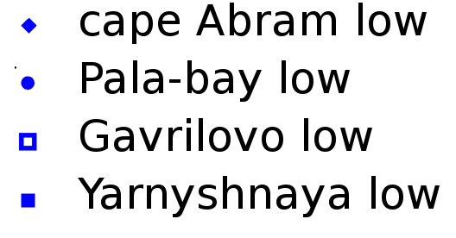
=
Murmansk coast of the Barents Sea:
7 tidal sites
14 growth description

Slide 5
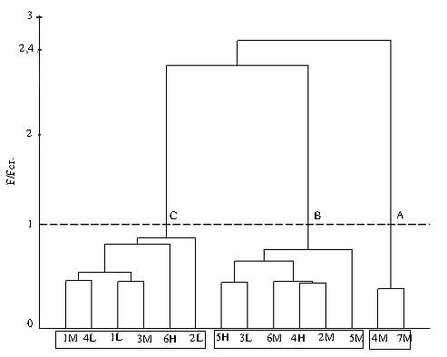
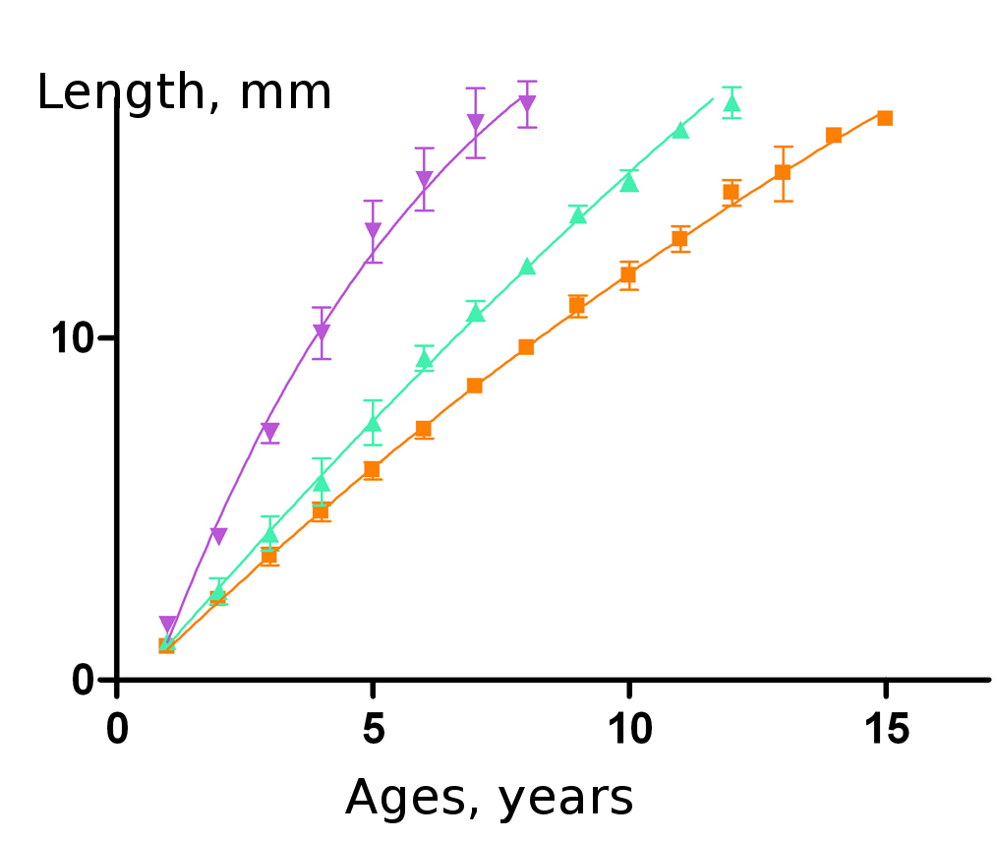
3 groups of Macoma balthica with different patterns of growth
As a result, no geographical or altitude patterns in group distribution were found.

Slide 6
Literature data:
North Atlantic and Arctic oceans
Hypothesys:
  At the north sites Macoma balthica growth rate is lower then at the south sites.

Slide 7
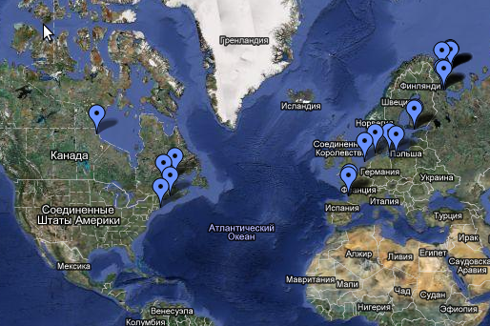
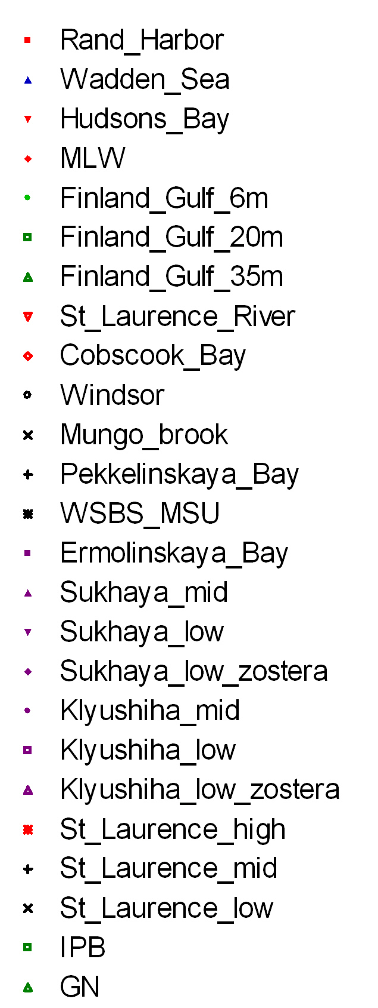
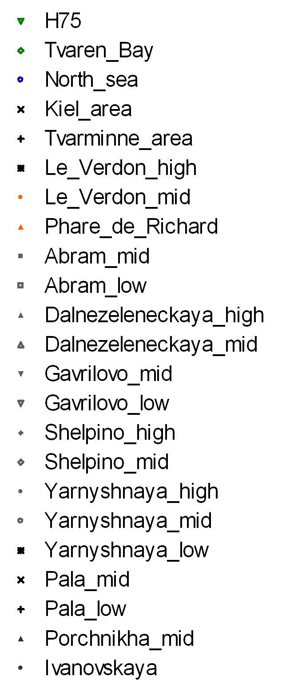
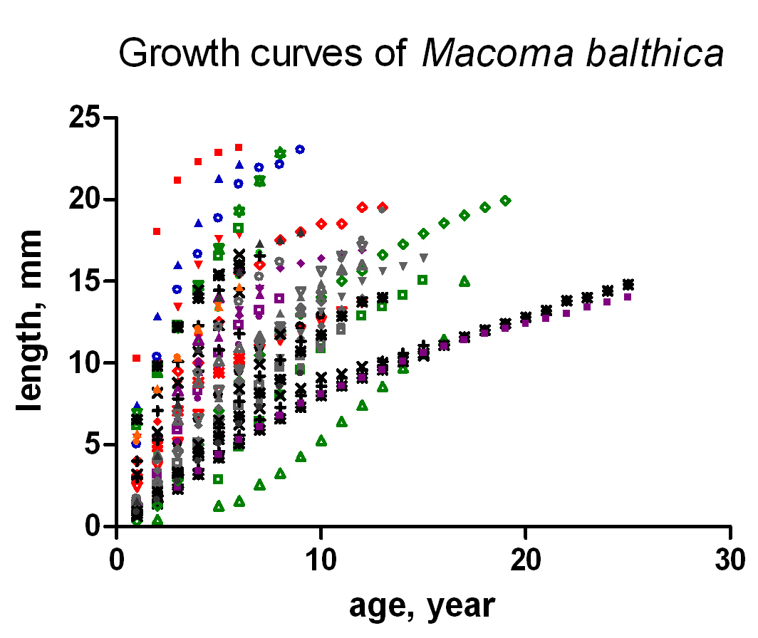
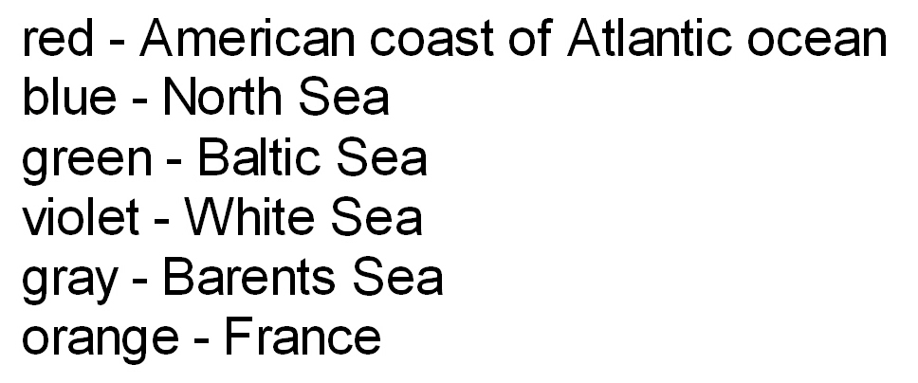
North Atlantic and Arctic oceans:
14 literature channels
32 sites
48 growth description

Slide 8
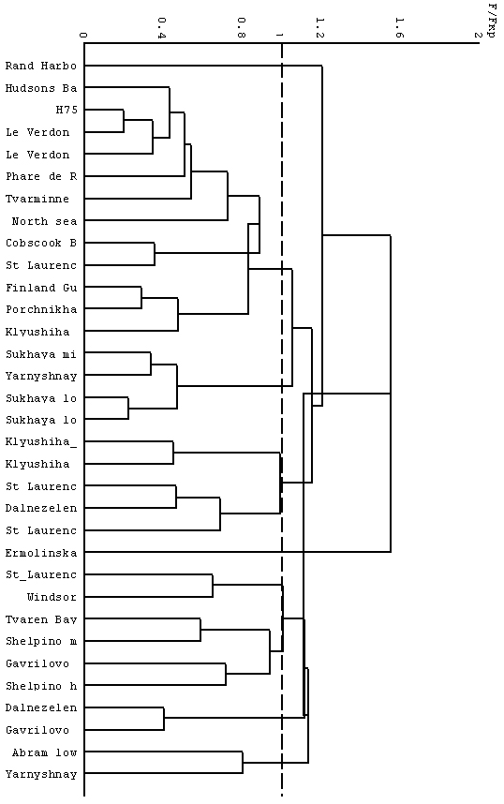
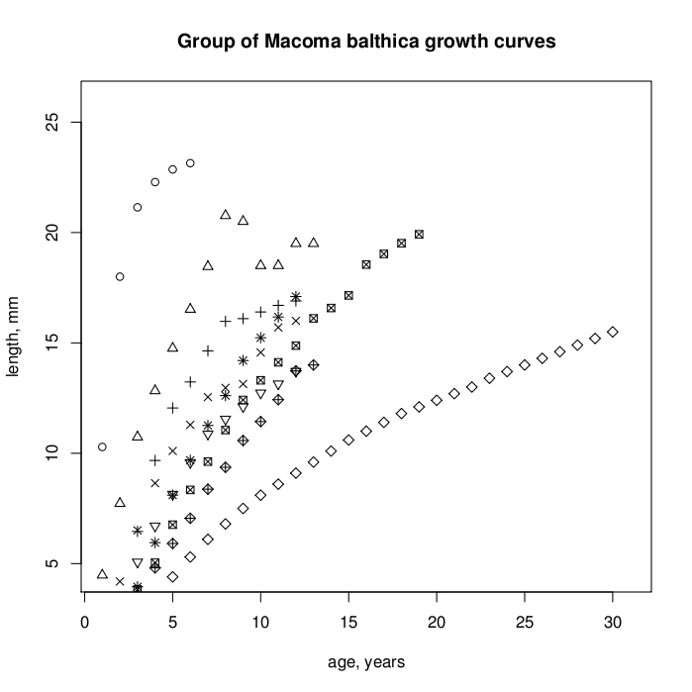
9 groups of Macoma balthica with different patterns of growth

Slide 9
Conclusions
The highest Macoma balthica growth rate was recorded for Rand Harbour (Masssachusets) — 23.1 mm in 6 years
The lowest Macoma balthica growth rate was recorded for Ermolinskaya bay (the White Sea) — 15.5 mm in 30 years
There are no latitudional or longitudional patterns in groupping of Macoma balthica growth curves. Factors acting at the local site are more importance for Macoma growth than climate.
Exposure time during tide cycle does not affect the growth rate of Macoma balthica.

Slide 10

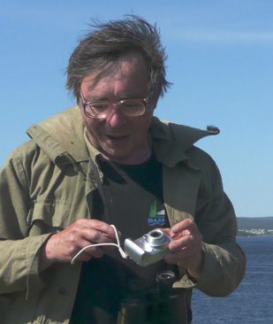
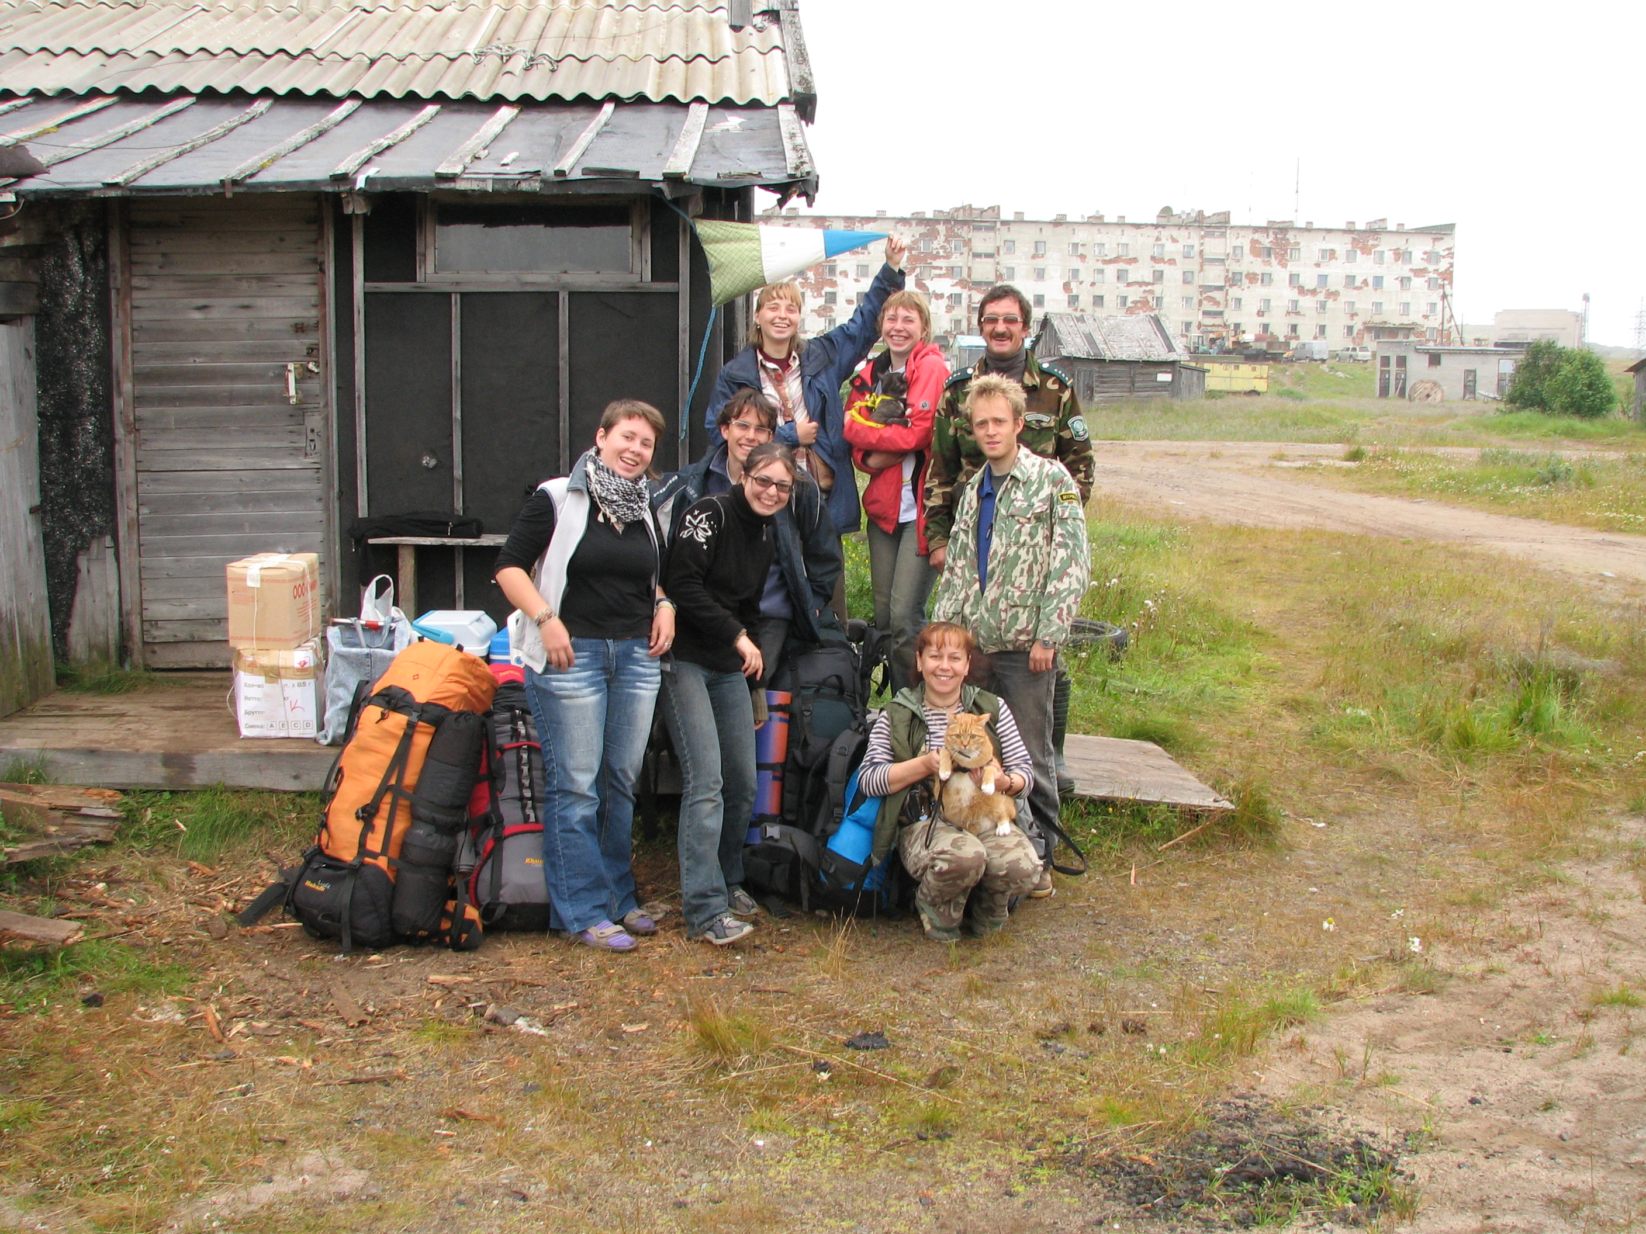
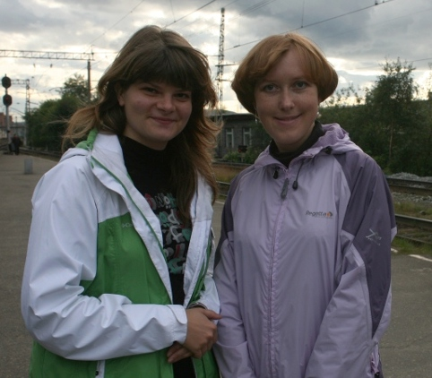
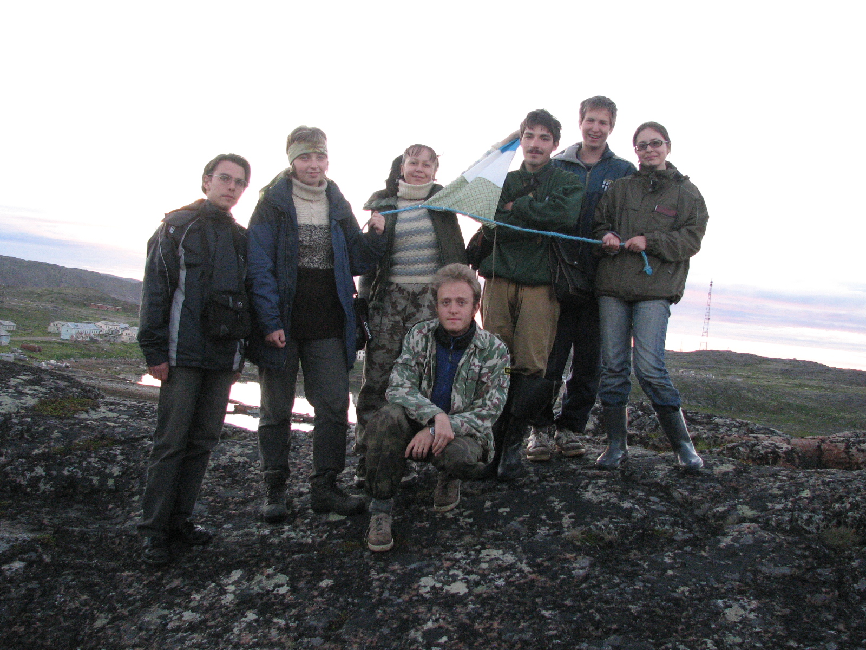
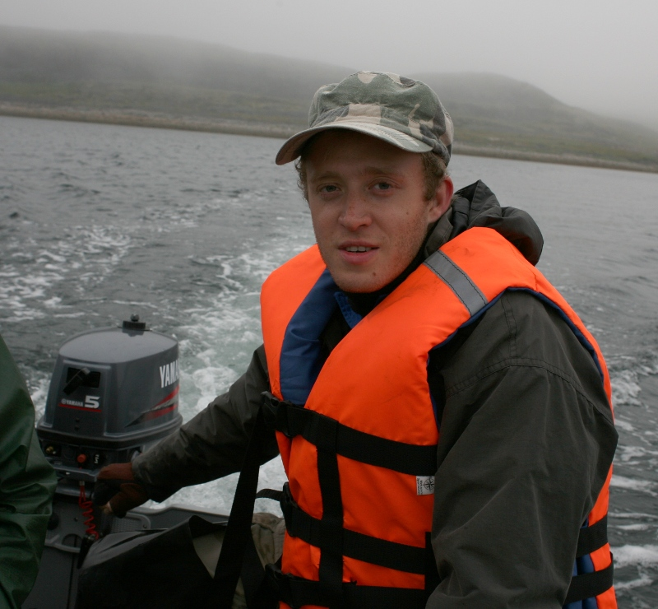
Acknowledgements
This project is supported by SPSU grants:

