Slide 1
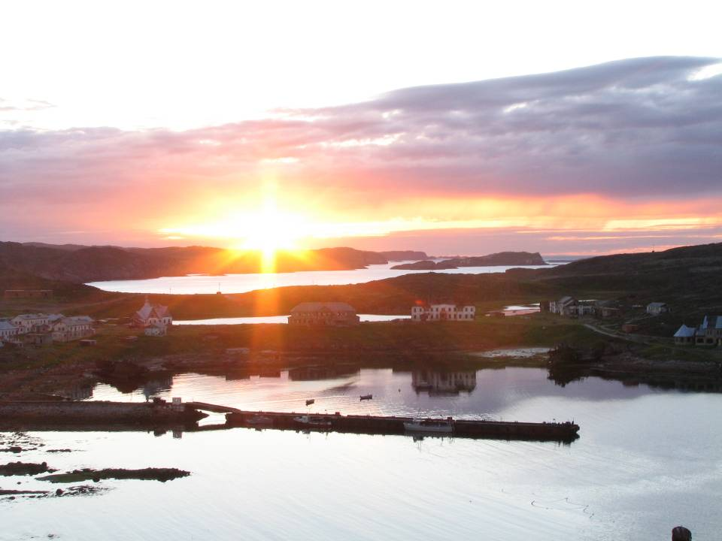



Linear growth of Macoma balthica
(North Atlantic and Arctic Oceans)
Sophia A. Nazarova, Nikolay V. Maximovich
St. Petersburg State University
Russian State Pedagogical University
Floating Marine Research Center

Slide 2
Author data:
Barents Sea, 2007-2008
Hypotheses:
  In western sites Macoma balthica growth rate is lower than in eastern sites because of smaller impact of the Nordkapp stream.
  At the low tidal level Macoma balthica growth rate is higher than at the middle and high levels because of more time for feeding.

Slide 3
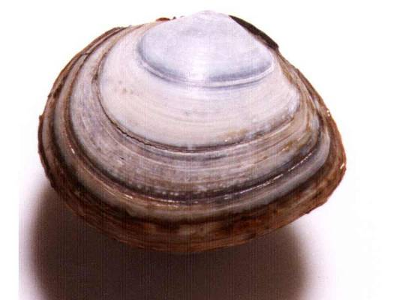
Methods
Growth is described by von Bertalanffy equation:
L=L_{a}*(1-exp(k*t-t₀))
Growth curves were compared using:
residual dispersion analysis (Allen, 1976)
F/Fcr ratio — distance index (Maximovich, 1989)
Www.marlin.co.uk
Growth rate was determined by the width of annual growth rings of shells (red arrows)

Slide 4
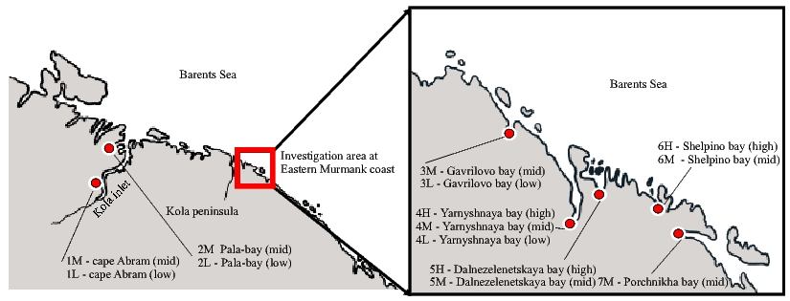
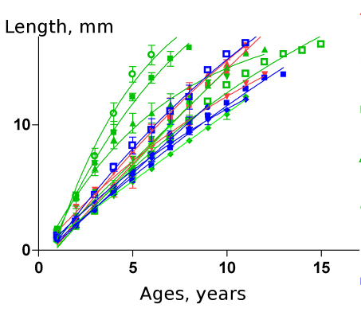

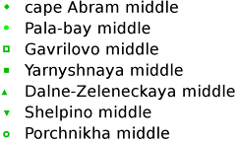

=
Murmansk coast of the Barents Sea:
7 tidal sites
14 growth descriptions

Slide 5
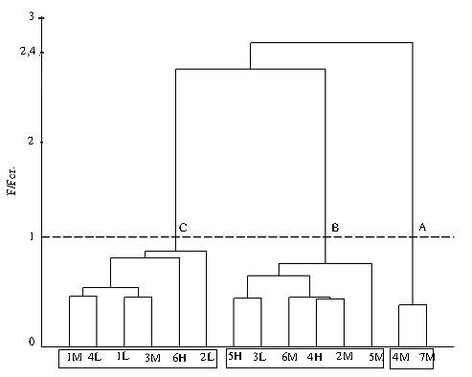
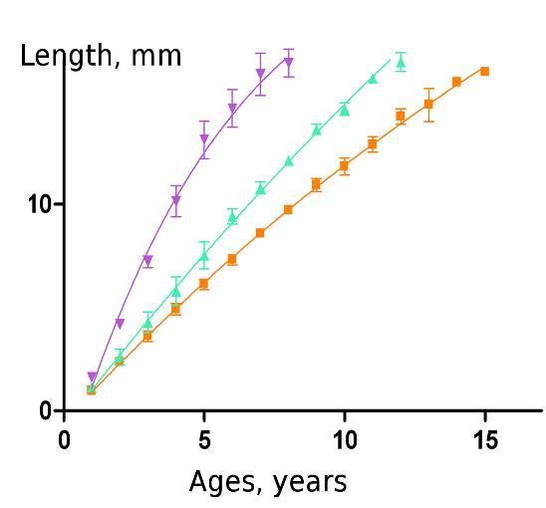
3 groups of Macoma balthica with different patterns of growth
As a result, no geographical or altitude patterns in group distribution were found.

Slide 6
Literature data:
North Atlantic and Arctic oceans
Hypothesis:
  In northern sites Macoma balthica growth rate is lower than in southern sites.

Slide 7
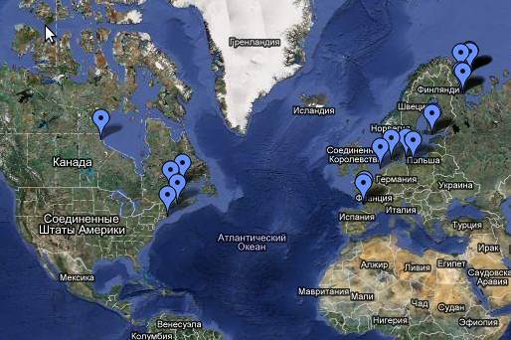
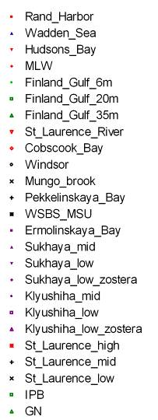
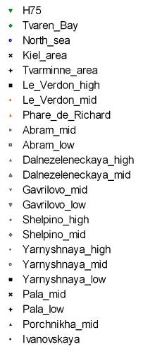
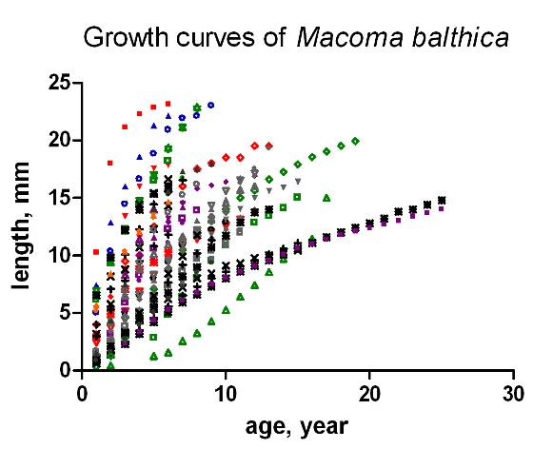
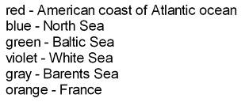
North Atlantic and Arctic oceans:
14 literature sources
32 sites
48 growth descriptions

Slide 8
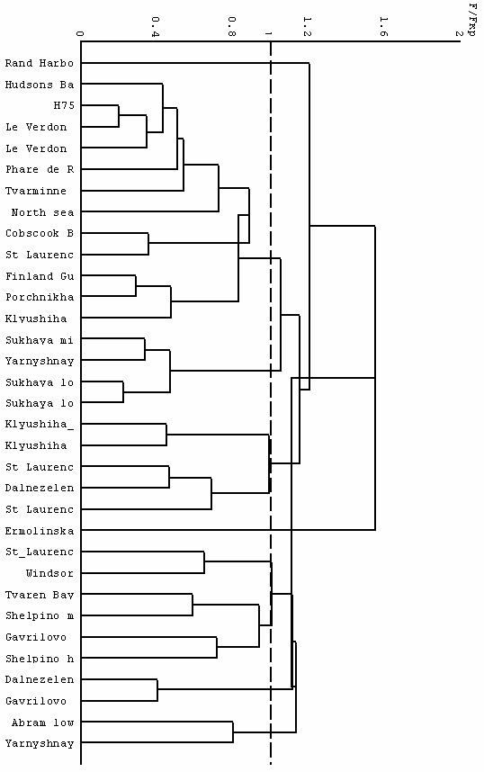
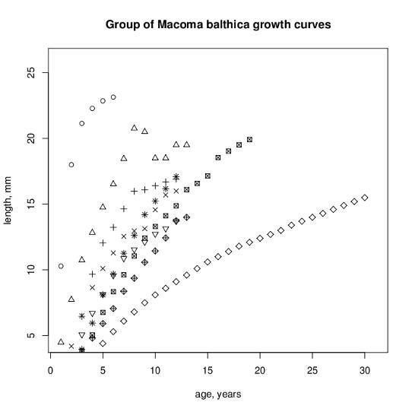
9 groups of Macoma balthica with different patterns of growth

Slide 9
Conclusions
The highest Macoma balthica growth rate was recorded for Rand Harbour (Massachusets) — 23.1 mm in 6 years.
The lowest Macoma balthica growth rate was recorded for Ermolinskaya bay (White Sea) — 15.5 mm in 30 years.
There are no latitudional or longitudional patterns in grouping of Macoma balthica growth curves. Factors acting at the local site are more important for Macoma growth than climate.
Exposure time during tide cycle does not affect growth rate of Macoma balthica.

Slide 10

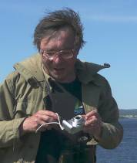
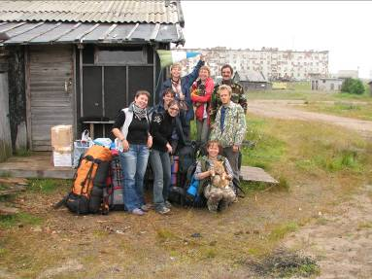

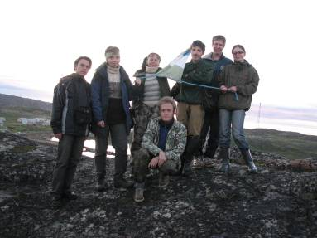
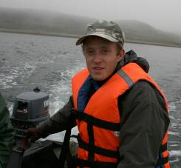
Acknowledgements
This project is supported by SPSU grants: 1.0.134.2010, 1.41.862.2011

