Slide 1
Challenges and Applications of Large Language Models
Jean Kaddour, Joshua Harris, Maximilian Mozes,
Herbie Bradley, Robert Raileanu, and Robert McHardy
Presented by
Rachel Montgomery & Sophia Tannir

Slide 2
Introduction
Rapid advancements in natural language processing (NLP) capabilities
Examples: GPT-3, PaLM, ChatGPT, Gemini
Challenge: Keeping up with fast-paced research
Purpose of the paper: Identify open problems and review applications and challenges
Literature review, easily readable

Slide 3
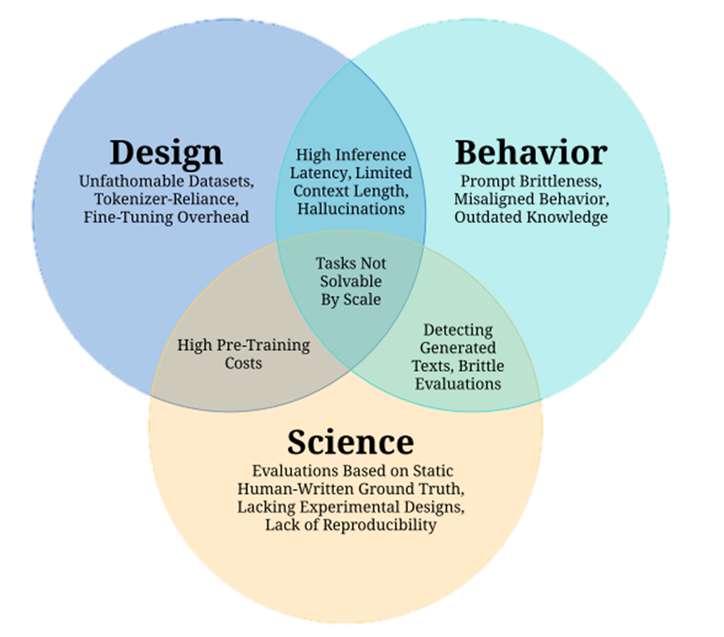

LLM Challenges
Paper groups challenges into 3 areas
Design: decisions taken before deployment
Behavior: challenges occur during deployment
Science: hinder academic progress

Slide 4
Design Challenges
Unfathomable Datasets
Pre-training datasets have grown so rapidly in size and diversity that no individual can manually check or understand all the data
Duplicates, benchmark contamination, inclusion of personally identifiable information (PII)
Tokenizer Reliance
Computational overhead, language dependence, inability to handle novel words, fixed vocabulary sizes, and hurt interpretability
High Pre-Training Costs
Compute hours
Potential solutions: optimizing training recipes and objectives

Slide 5
Behavioral Challenges
Prompt Brittleness
Small prompt variations can drastically change model outputs, requiring extensive prompt engineering
Misaligned Behavior
Models often generate untruthful, biased or toxic text, requiring better alignment techniques
Outdated Knowledge
Pretrained knowledge can become inaccurate over time
Updating models is costly and updating isolated facts without side effects remains difficult

Slide 6
Scientific Challenges
Brittle Evaluations
Evaluation results are very sensitive to small test set or metric changes
Reliance on Static Human Evaluations
Limitations as models exceed human abilities
Lacking Experimental Designs
Lacking Experimental Designs: Computational constraints on studies

Slide 7
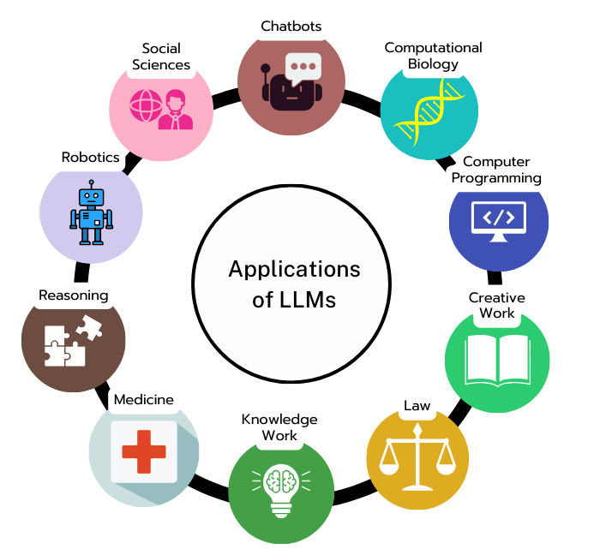
Applications of LLMs

Slide 8
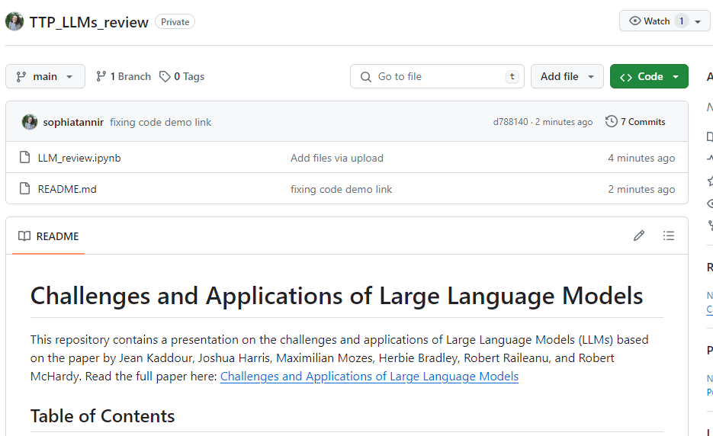
CODE DEMO: CHALLENGES
https://github.com/sophiatannir/TTP_LLMs_review

Slide 9
Critical Analysis
What was overlooked by the authors?
Lack of ethics section or mentioning
What could have been developed further?
Explaining why simplistic solutions to problems aren’t effective
Were there any errors?
Have others disputed the findings?
Related Work section of paper
Paper does note work similar to that of the paper, and that develops further into ideas mentioned

Slide 10
Discussion + Q&A Session
Questions for class:
Considering the large size of datasets used in training LLMs, what strategies could be implemented to ensure these datasets are balanced and free of biases without compromising the diversity and richness of the data?
Based on this paper’s classification of problem areas (design, behavior, science) what area would hallucinations be in?
Possible Discussion Questions
Which of the challenges is the furthest from being solved?
What domain can will grow the most with LLM applications?
What domain faces the most challenges with LLM applications?

Slide 11
Citation
Kaddour, J., Harris, J., Mozes, M., Bradley, H., Raileanu, R., & McHardy, R. (2023, July 19). Challenges and applications of large language models. arXiv.org. https://arxiv.org/abs/2307.10169

Slide 12
Additional Resources: Related Works
A Survey of Large Language Models
Judging LLM-as-a-Judge with MT-Bench and Chatbot Arena
A Survey on Evaluation of Large Language Models
Challenges and Applications of Large Language Models

Slide 13
Thank you!

