Slide 1
Challenge 2: Sound Locator
Agata Granosik, Sophia van Swaay, Yiannis Georgopoulos & Sarah Müller
Setup addressed
Sensory Substitution: Hearing → Vision
Mapping type: Topographic + Parametric
Topographic (place → place): the direction of the sound is shown at the same place on the LED bar. Sound from the left → left LED, from the front → middle LED, from the right → right LED.
Parametric (feature → parameter): we measure one number, the time difference between the two microphones. We turn this number into the position of the LED.
Idea
Deaf people can’t hear where a sound comes from (a door, a person calling, a car).
We hear direction with two ears: the sound reaches the closer ear first.
We copied this with two microphones as “ears” and show the direction with light.
Tools used:
Arduino Uno + Grove Base Shield
2 digital sound sensors
Grove LED Bar v2.0 (10 LEDs)
Arduino IDE + Serial Monitor
Grove LED Bar library (Seeed Studio)
clap
16 cm
L (D3)
R (D2)
Δt → angle → LED
−90°
0°
+90°
How the mapping works

Slide 2
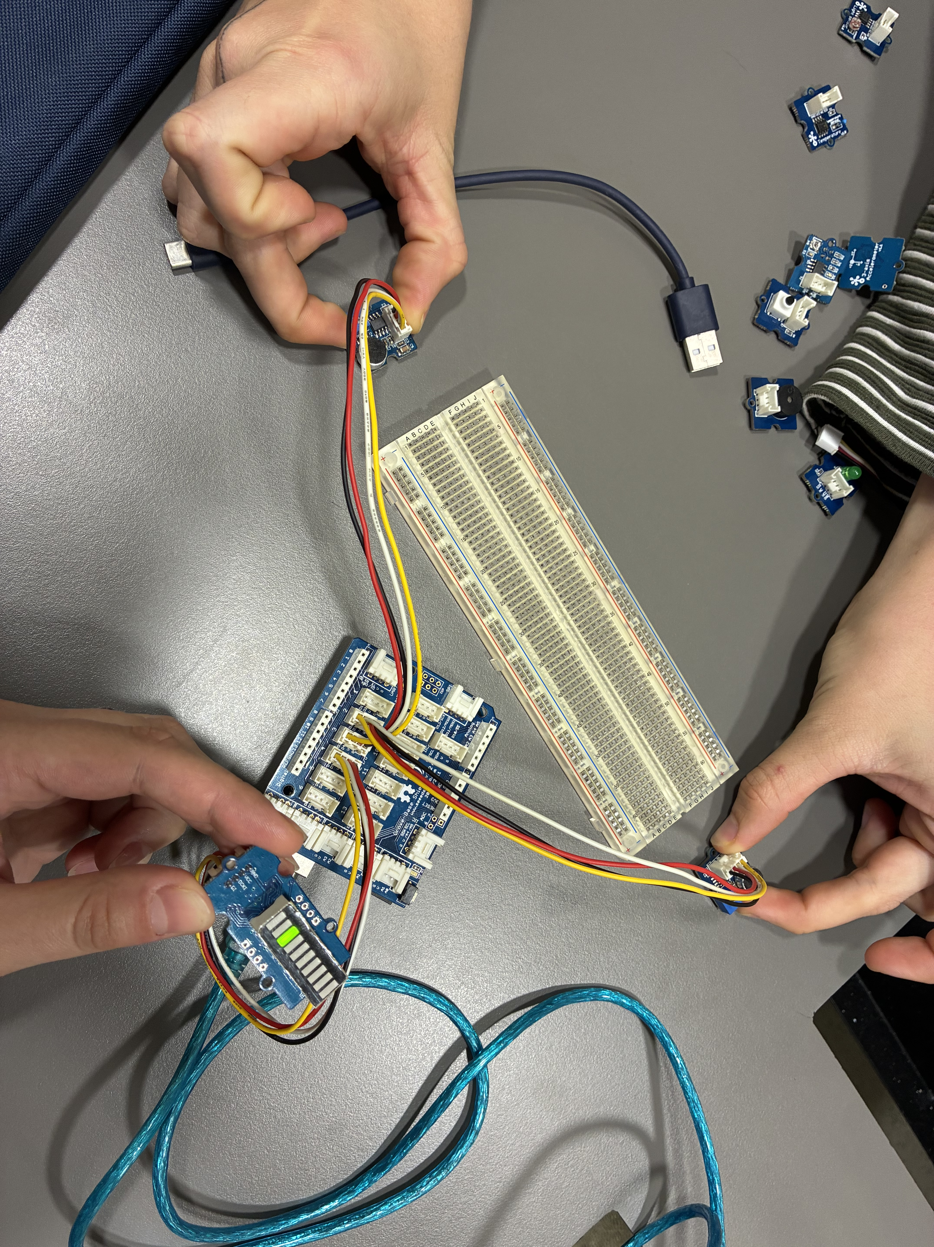
Challenge 2: Sound Locator
Agata Granosik, Sophia van Swaay, Yiannis Georgopoulos & Sarah Müller
Wiring
Right microphone → D2, left microphone → D3
LED Bar → Grove port D4 (D4 = data, D5 = clock)
The microphones are 16 cm apart, like two ears.
Finding the direction
A sound from the side reaches the closer microphone first. The time difference tells us where the sound comes from.
The code turns this time difference into a direction (left, front or right) and switches on the LED at that place.
Building it in Arduino
The time difference is very short (less than 0.5 ms). A normal loop() is too slow to measure this.
So we used interrupts: attachInterrupt() reacts at the exact moment a microphone hears a sound.
D2 and D3 are the only two interrupt pins on the Arduino Uno. That’s why the microphones are connected there.
Each microphone saves its time with micros() (time in microseconds since the Arduino started).
Our setup

Slide 3
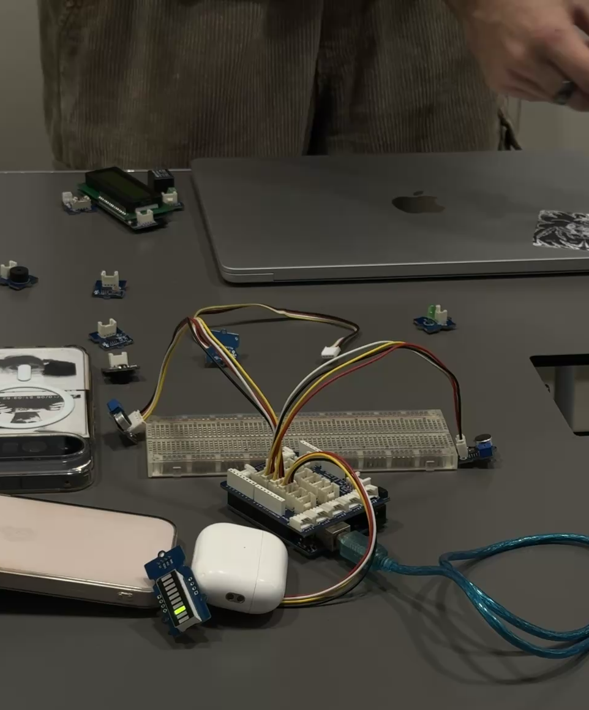
Challenge 2: Sound Locator
Agata Granosik, Sophia van Swaay, Yiannis Georgopoulos & Sarah Müller
Calculating the direction
When both microphones hear the sound, we calculate the time difference dt = tLeft − tRight.
We turn dt into an angle with asin(), and the angle into an LED number from 0 to 9.
If only one microphone hears the sound, the sound comes from that side.
If the time difference is too big to be real, we ignore it (noise).
Making it stable
After every sound we wait 120 ms (REARM_MS), so echoes don’t count as new sounds.
Sounds that come quickly one after another are averaged (SMOOTHING), so the LED doesn’t jump around.
The LED stays on for 1.5 s (HOLD_MS) and then turns off.
At the start, the LEDs move from left to right, so the user knows which side is which.
The Serial Monitor shows dt, the angle and the LED number, so we can check the values.
Result
It works: when we clap on the left, in front or on the right, the correct LED lights up (see video).
It can’t tell front and back apart -> same with our two ears
Our setup (demo video)

