Slide 1
Environmental Toxicity and
Resistance Risks of Antibiotics
Erythromycin effects on cyanobacteria
Environmental Toxicology
12-minute class presentation
Notes:
Suggested delivery time: 15 seconds.
Antibiotics protect human and animal health, but their biological activity can also matter after environmental release. Today I will connect five questions: where antibiotics come from, what they affect, how researchers detect toxicity, which mechanisms may explain the effects, and how we can manage the risks. Erythromycin exposure in Microcystis aeruginosa provides the experimental example. The central question is why an antibacterial drug can sometimes stimulate cyanobacterial growth, and why fewer cells may still leave a toxin concern.
Supporting points from the supplied outline:
A case study of erythromycin effects on cyanobacteria.
Why can low-dose erythromycin stimulate cyanobacterial growth in an experiment?
Sources and figure attribution:
[1] Kovalakova, P., Cizmas, L., McDonald, T. J., Marsalek, B., Feng, M., & Sharma, V. K. (2020). Occurrence and toxicity of antibiotics in the aquatic environment: A review. Chemosphere, 251, 126351. https://doi.org/10.1016/j.chemosphere.2020.126351
[2] Larsson, D. G. J., & Flach, C.-F. (2022). Antibiotic resistance in the environment. Nature Reviews Microbiology, 20, 257–269. https://doi.org/10.1038/s41579-021-00649-x
[3] Le Page, G., Gunnarsson, L., Snape, J., & Tyler, C. R. (2017). Integrating human and environmental health in antibiotic risk assessment: A critical analysis of protection goals, species sensitivity and antimicrobial resistance. Environment International, 109, 155–169. https://doi.org/10.1016/j.envint.2017.09.013
[4] Zhang, M., Steinman, A. D., Xue, Q., Zhao, Y., Xu, Y., & Xie, L. (2020). Effects of erythromycin and sulfamethoxazole on Microcystis aeruginosa: Cytotoxic endpoints, production and release of microcystin-LR. Journal of Hazardous Materials, 399, 123021. https://doi.org/10.1016/j.jhazmat.2020.123021
Figure file: p01.png. Figure source follows the supplied outline and source index.

Slide 2
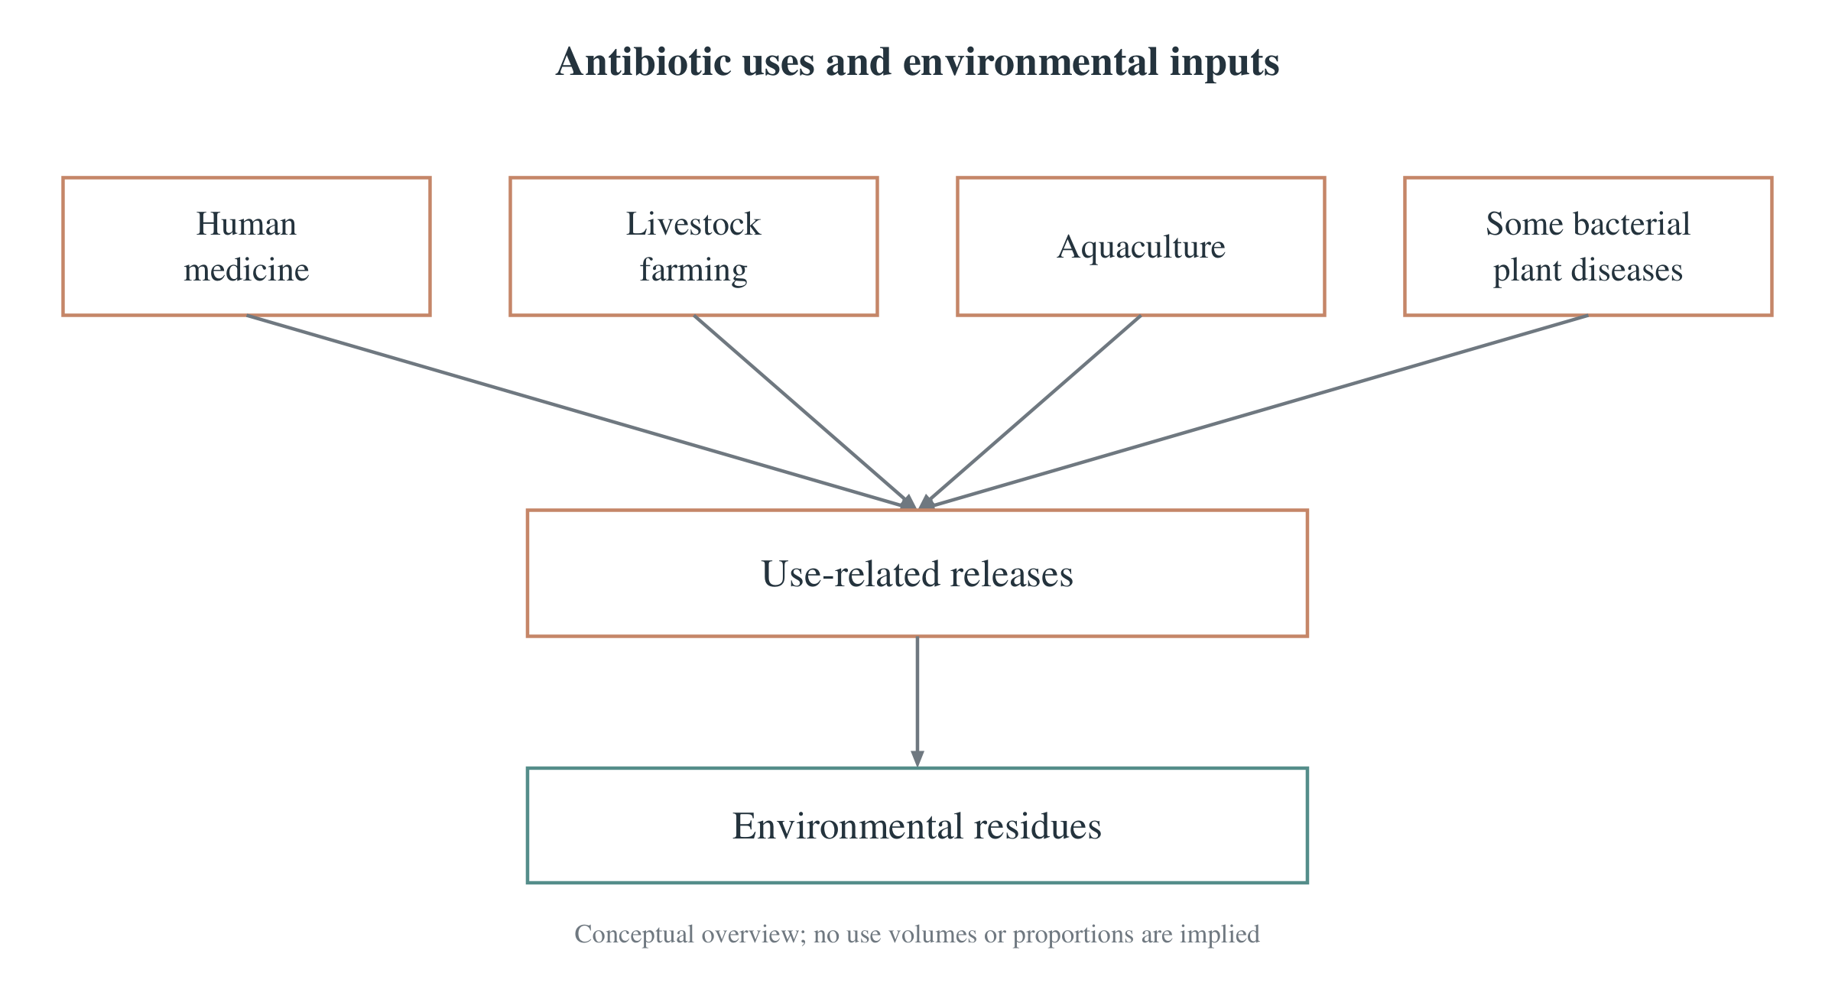
Overview
Exposure
Evidence
Resistance
Conclusions
Antibiotic uses and environmental release
Antibiotics kill bacteria or inhibit bacterial growth.
Human medicine, livestock and aquaculture create major use pathways.
Residues can enter waste streams after use or during production.
Widespread use connects therapeutic benefits with environmental emissions.
[1] Kovalakova et al. (2020). Supplied conceptual schematic.
02
Notes:
Suggested delivery time: 45 seconds.
Here, I use antibiotics to mean antibacterial drugs. Their benefits remain essential, so the environmental question concerns emissions and exposure rather than whether treatment should stop. Uses include human medicine, livestock, aquaculture and the control of some bacterial plant diseases. Residues may leave these systems through wastewater or solid waste. Erythromycin, abbreviated ERY, is the recurring case in this presentation. The same drug can have different effects depending on the exposed organism and environmental conditions.
Supporting points from the supplied outline:
Here, antibiotics refer to drugs that kill bacteria or inhibit bacterial growth.
Uses include human medicine, livestock, aquaculture, and control of some bacterial plant diseases.
Residues can enter the environment after use; erythromycin is the recurring case here.
Sources and figure attribution:
[1] Kovalakova, P., Cizmas, L., McDonald, T. J., Marsalek, B., Feng, M., & Sharma, V. K. (2020). Occurrence and toxicity of antibiotics in the aquatic environment: A review. Chemosphere, 251, 126351. https://doi.org/10.1016/j.chemosphere.2020.126351
Figure file: p02.png. Figure source follows the supplied outline and source index.

Slide 3
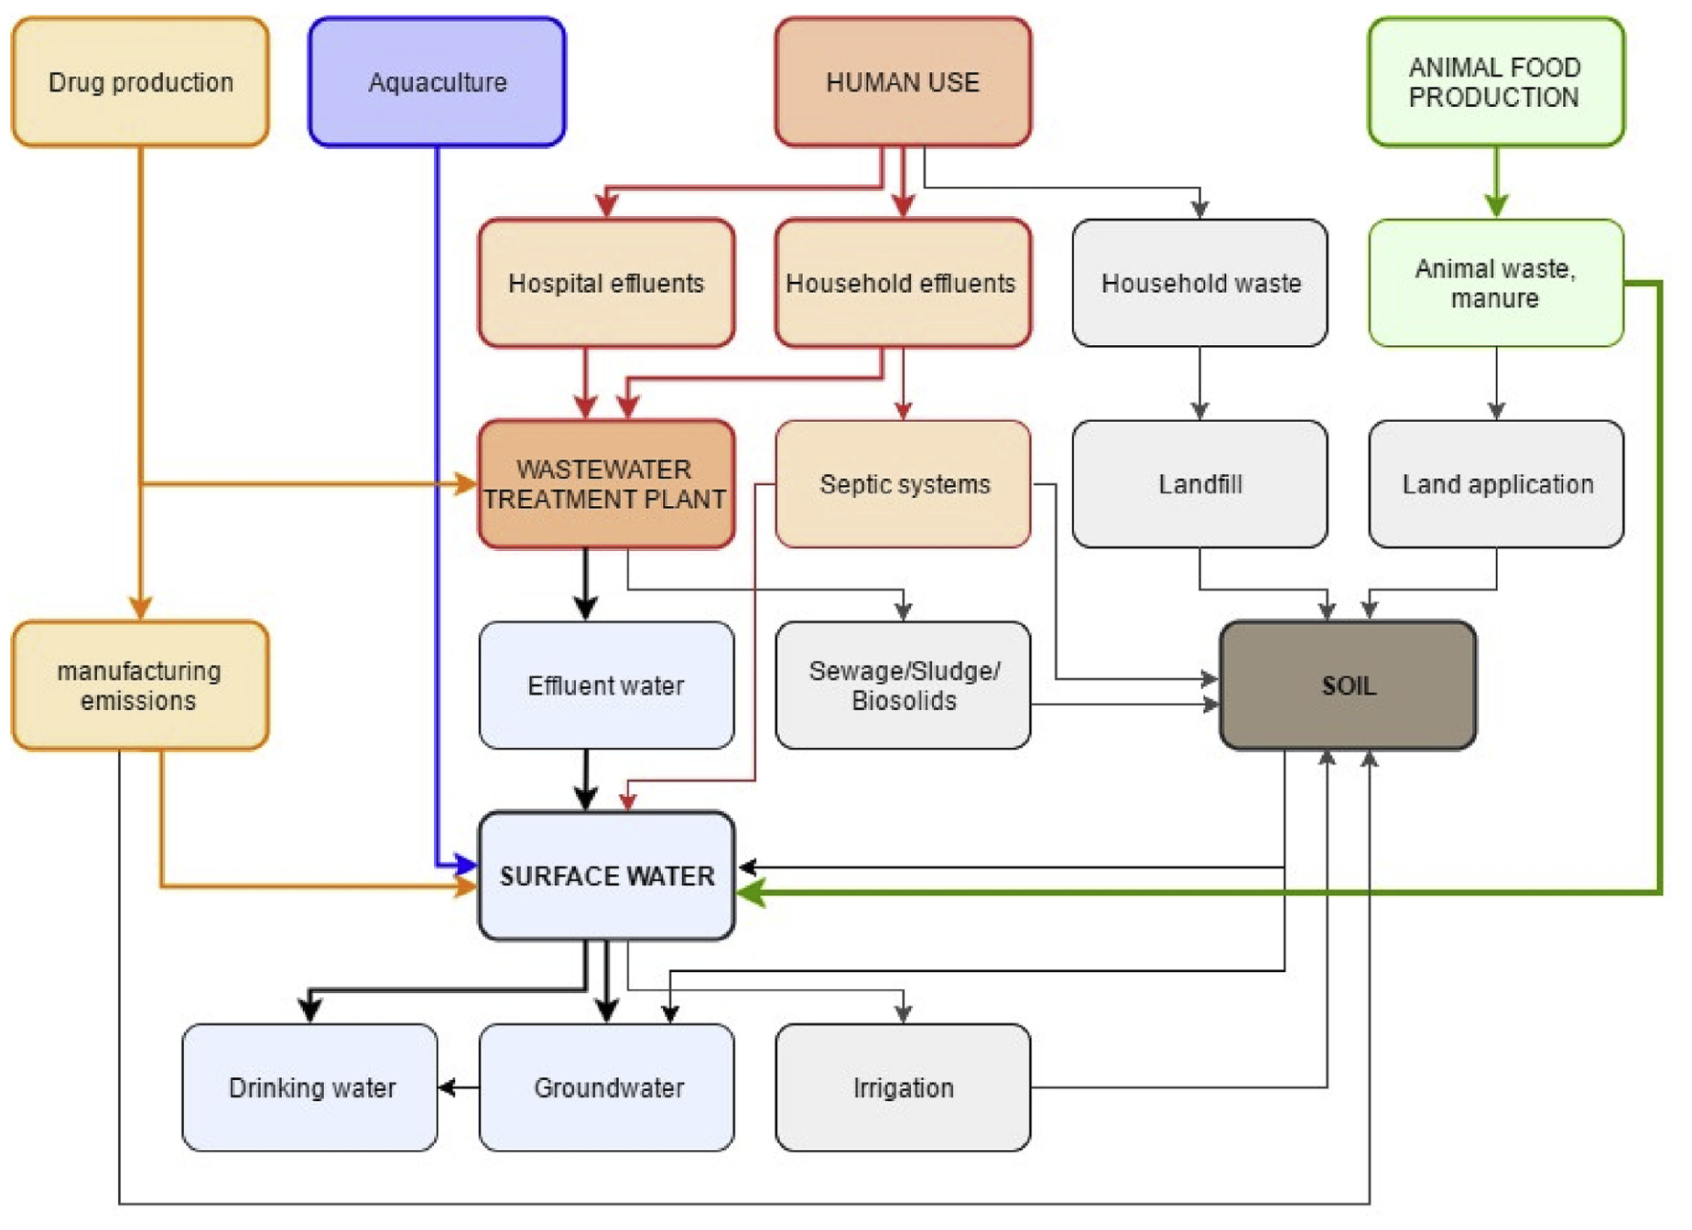
Overview
Exposure
Evidence
Resistance
Conclusions
Sources and pathways of antibiotic residues
Medicine, farming and manufacturing generate contaminated waste streams.
Effluent, manure and sludge connect these sources to water and farmland.
Sorption, degradation and runoff alter the resulting exposure.
Environmental exposure depends on both emissions and what happens after release.
[1] Kovalakova et al. (2020), environmental pathways.
03
Notes:
Suggested delivery time: 45 seconds.
The figure connects use and production with environmental water pathways. Wastewater treatment can reduce some inputs, but the removal of individual compounds varies. Manure and sludge application create an additional route to farmland, while aquaculture can release residues directly into water. After release, sorption, degradation and runoff change where residues occur and how much remains available to organisms. This is why knowing the amount used alone cannot tell us the biologically relevant exposure at a particular location.
Supporting points from the supplied outline:
Medicine, farming, and manufacturing generate wastewater or waste streams containing antibiotic residues.
Effluent, sludge or manure application, and aquaculture discharge introduce residues into water and farmland.
Sorption, degradation, and runoff further alter distribution and actual exposure.
Sources and figure attribution:
[1] Kovalakova, P., Cizmas, L., McDonald, T. J., Marsalek, B., Feng, M., & Sharma, V. K. (2020). Occurrence and toxicity of antibiotics in the aquatic environment: A review. Chemosphere, 251, 126351. https://doi.org/10.1016/j.chemosphere.2020.126351
Figure file: p03.png. Figure source follows the supplied outline and source index.

Slide 4
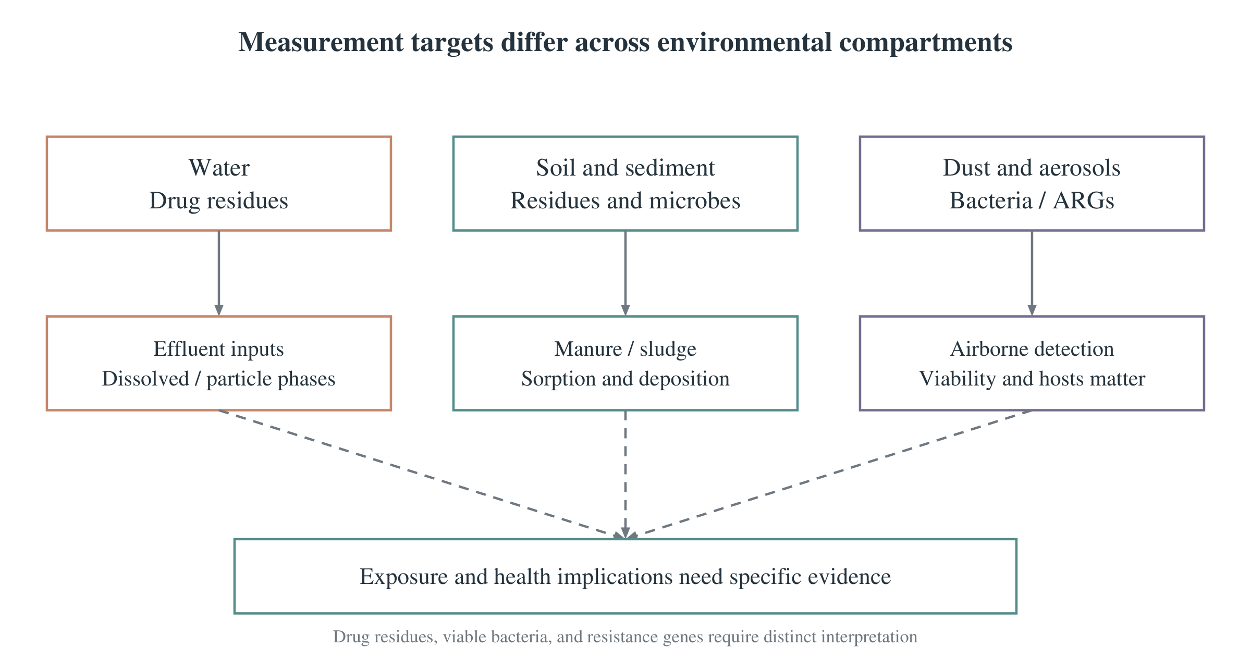
Overview
Exposure
Evidence
Resistance
Conclusions
Distribution across water, soil and air
Water receives sewage and aquaculture inputs that vary over time.
Soil and sediment receive manure, sludge and particle-associated residues.
Dust and aerosols may carry bacteria and antibiotic resistance genes.
Chemical residues, viable bacteria and resistance genes require distinct measurements.
[1,2] Supplied conceptual schematic.
04
Notes:
Suggested delivery time: 45 seconds.
Environmental distribution includes different substances and biological agents. In water, researchers often measure antibiotic concentrations. In soil and sediment, particle interactions can affect storage and bioavailability. For dust and aerosols, the relevant targets may include bacteria and antibiotic resistance genes, or ARGs. These measurements have different units and meanings. Detecting a gene does not establish that it belongs to a viable pathogen or that people received a harmful exposure. Cross-media comparisons therefore need a clearly defined measurement target.
Supporting points from the supplied outline:
Water: sewage and aquaculture introduce residues, with concentrations varying over space and time.
Soil and sediment: manure, sludge, and particle deposition contribute inputs and storage.
Dust or aerosols can carry bacteria and ARGs; viability, hosts, and exposure need further assessment.
Sources and figure attribution:
[1] Kovalakova, P., Cizmas, L., McDonald, T. J., Marsalek, B., Feng, M., & Sharma, V. K. (2020). Occurrence and toxicity of antibiotics in the aquatic environment: A review. Chemosphere, 251, 126351. https://doi.org/10.1016/j.chemosphere.2020.126351
[2] Larsson, D. G. J., & Flach, C.-F. (2022). Antibiotic resistance in the environment. Nature Reviews Microbiology, 20, 257–269. https://doi.org/10.1038/s41579-021-00649-x
Figure file: p04.png. Figure source follows the supplied outline and source index.

Slide 5
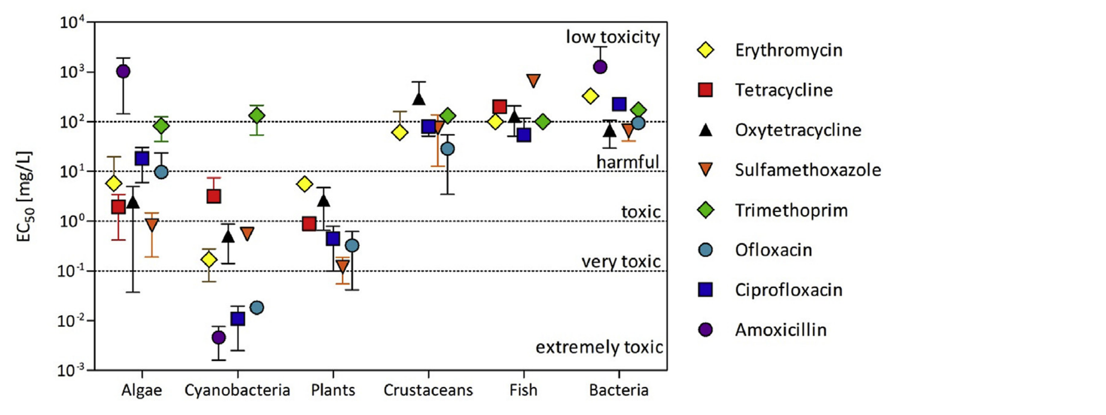
Overview
Exposure
Evidence
Resistance
Conclusions
Ecological effects and resistance risks
Microbial community changes may alter biogeochemical cycling.
Plant and aquatic responses depend on the compound, dose and organism.
Resistance can compromise infection treatment when transmission and exposure occur.
Ecotoxicity and resistance address different biological outcomes.
[1] Kovalakova et al. (2020), Fig. 7.
05
Notes:
Suggested delivery time: 50 seconds.
There are two main branches of concern. Ecotoxicity includes changes in growth, development, reproduction or ecological functions. Microbial communities may also change as susceptible populations respond. Resistance concerns the ability of bacteria to survive treatment and the conditions that connect resistant organisms to hosts. These branches can share an exposure source, but they require different endpoints and evidence. The supplied review figure illustrates variation among species and test conditions, so a single result should not stand in for every organism or antibiotic.
Supporting points from the supplied outline:
Microbial communities: changes in susceptible populations and metabolism may affect biogeochemical cycling.
Plants and aquatic organisms: growth, photosynthesis, development, or reproduction require compound- and exposure-specific assessment.
Health-related risks: resistance can undermine infection treatment, requiring assessment of transmission and exposure.
Sources and figure attribution:
[1] Kovalakova, P., Cizmas, L., McDonald, T. J., Marsalek, B., Feng, M., & Sharma, V. K. (2020). Occurrence and toxicity of antibiotics in the aquatic environment: A review. Chemosphere, 251, 126351. https://doi.org/10.1016/j.chemosphere.2020.126351
[2] Larsson, D. G. J., & Flach, C.-F. (2022). Antibiotic resistance in the environment. Nature Reviews Microbiology, 20, 257–269. https://doi.org/10.1038/s41579-021-00649-x
Figure file: p05.png. Figure source follows the supplied outline and source index.

Slide 6
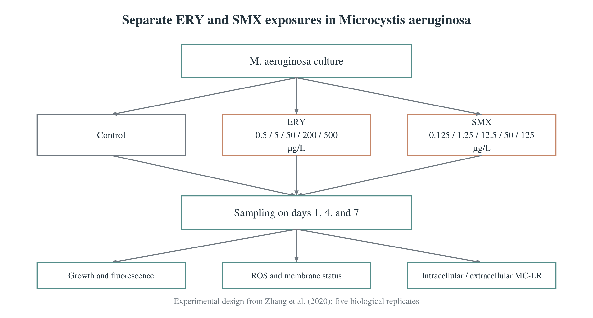
Overview
Exposure
Evidence
Resistance
Conclusions
How researchers test environmental toxicity
Controlled exposures separate drug effects from background changes.
The case tested Microcystis aeruginosa with ERY and SMX separately.
Five replicates per group covered days 1, 4 and 7 and multiple endpoints.
Controls, dose responses and time courses make the evidence interpretable.
[4] Zhang et al. (2020), Methods.
06
Notes:
Suggested delivery time: 65 seconds.
This case is an example of how toxicity is investigated, rather than a claim about its historical first discovery. The authors separately exposed Microcystis aeruginosa strain FACHB-905 to erythromycin and sulfamethoxazole, abbreviated SMX. My discussion focuses on erythromycin. They assessed five biological replicates per group on days one, four and seven. Flow cytometry assessed growth and physiological responses, electron microscopy assessed morphology, and UPLC/MS measured microcystin-LR. The endpoints included intracellular and extracellular toxin. The higher concentrations represented severe pollution scenarios and should not all be described as typical river exposure.
Supporting points from the supplied outline:
Monitoring informs exposure scenarios; controlled experiments test dose and time effects.
The case separately exposed Microcystis aeruginosa to ERY and SMX; the focus here is ERY.
On days 1, 4, and 7, five replicates per group were assessed for growth, damage, and intracellular/extracellular MC-LR.
Sources and figure attribution:
[4] Zhang, M., Steinman, A. D., Xue, Q., Zhao, Y., Xu, Y., & Xie, L. (2020). Effects of erythromycin and sulfamethoxazole on Microcystis aeruginosa: Cytotoxic endpoints, production and release of microcystin-LR. Journal of Hazardous Materials, 399, 123021. https://doi.org/10.1016/j.jhazmat.2020.123021
Figure file: p06.png. Figure source follows the supplied outline and source index.

Slide 7
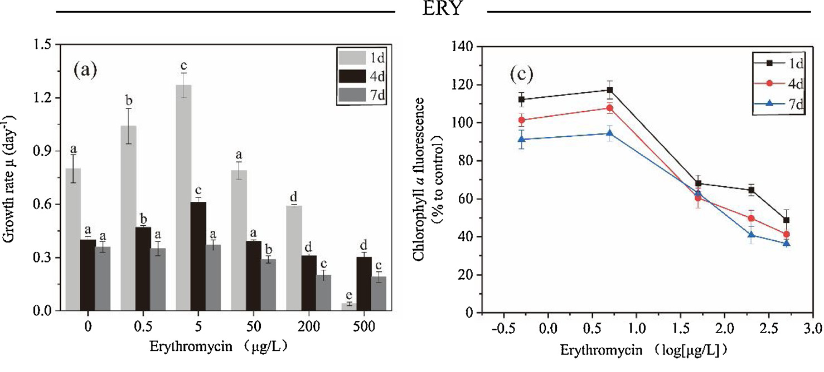
Overview
Exposure
Evidence
Resistance
Conclusions
Growth responses depend on dose and time
Low ERY doses stimulated growth at some early time points. High doses inhibited growth.
0.5 and 5 μg/L showed early stimulation. 200 and 500 μg/L inhibited growth.
[4] Zhang et al. (2020), Fig. 1a,c. n = 5 biological replicates.
07
Notes:
Suggested delivery time: 60 seconds.
Start with panel a, which shows growth rate. At some early time points, the 0.5 and 5 micrograms per litre treatments increased growth relative to the control. At 200 and 500 micrograms per litre, growth was significantly inhibited during the seven-day experiment. Compare concentrations within a single time point first, then compare time points within a concentration. The low-dose response was not universal across time. Panel c shows chlorophyll a fluorescence, a physiological signal that should not be equated directly with photosynthetic efficiency. The data include five biological replicates. Together, the panels show why both dose and duration matter.
Supporting points from the supplied outline:
ERY at 0.5 and 5 μg/L stimulated cyanobacterial growth at some early time points.
ERY at 200 and 500 μg/L significantly inhibited growth during the seven-day experiment.
Low-dose stimulation did not occur at every time point; responses were time-dependent.
Sources and figure attribution:
[4] Zhang, M., Steinman, A. D., Xue, Q., Zhao, Y., Xu, Y., & Xie, L. (2020). Effects of erythromycin and sulfamethoxazole on Microcystis aeruginosa: Cytotoxic endpoints, production and release of microcystin-LR. Journal of Hazardous Materials, 399, 123021. https://doi.org/10.1016/j.jhazmat.2020.123021
Figure file: p07.png. Figure source follows the supplied outline and source index.

Slide 8
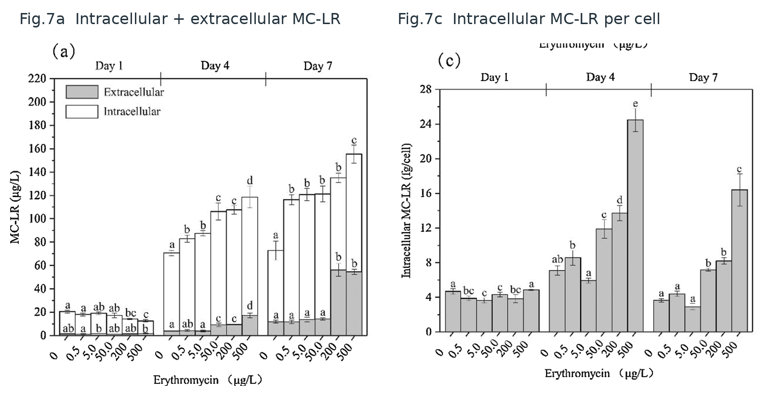
Overview
Exposure
Evidence
Resistance
Conclusions
Toxin changes can outlast growth inhibition
Total MC-LR increased in ERY treatments on days 4 and 7, despite inhibited growth at high doses.
Cell counts alone can miss changes in toxin production and extracellular release.
[4] Zhang et al. (2020), Fig. 7a,c. n = 5 biological replicates.
08
Notes:
Suggested delivery time: 60 seconds.
MC-LR means microcystin-LR, a toxin produced by the cyanobacterium. It is different from the antibiotic itself. In panel a, first compare the total height of the stacked bars, then examine the extracellular fraction. Total toxin increased relative to the control in the erythromycin treatments on days four and seven. Some high-dose and longer exposures also increased the extracellular fraction. Panel c describes intracellular toxin per cell, which is another distinct endpoint. The practical implication is that reduced cell growth alone cannot establish a lower toxin concern. This laboratory study did not measure drinking-water exposure or human health damage.
Supporting points from the supplied outline:
Total MC-LR increased relative to the control in ERY treatments on days 4 and 7.
The extracellular MC-LR fraction increased under some high-dose and longer exposures.
Growth, toxin content per cell, and extracellular release are distinct endpoints requiring joint assessment.
Sources and figure attribution:
[4] Zhang, M., Steinman, A. D., Xue, Q., Zhao, Y., Xu, Y., & Xie, L. (2020). Effects of erythromycin and sulfamethoxazole on Microcystis aeruginosa: Cytotoxic endpoints, production and release of microcystin-LR. Journal of Hazardous Materials, 399, 123021. https://doi.org/10.1016/j.jhazmat.2020.123021
Figure file: p08.png. Figure source follows the supplied outline and source index.

Slide 9
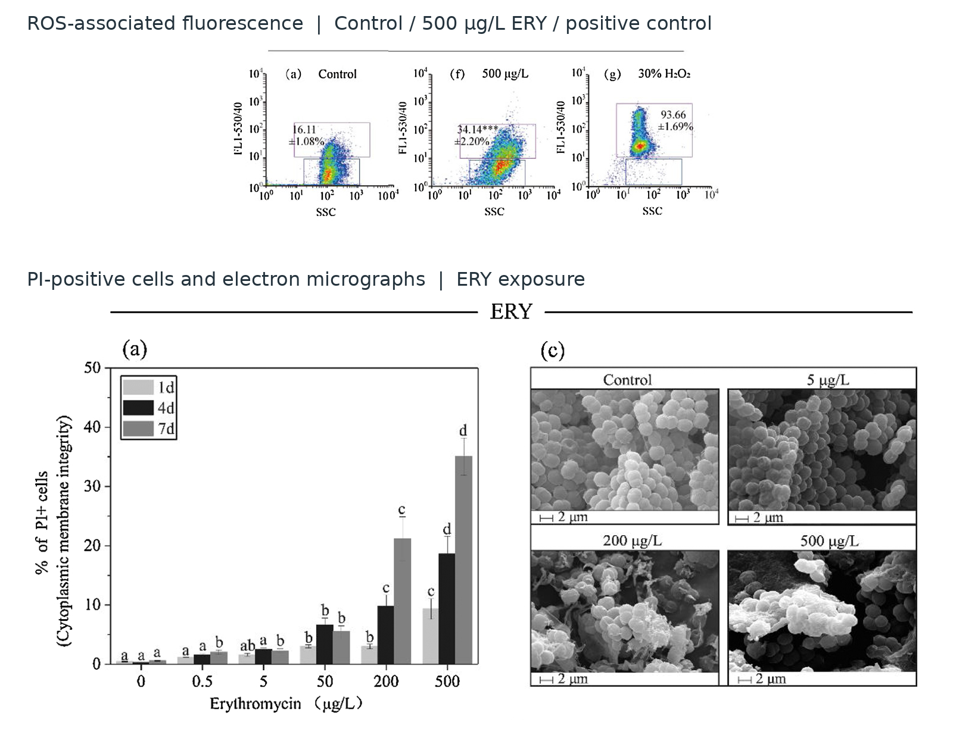
Overview
Exposure
Evidence
Resistance
Conclusions
Oxidative stress and membrane damage
ERY exposure coincided with increased ROS-related signals.
PI-positive cells and electron micrographs supported membrane damage.
Stress and loss of membrane integrity may help explain extracellular MC-LR.
The observations support a mechanism hypothesis that still needs causal testing.
[4] Zhang et al. (2020), ROS and membrane endpoints.
09
Notes:
Suggested delivery time: 80 seconds.
The study measured reactive oxygen species-related fluorescence, membrane integrity and cell morphology. The combined observations support links among physiological stress, membrane damage and toxin changes. However, a ROS probe signal is not a specific absolute measurement of hydrogen peroxide, and PI-positive cells indicate impaired membrane integrity rather than proving that every cell is dead. Increased extracellular toxin may partly reflect this damage. The authors did not directly measure mcy gene expression or perform a ROS-scavenger rescue experiment. Those missing interventions matter because association among endpoints does not verify every step in a causal chain.
Supporting points from the supplied outline:
Erythromycin exposure was associated with increased ROS-related signals and physiological changes.
PI-positive cell proportions and electron micrographs jointly supported membrane damage.
Oxidative stress and impaired membrane integrity may partly explain increased extracellular MC-LR.
Sources and figure attribution:
[4] Zhang, M., Steinman, A. D., Xue, Q., Zhao, Y., Xu, Y., & Xie, L. (2020). Effects of erythromycin and sulfamethoxazole on Microcystis aeruginosa: Cytotoxic endpoints, production and release of microcystin-LR. Journal of Hazardous Materials, 399, 123021. https://doi.org/10.1016/j.jhazmat.2020.123021
Figure file: p09_additional_ros_and_membrane.png. Figure source follows the supplied outline and source index.

Slide 10
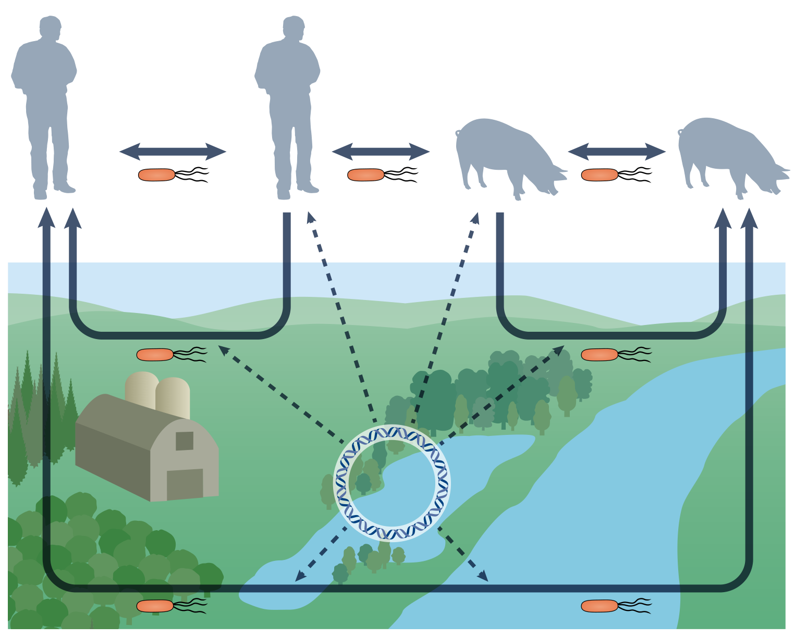
Overview
Exposure
Evidence
Resistance
Conclusions
Resistance and connections to human health
Selection can enrich resistant bacteria during antibiotic exposure.
Plasmids and other mobile elements can transfer resistance genes.
Health relevance depends on viable hosts, transmission routes and exposure.
Residue transport, bacterial spread and gene transfer are different processes.
[2] Larsson & Flach (2022), Fig. 3.
10
Notes:
Suggested delivery time: 75 seconds.
The One Health figure connects human, animal and environmental compartments. Antibiotics can change competition and enrich resistant bacteria. Mobile genetic elements, including plasmids, can help resistance genes move between bacteria. Water, food and environmental contact may connect bacterial hosts, but health risk still depends on viability, the host carrying the gene and the actual exposure route. Chemical bioaccumulation, the spread of a bacterial strain and horizontal gene transfer are distinct processes. Detecting an ARG does not by itself prove an infection. The cyanobacterial experiment discussed earlier did not test resistance development.
Supporting points from the supplied outline:
Selection: antibiotic exposure can alter strain competition and enrich resistant bacteria.
Spread: mobile genetic elements, including plasmids, can transfer resistance genes between bacteria.
Exposure: contaminated water, food, or environmental contact can connect hosts; health risk requires evidence on viability, hosts, and exposure.
Sources and figure attribution:
[2] Larsson, D. G. J., & Flach, C.-F. (2022). Antibiotic resistance in the environment. Nature Reviews Microbiology, 20, 257–269. https://doi.org/10.1038/s41579-021-00649-x
Figure file: p10.png. Figure source follows the supplied outline and source index.

Slide 11
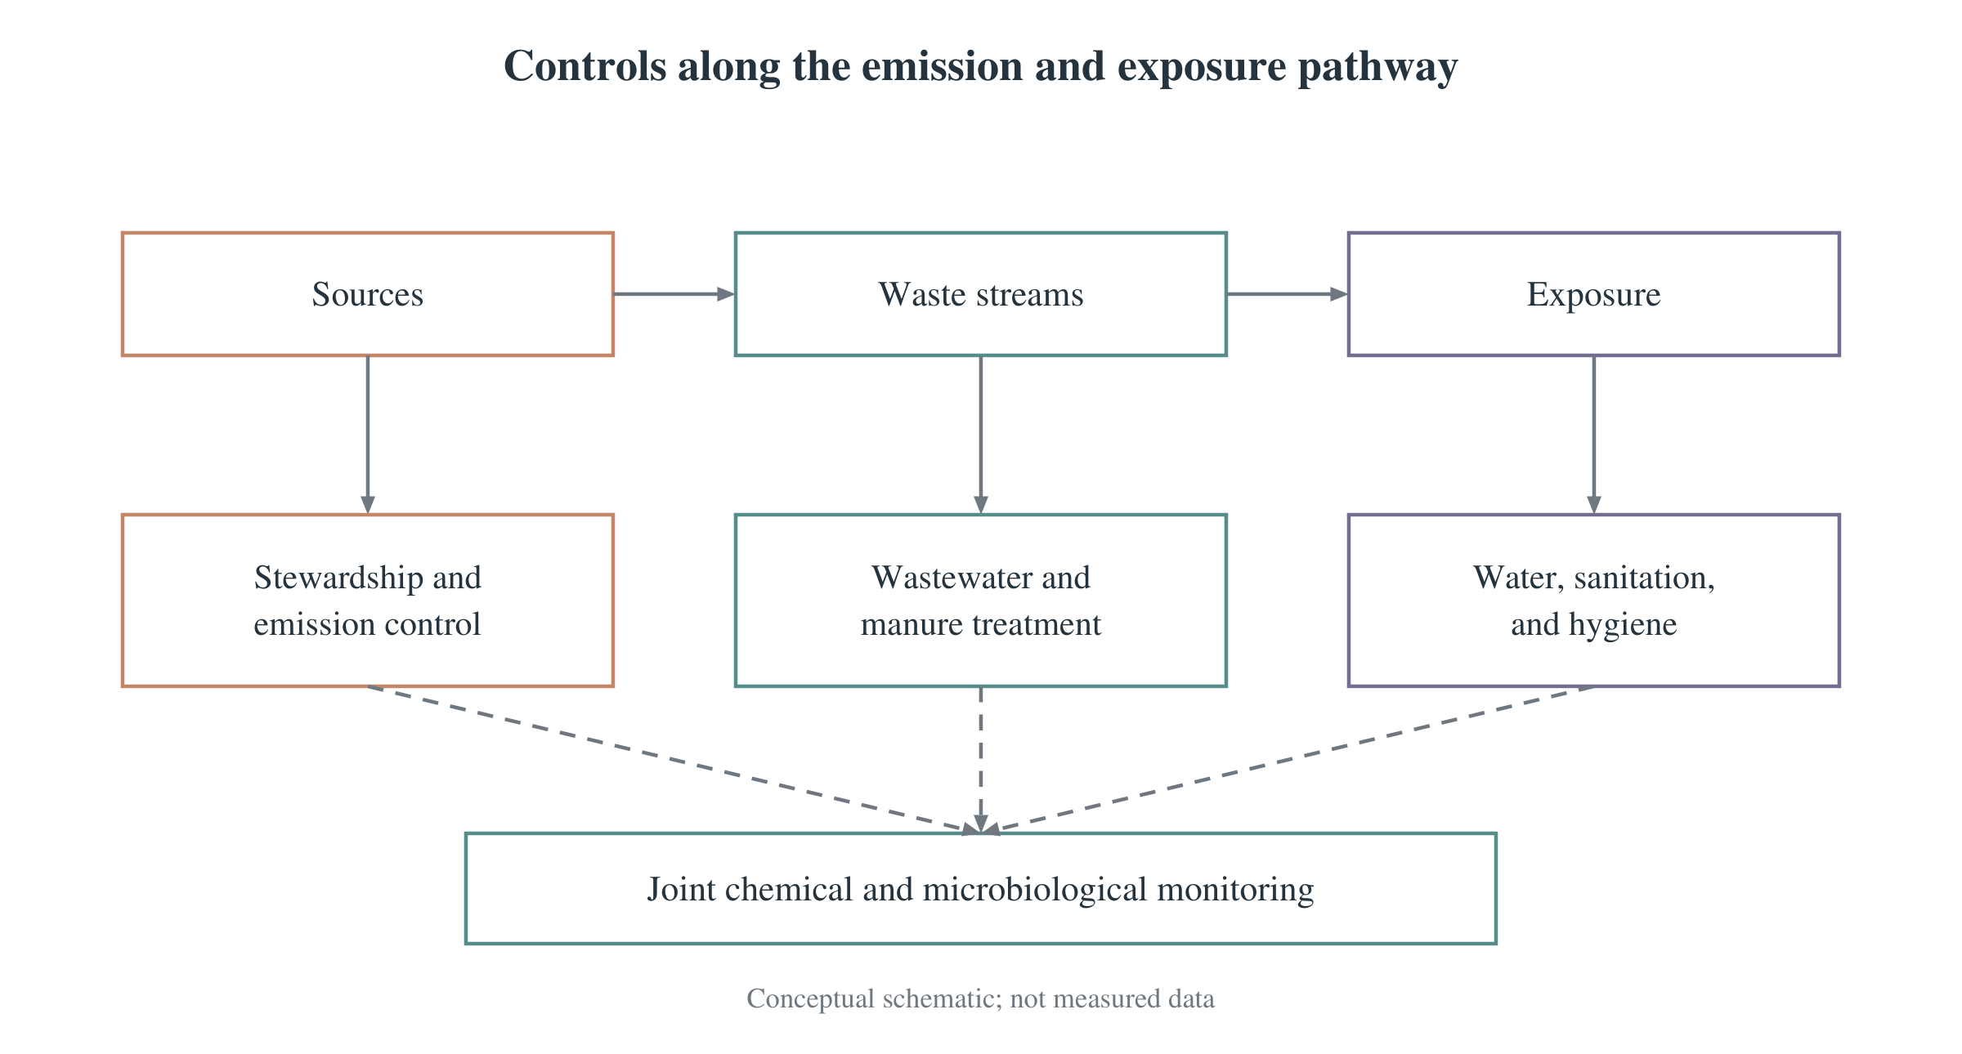
Overview
Exposure
Evidence
Resistance
Conclusions
Control measures along the exposure pathway
Sources: improve stewardship, manufacturing control and disposal.
Waste streams: strengthen wastewater, manure and sludge management.
Verification: track residues, viable resistance and ARG context together.
Effective management combines emission reduction with transmission prevention.
[1,2] Supplied management schematic.
11
Notes:
Suggested delivery time: 65 seconds.
Management should protect necessary treatment while reducing avoidable environmental inputs. At the source, this includes appropriate use, manufacturing emission control and correct disposal. Along waste pathways, wastewater, manure and sludge management can reduce the routes to water and farmland. Improved water and sanitation can also reduce contact and transmission. Adsorption or ozonation may support treatment, but effectiveness depends on the compound and operating conditions. A lower parent-drug concentration alone cannot prove that all risks have disappeared. Evaluation should also consider transformation products and relevant microbial or ecological endpoints.
Supporting points from the supplied outline:
At sources: improve stewardship, control manufacturing emissions, and ensure appropriate disposal.
Along pathways: strengthen wastewater, manure, and sludge management, including exposure through land application and irrigation.
For exposure and verification: improve water and sanitation, and jointly monitor drug residues, viable resistant bacteria, and ARG context.
Sources and figure attribution:
[1] Kovalakova, P., Cizmas, L., McDonald, T. J., Marsalek, B., Feng, M., & Sharma, V. K. (2020). Occurrence and toxicity of antibiotics in the aquatic environment: A review. Chemosphere, 251, 126351. https://doi.org/10.1016/j.chemosphere.2020.126351
[2] Larsson, D. G. J., & Flach, C.-F. (2022). Antibiotic resistance in the environment. Nature Reviews Microbiology, 20, 257–269. https://doi.org/10.1038/s41579-021-00649-x
Figure file: p11.png. Figure source follows the supplied outline and source index.

Slide 12
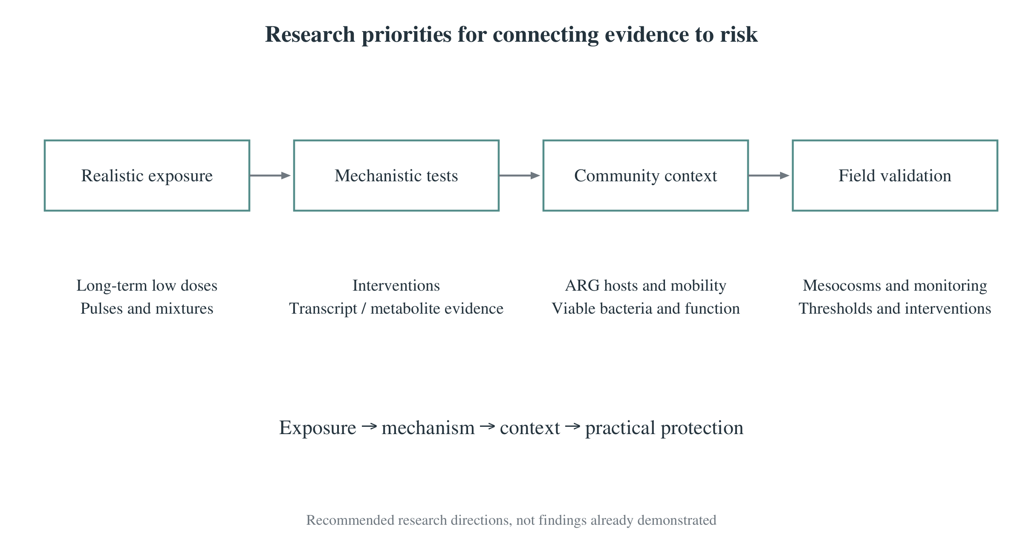
Overview
Exposure
Evidence
Resistance
Conclusions
Experiments that better represent real exposure
Chronic low doses, pulsed inputs and mixtures improve exposure realism.
Mechanistic interventions can test proposed causal links.
Community studies and field monitoring can evaluate ecological outcomes.
Laboratory findings need a bridge to environmental exposure and management results.
[1–4] Research priorities summarized in the supplied outline.
12
Notes:
Suggested delivery time: 45 seconds.
The seven-day single-strain experiment identifies responses under controlled conditions. It cannot quantify long-term natural bloom formation, mixed-pollutant exposure or human infection risk. Future work should test chronic and pulsed exposures at relevant concentrations. Mechanistic interventions would help establish whether the proposed pathways actually drive toxin changes. Community experiments can show whether responses persist in a more complex ecological setting. Field monitoring paired with intervention evaluation can then test whether a control measure reduces the outcomes that matter.
Supporting points from the supplied outline:
Extend exposure studies to chronic low doses, pulsed inputs, and mixtures.
Use mechanistic interventions and community experiments to test causal links and functional changes.
Combine field monitoring with intervention evaluation to test reductions in ecological and resistance risks.
Sources and figure attribution:
[1] Kovalakova, P., Cizmas, L., McDonald, T. J., Marsalek, B., Feng, M., & Sharma, V. K. (2020). Occurrence and toxicity of antibiotics in the aquatic environment: A review. Chemosphere, 251, 126351. https://doi.org/10.1016/j.chemosphere.2020.126351
[2] Larsson, D. G. J., & Flach, C.-F. (2022). Antibiotic resistance in the environment. Nature Reviews Microbiology, 20, 257–269. https://doi.org/10.1038/s41579-021-00649-x
[3] Le Page, G., Gunnarsson, L., Snape, J., & Tyler, C. R. (2017). Integrating human and environmental health in antibiotic risk assessment: A critical analysis of protection goals, species sensitivity and antimicrobial resistance. Environment International, 109, 155–169. https://doi.org/10.1016/j.envint.2017.09.013
[4] Zhang, M., Steinman, A. D., Xue, Q., Zhao, Y., Xu, Y., & Xie, L. (2020). Effects of erythromycin and sulfamethoxazole on Microcystis aeruginosa: Cytotoxic endpoints, production and release of microcystin-LR. Journal of Hazardous Materials, 399, 123021. https://doi.org/10.1016/j.jhazmat.2020.123021
Figure file: p12.png. Figure source follows the supplied outline and source index.

Slide 13
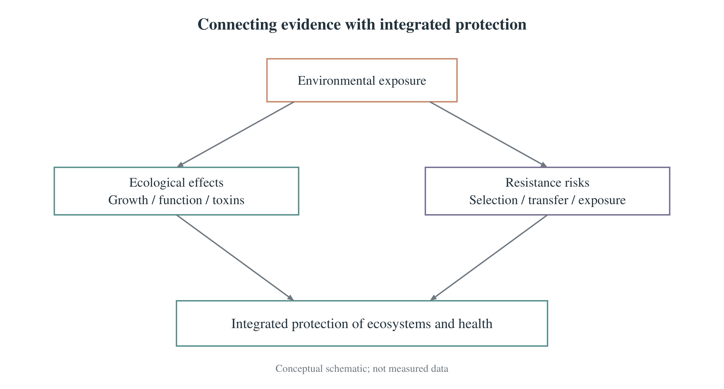
Overview
Exposure
Evidence
Resistance
Conclusions
Conclusions
Sources and exposure determine which organisms encounter residues.
Dose, duration and multiple endpoints shape toxicity conclusions.
Ecological protection and resistance control require coordinated management.
Antibiotic effects depend on the compound, organism and exposure context.
[1–4] Synthesis of the supplied materials.
13
Notes:
Suggested delivery time: 50 seconds.
Returning to the five questions, use and production create sources, and environmental pathways determine exposure. Controlled studies reveal effects by comparing doses, time points and endpoints. In the erythromycin case, low-dose stimulation occurred under some conditions, while inhibited growth did not necessarily mean less toxin. Stress and membrane damage offer a plausible explanation, with important causal steps still untested. Resistance adds a separate outcome that connects environmental processes to infection treatment. Management should therefore reduce avoidable antibiotic inputs and opportunities for resistant bacteria to spread. Thank you. I welcome questions about the case and its limits.
Supporting points from the supplied outline:
Sources and impacts: antibiotic use and production introduce residues that can affect ecological functions and resistance risks.
Evidence and mechanisms: controlled, multi-endpoint studies reveal dose–time responses and links among stress, membrane damage, and toxin dynamics.
Management: use exposure-based strategies to reduce antibiotic inputs and resistant-bacteria transmission together.
Sources and figure attribution:
[1] Kovalakova, P., Cizmas, L., McDonald, T. J., Marsalek, B., Feng, M., & Sharma, V. K. (2020). Occurrence and toxicity of antibiotics in the aquatic environment: A review. Chemosphere, 251, 126351. https://doi.org/10.1016/j.chemosphere.2020.126351
[2] Larsson, D. G. J., & Flach, C.-F. (2022). Antibiotic resistance in the environment. Nature Reviews Microbiology, 20, 257–269. https://doi.org/10.1038/s41579-021-00649-x
[3] Le Page, G., Gunnarsson, L., Snape, J., & Tyler, C. R. (2017). Integrating human and environmental health in antibiotic risk assessment: A critical analysis of protection goals, species sensitivity and antimicrobial resistance. Environment International, 109, 155–169. https://doi.org/10.1016/j.envint.2017.09.013
[4] Zhang, M., Steinman, A. D., Xue, Q., Zhao, Y., Xu, Y., & Xie, L. (2020). Effects of erythromycin and sulfamethoxazole on Microcystis aeruginosa: Cytotoxic endpoints, production and release of microcystin-LR. Journal of Hazardous Materials, 399, 123021. https://doi.org/10.1016/j.jhazmat.2020.123021
Figure file: p13.png. Figure source follows the supplied outline and source index.

Slide 14
Overview
Exposure
Evidence
Resistance
Conclusions
References
[1] Kovalakova, P., Cizmas, L., McDonald, T. J., Marsalek, B., Feng, M., & Sharma, V. K. (2020). Occurrence and toxicity of antibiotics in the aquatic environment: A review. Chemosphere, 251, 126351.
https://doi.org/10.1016/j.chemosphere.2020.126351
[2] Larsson, D. G. J., & Flach, C.-F. (2022). Antibiotic resistance in the environment. Nature Reviews Microbiology, 20, 257–269.
https://doi.org/10.1038/s41579-021-00649-x
[3] Le Page, G., Gunnarsson, L., Snape, J., & Tyler, C. R. (2017). Integrating human and environmental health in antibiotic risk assessment: A critical analysis of protection goals, species sensitivity and antimicrobial resistance. Environment International, 109, 155–169.
https://doi.org/10.1016/j.envint.2017.09.013
[4] Zhang, M., Steinman, A. D., Xue, Q., Zhao, Y., Xu, Y., & Xie, L. (2020). Effects of erythromycin and sulfamethoxazole on Microcystis aeruginosa: Cytotoxic endpoints, production and release of microcystin-LR. Journal of Hazardous Materials, 399, 123021.
https://doi.org/10.1016/j.jhazmat.2020.123021
14
Notes:
Suggested delivery time: 20 seconds.
These four supplied references provide the core evidence: three reviews and one experimental case. The occurrence and toxicity review supports the environmental background. The environmental resistance review supports the One Health and transmission discussion. Le Page and colleagues support the discussion of ecological and resistance endpoints in risk assessment. Zhang and colleagues provide the cyanobacterial experiment. The DOI links allow the underlying publications to be located for questions about methods or figure interpretation.
Supporting points from the supplied outline:
[1] Review of aquatic occurrence and ecotoxicity.
[2] Review of environmental resistance; [3] review of integrated risk assessment.
[4] Experimental case of erythromycin and sulfamethoxazole effects on cyanobacteria.
Sources and figure attribution:
[1] Kovalakova, P., Cizmas, L., McDonald, T. J., Marsalek, B., Feng, M., & Sharma, V. K. (2020). Occurrence and toxicity of antibiotics in the aquatic environment: A review. Chemosphere, 251, 126351. https://doi.org/10.1016/j.chemosphere.2020.126351
[2] Larsson, D. G. J., & Flach, C.-F. (2022). Antibiotic resistance in the environment. Nature Reviews Microbiology, 20, 257–269. https://doi.org/10.1038/s41579-021-00649-x
[3] Le Page, G., Gunnarsson, L., Snape, J., & Tyler, C. R. (2017). Integrating human and environmental health in antibiotic risk assessment: A critical analysis of protection goals, species sensitivity and antimicrobial resistance. Environment International, 109, 155–169. https://doi.org/10.1016/j.envint.2017.09.013
[4] Zhang, M., Steinman, A. D., Xue, Q., Zhao, Y., Xu, Y., & Xie, L. (2020). Effects of erythromycin and sulfamethoxazole on Microcystis aeruginosa: Cytotoxic endpoints, production and release of microcystin-LR. Journal of Hazardous Materials, 399, 123021. https://doi.org/10.1016/j.jhazmat.2020.123021
Figure file: p14.png. Figure source follows the supplied outline and source index.

Slide 15
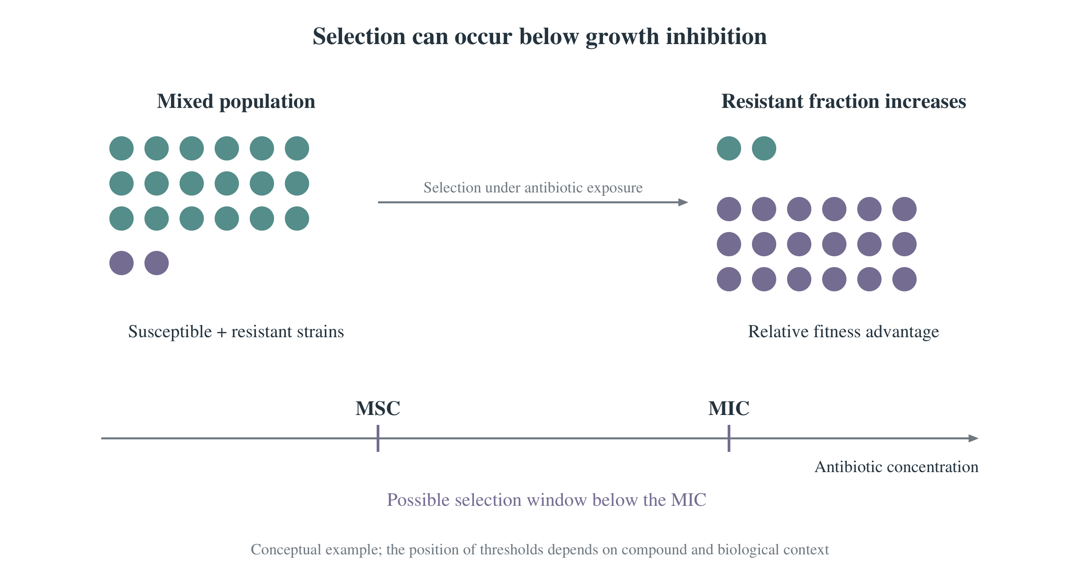
Overview
Exposure
Evidence
Resistance
Conclusions
Discussion: low concentration and risk
Low-dose effects vary with the compound, organism, time and endpoint.
Resistance-selection thresholds can differ from growth-inhibition thresholds.
Risk interpretation needs actual exposure and relevant effect thresholds.
MSC and MIC describe different thresholds. The figure is conceptual.
[2,3] Supplied conceptual MSC/MIC schematic.
B1
Notes:
Backup slide for discussion.
A low concentration does not determine the risk by itself. The minimum selective concentration, or MSC, describes a possible threshold for a resistance-selection advantage, while the minimum inhibitory concentration, or MIC, describes inhibition of visible growth under a defined assay. Their relationship depends on the system and compound. The conceptual figure has no universal numerical threshold. Compare a relevant exposure estimate with an endpoint-specific threshold and consider bioavailability. A single low-dose laboratory effect does not establish risk under every environmental condition.
Supporting points from the supplied outline:
Not necessarily. Low-dose effects depend on the compound, organism, time, and endpoint.
Thresholds for resistance selection differ from those for visible growth inhibition.
Actual exposure should be compared with relevant thresholds, considering bioavailability.
Sources and figure attribution:
[2] Larsson, D. G. J., & Flach, C.-F. (2022). Antibiotic resistance in the environment. Nature Reviews Microbiology, 20, 257–269. https://doi.org/10.1038/s41579-021-00649-x
[3] Le Page, G., Gunnarsson, L., Snape, J., & Tyler, C. R. (2017). Integrating human and environmental health in antibiotic risk assessment: A critical analysis of protection goals, species sensitivity and antimicrobial resistance. Environment International, 109, 155–169. https://doi.org/10.1016/j.envint.2017.09.013
Figure file: b01.png. Figure source follows the supplied outline and source index.

Slide 16
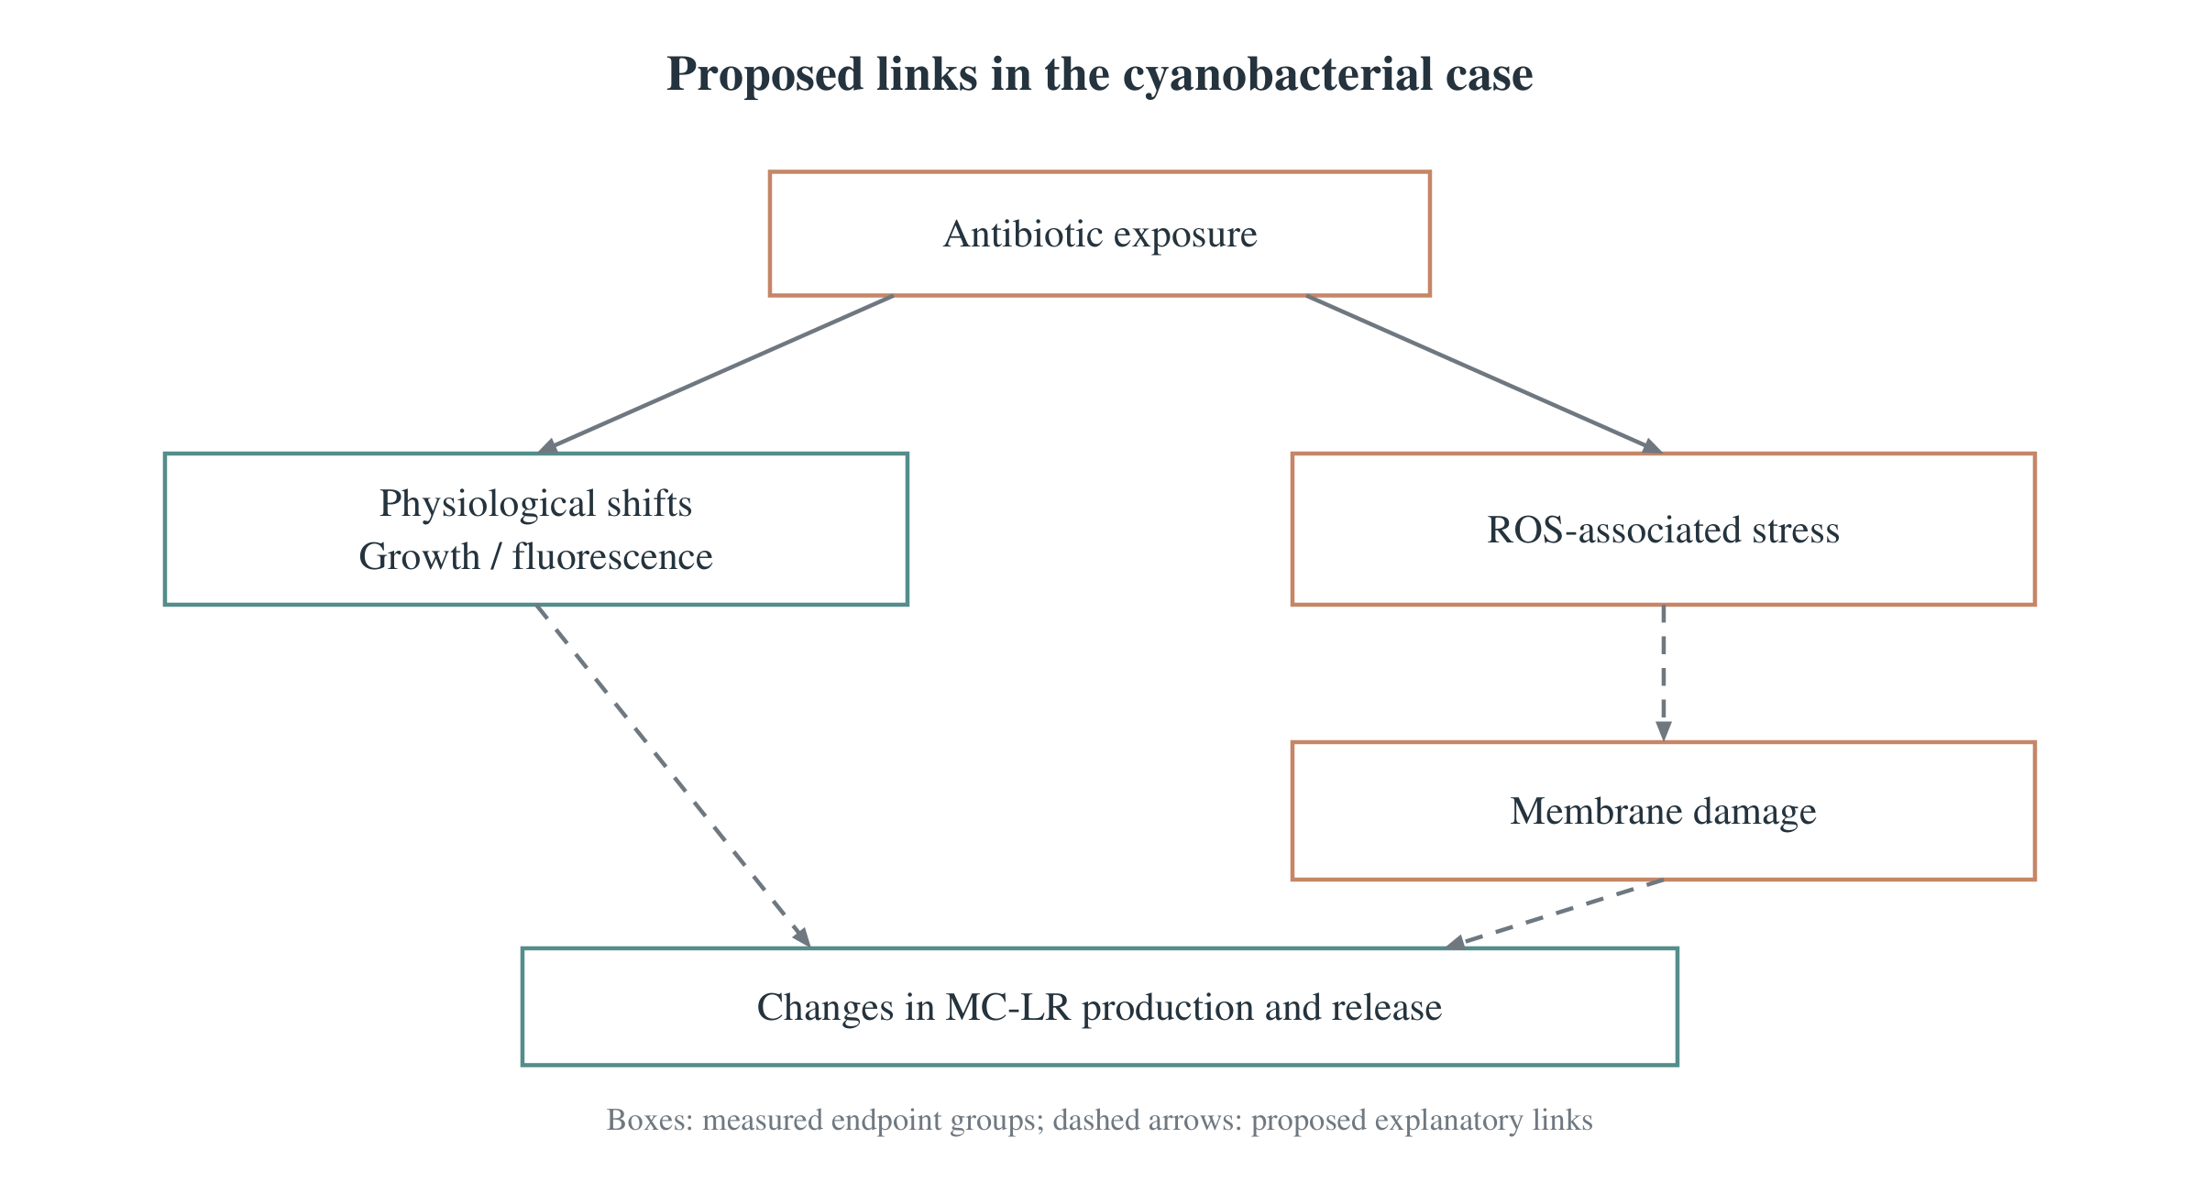
Overview
Exposure
Evidence
Resistance
Conclusions
Discussion: what the case establishes
The experiment established growth, physiological and toxin responses.
Natural blooms, human damage and resistance development remain untested.
Chronic community studies and mechanism tests can address these gaps.
Dashed links in the supplied mechanism diagram represent proposed explanations.
[4] Supplied mechanism schematic based on Zhang et al. (2020).
B2
Notes:
Backup slide for discussion.
The case demonstrates measured responses in one cyanobacterial strain under the tested concentrations and durations. The supplied diagram distinguishes measured endpoint groups from proposed explanatory links. It cannot establish that the same chain causes a natural bloom or that a person has suffered harm. The experiment also did not measure resistance genes. ROS-scavenger rescue experiments, direct gene-expression measurements and longer community exposures would help separate alternative explanations. These boundaries preserve the value of the findings while keeping the conclusions within the evidence.
Supporting points from the supplied outline:
It demonstrated growth, physiological, and toxin responses under the tested conditions.
It did not demonstrate natural bloom formation, human health damage, or resistance development.
Further work requires chronic community experiments, mechanistic interventions, and field validation.
Sources and figure attribution:
[4] Zhang, M., Steinman, A. D., Xue, Q., Zhao, Y., Xu, Y., & Xie, L. (2020). Effects of erythromycin and sulfamethoxazole on Microcystis aeruginosa: Cytotoxic endpoints, production and release of microcystin-LR. Journal of Hazardous Materials, 399, 123021. https://doi.org/10.1016/j.jhazmat.2020.123021
Figure file: b02.png. Figure source follows the supplied outline and source index.

Slide 17
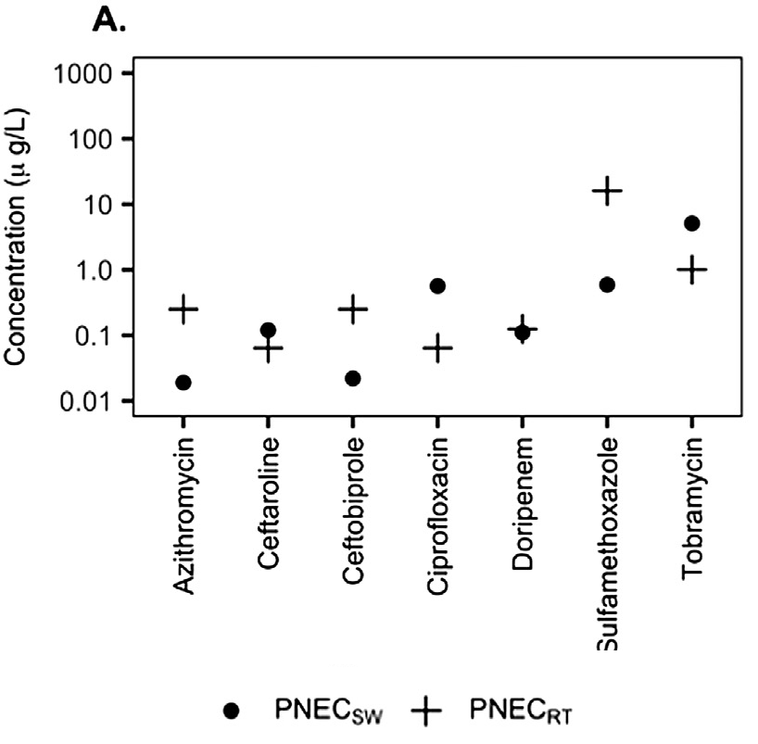
Overview
Exposure
Evidence
Resistance
Conclusions
Discussion: ecotoxicity and resistance thresholds
Ecotoxicity PNECs address endpoints such as growth and reproduction.
Resistance PNECs address selection and vary by compound.
RQ = MEC / PNEC screens for concern and further assessment.
RQ ≥ 1 signals potential concern. It does not prove harm or infection.
[3] Le Page et al. (2017), Fig. 5A.
B3
Notes:
Backup slide for discussion.
PNEC means predicted no-effect concentration, MEC means measured environmental concentration, and RQ means risk quotient. The supplied figure compares ecological and resistance-related thresholds for different compounds. Their ordering is compound-specific, so one type of endpoint cannot always represent the other. An RQ of one or above flags potential concern and a need for further assessment. It is not proof that ecological damage or human infection has occurred. This figure is an example from the 2017 analysis rather than a current universal regulatory standard. The paper's proposed 100 nanograms per litre should not be presented as a legal safety limit for all antibiotics.
Supporting points from the supplied outline:
Ecotoxicity PNECs address ecological effects such as growth and reproduction.
Resistance PNECs address selection; their ranking relative to ecotoxicity PNECs is compound-specific.
Compare environmental concentrations with the relevant PNEC to screen for concern and guide further assessment.
Sources and figure attribution:
[1] Kovalakova, P., Cizmas, L., McDonald, T. J., Marsalek, B., Feng, M., & Sharma, V. K. (2020). Occurrence and toxicity of antibiotics in the aquatic environment: A review. Chemosphere, 251, 126351. https://doi.org/10.1016/j.chemosphere.2020.126351
[3] Le Page, G., Gunnarsson, L., Snape, J., & Tyler, C. R. (2017). Integrating human and environmental health in antibiotic risk assessment: A critical analysis of protection goals, species sensitivity and antimicrobial resistance. Environment International, 109, 155–169. https://doi.org/10.1016/j.envint.2017.09.013
Figure file: b03.png. Figure source follows the supplied outline and source index.

