Slide 1

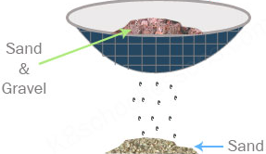
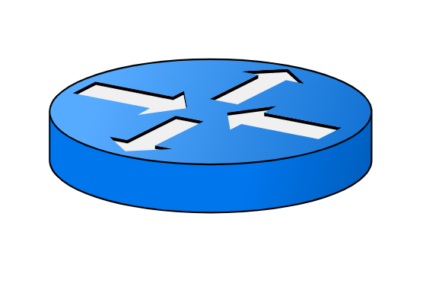




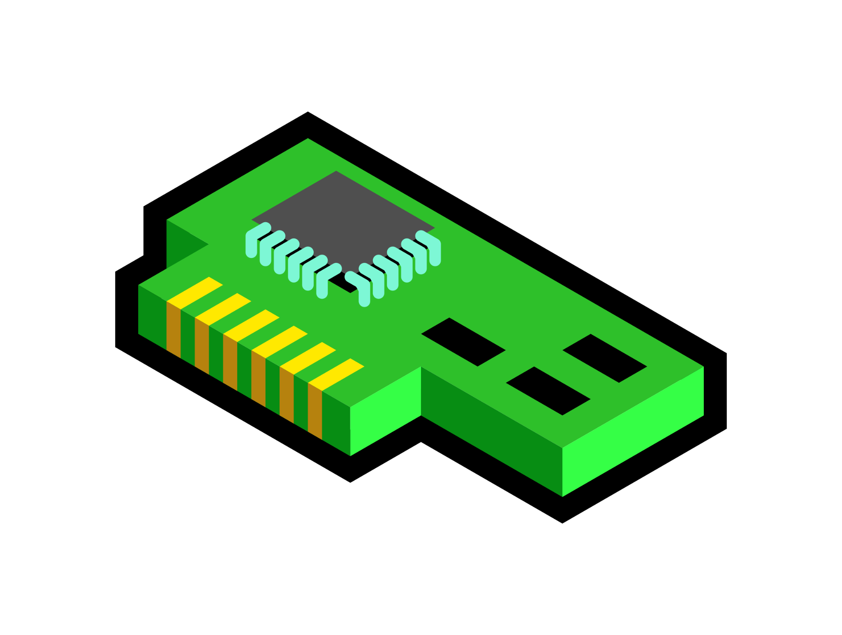
We❤️high-speed switches (& stateful NFs)!
Offload exact partition of stateful NF => Cache Style
Cache Firewall:
🎉 Sieve drops most bad traffic early and never drops good traffic!
Sieve Firewall:
⚠️ Cache misses drop good traffic!
[SyNAPSE, SOSR’22], [Clara, SOSP’21], [Flightplan, NSDI’21], [Pigasus, OSDI’20], [Gallium, SIGCOMM’20], [Lyra, SIGCOMM’20]...
Middlebox Server
100G
High-Speed Switch
Goal: Drop as much unwanted traffic as early as possible, but never drop wanted traffic
100G
20G
100G
5G
100G
😢
Refactor full NF across layers
=> Sieve!
95G
80G
🙂
5G
Sieve: Layered Network Defenses Against Large-Scale Attacks
Sophia Yoo, Sata Sengupta, Maria Apostolaki, Jen Rexford
Princeton University
Sieve - Promising Initial Results!
Future: Other programmable platforms & network defenses
Vision: Automatically determine & perform layered design
Cache
Exact | 🙂
Limited coverage | 😢
Both FP and FN errors | 😢
Sieve
Leaky (Approx.) | 🤔
Full coverage | 🙂
Only (bounded) FP error | 🙂
High-speed switches
SmartNICs
eBPF
Server (software)

