Slide 1

SipID: (Half)SipHash In the Data Plane
Secure Keyed Hashing on Programmable Switches
Sophia Yoo & Xiaoqi Chen

Slide 2

Today’s Data Plane Applications
Opportunity for improved
Security
Privacy
Performance
Reliability
Implementation Challenges
Sophisticated
Applications
Hardware Implementation Challenges
Limited Arithmetic Operations
Limited Pipeline Stages
Notes:
Packet-level programmability enables new applications, but with significant constraints
Applications must be high-speed and robust to be useful and deal with adversarial traffic (want P4 that actually fits on Tofino)
Also if you have hashing that can run in line rate but is not secure that’s no good either
Tug of war, exciting new applications (programmability/flexibility) vs implementation challenges/constraints
Efficiency vs security

Slide 3

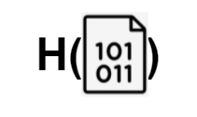

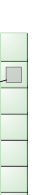



Network Applications use Hashing Extensively
Indexing
Hash of header fields used as array index for hash tables (e.g., Jaqen, NetCache)
Fingerprinting
Hash stored in register array as fingerprint of longer flow IDs (e.g., SilkRoad, P4RTT)
Sampling
Pseudo-random hash compared with thresholds to sample a subset of traffic (e.g., AROMA, BeauCoup)
Notes:
Briefly describe purpose of hash (takes some input, spits out some random output which an outsider could not generate without insider knowledge of keys and input)
Note that the hashing in network applications is over a small field (typically headers etc.)
Add visuals under each column (minimal), indexing a table, large key into smaller key for fingerprinting, sampling of packets
Hash without a key! (not crypto yet)

Slide 4


CRC32 is widely used in the data plane
Efficient
Significant limitations
Computationally inexpensive
Not a cryptographic function
Fast
Insecure as a hash
Input: 0b11000010
CRC Verification
Zero: checksum correct
Checksum: 0b00001111
Non-zero: checksum incorrect
CRC: Designed to catch accidental bit flips, not intentional changes
Notes:
From Jen: Could frame this more as line-rate hashing or state-of-the-art line-rate hashing... and then pull the rug out from under us in the 2nd half
CRC on bitstreams (actual binary) to illustrate dealing with accidental bit flips, high level
Insecure in what way? - Not robust to adversaries who might specifically design inputs to generate certain checksums (even if a key is used, adversary could still manipulate the input to get desired output)

Slide 5

Vulnerabilities due to CRC32
Indexing
Fingerprinting
Sampling
Collisions that force table updates and evictions to go to the same index
Collisions that inaccurately group flow IDs together with the same fingerprint
Construct hashes that cause traffic to never be sampled (bypass monitoring) or always sampled (system overload)
Always sampled!
Never sampled!
Notes:
Add visuals here, two hashes going to same index
Weak hashing properties, exploit security loopholes, cause application loopholes, unintended behavior (evil packets “with devil red horns” in all visuals, pointing to same entry etc.)
Add specific examples of network attacks??

Slide 6
We need a secure hash, do these exist?
Yes!
E.g., SHA256, Scrypt, Blowfish
But, there are some problems…
Computationally expensive
Complex implementation unfriendly to data plane
Inefficient, slow
Security
Speed
SHA256, Scrypt,
Blowfish
SipID
(HalfSipHash in the Data Plane)
CRC32, Checksum
Notes:
Because of the number of operations that have to be performed for security, while friendly to data plane, is going to require more processing, take more time
Spectrum! (ess-scrypt)
Computational expense is often not worth overcoming since oftentimes security is lower priority than speed

Slide 7
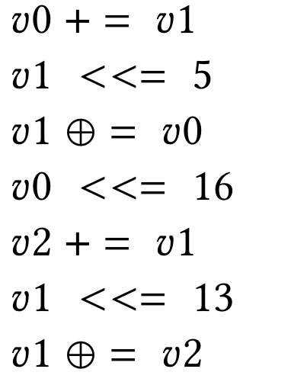

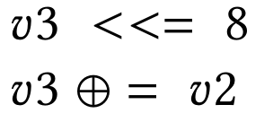
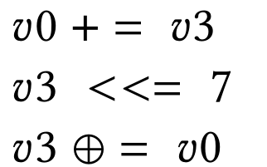

HalfSipHash-c-d
HalfSipHash-2-4 on an
8-byte (m=2 words) input
“Compression” Rounds
“Finalization” Rounds
Preprocessing(keys, initial values)
v₃
v₂
v₁
v₀
m₀
Compression Round
Compression Round
m₁
m₀
Compression Round
Compression Round
0xff
m₁
Finalization Round
Finalization Round
One Original HalfSipHash Round
Finalization Round
Finalization Round
Jean-Philippe Aumasson and Daniel J. Bernstein. 2012. SipHash: A Fast Short-Input PRF.
Notes:
SipRound is expensive in its own right, but we have to do it multiple times so need to do so efficiently
Goes through multiple rounds of processing, doing the same operations multiple times (iteratively on intermediate results)
In order
Say less! Start at high level (with numbers too)
Note: circular bit shifts, can be expensive if implemented naively + 14 steps (lots of steps!), need them to fit efficiently/exploit concurrency to do multiple operations in single stage
Give sense of naive implementation and problems that would occur (not being able to fit)
SipHash created by Jean-Philippe Aumasson and Daniel J. Bernstein, 2012
Provably secure to certain extent etc.

Slide 8



Challenge #1: Limited Arithmetic Operations
Circular Bit Shifts
Computationally Expensive!
n = 5
a = 0b11010010
a <<< 5 = 0b01011010
Intermediate Steps:
x = a << 5 = 0b01000000
y = a >> (8-5) = 0b00011010
b = x OR y = 0b01011010
Strawman circular bit shifting
Semantically equivalent slicing
Notes:
Explain slicing (note, only need to do shifts for known values of n) - why is this easier to implement? ALU dependency for shifting and then OR. Not using ALU for second operation, just copying bits over - but using hash units
n = 5
a << n
b[31: 0] = a[26:0] ++ a[31:27]
Direct slicing can mess up with container alignment by bytes (so first do identity hashing) -- backup info
Circular bit shift - very common in many cryptography algorithms
Using traditional bit shifting, needs two stages (first do shifting, then do OR)
Instead using P4’s slicing semantics to use only one stage
Hard to fit in pipeline stages because of read/write access constraints

Slide 9
Challenge #1: Limited Arithmetic Operations
Circular Bit Shifts
Computationally Expensive!
n = 5
a = 0b11010010
a <<< 5 = 0b01011010
Intermediate Steps:
x = a << 5 = 0b01000000
y = a >> (8-5) = 0b00011010
b = x OR y = 0b01011010
Strawman circular bit shifting
Semantically equivalent slicing
n = 5
a <<< 5
b[31:0] = a[26:0] ++ a[31:27]
Notes:
Explain slicing (note, only need to do shifts for known values of n) - why is this easier to implement? ALU dependency for shifting and then OR. Not using ALU for second operation, just copying bits over - but using hash units
n = 5
a << n
b[31: 0] = a[26:0] ++ a[31:27]
Direct slicing can mess up with container alignment by bytes (so first do identity hashing)
Circular bit shift - very common in many cryptography algorithms
Using traditional bit shifting, needs two stages (first do shifting, then do OR)
Instead using P4’s slicing semantics to use only one stage
Hard to fit in pipeline stages because of read/write access constraints

Slide 10
Challenge #2: Limited Pipeline Stages
Original HalfSipHash Round
Constraints:
Dependent operations need to be in different stages
Some operations can be performed concurrently if they are independent
Limited memory: limited number of active variables
Notes:
If use original operations, use X stages (if do grouping, use 4 stages) → accomplished by variable renaming and conceptually grouping, makes it easier to generate machine code etc.
Conceptually can be split into 4 parallel stages, can also do some variable renaming to help compiler generate machine code that uses exactly four stages
Can now implement each operation in a single stage (even circular bit shifts). Hardware can’t do multiple operations if they have dependencies.
Bullets:
- dependent operations need to be in different stages
- small number of operations can be in same stage if they are independent
- limited memory, can’t have too many active variables in memory at given time
- variable renaming was just for conceptual understanding (containers/active bits/something else?)
How much memory is needed. If you use variables across stages, you allocate same memory twice across stages.

Slide 11
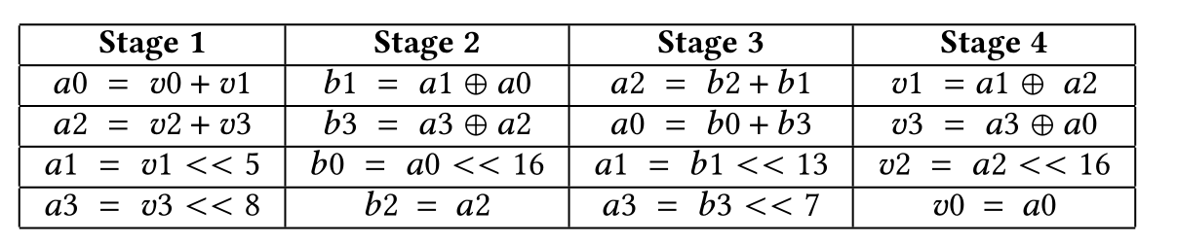
Challenge #2: Limited Pipeline Stages
Original HalfSipHash Round
HalfSipHash Round Grouped by Dependencies
Notes:
Slide with round on left and bullet points on right
Next slide with round on left and stages on right (just walk through stage 1 steps)
If use original operations, use X stages (if do grouping, use 4 stages) → accomplished by variable renaming and conceptually grouping, makes it easier to generate machine code etc.
Conceptually can be split into 4 parallel stages, can also do some variable renaming to help compiler generate machine code that uses exactly four stages
Can now implement each operation in a single stage (even circular bit shifts). Hardware can’t do multiple operations if they have dependencies.
Bullets:
- dependent operations need to be in different stages
- small number of operations can be in same stage if they are independent
- limited memory, can’t have too many active variables in memory at given time
- variable renaming was just for conceptual understanding (containers/active bits/something else?)
How much memory is needed. If you use variables across stages, you allocate same memory twice across stages.

Slide 12
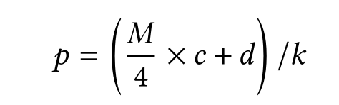
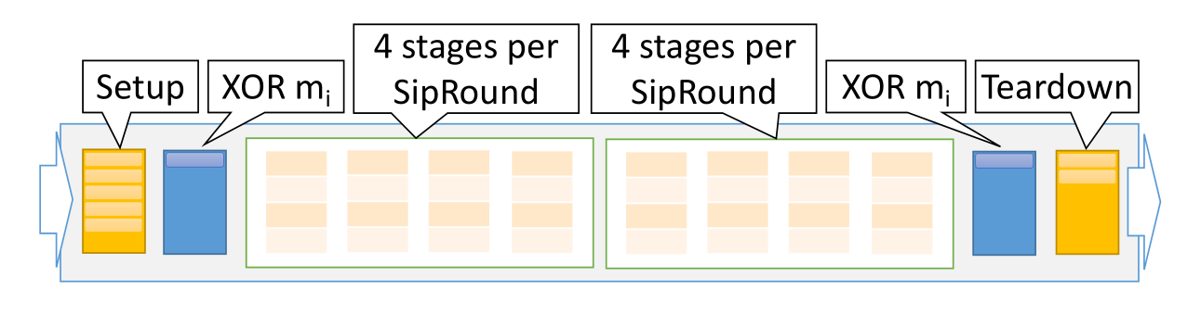
Implementing Multiple SipRounds
One pipeline pass
Ingress+Egress pipelines
Recirculation
Number of passes required per M-byte input.
M = 16 bytes,
c = 2 compression rounds,
d = 4 finalization rounds,
k = 2 SipRounds/pass
⇒ p = 6 passes
Ingress-Only: 5 recirculations with 16-byte input
Ingress+Egress: 2 recirculations with 16-byte input
Notes:
Note that applications will differ in how many recirculations they need, what overhead they have (based on input size)

Slide 13
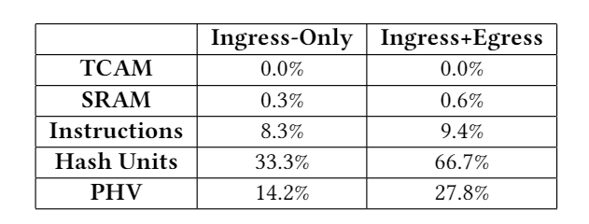
SipID Hardware Prototype
Ingress-Only version
Implemented in 490 lines of P4 code
Ingress+Egress version
Implemented in 779 lines of P4 code
Runs on Barefoot Tofino Wedge32X-100B
Hardware Resource Utilization
Notes:
Key point: not only does SipID fit in hardware, it also leaves room for other applications
Resource use is relatively low, mostly using hash units (for circular bit shifts) and packet header vector (to do recirculations etc.)
→ biggest constraint is number of stages, not using many other resources
Justify use of hash units - > hash units normally used heavily for CRC32, but hopefully programmers who use SipID will not need to do CRC32, making the amount of hash unit resources used okay

Slide 14
Application-Dependent Overhead
Iterative processing for each word in M-word input
Network applications typically require short inputs
Jaqen | NetCache | SilkRoad | P4RTT | AROMA | BeauCoup
12 bytes | 16 bytes | 13/37 bytes | 16 bytes | 13/21 bytes | 2~18 bytes
Acceptable to be below line-rate?
Not all ports serve adversarial traffic (e.g., only internet-facing ports)
Not all packets need hashing (e.g., only handshake packets)
Recirculation ports dedicated for security measures
Notes:
SipHash/HalfSipHash iterates over each word of input, so longer the input, more processing to do
Hashing itself is not the issue, its when you have to hash adversarial packets that processing increases too much
Some packets come from “secure” side of network so acceptable to use faster, potentially less secure, hashes

Slide 15
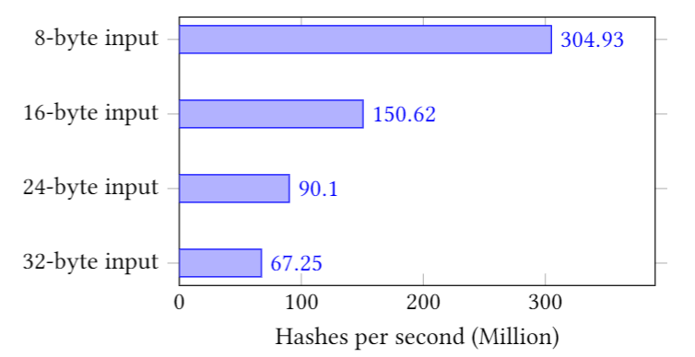
Evaluation
NetCache (Load-Balancing):
16-byte input
150 million hashes per second
SipID Hash Rate with Different Input Lengths
Ingress+Egress vs. Ingress-Only: increase maximum hash rate by 3x
16 byte input (Ingress + Egress)
Approximately 5x speed of single-core CPU
Notes:
Put results into context, typical input sizes are header fields (small!)
Compare with CPU core
This result is for default 100GBPS reserved recirculation throughput per pipeline (but can make tradeoff that is more aggressive)
Reduce forwarding throughput to increase recirculation throughput (higher hash rates) → desirable for applications that need faster data plane hashing

Slide 16
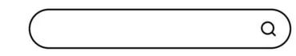

Conclusions
In-network applications
Rely on hashing
CRC32 is fast, but insecure
Want speed and security
SipID: HalfSipHash in the Data Plane!
Open-Source P4 implementation for Tofino
https://github.com/Princeton-Cabernet/p4-projects
SipHash Tofino
Future work
Integrating SipID in network applications
Notes:
General improvement to security in all spaces, not just in security applications
Note open source implementation, available for use
Font sizes and spacings!!

Slide 17
Thank you!
Questions?

