Slide 1
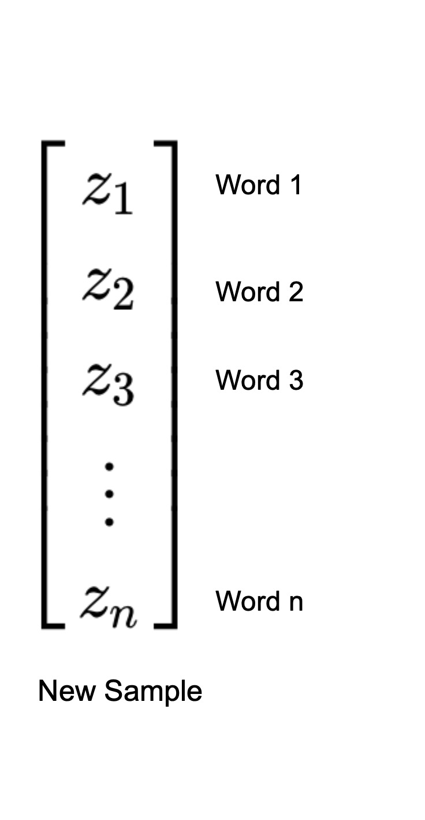
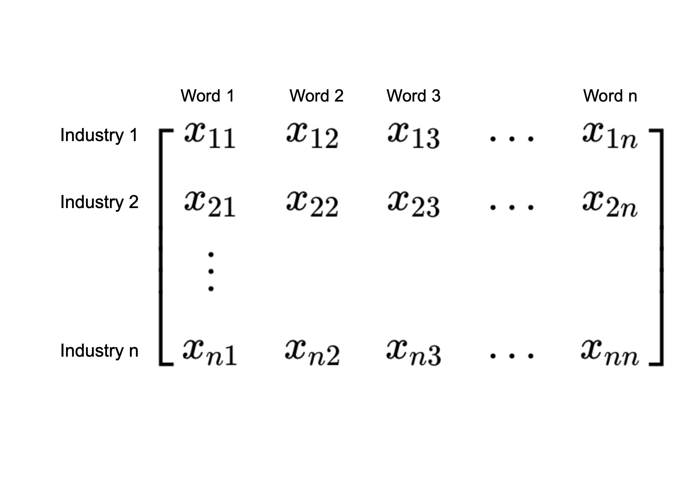
Count of Word (normalized)
BoW representation of unclassified job description
BoW representation of all industries

